Slide 1
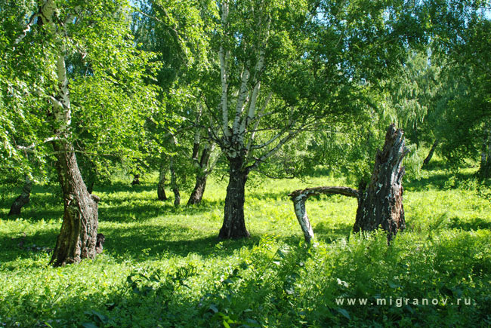
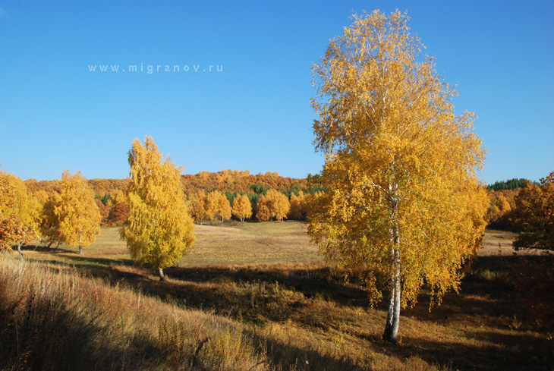
SEASONS AND WEATHER 4 класс
ВЫПОЛНИЛА УЧИТЕЛЬ МОУ «ПОДСИНСКАЯ»СОШ
Лапшина Нина Ивановна

Slide 2
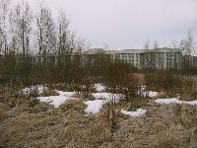
There are four seasons in the year, they are:
Spring

Slide 3
SUMMER

Slide 4
AUTUMN

Slide 5
WINTER

Slide 6
When is it snowy?

Slide 7
When is it foggy?

Slide 8
When is it windy?

Slide 9
When is it rainy?

Slide 10
When is it hot?

Slide 11
When is it slippery?

Slide 12
When is it cloudy?

Slide 13
When is it cold?

Slide 14
When is it frosty?

Slide 15
When is it sunny?

Slide 16
When is it warm?

Slide 17
Write Russian words in English:
It is (снежно) in (зимой).
It is (солнечно) in (летом).
It is (морозно) in (зимой).
It is (скользко) in (зимой).
It is (дождливо) in (осенью).
It is (облачно) in (весной).
It is (жарко) in (летом)

Slide 18
Good luck! Good bye!

