Slide 1
My flat
Презентация –автоматизация лексики по теме « Мой дом» в 3 классе. Учитель -Лапшина Нина Ивановна.

Slide 2
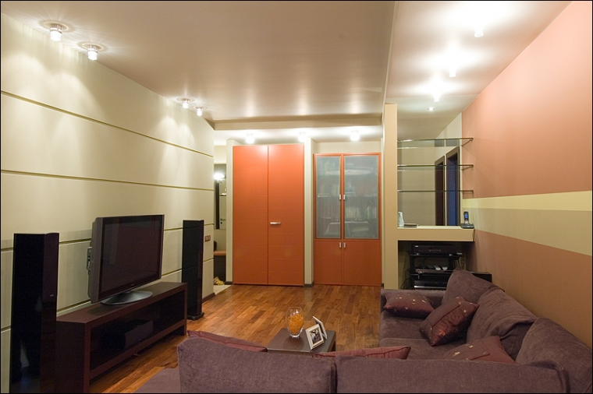
What is this room?

Slide 3
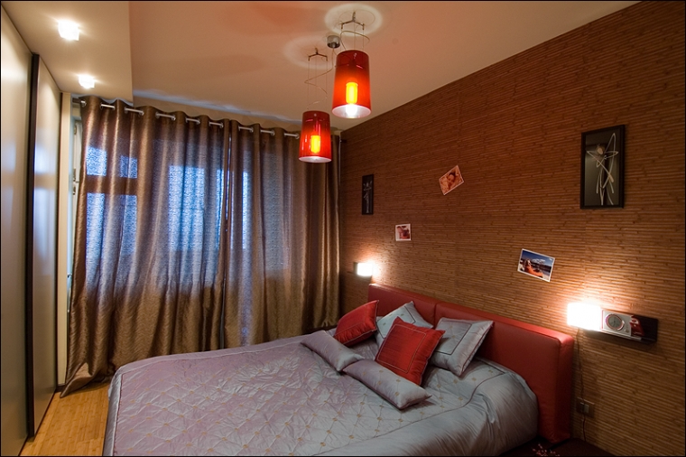
Is it a bedroom?

Slide 4
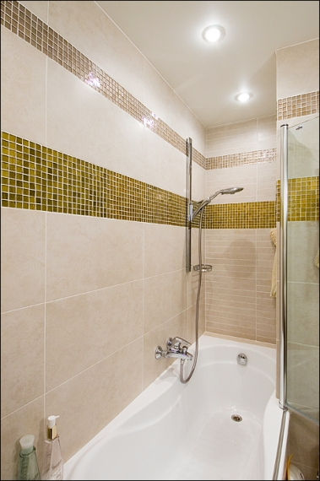
Is it a bathroom?

Slide 5
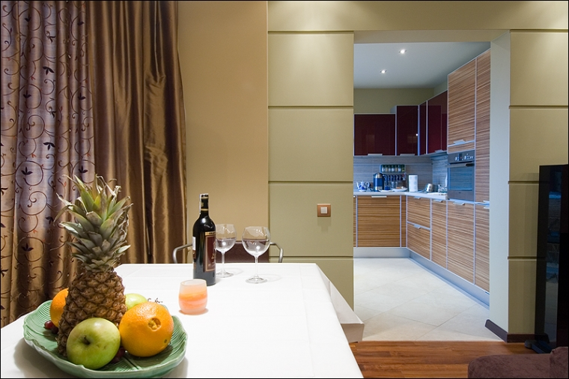
This is a kitchen

Slide 6
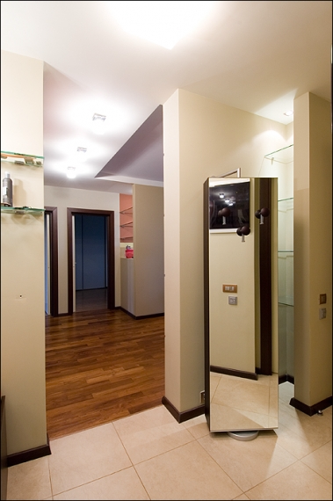
Is it a hall?

Slide 7
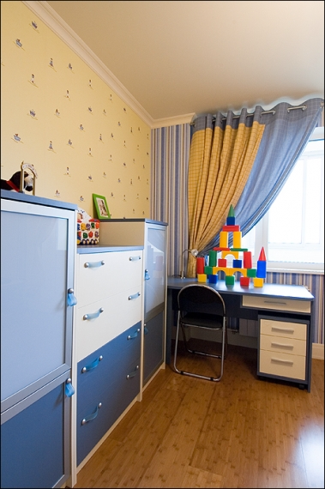
Is it a room?

Slide 8
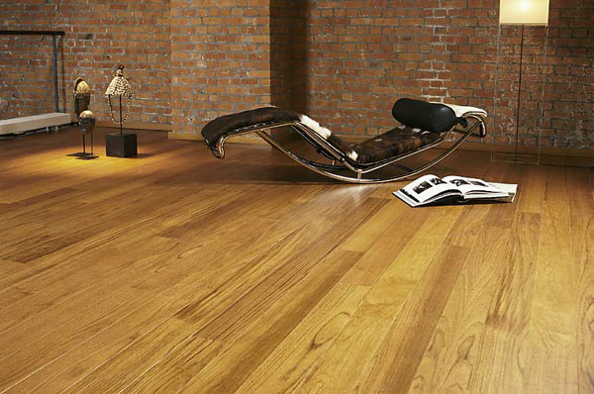
It is a floor

Slide 9
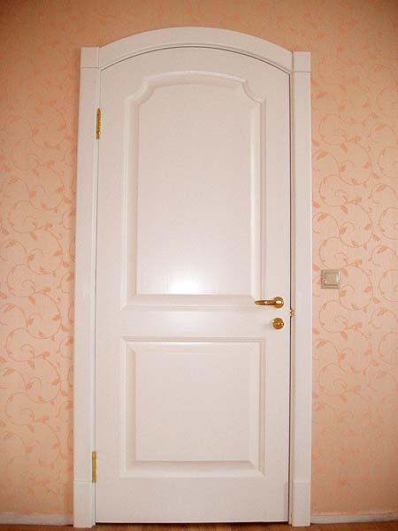
Is it a door?

Slide 10
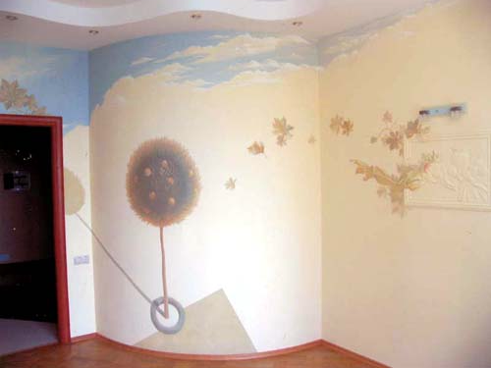
It is a wall

Slide 11
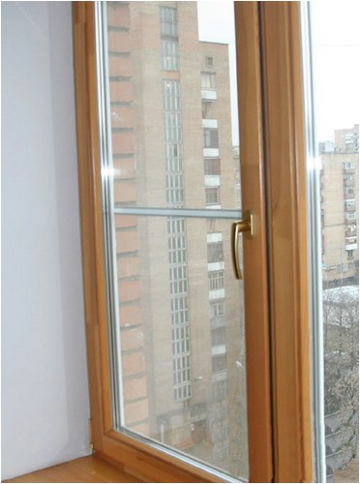
Is this a window?

