Slide 1
3 класс
MUCH - MANY
ПРИГОТОВИЛА:
УЧИТЕЛЬ МОУ «ПОДСИНСКАЯ» СОШ
ЛАПШИНА НИНА ИВАНОВНА

Slide 2
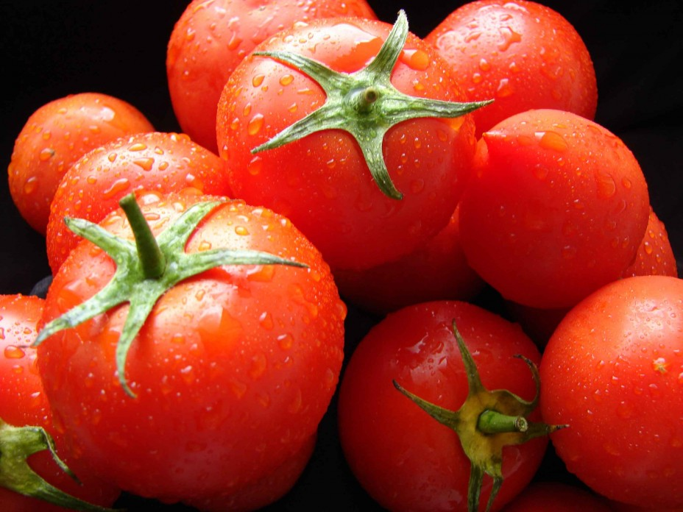
TOMATO

Slide 3
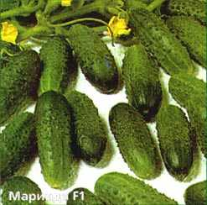
CUCUMBER

Slide 4
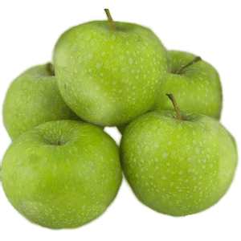
APPLE

Slide 5
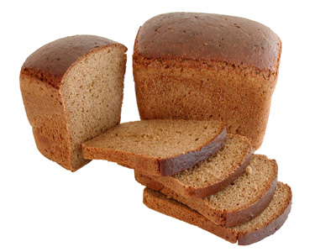
BREAD

Slide 6
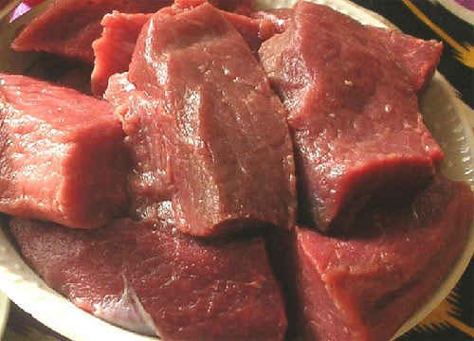
MEAT

Slide 7
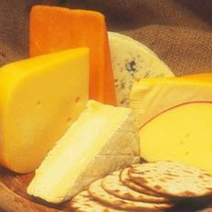
CHEESE

Slide 8
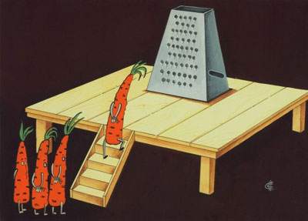
CARROT

Slide 9
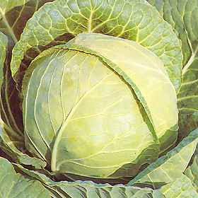
CABBAGE

Slide 10
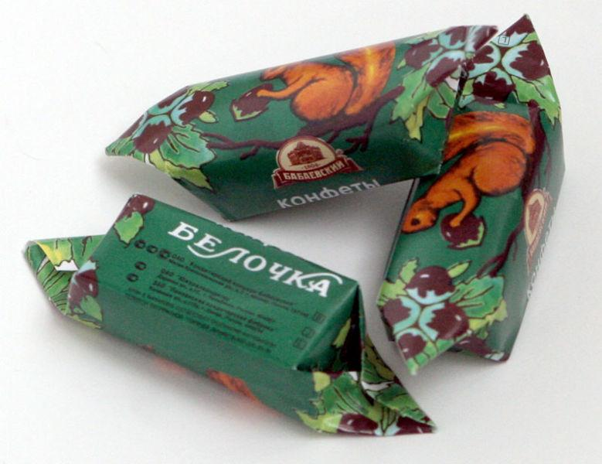
SWEETS

Slide 11
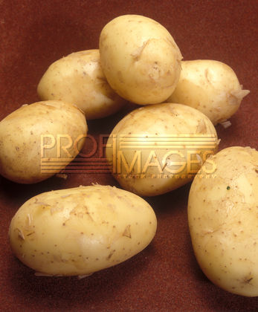
POTATO

Slide 12
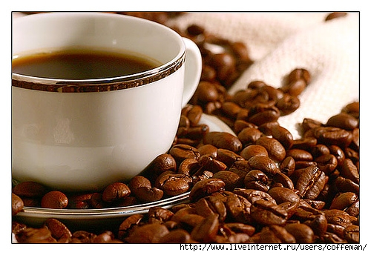
COFFEE

Slide 13

TEA

Slide 14
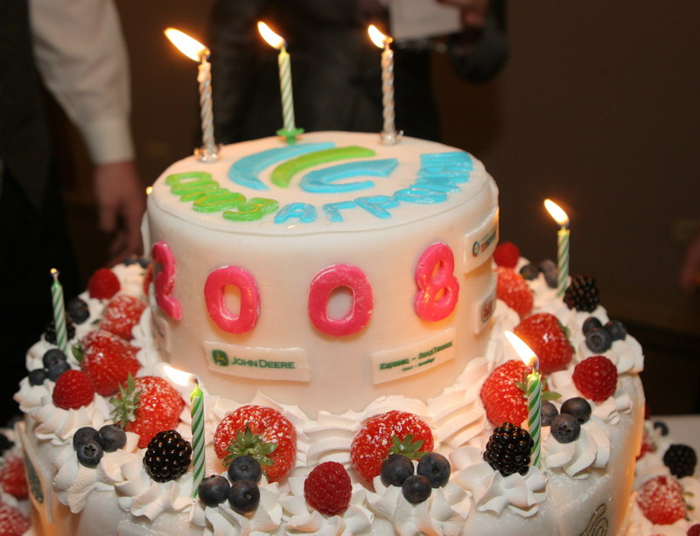
CAKE

Slide 15
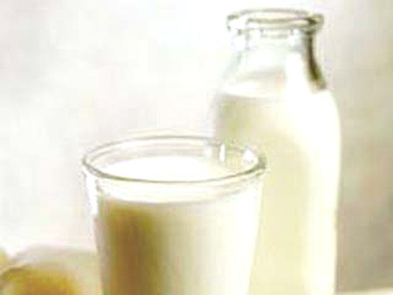
MILK

Slide 16
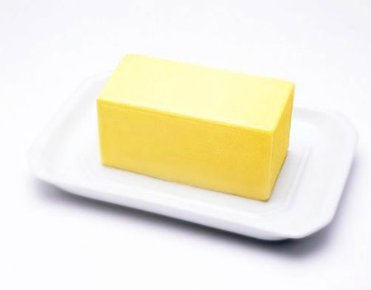
BUTTER

Slide 17
НАПИШИ СЛОВА В ДВЕ КОЛОНКИ
MANY MUCH
POTATO TEA
MEAT CUCUMBER
COFFEE SWEETS
CAKE CHEESE
BREAD APPLE
MILK CARROT
TOMATO BUTTER
CABBAGE

Slide 18
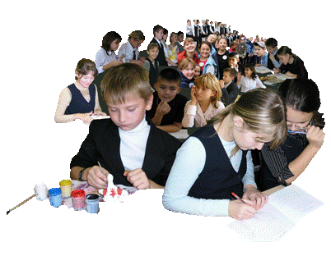
YOU ARE VERY CLEVER CHILDREN!

