Slide 1
2 класс Введение новой лексики к уроку №4 «Where do you live?»
Учитель МОУ Подсинская СОШ
Лапшина Нина Ивановна

Slide 2
Forest Do you live in the forest? Who lives in the forest?

Slide 3
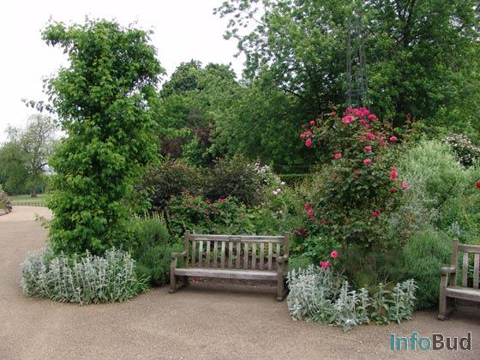
Garden Do you live in the garden? Who lives in the garden?

Slide 4
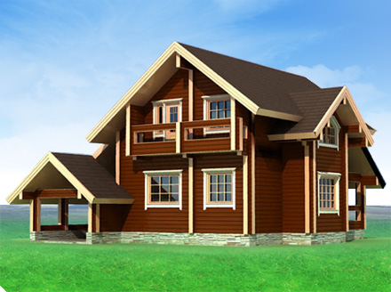
House Do you live in the house? Who lives in the house?

Slide 5
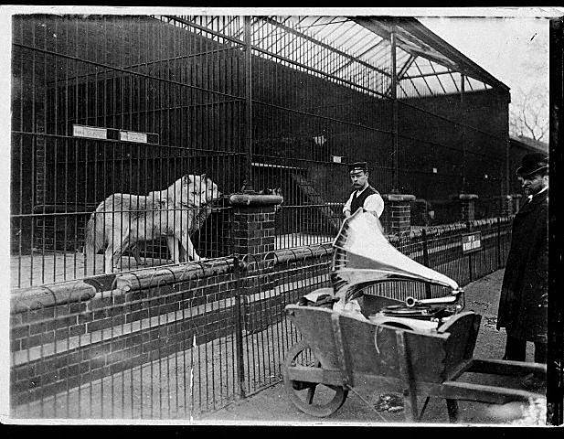
Zoo Do you live in the zoo? Who lives in the zoo?

Slide 6
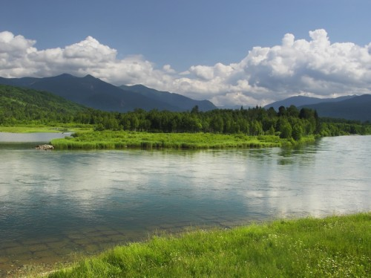
River Do you live in the river? Who lives in the river?

Slide 7
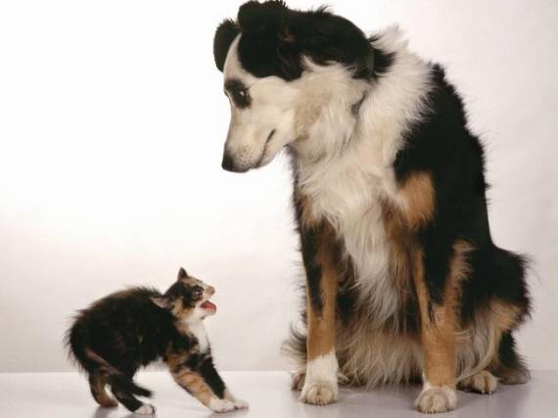
A dog lives in a house A cat lives in a house A mouse lives in a house

Slide 8
A crocodile lives in a river A fish lives in a river

Slide 9
A tiger lives in a forest A fox lives in a forest

Slide 10
A lion lives in the zoo An elephant lives in the zoo

Slide 11
Learn these words! Be clever things!

