Slide 1
Family
Sport
Animals

Slide 2
Animals
Wild
Domestic

Slide 3
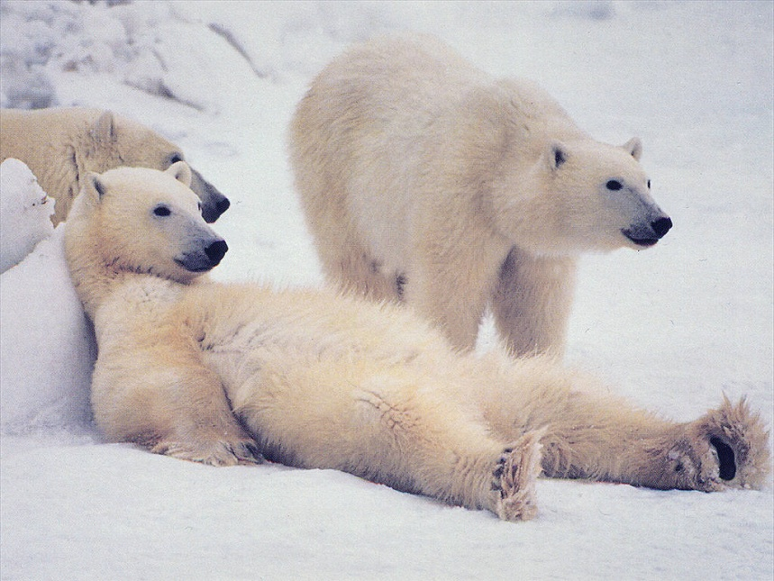
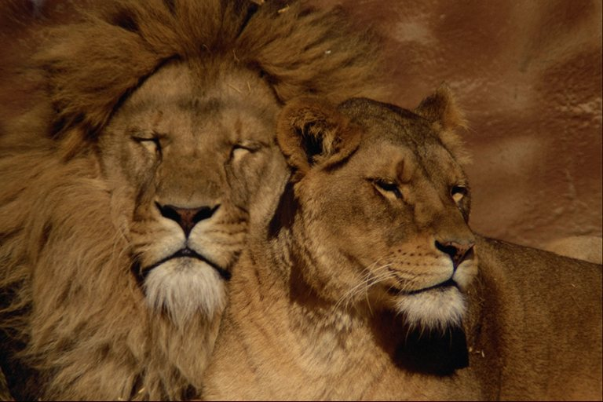
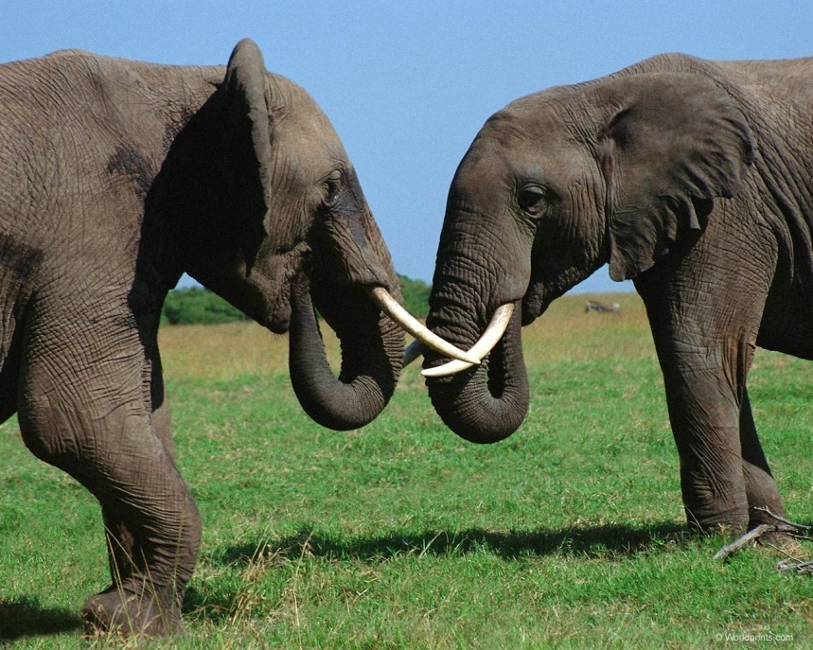
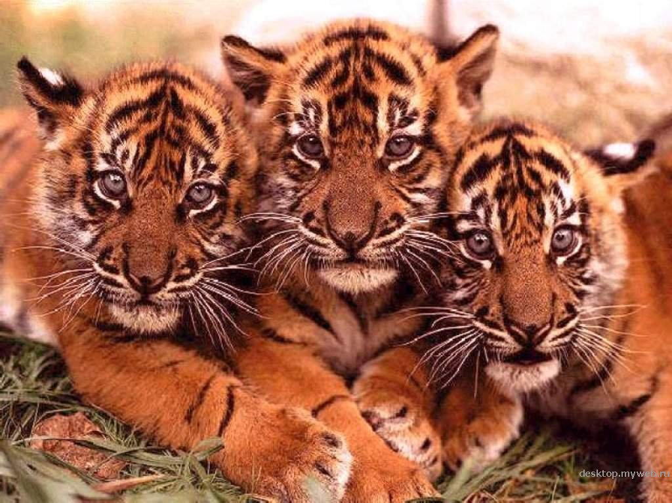
Wild animals

Slide 4
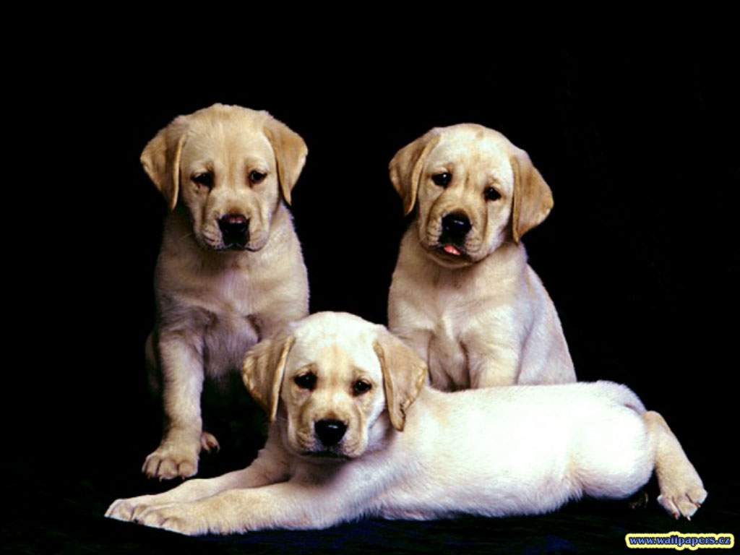
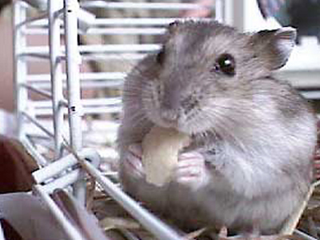
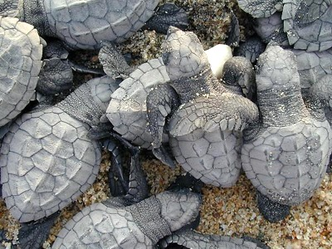
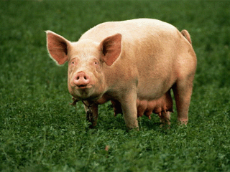
Domestic animals

Slide 5
P.R.O.
PARROT
H.M.TE.
HAMSTER
B.AUT.F.L
BEAUTIFUL
S.E.P
SHEEP
T.RTO.S.
TORTOISE
F.V.UR.T.
FAVOURITE
W.L.
WILD
D.M.ST.C
DOMESTIC

Slide 6
are
funnier
than

Slide 7
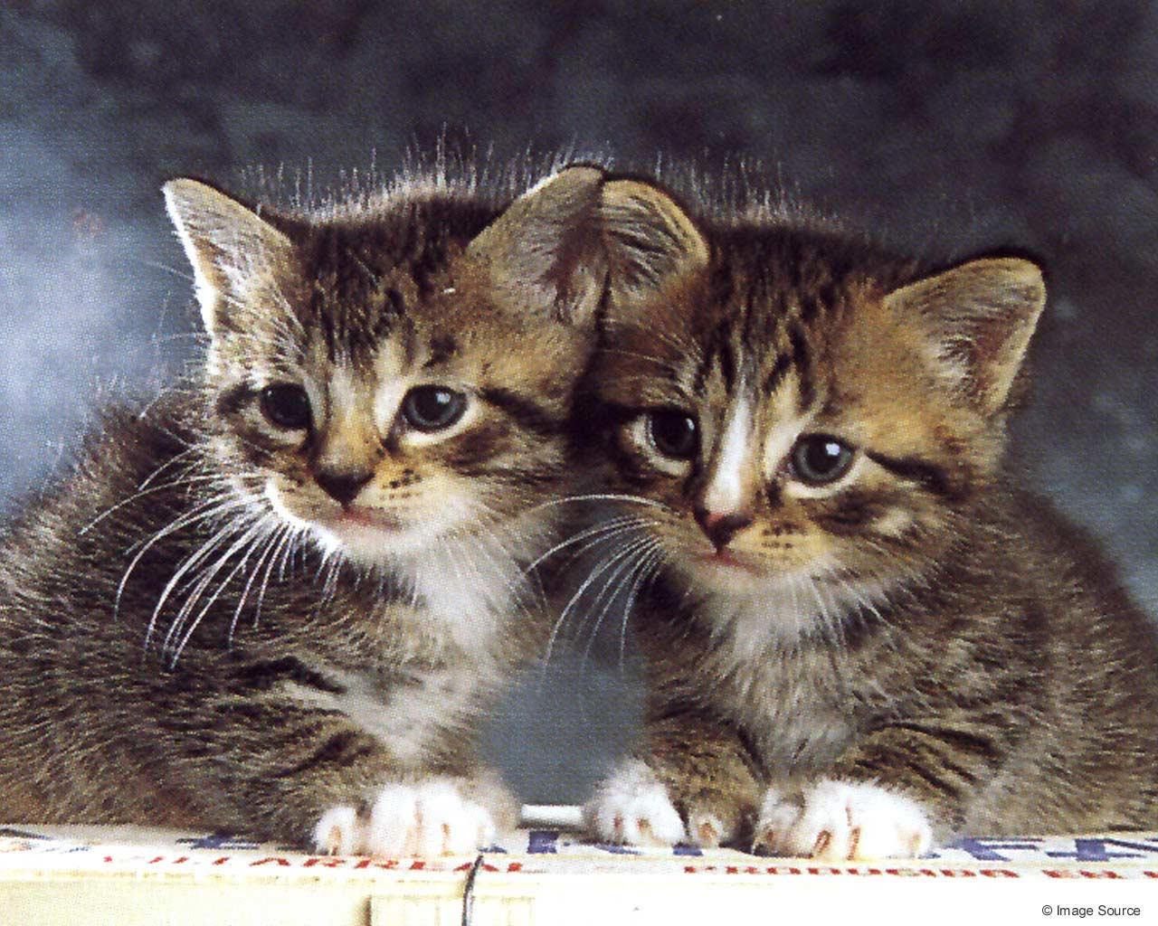
Have got
big
small

