Slide 1
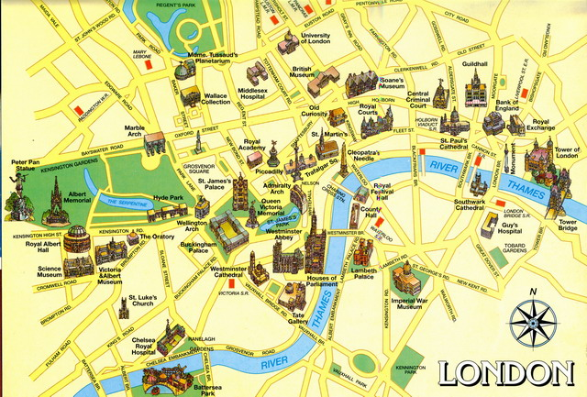
Welcome to London sightseeing tour !

Slide 2
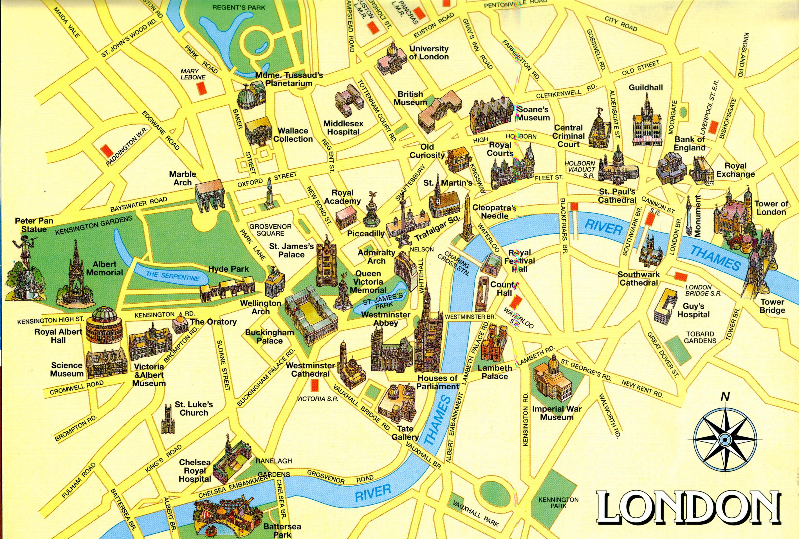

Slide 3
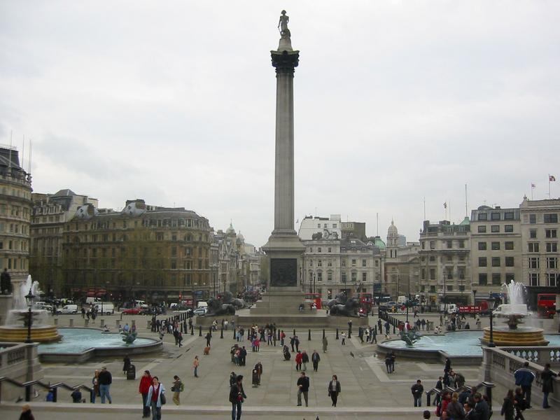
Trafalgar Square

Slide 5
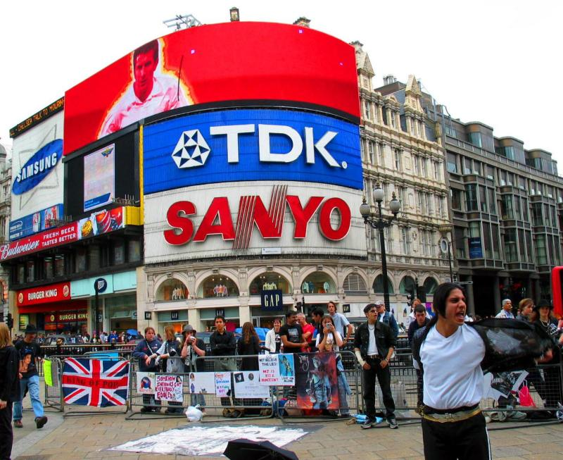
Piccadilly Circus

Slide 7
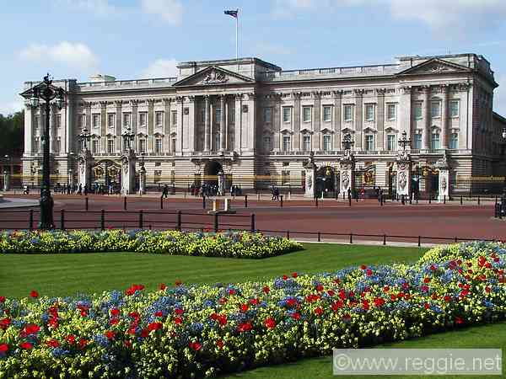
Buckingham Palace

Slide 8
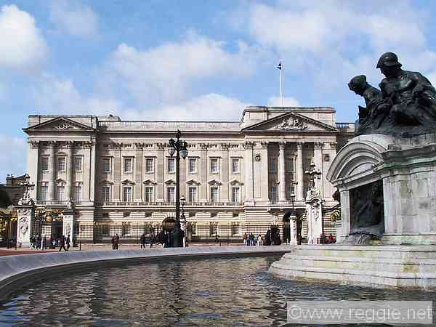
Buckingham Palace

Slide 10
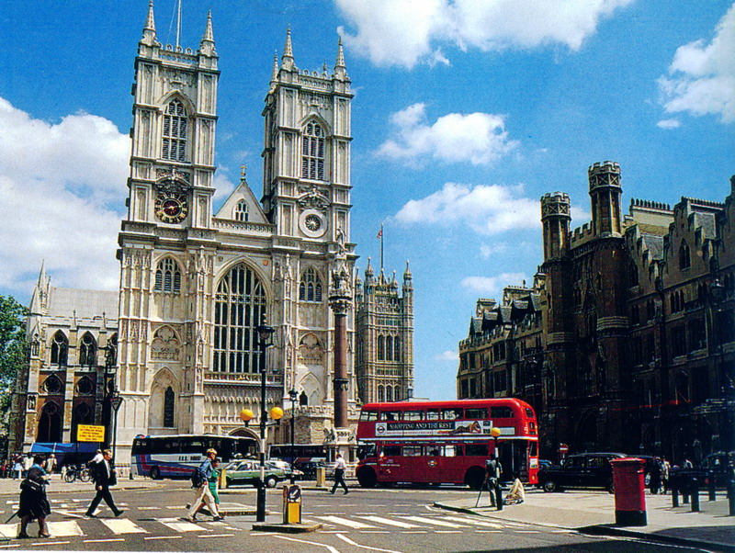
Westminster Abbey

Slide 12
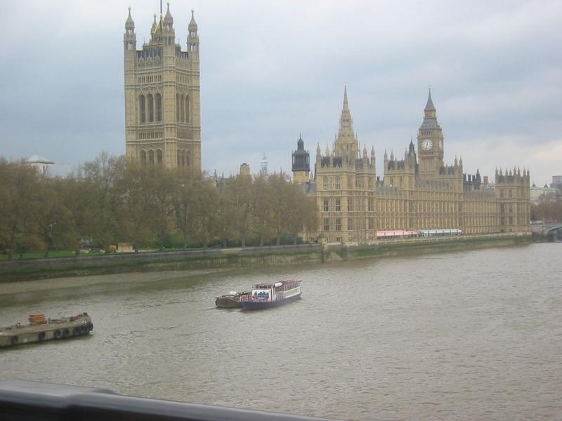
The Houses of Parliament
and Big Ben

Slide 13
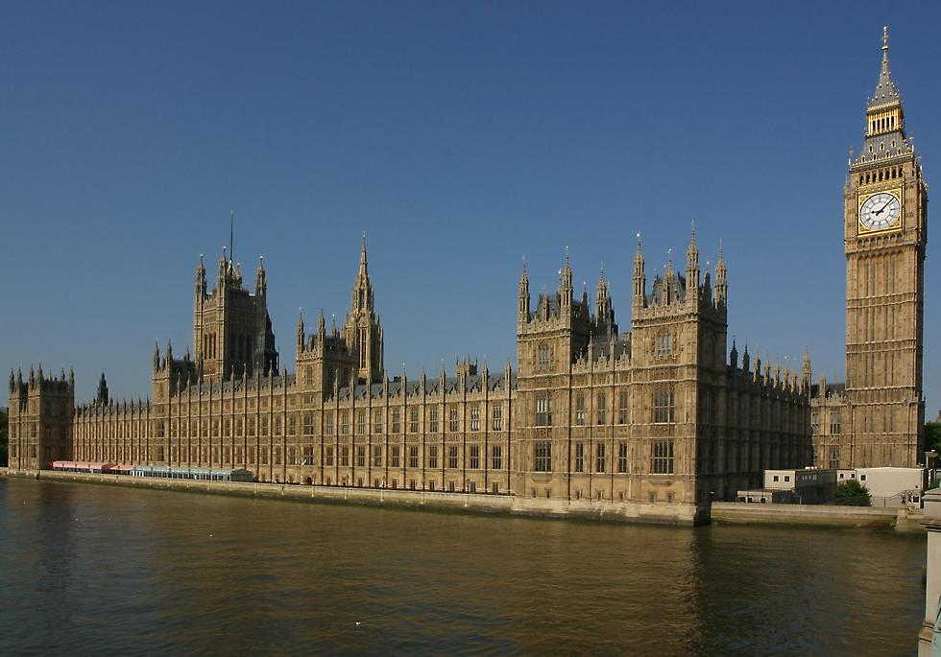
The Houses of Parliament
and Big Ben

Slide 15
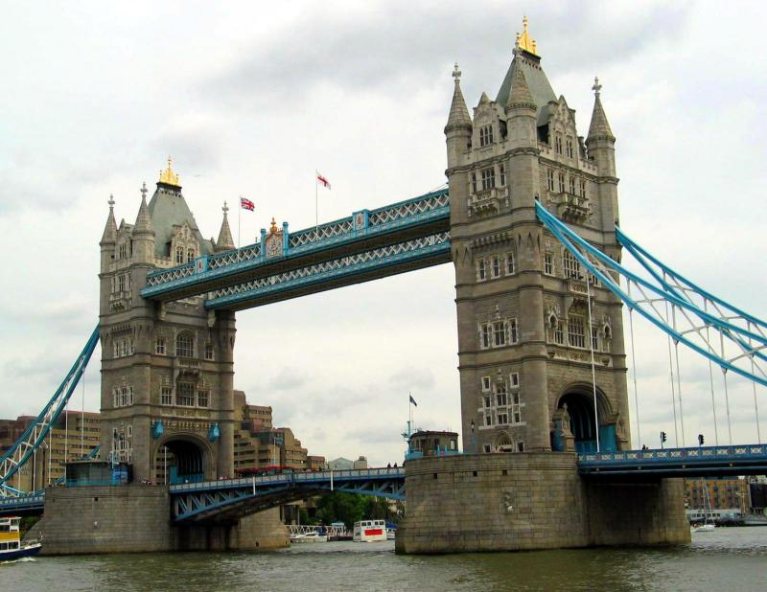
Tower Bridge

Slide 17
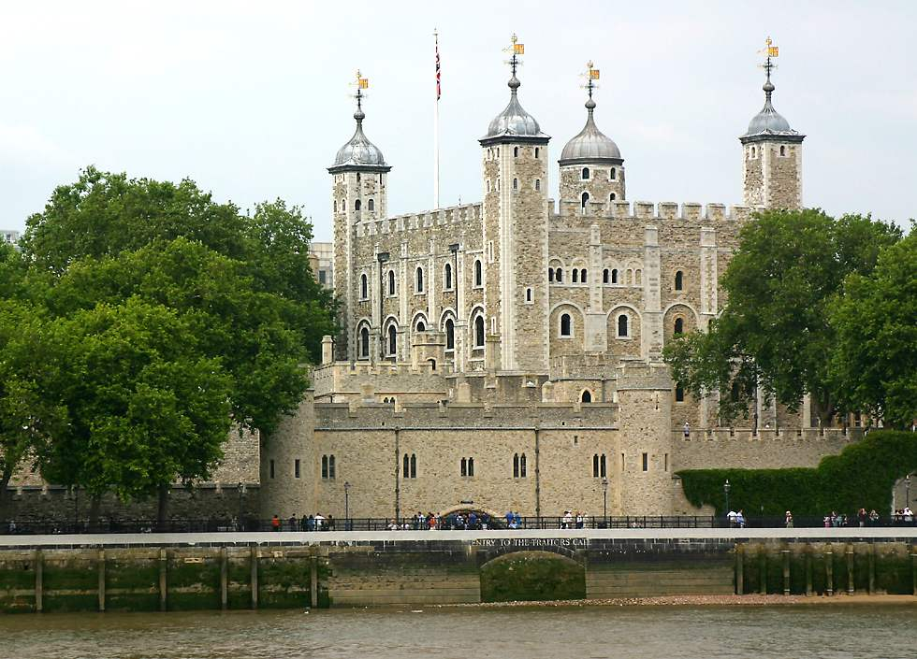
The Tower of London

Slide 19
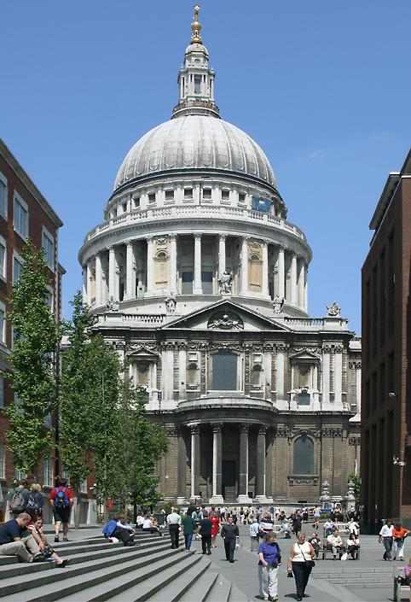
St. Paul’s Cathedral

Slide 21
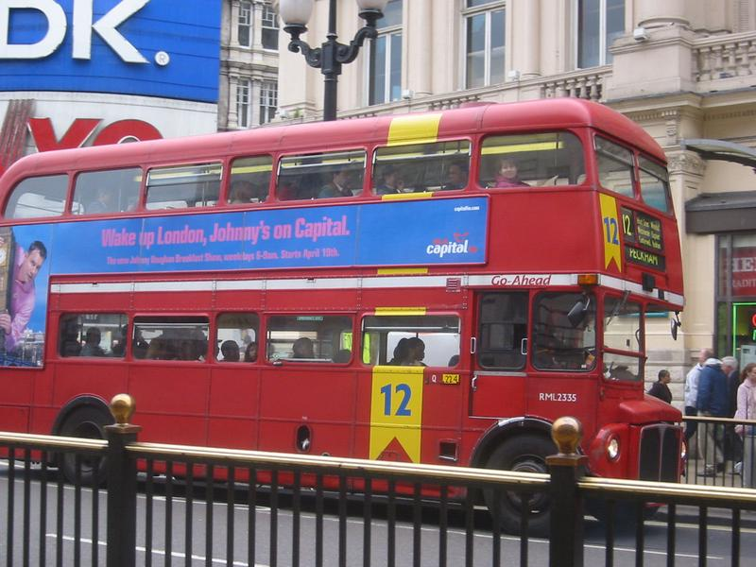
Welcome to Covent Garden!

