Slide 1
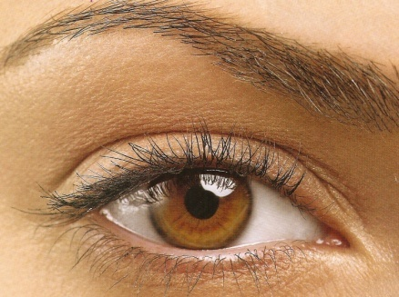
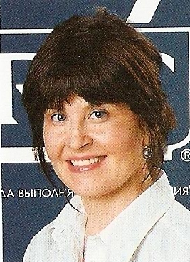
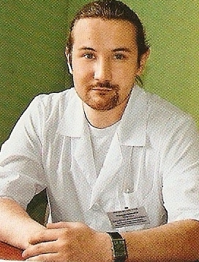



“Body”
“Food”
“At the Doctor’s”

Slide 2
“In the Reception”

Slide 3
“The optician’s”

Slide 4
“At the Dentist’s”

Slide 5
“At the ETN’S”

Slide 6
“At the Surgeon’s”

Slide 7
“At the Physition’s”

Slide 8
“At the Dietitian’s”

Slide 9

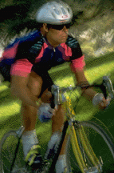

Здоровый образ жизни

