Slide 1


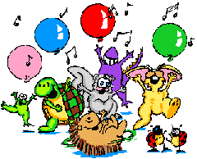
Winnie’s birthday
Notes:
Пестрякова И.В., учитель английского языка МОУ СОШ №3 имени Ю.А. Гагарина, г. Туринск

Slide 2

Фонетическая зарядка
[ei]
skate, game, player
[m]
summer, month, computer
[R]
park, mark, star
[h]
hello, horse, honey
[ai]
nice, five, July
[qu]
home, nose, yellow
[x]
cat, happy, sad

Slide 3
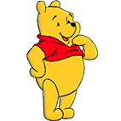

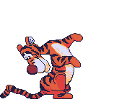

When is your birthday?
My birthday is on…
the 1st of September
the 3rd of January
the 24th of December
the 19th of August

Slide 4






January, February
It is winter time.
January, February
Look at the snow.
March, April, May.
It is spring time.
March, April, May.
Listen to the birds.
June, July, August.
It is summer time.
June, July, August.
Look at the sun.
September, October, November.
It is autumn.
September, October, November.
Listen to the rain.
December. It’s winter time again.
It is Christmas time.

Slide 5

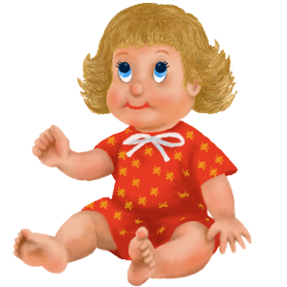
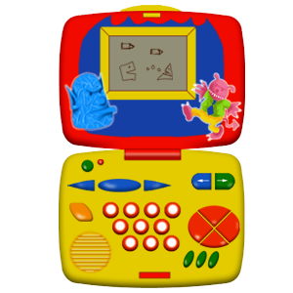
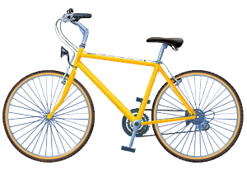




I would like to have …
a doll
a computer game
a bike
a CD player
a computer
a ball
a scooter

Slide 6

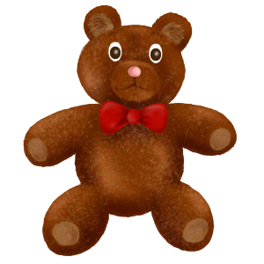

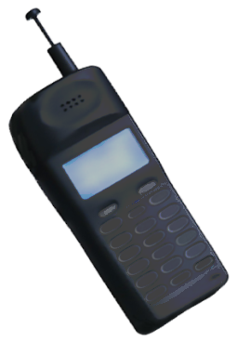


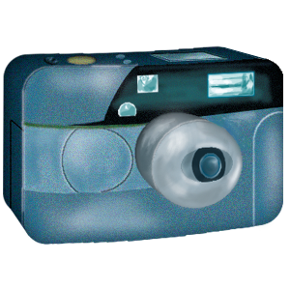
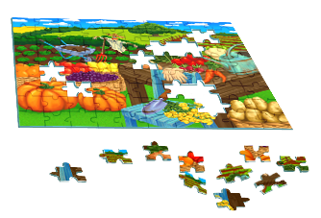
I would like to have …
ice skates
a teddy bear
a mobile phone
a guitar
a book
a camera
a puzzle

Slide 7

Fill in the blanks.
a
e
i
p…zzle
ca…era
m
b…ll
b…ke
c
e
s…ooter
b…ar
o
u
comput…r
d…ll

Slide 8



Физкультминутка.
If you’re happy and you know it, clap your hands.
If you’re happy and you know it, clap your hands.
If you’re happy and you know it
and you really want to show it,
If you’re happy and you know it, clap your hands.
Stamp your feet.
Snap your fingers.
Click your tongue.
Nod your head.
Say OK.

Slide 9



Послушай разговор Джилл с её новым другом Тайни. Скажи, какой подарок он получил на день рождения.

Slide 10

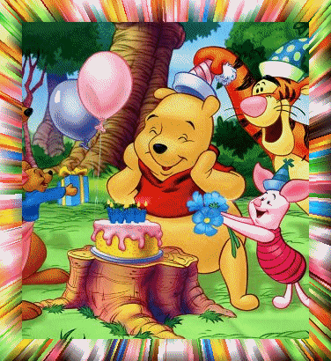



Listen, read and act out.
It’s great!
Thank you!
Happy birthday
to you!

Slide 11


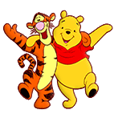

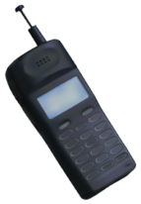

Посмотри на картинки и закончи предложения.
April, 8
Winnie’s birthday is on…
Winnie likes to ….
They… at the party.
Winnie has got… for his birthday.

Slide 12

Find the odd word
BIRTHDAY, MONDAY, FRIDAY, SUNDAY
APRIL, NOVEMBER, MAY, MARCH
AUTUMN, WINTER, BRIGHT, SPRING
FIRST, FIFTH, SECOND, FOURTH, THINK
BOOK, PUZZLE, BIKE, PLAY, SCOOTER

