Slide 1
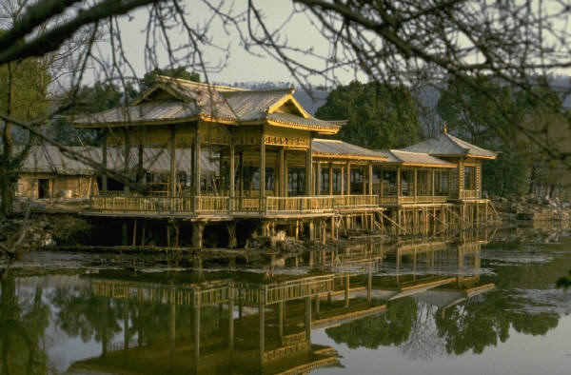
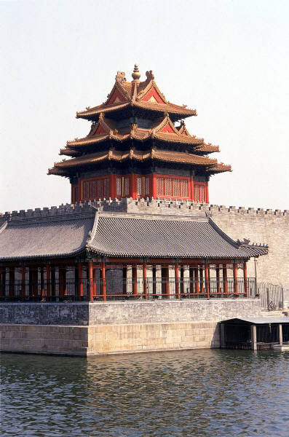
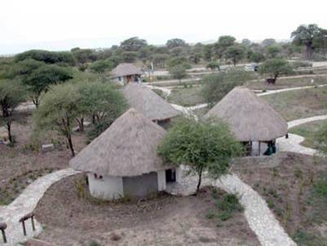
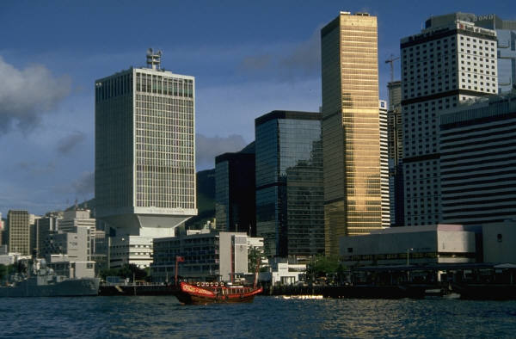
February, 20th.
Wednesday.
Home. Sweet Home.

Slide 2
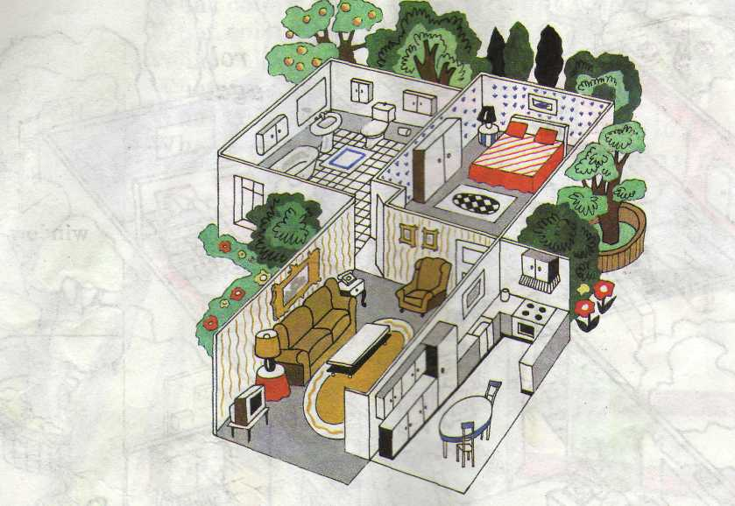
There is/are …
Where? It is …
bedroom
bathroom
kitchen
living-room

Slide 3
Match the pictures and the words, fill in the right letters:
fr_dg_
c_mp_t_r
s_f_
t_bl_
st_v_
b_d
ch_ _r
TV s_t

Slide 4


Slide 5
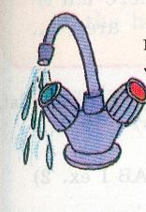
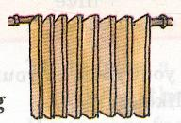
An ordinary house / flat
Modern conveniences
Running water
Central heating
Electricity
Gas
advantages
disadvantages

Slide 6
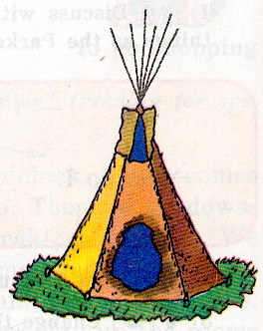
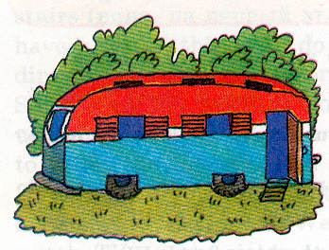
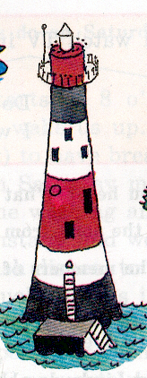
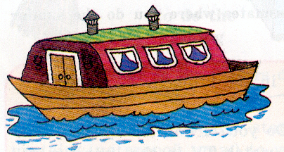
Would You Like to Live in an Unusual House?
a teepee
a caravan
a houseboat
a lighthouse

Slide 7
Put the sentences in the correct order to make the conversations:
– We live in a lighthouse.
– No, we don’t.
– Where do you live?
– Do you live in an ordinary house?
– Do you like living there?
– It’s romantic and unusual. But I think it’s better to live in an ordinary house with all modern conveniences.

Slide 8
– Do you live in an ordinary house?
– No, we don’t.
– Where do you live?
– We live in a lighthouse.
– Do you like living there?
– It’s romantic and unusual. But I think it’s better to live in an ordinary house with all modern conveniences.

Slide 9
Put the sentences in the correct order to make the conversations:
– Do you live in a quiet place?
– Yes, we do. We have gas, electricity, running water and central heating. It is very convenient.
– Do you have all the modern conveniences?
– Do you live in an unusual house?
– No, we don’t. We live in an ordinary house.
– Yes, we do. And our house is not far from my school.

Slide 10
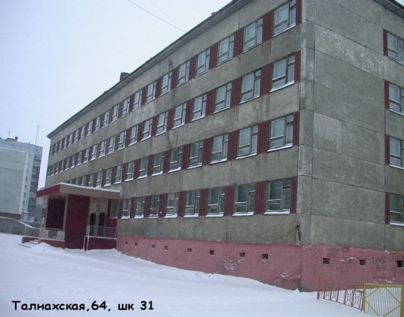
– Do you live in a quiet place?
– Yes, we do. And our house is
not far from my school.
– Do you live in an unusual house?
– No, we don’t. We live in an ordinary house.
– Do you have all the modern conveniences?
– Yes, we do. We have gas, electricity, running water and central heating. It is very convenient.

Slide 11
The place
I would like to live in
Location
Size (rooms) and their description
Conveniences
Furniture and its description
Conclusion

