Slide 1
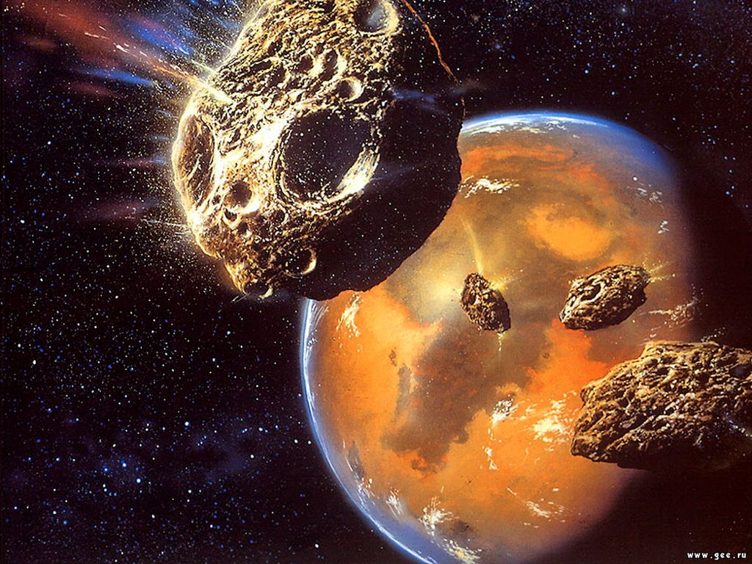
Who is the best space explorer?

Slide 2
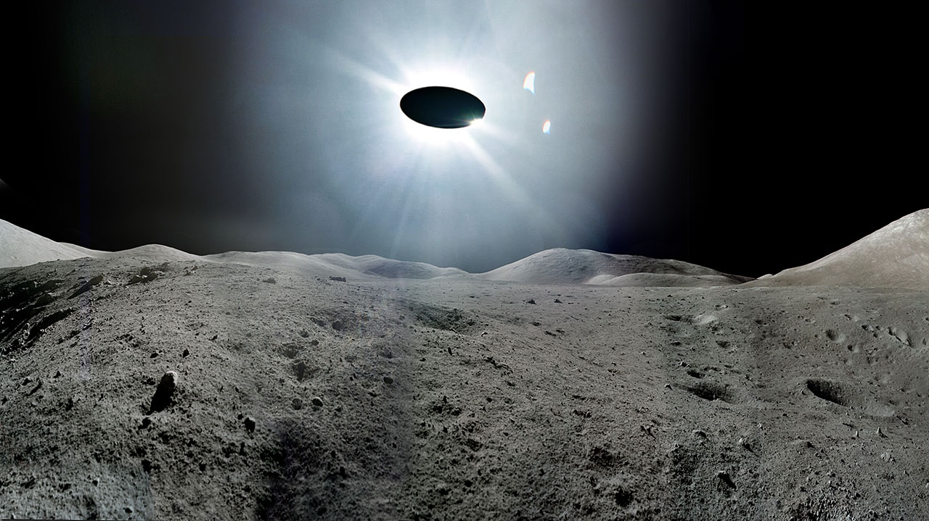
galaxy
universe
space
planet
distance
satellite
star
spacesuit
pole

Slide 3
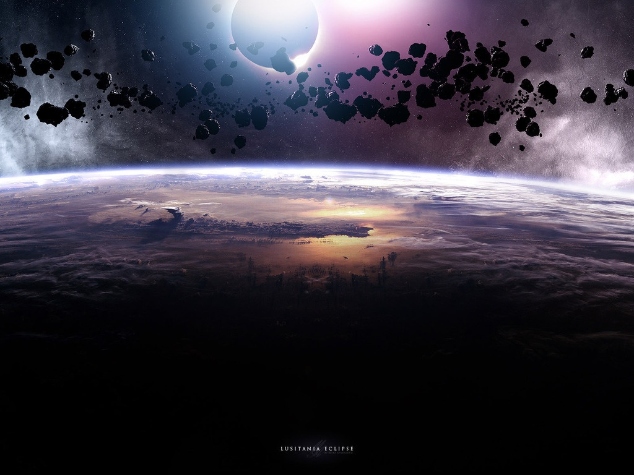
GUESS WHAT IS IT
All space and everything that exist in it.
Large round object that goes round a star.
A place far above the Earth where is no air.
The Sun with the planets going round it.
The universe
planet
Solar System
galaxy

Slide 4
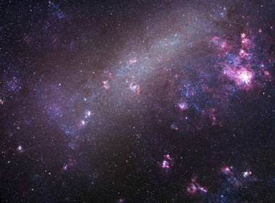
QUIZ
Слайд 5 | Слайд 6 | Слайд 7 | Слайд 8
Слайд 9 | Слайд 10 | Слайд 11 | Слайд 12
Слайд 13 | Слайд 14 | Слайд 15 | Слайд 16
Space
researches
Space
inventions
other
questions
galaxies
100
100
100
100
300
300
300
300
500
500
500
500

Slide 5
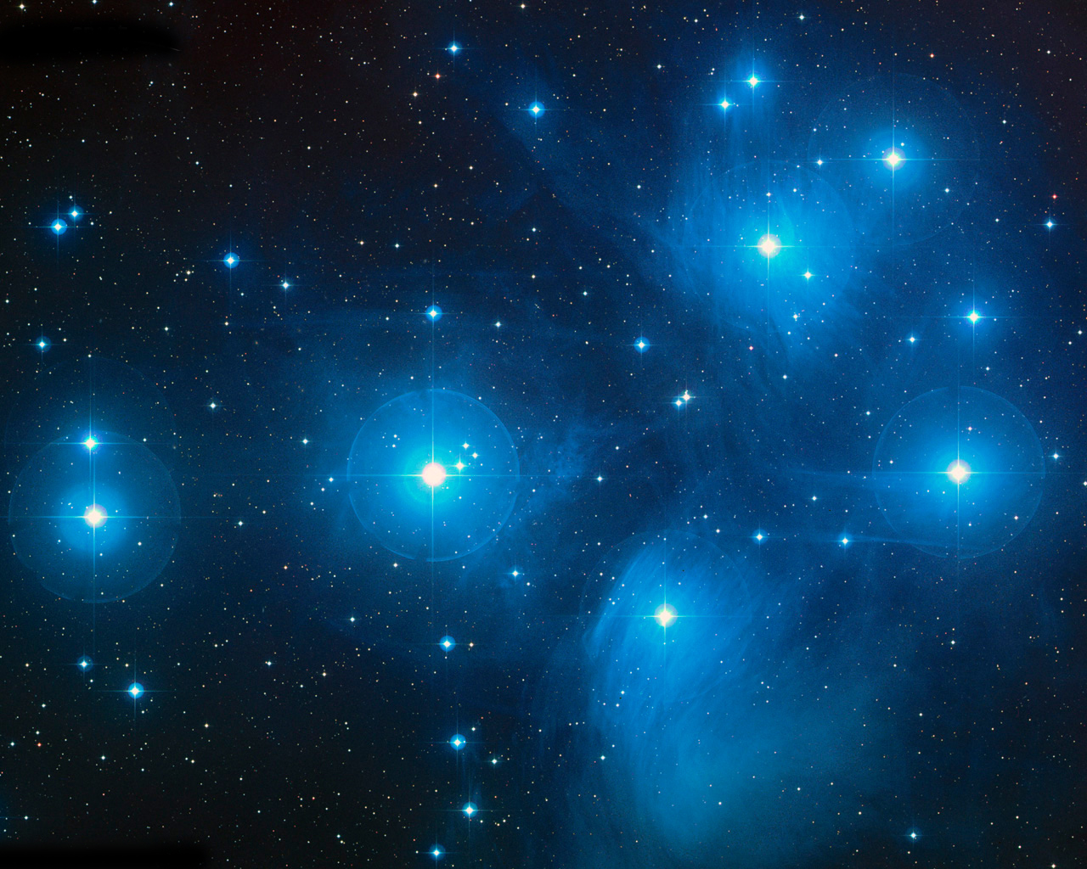
GALAXIES
QUIZ
WHAT IS THE NAME OF OUR GALAXY ?
THE MILKY WAY

Slide 6
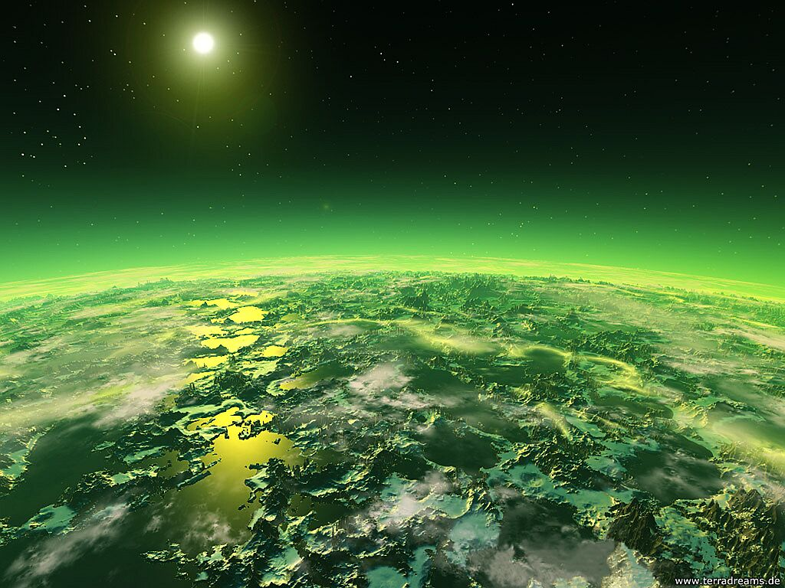
SPACE RESEARCHES
QUIZ
WHO WAS THE FIRST MAN
ON THE MOON?
NEIL ARMSTRONG

Slide 7
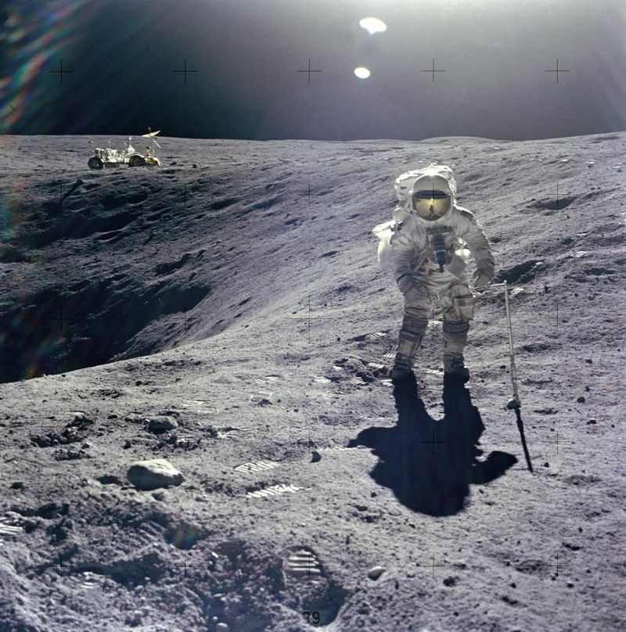
SPACE INVENTIONS
QUIZ
WHO INVENTED
THE FIRST TELESCOPE?
GALILEO
galilei

Slide 8
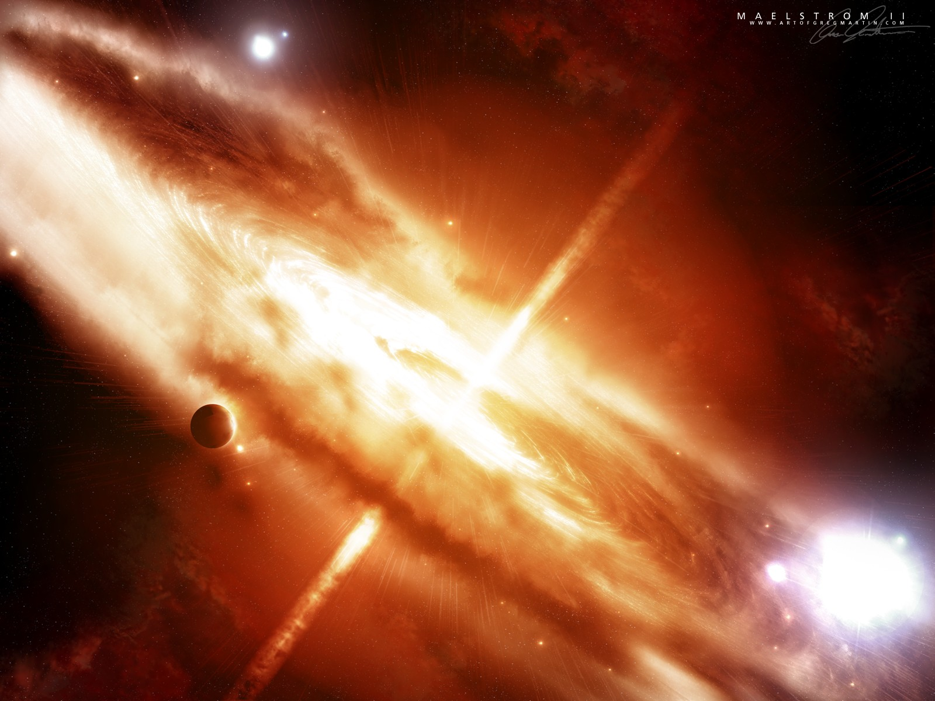
OTHER QUESTIONS
QUIZ
WHAT WAS THE NAME OF
THE FATHER OF
SERGEI PAVLOVICH KOROLYOV ?
PAVEL

Slide 9
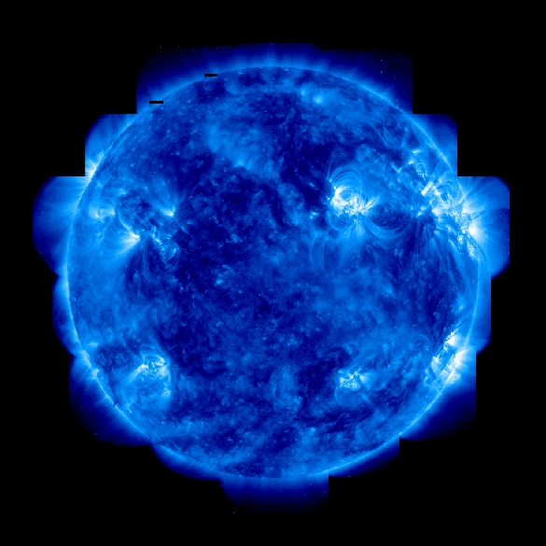
GALAXIES
QUIZ
WHAT IS THE FORM
OF OUR GALAXY?
A HUGE DISC
WITH
A BULGE IN THE MIDDLE

Slide 10
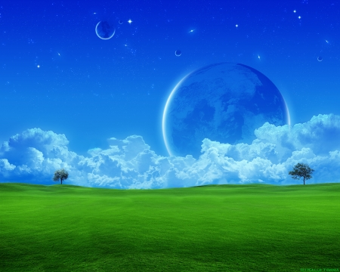
SPACE RESEARCHES
QUIZ
WHO BECAME
THE FIRST PERSON IN SPACE?
ALEXEI LEONOV

Slide 11
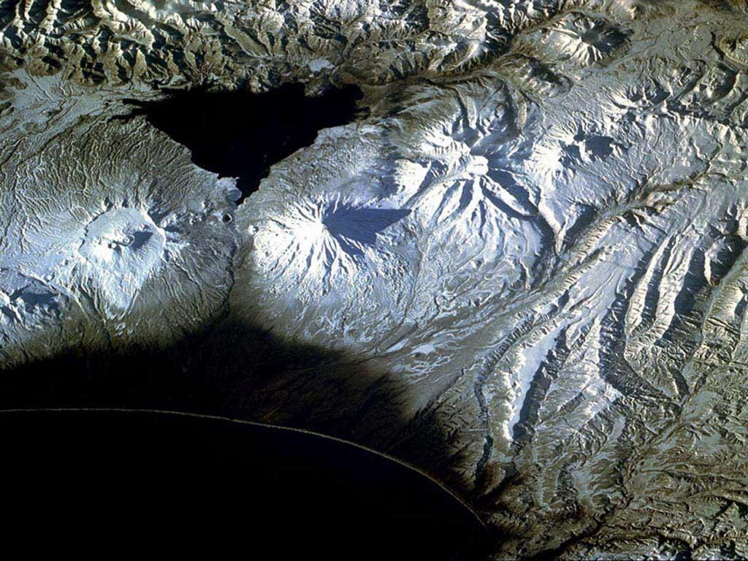
SPACE INVENTIONS
QUIZ
WHAT DID S. KOROLYOV
DESIGN IN 1957?
THE FIRST ARTIFICIAL
SATELLITE

Slide 12
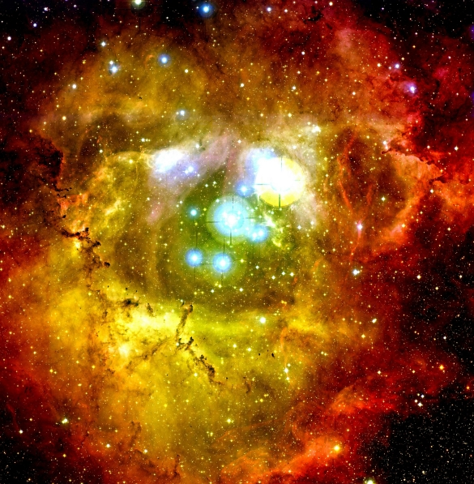
OTHER QUESTIONS
QUIZ
A doctor has a brother who is a cosmonaut in
San francisco. But the cosmonaut in
San francisco doesnot have a brother
who is a doctor.
How can this be?
The doctor is his sister

Slide 13
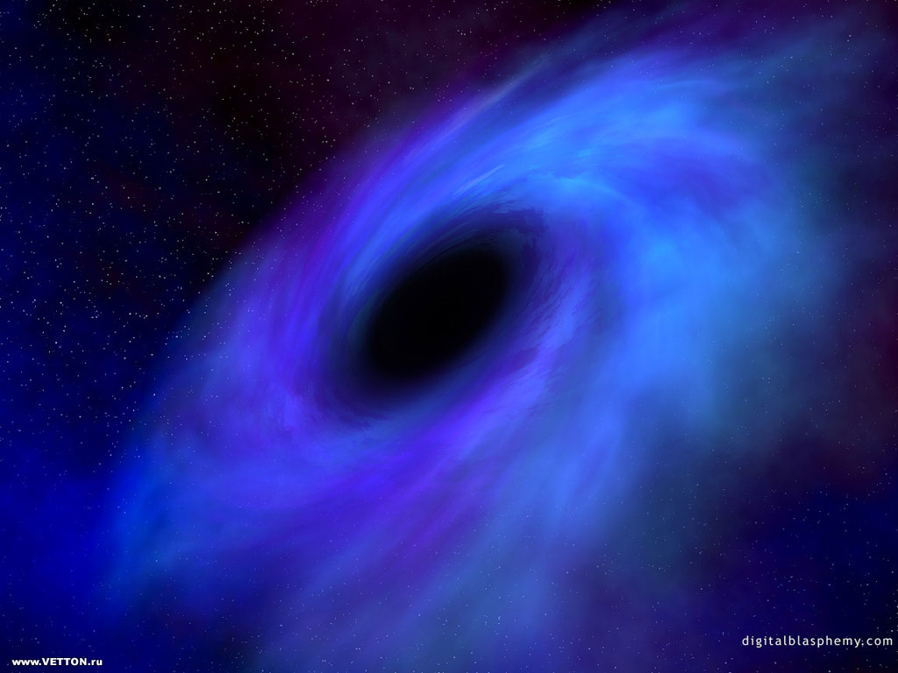
GALAXIES
QUIZ
WHAT IS THE CLOSEST GALAXY
TO THE MILKY WAY?
THE ANDROMEDA GALAXY

Slide 14
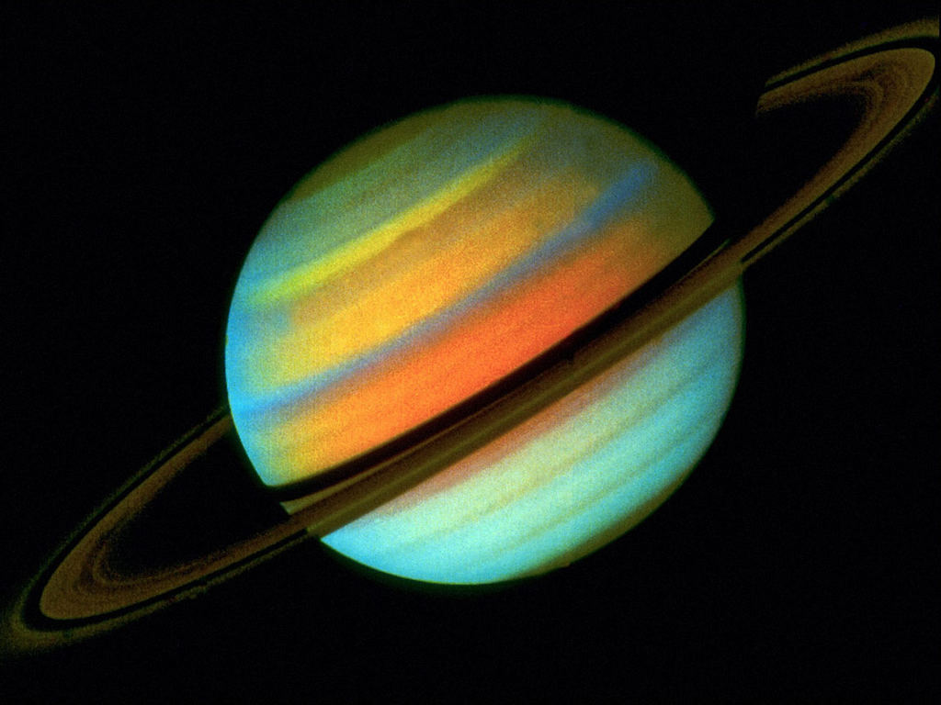
SPACE RESEARCHES
QUIZ
Who created the IDEA OF SPACESHIP
BASED ON THE USE
OF LIqUID FUELS?
KONSTANTIN
EDUARDOVICH
TSIOLKOVSKY

Slide 15
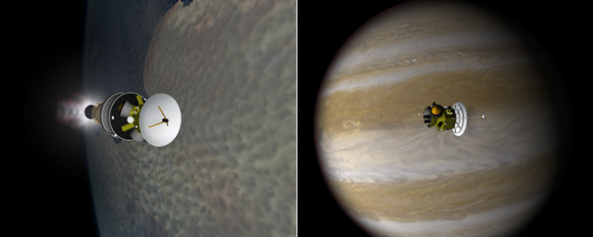
SPACE INVENTIONS
QUIZ
WHAT WAS THE NAME
OF THE FIRST
JOINT SPACE MISSION
of THE U. S. AND the U.S.A.?
Soyus-Apollo

Slide 16
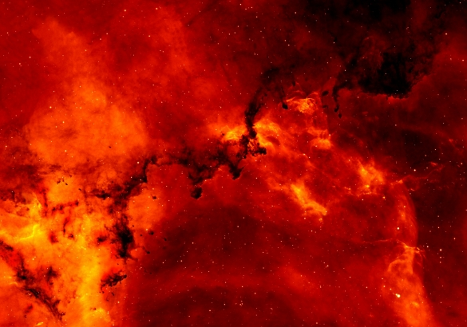
OTHER QUESTIONS
QUIZ
How many
of each kind Of animal
would moses take On the ark
If the ark WAS a spaceship?
Moses? It was Noah!

Slide 17
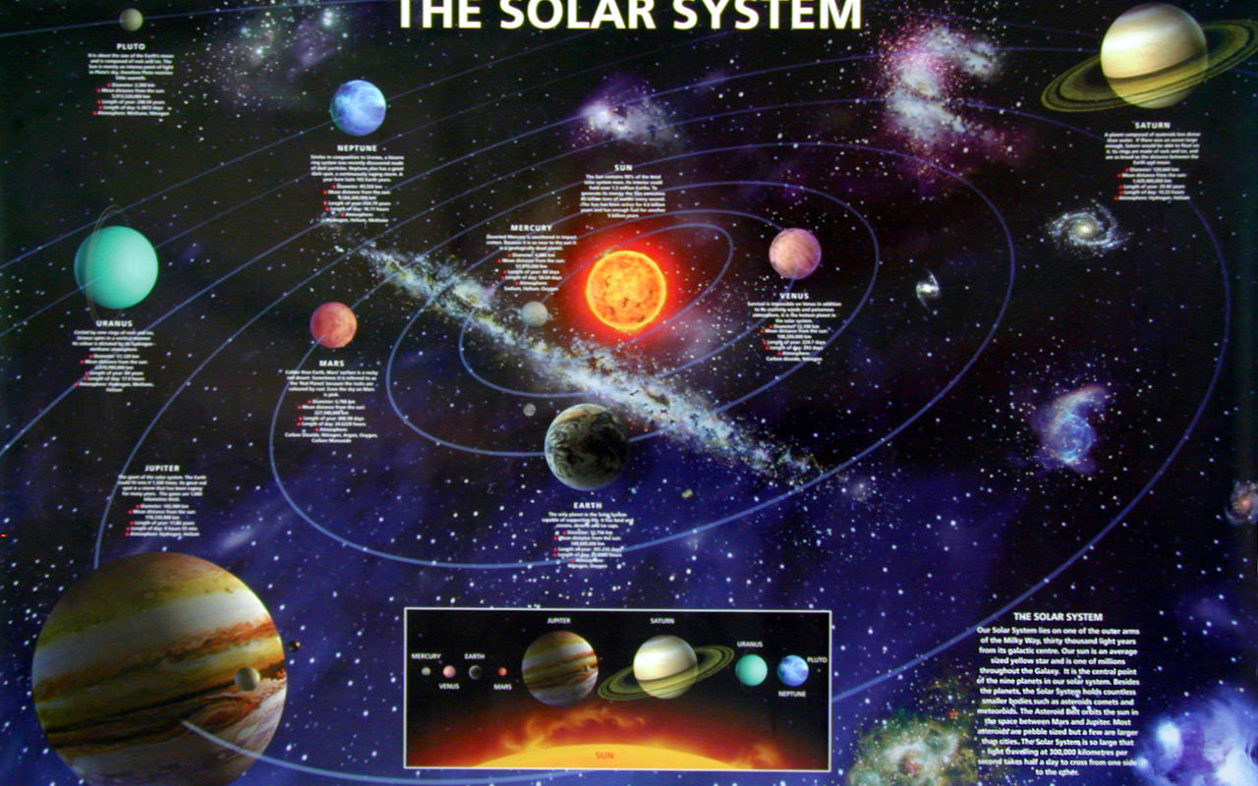
YOU ARE THE BEST SPACE
EXPLORER!

