Slide 1

“Enjoy English-2"
Biboletova M.Z.
“The fashion house”
Автор: Учитель английского языка
Маслова Юлия Фёдоровна
Nadvoitsy
Next
2008

Slide 2
Contents
Introduction
Vocabulary Work
Vocabulary Game
Listening
Pair Work
Next
Next
Next

Slide 3
The fashion house

Slide 4
Fashion is beautiful, modern and comfortable clothes.
Next

Slide 5
Let's play the game
"Rhymes".
Example:
beans - jeans
map - cap
Next

Slide 6
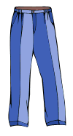




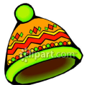
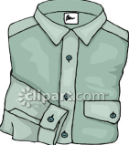
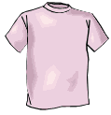

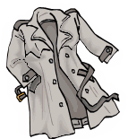

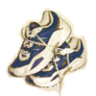
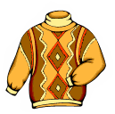


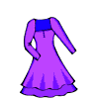
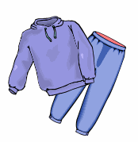
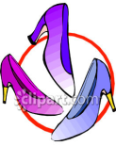
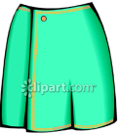

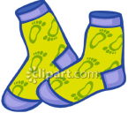
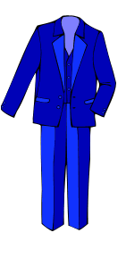

Let’s play
"Words and pictures"
Next

Slide 7
Do you know these words ?
When you see a word click on the picture.
Click here to start!
Next

Slide 8
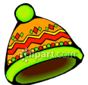
Find the picture !
a cap

Slide 9

a cap
Click on the picture !
a T-shirt

Slide 10
a cap
a T-shirt
Click on the picture !
sneakers

Slide 11
a cap
a T-shirt
Click on the picture !
a dress
sneakers

Slide 12
a cap
a T-shirt
Click on the picture !
mittens
sneakers
a dress

Slide 13
a cap
a T-shirt
Click on the picture !
a blouse
sneakers
a dress
mittens

Slide 14
a cap
a T-shirt
Click on the picture !
socks
sneakers
a dress
mittens
a blouse

Slide 15
a cap
a T-shirt
Click on the picture !
a track suit
sneakers
a dress
mittens
socks
a blouse

Slide 16
a cap
a T-shirt
Click on the picture !
a sweater
sneakers
a dress
a track suit
mittens
socks
a blouse

Slide 17
a cap
a T-shirt
Click on the picture !
shorts
sneakers
a sweater
a dress
a track suit
mittens
socks
a blouse

Slide 18
a cap
a T-shirt
shorts
Click on the picture !
a hat
sneakers
a sweater
a dress
a track suit
mittens
socks
a blouse

Slide 19
a cap
a hat
a T-shirt
shorts
Click on the picture !
trousers
sneakers
a sweater
a dress
a track suit
mittens
socks
a blouse

Slide 20
a cap
trousers
a hat
a T-shirt
shorts
Click on the picture !
a jacket
sneakers
a sweater
a dress
a track suit
mittens
socks
a blouse

Slide 21
a cap
trousers
a hat
a jacket
a T-shirt
shorts
Click on the picture !
a raincoat
sneakers
a sweater
a dress
a track suit
mittens
socks
a blouse

Slide 22
a cap
trousers
a hat
a jacket
a T-shirt
shorts
a raincoat
Click on the picture !
gloves
sneakers
a sweater
a dress
a track suit
mittens
socks
a blouse

Slide 23
trousers
a cap
a hat
a jacket
shorts
a T-shirt
a raincoat
Click on the picture !
shoes
sneakers
a sweater
gloves
a dress
a track suit
mittens
socks
a blouse

Slide 24
trousers
a cap
a hat
a jacket
a T-shirt
shorts
a raincoat
Click on the picture !
sandals
sneakers
a sweater
mittens
a dress
a track suit
shoes
mittens
socks
a blouse

Slide 25
trousers
a cap
a hat
a jacket
a T-shirt
shorts
Click on the picture !
a raincoat
a suit
sneakers
a sweater
gloves
a dress
a track suit
shoes
mittens
sandals
socks
a blouse

Slide 26
a cap
trousers
a hat
a jacket
a T-shirt
shorts
Click on the picture !
a raincoat
a skirt
sneakers
a sweater
gloves
a dress
a track suit
shoes
mittens
sandals
a suit
socks
a blouse

Slide 27
a cap
trousers
a hat
a jacket
a T-shirt
shorts
Click on the picture !
a raincoat
boots
sneakers
a sweater
gloves
a dress
a track suit
shoes
a skirt
mittens
sandals
a suit
socks
a blouse

Slide 28
a cap
trousers
a hat
a jacket
a T-shirt
shorts
Click on the picture !
a raincoat
sneakers
jeans
a sweater
gloves
boots
a dress
a track suit
shoes
a skirt
mittens
sandals
a suit
socks
a blouse

Slide 29
trousers
a cap
a hat
a jacket
a T-shirt
shorts
Click on the picture !
a raincoat
jeans
a shirt
sneakers
a sweater
gloves
boots
a dress
a track suit
shoes
mittens
a skirt
sandals
a suit
socks
a blouse

Slide 30
trousers
a hat
a cap
a jacket
a shirt
a T-shirt
shorts
a raincoat
Click on the picture !
jeans
sneakers
a coat
a sweater
gloves
boots
a dress
a track suit
shoes
mittens
a skirt
sandals
a suit
socks
a blouse

Slide 31
trousers
a coat
a cap
a hat
a jacket
a shirt
a T-shirt
shorts
a raincoat
jeans
sneakers
Well done !!!
a sweater
gloves
boots
a dress
a track suit
shoes
a skirt
mittens
socks
a suit
sandals
a blouse
Menu
Next

Slide 32
You are mistaken!!!
Return

Slide 33
You are not right!!!
Return

Slide 34
Try again !!!
Return

Slide 35
Meet Helen!
Helen tells what clothes she likes to wear.
Next

Slide 36
Check up!!!
Hello! I’m Helen. I am from England. I like to wear fashionable clothes.
When I visit birthday parties I often wear
a beautiful pink dress and nice shoes.
I enjoy going for sports so I usually put my yellow track suit and modern sneakers on.
But most of all I like to go to school. When I go there I always wear my uniform. It’s a white blouse, a blue skirt and a jacket. My uniform is very comfortable and nice.
Next

Slide 37
When she’s going for sports she puts....... on.
When she goes to school she wears ...
When she visits birthday parties she likes to wear……
Menu
Next

Slide 38
And what about you?
Exchange your opinions.
Use
When I am going for sports
When I visit birthday parties
I wear ……
When I go to school
Next

Slide 39

Let's talk about your classmate.
When is going for sports
When visits birthday patrties
he/she wears...
When goes to school
Menu

