Slide 1
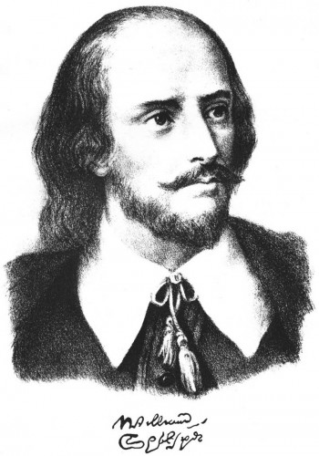
My favourite writer is William Shakespeare.
The project is made by the pupil of 7a
Klinchukov A.

Slide 2
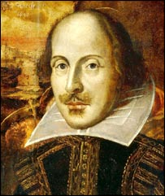
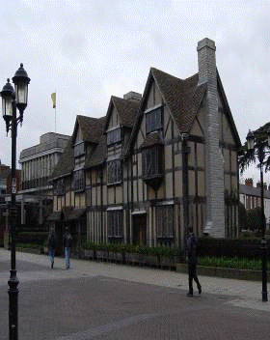
William Shakespeare is one of the world’s greatest writers . William Shakespeare was born on the 23d of April, 1564 in Stratford-on-Avon. It is a house where he was born. His father John Shakespeare, was a glover. He was a respected figure in Stratford. At the age of six William was sent to school.

Slide 3
The best thing of all in William’s life were groups of actors who visited Stratford from time to time. He watched them and knew that he wanted to be an actor.

Slide 4
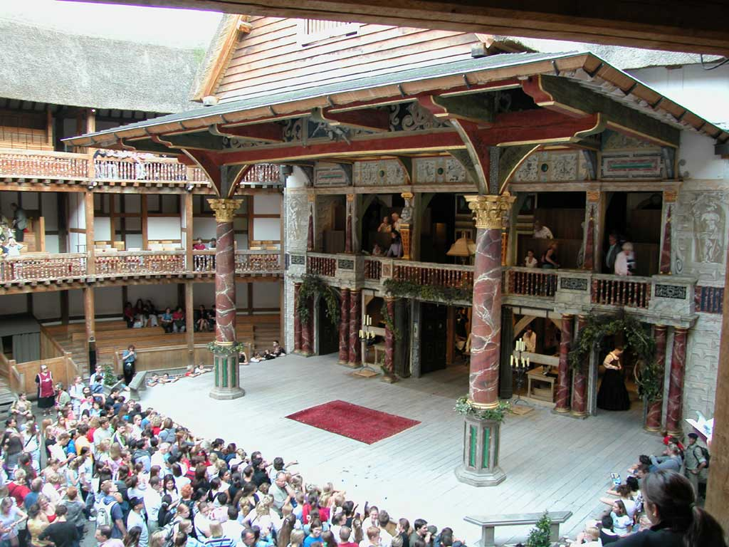
But the actors didn’t have their own theatre, that’s why they built a theatre and called it “Globe”. There was a sign on it’s main door: “All the world is a stage”. Shakespeare’s Globe was rather different from modern theatres.

Slide 5
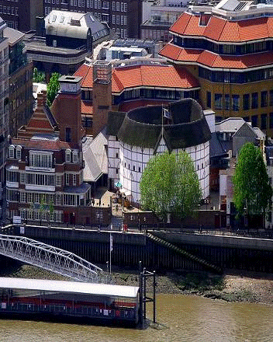
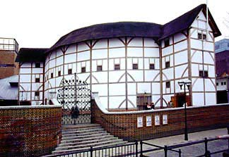
In 1613 the Globe burnt down.
In 1949 an American actor Sam Wanamaker decided to rebuilt the Globe. It took many years to raise money, get permission and find out exactly what the place looked out like in the old days. On June 12 1997, Her Majesty the Queen opened the International Shakespeare Globe Center. Unfortunately, Sam Wanamaker died in 1993 and wasn’t in the audience to see his dream finally come true. This new theatre is as close to the original as it is possible to be.

Slide 6
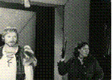
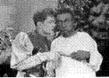
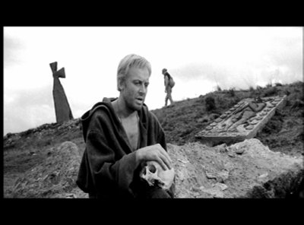
Macbeth
Othello
Hamlet

Slide 7
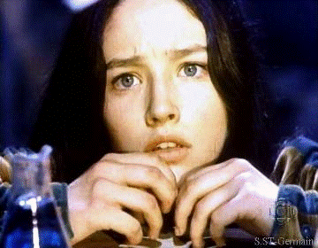
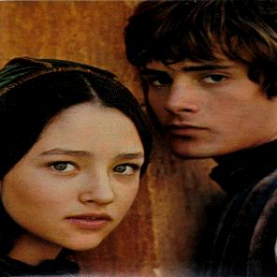
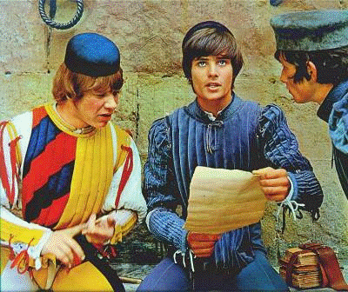
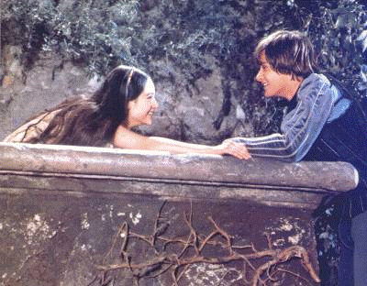

Slide 8
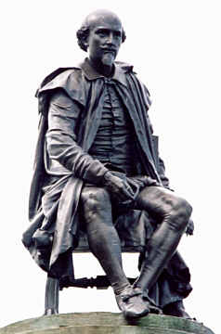
In 1612 Shakespeare left London. He died on April 23 1616, and he was buried in Stratford. A monument was erected to the memory of the great playwright in the Poet’s Corner in Westminster Abbey. And this is the Shakespeare Memorial in Stratford-upon-Avon.

