Slide 1
Robert Burns is my favourite writer. The project of the pupil of the 7a class. Tolstikov Alexander.

Slide 2
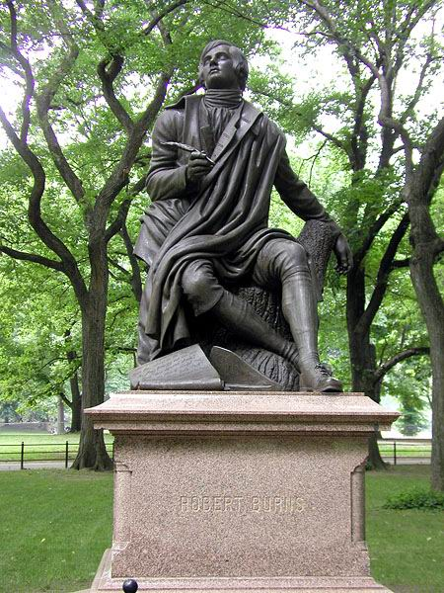

Slide 3
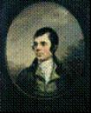
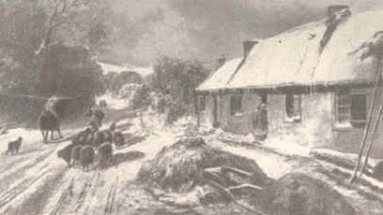
Robert Burns is the famous poet of Great Britain and the national poet of Scotland. He was born in 1759 on the 25th of January. He was born in Ayrshire, Scotland. He was the eldest of 7 children, growing up in a life of poverty and hard farm work.
And this is the cottage, where Robert Burns was born. The family was very poor. His father’s greatest wish was to give his children the best education he could afford. He was a clever man and had a shelf with books in his poor house.

Slide 4
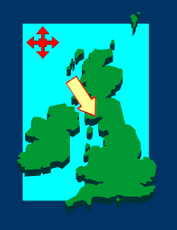
Here in
the heart
of Britain
was born
Robert
Burns.

Slide 5
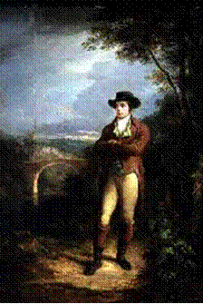
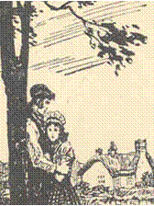
In February 1784 Robert’s father died and Robert became the head of the family. The farm was a failure, the crops wouldn’t grow. In 1784 at a dancing party, Robert Burns met the “beauty of the village” - Jean Armour, the daughter of a rich master-mason. It was “love at first sight”. They wanted to marry but Jean’s father disapproved. Burns was a poor farmer and not good enough for his daughter. Robert decided to emigrate to Jamaica. The words of the following poem reflect his thoughts and feelings.
In order to make some money for the voyage he decided to print some of his poems. When his poems were published, Burns became famous overnight and editions appeared all over the world. In 1788 Burns and Jean Armour married and went to live at Ellisland Farm.

Slide 6
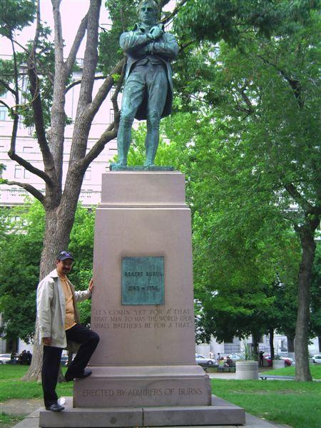
By 1796 Burns had become dangerously ill and on the 21 of July he died, aged 37 years old. Scotland had lost one of its best loved poets and a national hero. Burns dreamt of immortality and wanted to be the best poet of Scotland. His dream came true and today his work is loved by millions all over the world.

Slide 7
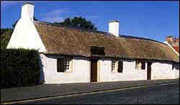
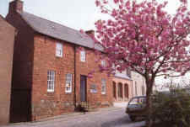
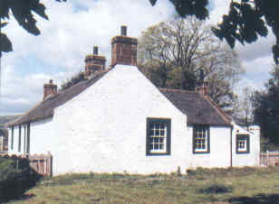
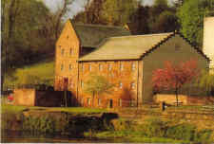
Alloway coottage
Birthplace of the poet
His house in
Dumfries
It's a museum now
Elliseland farm

Slide 8
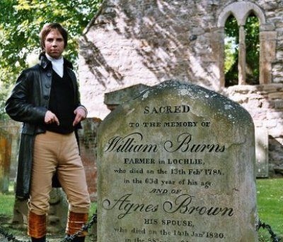

Slide 9
My Heart's In The Highlands
My heart's in the Highlands, my heart is not here,
My heart's in the Highlands a-chasing the deer;
A-chasing the wild deer, and following the roe-
My heart's in the Highlands wherever I go.

Slide 10
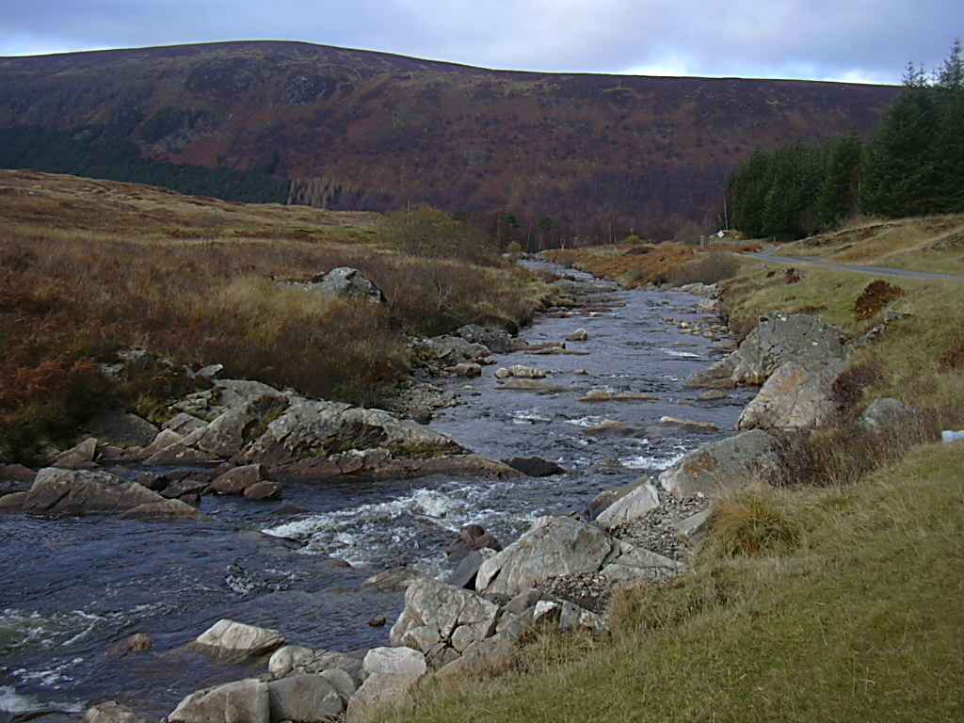
В горах моё сердце
В горах моё сердце...Доныне я там.
По следу оленя лечу по скалам.
Гоню я оленя, гоню я козу.
В горах моё сердце, а сам я внизу.
Прощай, моя родина! Север, прощай,-
Отечество славы и доблести край.
По белому снегу судьбою гоним.
Навеки останусь я сыном твоим!

Slide 11
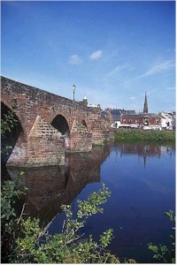
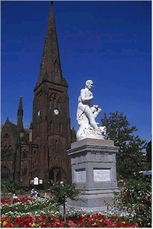
Dumfries-the town, where Burns spent his last years.

Slide 12
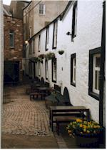
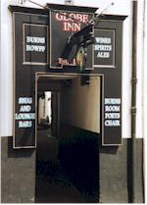

Slide 13
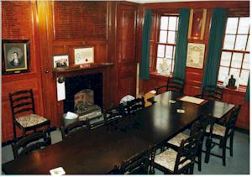

Slide 14
Gaelic ballade
O, wert thou in the cauld blast
On younder lee, on younder lee.
My plaidy to the angry airt
I’d shelter thee, I’d shelter thee.
Or did misfortunes’ bitter storms
Around thee blau, around thee blau.
Thy bield should be my bosom.
To share it a, to share it a.
В полях под снегом и дождём
Мой милый друг,мой нежный друг,
Тебя укрыл бы я плащом
От зимних вьюг,от снежных вьюг.
А если мука суждена
Тебе судьбой,твоей судьбой
Готов я скорбь твою до дна
Делить с тобой, делить с тобой.

Slide 15
Auld Lang Syne
Should auld acquaintance be forgot
And never brought to mind?
Should auld acquaintance be forgot,
And auld lang syne!
For auld lang syne, my dear,
For auld lang syne,
We’ll take a cup of kindness yet
For auld lang syne.
And here’s a hand,
My trusty friend
And give a hand of thine!
We’ll take a right good cordial drink
For auld lang syne.

Slide 16
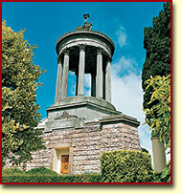
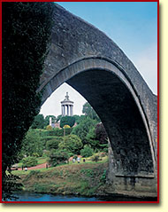
Alloway Monument built on the
bank of the River Don was designed
by Thomas Hamilton and founded
in 1820 by Mr Alexander Boswell.
The cost-over 3305 pounds was
met by public subscription.

