Slide 1
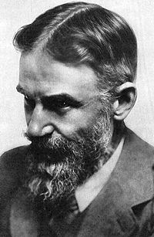
I like the outstanding British dramatist George Bernard Shaw most of all.
Inutina Natasha
Class 7a

Slide 2
George Bernard Show was born in Dublin, Ireland, on the 26 of July in 1856. His family was very poor. He had to live school when he was 15. Shaw became a cashier in a Dublin land agency. He hated his job and after he had worked for five years he gave it up and left for London.

Slide 3
Show tried to make a living by writing. He wrote four novels which were published in magazines but they were not a success. From 1885 to 1898 he wrote a lot as a critic of art, music, literature and drama and was very popular with the readers.

Slide 4
In the nineties Show began to write for the theatre. He was the creator of the new publicist drama. Shaw wrote over twenty plays. One of his most popular plays is “Saint Joan” (1923). The play is devoted to Joan of Arc (the Maid of Orleans). Since its first performance the play has always been a great success with the public. Shaw himself liked this play very much.

Slide 5
In 1931 he made a tour visiting India, China, Africa, America and Russia. In 1925 he was awarded the Nobel Prize for Literature and in 1934 the medal of the Irish Academy of Letters.

Slide 6
“Pygmalion” is one of Shaw’s most popular and successful plays. It is an exhilarating, amusing and deep comedy. Pygmalion, an ancient sculptor, while creating a statue of a beautiful girl called Galatea, fell in love with his creation. His love was so great that he began to pray to Aphrodite, the goddess of love, to breathe live into the statue. The goddess made the statue alive, and Pygmalion married Galatea.

Slide 7
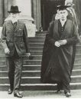
B. Shaw wrote “Pygmalion”, which scandalized the “respectable” public by using folk words which English usage considered vulgar, in 1912. Today “Pygmalion” is ninety six years old. And many people all over the world admire it today. B. Shaw is part of British culture and history. B. Shaw is a success with millions of readers today.

