Slide 1
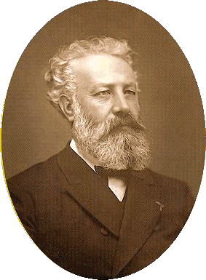
The French novelist Jules Verne was the first authentic exponent of modern science fiction.

Slide 2
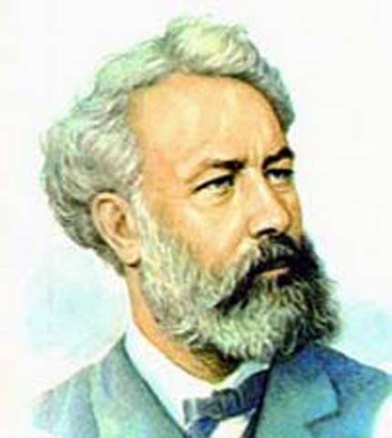
Jules (Gabriel) Verne (1828-1905) was born in Nantes, France, on February 8 in a family of a lawyer.

Slide 3
He loved the sea and when he was only 12 he tried to run away on a ship to the West Indies. Unfortunately for him, the sailors caught him and sent home.

Slide 4

Jules Verve began his literature career in 1849. He had a great imagination and wrote several adventure stories and created mysterious characters like Captain Nemo, who, in Twenty Thousand Leagues Under the Sea, travels under the sea in his submarine the Nautilus.

Slide 5
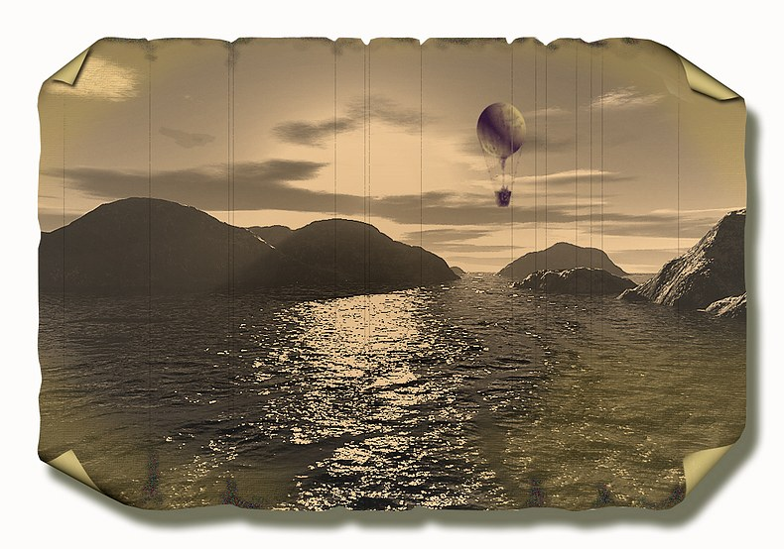
Jules Verne travelled a lot by sea. He visited Italy, England, Scotland, Ireland and other countries.

Slide 6

“ I take into account the interests of young readers for whom are written all my books”, said Jules Verne to the correspondent of “The New Viennese Newspaper” in 1902.

Slide 7

The novel written in 1867-1868 is translated into many languages. It is very popular with the children all over the world.

Slide 8






Jules Verve is the author of about 100 books. Among them there are poems, plays, stories and about 70 novels.

Slide 9
