Slide 1
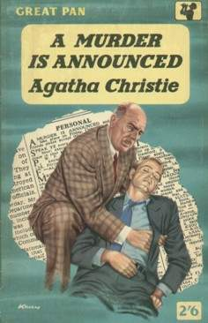
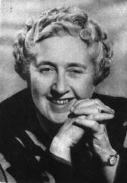
BE THE BEST!
Agatha Christie
(1891 – 1976)
wrote 75 detective stories

Slide 2
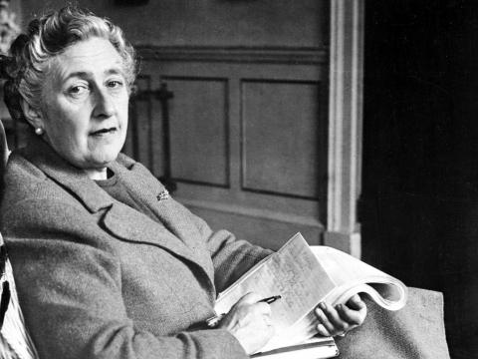
Agatha Christie was the
“Queen of Crime”
She was born in the family home
Ashfield in Torquay, England on
15 September 1890. Agatha Mary Clarissa Miller was the youngest of three children. Her father died when Agatha was ten years old. The shy and sensitive Agatha, who was very closed to her mother, had an older sister, Margaret (1879-1950) and brother Louis (1880-1929).

Slide 3
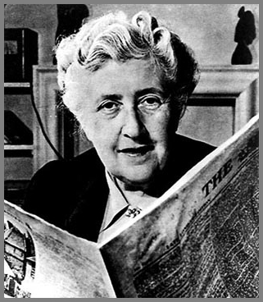
While Agatha received no formal education, her mother and then governesses taught her at home to read before she entered finishing school in Paris, France in 1906. Having long been encouraged by her mother to write, Agatha continued to write there while also studying music (which became a life-long love),singing, and piano.

Slide 4
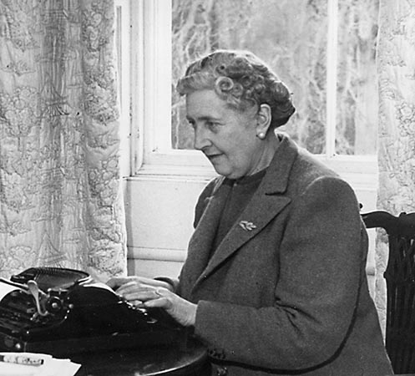
On 24 December 1924 Agatha married Royal Flying Corps pilot Archie Christie. During WW I she worked as a nurse, tending to the ill and injured, many who were displaced Belgians. Their bewilderment and personal sorrows affected her deeply.
In 1928, Archie divorced Agatha. She then set off on her first of many trips to the Middle East. During her second trip she met her future husband, archaeologist Sir Max Edgar Lucien Mallowan.

Slide 5
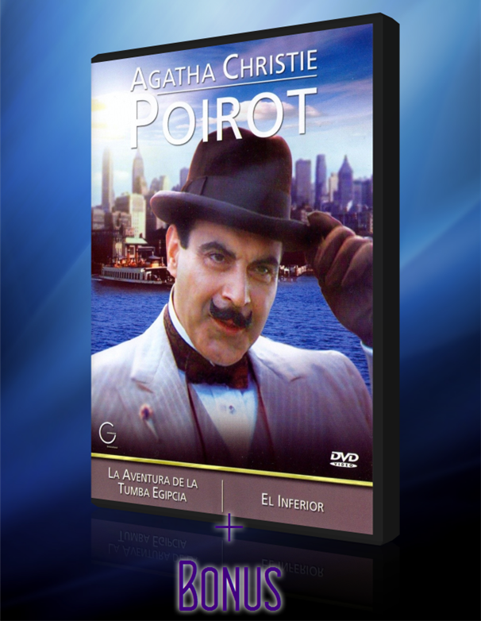
Agatha Christie created many fictional detectives, the most famous of which were Hercule Poirot and Miss Marple. Hercule Poirot appeared in over 30 novels and 50 short stories. He was a Belgian detective, famous for his neat appearance, his obsession with order and his use of psychology in his investigations of crimes.

Slide 6
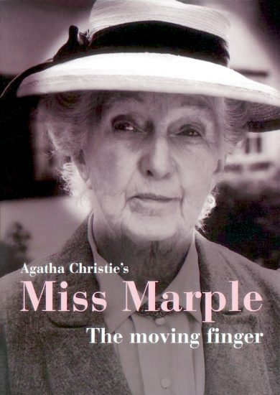
Miss Marple was nothing like a typical detective. At first glance she was an ordinary old lady who loved knitting and gossip but she could solve the hardest of mysteries and sent many criminals behind bars! She appeared first in the novel “Murder at the Vicarage” in 1930.

Slide 7

Novels, which were not detective, were written by Agatha Christie under the pseudonym Mary Westmacott. There were 10 of them.

Slide 8
