Slide 1
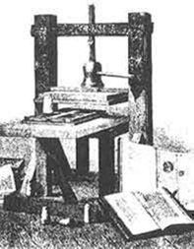
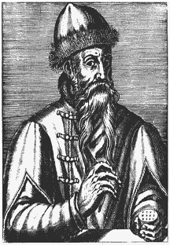
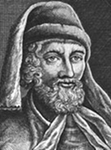
J. Gutenberg
W. Caxton
The invention of paper played a very important part in the development of books. In the 11th century the art of papermaking reached Europe but no trace of printing was found in Europe until 1423. It is known that Johann Gutenberg secretly tried out ways of printing in Strasbourg, Germany, in 1440.
The knowledge of the methods of printing spread so quickly over the Continent of Europe that by the year 1487 nearly every country had started printing books. The first person to print books in the English language was William Caxton, in Russia – Ivan Fedorov.
The first book printed in the Russian language appeared in Moscow on the first of March, 1564. Up to that time there were only handwritten books in Russia.

