Slide 1
When you are best to others,
you are best to yourself.

Slide 2
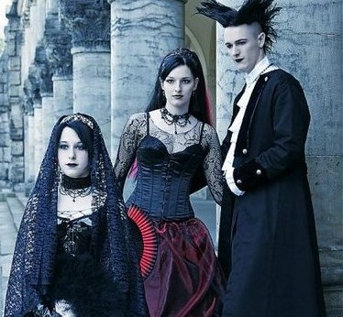
Music (“dark” sound
Gothic Rock,
Philosophy mystical Rock, Gothic Metall)
Ideas (World is a dark place and we like it)
Desires (to look for beauty even in the world which doesn’t have it)
It is a way of life, the way to find yourself.
GOTHS

Slide 3
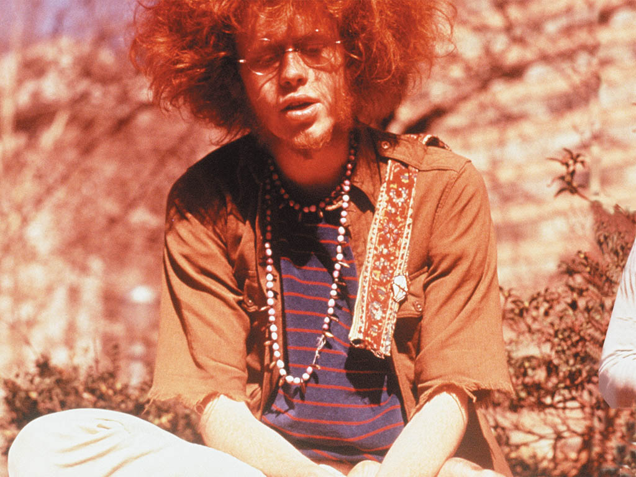
Music (Rock’n’roll)
Ideas (living in groups together, accepting others as they are)
Desires (Peace, Love, Freedom)
It is a way of life, the way to find yourself.
HIPPIES

Slide 4
Lifestyle
a set of attitude, habits or possessions associated with
a particular person or group.

Slide 5
Desires
Believes
Likes/
Dislikes
Points
to consider lifestyle
Attitude
to different sides of life
Music
Clothes

Slide 6
1.The way people look at the world is …
different
2.The idea of what is early and what is late …
differs from country to country
Finish up the sentence:

Slide 7
Choose the correct answers
3. Americans like to stand about …. from each
other when they talk
a) twelve to fourteen inches;
b) eighteen to twenty inches;
c) it doesn’t matter for them.
Finish up the sentence:
4.To express the idea that everyone has his own point of view, the English say, "..."
“To each his own”

Slide 8
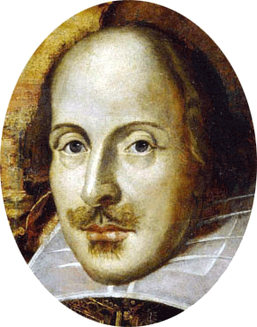
Is it good or bad to be different?
“Nothing is good or
bad ,” said
Shakespeare,
“ but thinking
makes it so”.

Slide 9
Proclaimed and signed by the Member States of UNESCO on 16 November 1995.
Article 1. – Meaning of Tolerance.
Tolerance is respect, acceptance and appreciation of the rich diversity of our world’s cultures, our forms of expression and ways of being human.
Tolerance, the virtue that makes Peace possible, contributes to the replacement of the culture of war by the culture of Peace.
Declaration
of Principles on Tolerance.

Slide 10
In Spanish language it means ability to recognize indistinct from all own idea or opinion.
In French the relation at which it is supposed that others can think or work differently, rather than you.

Slide 11
In English it means readiness to be tolerant, indulgent.
In Chinese – to allow, to accept.

Slide 12
In Arabian – pardon, condescension, softness, mercy, compassion, patience.
In Russian – ability to suffer something or someone.

Slide 13
Tolerant
Intolerant
respect others opinion
desire to do something together
goodwill
understanding
acceptance
kindness
trust
unmotivated aggression
misunderstanding
ignoring
egoism
irritability

Slide 14
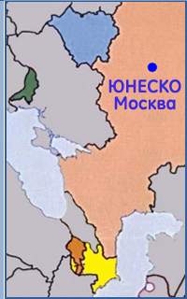
Rules of tolerant communication.
Try to understand what other people speak about.
Assert the opinion tactfully.
Search for the best arguments.
Be fair, ready to recognize correctness of another person.
Try to take into account the opinions of other people.

Slide 15
Your team is loosing …
you break things
you support it right to the end.
Your team wins:
it’s thanks to you;
you say “we play well”

Slide 16
You don’t like someone in the team:
you act as though he doesn’t exist.
you pass him the ball when you can.
Your team is loosing …
you congratulate the winners;
you refuse to shake their hands.

Slide 17
You miss an easy goal
you fell useless
you’ll score next time.
A beginner plays badly…
you remember you were a beginner once
you want him or her replace

Slide 18
The referee whistles…
you accept the rules of the game
you argue anyway
You feel violent…
you hit someone
you kick a ball

Slide 19
You have 8 circles: Well done! You are very tolerant! You have character, you are a good sport and you can keep yourself and others from being aggressive. Tell your friends how you do it!
Between 7 and 3 circles: You aren’t very tolerant! You can be touchy but you’re brave and you can improve. Start practicing now!
2 circles or less: Oh dear! You aren’t tolerant! If you respected yourself and others a bit more, you’d be much happier. Give it a try!

Slide 20
When you are best to others,
you are best to yourself.

Slide 21
The Value of a Smile

