Slide 1
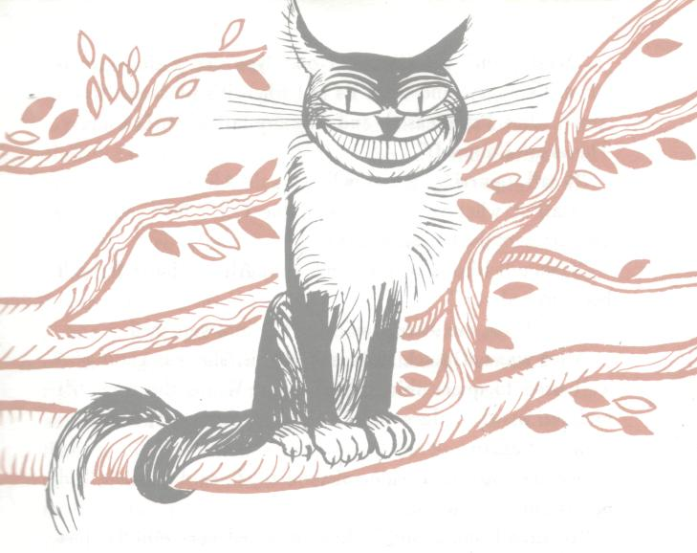
The Cheshire Cat
Приложение 2
Слайд 1
2
1
3
6
4
5

Slide 2
The Cheshire Cat
Слайд 2
2. grin
1.A bough
of a tree
3.A great many teeth
6.The left paw
4.Very long claws
5.The right paw

Slide 3
Who lives in those directions?
Слайд 3
8
7

Slide 4
Who lives in those directions?
Слайд 4
March Hare
Mad Hatter

Slide 5
Слайд 5
What is the philosophy of the
Cheshire Cat?

Slide 6
Слайд 6
What is the philosophy of the Cheshire Cat?
“we’re all mad.”
“How do you know I’m mad?”
said Alice.
“You must be,” said the Cat, “or you wouldn’t have come here.”

