Slide 1
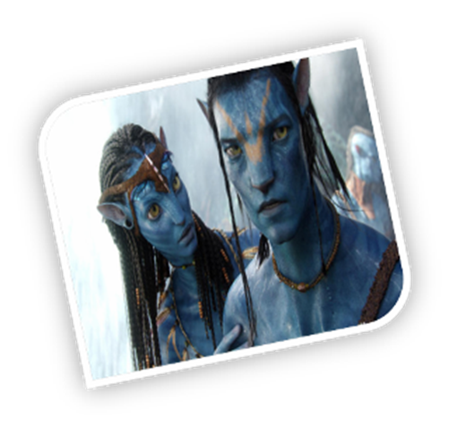
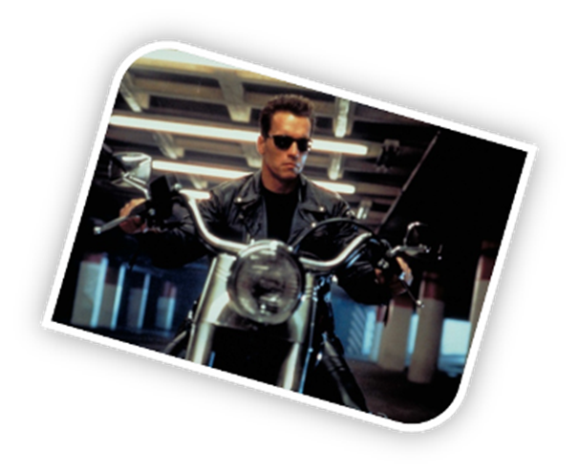
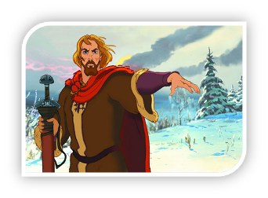
A FILM REVIEW

Slide 2
COMEDY
FANTASY
CARTOON
HORROR
SCIENCE-FICTION
ADVENTURE
ROMANCE
ACTION FILM
DETECTIVE
1. … is one with a lot of action.
2. Film with a lot of funny situations, which make you laugh, is a … .
3. A … presents spooky situations.
4. In a … there is always a touching story of two people with a happy end.
5.. .. is about police and detectives.
6. This … film about pirates and treasures.
7. Lord of the Rings is very … film.
8. Star Wars is a … film.
9. Tom and Jerry is a very funny … .

Slide 3
gripping (захватывающий, интересный, интригующий) – I like detective, they are usually so gripping.
brilliant (блестящий, нормальный, удивительный) - the acting was brialliant.
entertaining (развлекательный, забавный, восхитительный)– I don’t watch anything scary or dramatic, let’s choose an entertaining film.
hilarious (очень смешной, комичный, юморный) – I adore Jim Carrey, he is totally hilarious.
fast-moving (динамичный, быстрый, молниеносный) – why do you like this film? Well, it’s fast-moving and exciting.
predictable (ожидаемый, будущий, предсказуемый) - this happy end was quite predictable.
truthful (идеальный, правдивый, реальный) - this director shows a truthful life of Leningrad during the war.

Slide 4
Pirates of the Carribbean is action film starring Johnny Depp and Orlando Bloom. This film is about sea adventures and pirates. The main characters are Elizabeth Swann, Jack Sparrow. The film is full of fast – moving and action-packed with amazing special effects. I like that the main characters are brave, clever, helpful. I like this film because it is really gripping and entertaining.
I recommend this film to people who like adventures and stories about pirates.

Slide 5
5 Steps to Writing a Film Review
Write the title.
Write the stars
Write 2 or 3 sentences about the film.
What is the story about?
Who are the main characters?
Who is your favourite character?
4. Do you like the story? Why?
5. Your recommendation.

