Slide 1
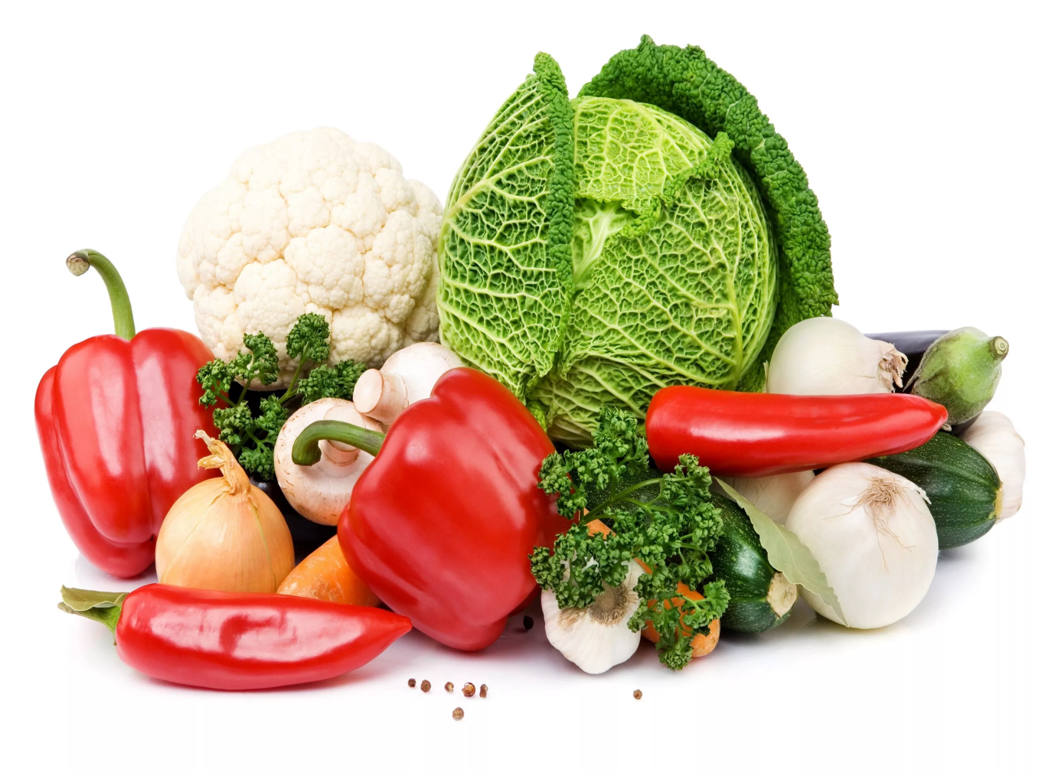
Products

Slide 2
I'm a fruit. I'm small.
I'm sweet.

Slide 3
cherry

Slide 4
I'm white and
you can drink me.
I come from a cow.

Slide 6
I'm a vegetable.
I'm long and orange.
Rabbits like me.

Slide 7
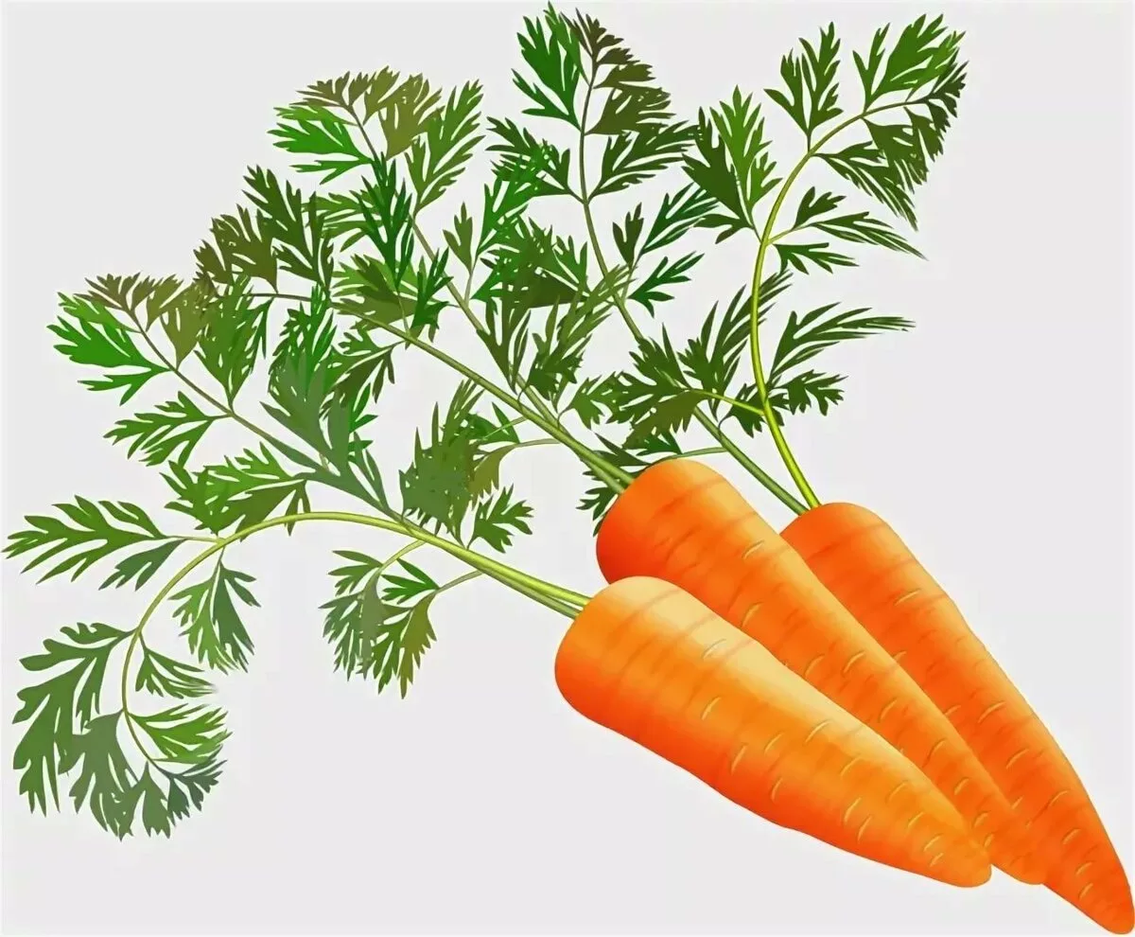
carrot

Slide 8
I'm a vegetable. I'm yellow.
People cry when they cut me.

Slide 9
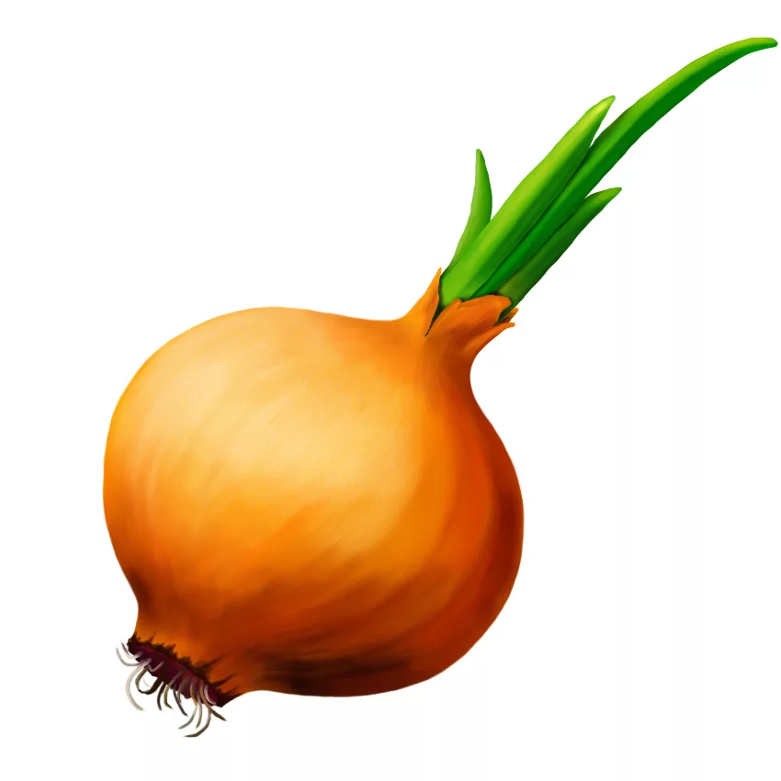
onion

Slide 10
I'm a fruit. I'm sour. People like to drink tea with it.

Slide 11
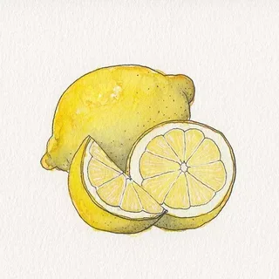
lemon

Slide 12
I'm white. You can eat me
at the cinema.

Slide 14
I'm a vegetable. I'm brown.
I'm round and small.

Slide 15
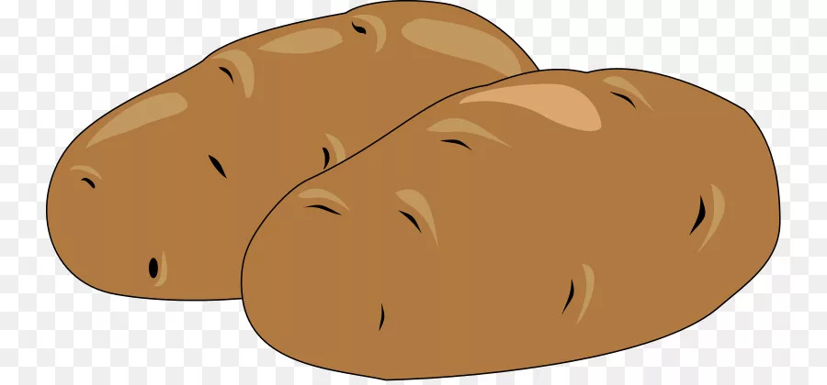
potatoes

Slide 16
Name a fruit thatstarts with «A».
It is white on the inside and can be
red, yellow, or green
on the outside.
It grows on a big tree.
Children like it.

Slide 17
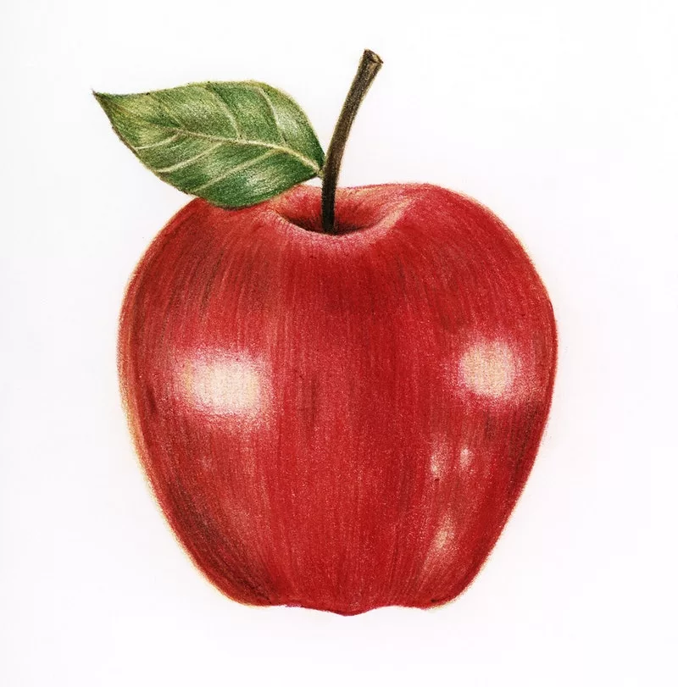
apple

Slide 18
I'm sweet. You can eat me at your birthday party.

Slide 19
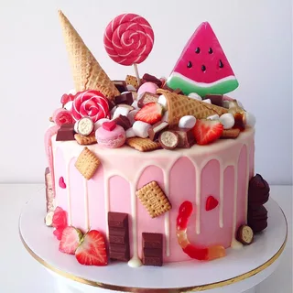
cake

Slide 20
Name a red juicy fruit
that we eat in salads
or cook it to make ketchup.
Some people think that it is
a vegetable, but it is not.

Slide 21
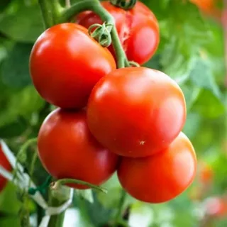
tomatoes

Slide 22
It’s the same color as its name.

Slide 23
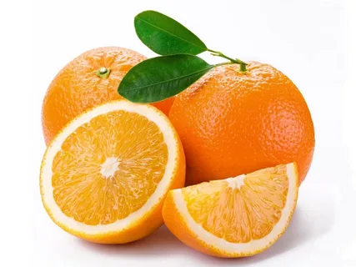
orange

Slide 24
I'm brown. I'm very sweet.
I'm very useful. I help people to be clever and happy.

Slide 25
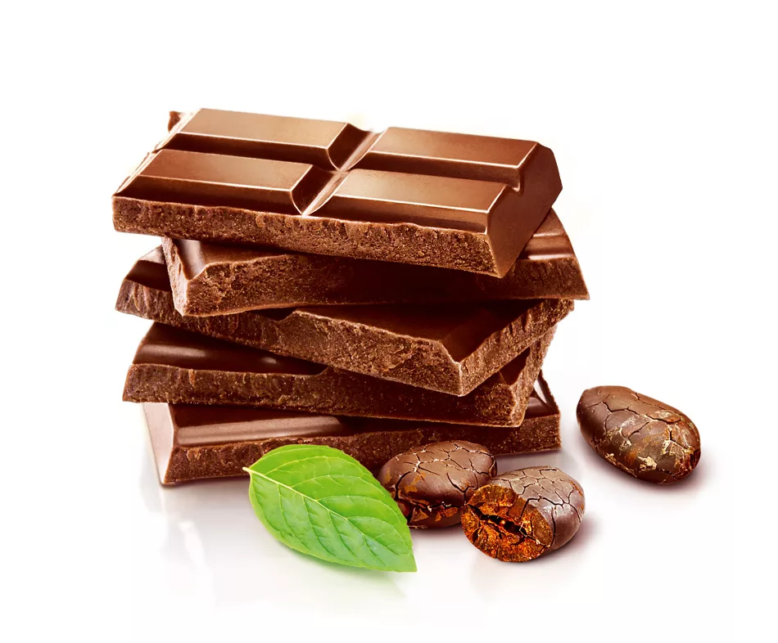
chocolate

Slide 26
You smile when you name it.
The mouse likes it very much.

Slide 27
cheese

Slide 28
They are white outside and yellow inside.
We have them from chicken.

Slide 29
Eggs

Slide 30
It is round, with sausage,
tomato and cheese on top.

Slide 31
pizza

