Slide 1
What is the theme of our lesson?

Slide 2
Travelling by plane
What is the aim of our lesson?
To discuss what you should do while travelling by air

Slide 3
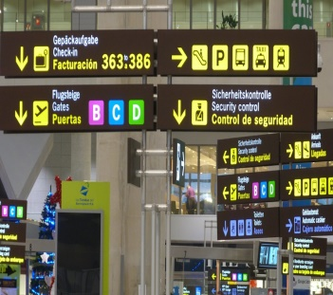
Our lesson is divided into steps
Step 1
Learn what things you need to take while travelling
Step 2
Learn new words
Step 3
Revise the use of modal verbs
Step 4
Listen to the airport announcements
Step 5
Learn how to act at the airport

Slide 4
What should you take?
You should take …
I don’t think you need …

Slide 5
Have we reached the aim of the lesson?
HAVE A GOOD FLIGHT!
I know what things to take to the trip | 1 point
I have learnt new words | 9 points
I’ve revised modal verbs | 8 points
I understand airport announcements | 4 points
I know how to act at the airport | 9 points

Slide 6
My score
28-31 | 22-27 | 16-21 | <16
Very good! | Good! | Not bad! | Try again!

Slide 7
Your hometask
Ex.59, p.80

