Slide 1
Symbols of the United Kingdom of Great Britain and Northern Ireland

Slide 2
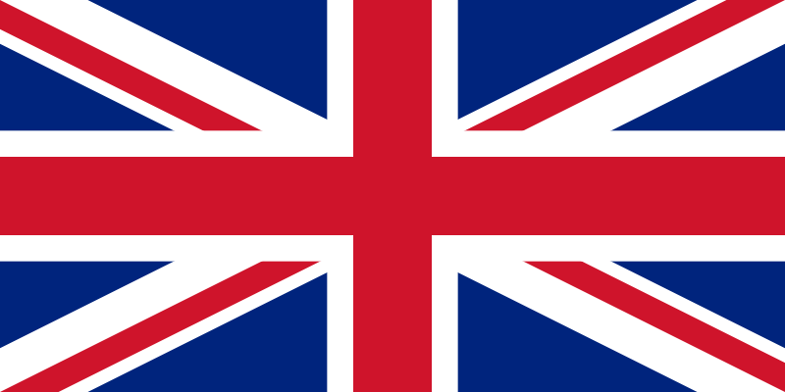
Symbols of the United Kingdom of Great Britain and Northern Ireland
Flag of the UK is called Union flag or “Union Jack”

Slide 3
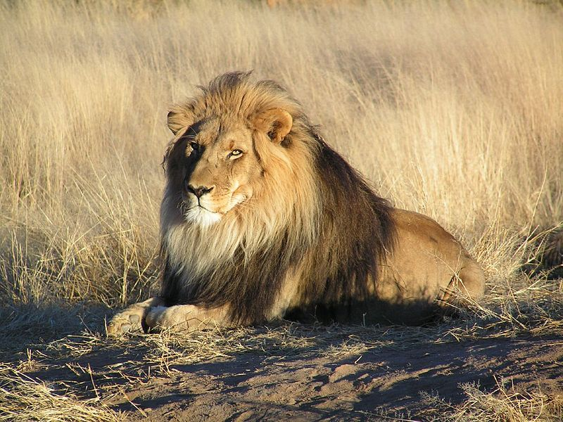
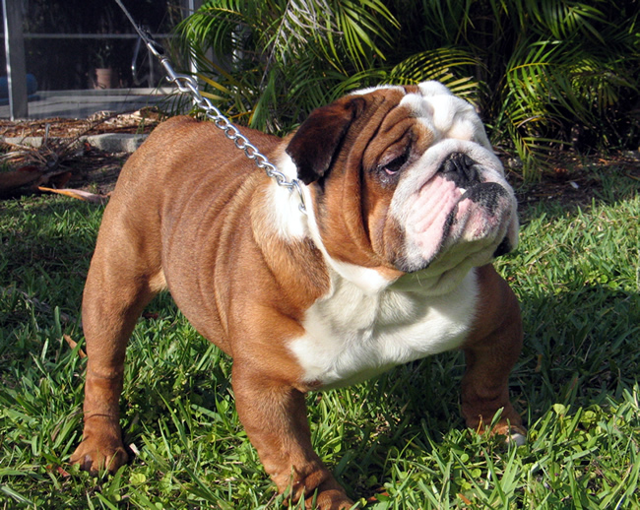
National Animals
Lion
Bulldog

Slide 4
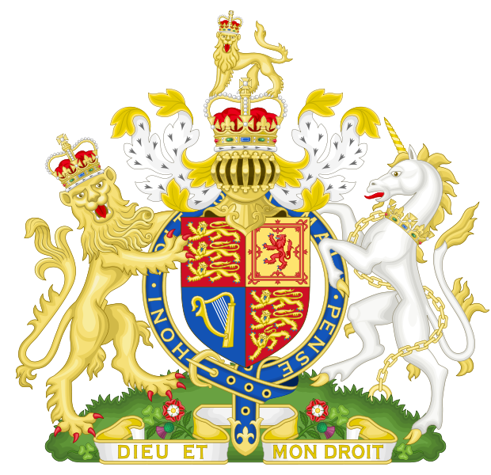
Coat of Arms of the United Kingdom
The Royal coat of arms of the United Kingdom is the official coat of arms of the British monarch, currently Queen Elizabeth II.

Slide 5
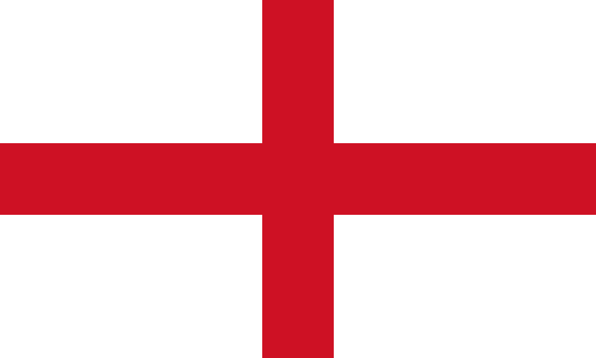
National flag of England (Saint George’s cross)

Slide 6
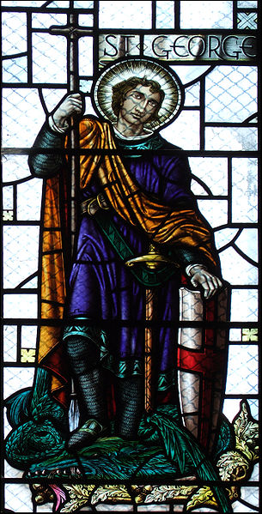
Patron Saint Saint George
Saint George
(c. 275/281 – 23 April 303)
was a Roman soldier. His memorial is celebrated on 23 April, and he is regarded as one of the most prominent military saints.

Slide 7
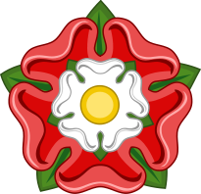
National flower of England Tudor’s rose
It takes its name from Tudor dynasty. It is a symbol of beefeaters and yeomen.

Slide 8
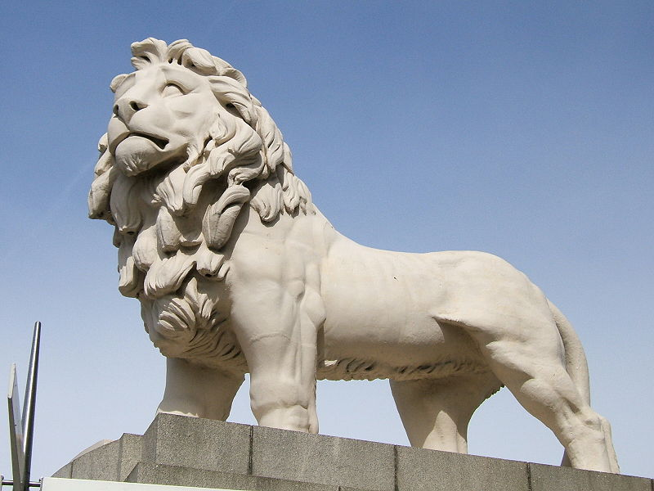
National animal of England Lion
It traditionally symbolises bravery, strength, and royalty, since traditionally, it is regarded as the king of beasts.

Slide 9
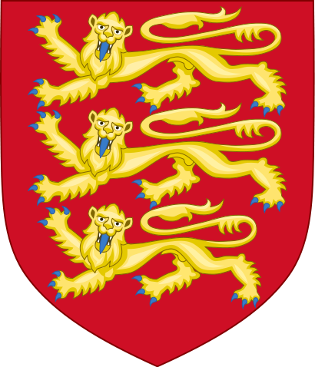
Coats of Arms of England
The Coats of Arms is symbolises England and its monarchs. It did not change since the reign of Richard I.

Slide 10
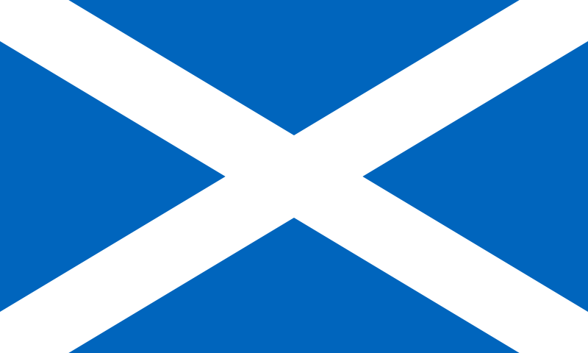
National flag of Scotland (Saint Andrew’s cross)

Slide 11
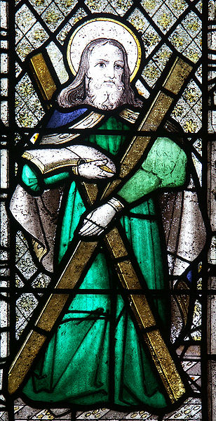
Patron Saint Saint Andrew
Saint Andrew ( from the early 1st century—mid to late 1st century AD), is a Christian apostle and the brother of Saint Peter. He was a fisherman. Later he was the founder and the first Bishop of the Church of Byzantium.

Slide 12
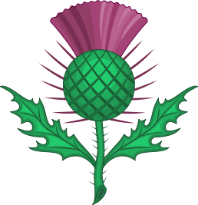
National flower of Scotland Thistle
According to the legend a sleeping party of Scots warriors were saved from ambush by an invading Norse army when one of the attackers trod on a thistle with his bare feet. His cries raised the alarm, the roused Scots duly defeated the invaders, and the thistle was adopted as the symbol of Scotland. Unfortunately, there is no historical evidence for this, but Scots, like other nations, love a good story.

Slide 13
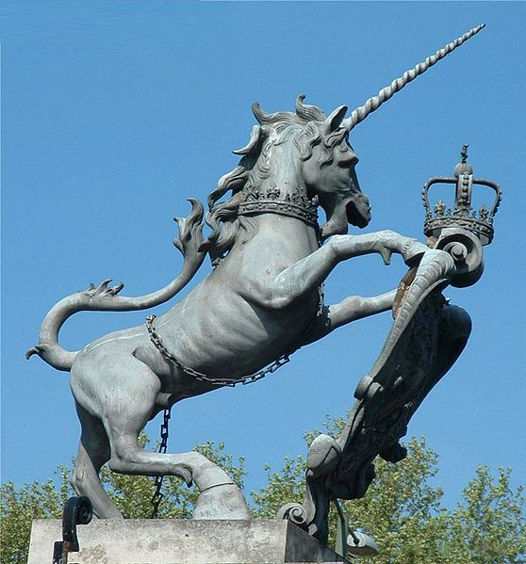
National animal of Scotland Unicorn
the Unicorn is the mythical creature, it is also a popular Scottish symbol, Unicorns are associated with Royalty since at least the time of the Romans. It symbolizes innocence and purity, healing powers, joy and even life itself.

Slide 14
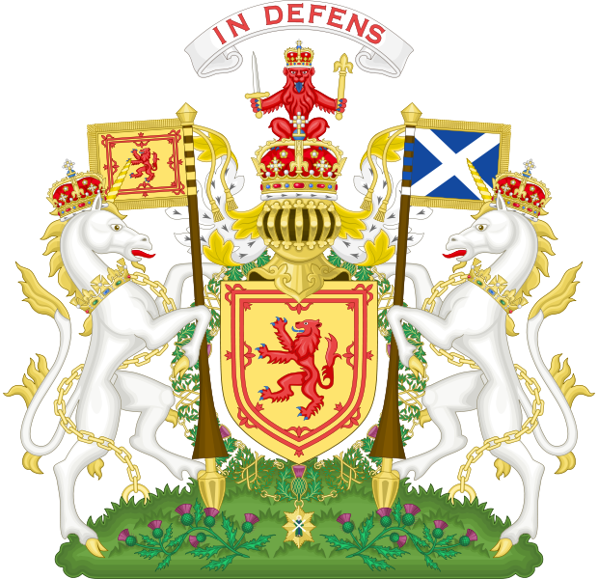
Coats of Arms of Scotland
The Royal Coat of Arms of Scotland was the official coat of arms of the monarchs of Scotland, and was used as the official coat of arms of the Kingdom of Scotland until 1707.

Slide 15
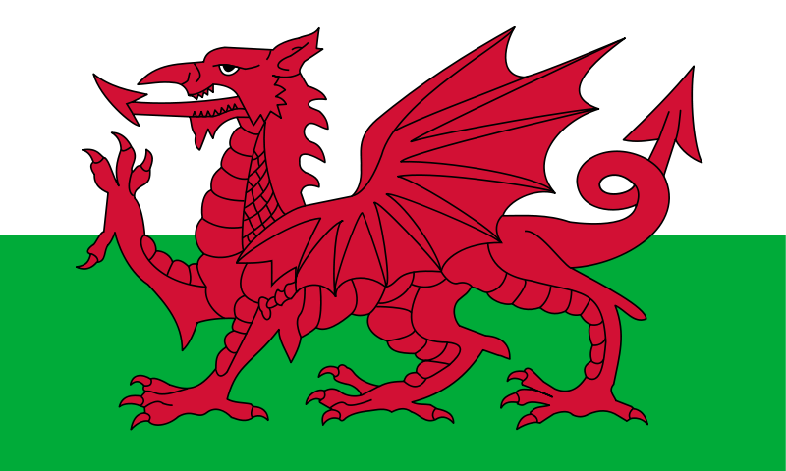
National flag of Wales (The Red Dragon)

Slide 16
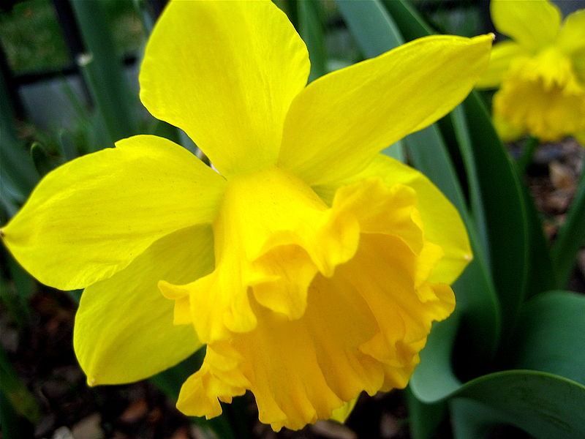
National flowers of Wales Daffodil and Leek
The daffodil is the national flowers of Wales, people wear on St David' s Day each 1 March.
The vegetable called leek is also considered to be a traditional emblem of Wales. One is that St David advised the Welsh, on the eve of battle with the Saxons, to wear leeks in their caps to distinguish friend from foe.

Slide 17
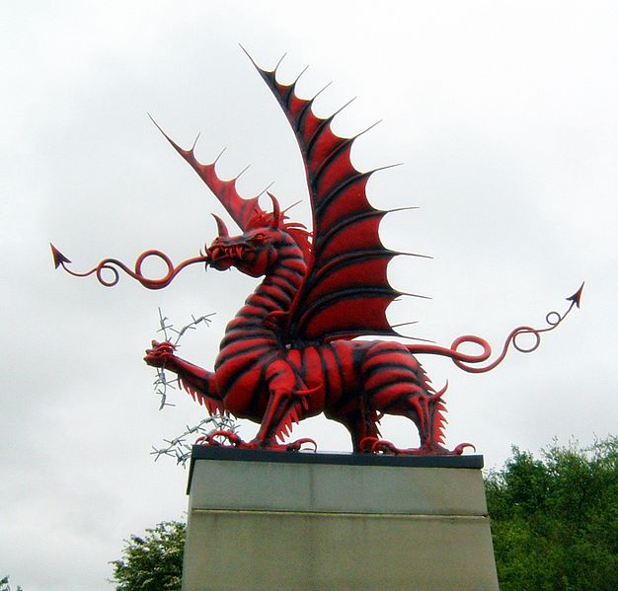
National animal of Scotland Red Dragon
The Red Dragon is a popular Welsh symbol. This myth of Red Dragon is connected with a Red (The Native Britons) and a White (The Saxon Invaders) dragon battling, with the red dragon being victorious.

Slide 18
National flag of Northern Ireland
There is no official National flag of Northern Ireland or any unofficial flag universally supported in Northern Ireland.

Slide 19
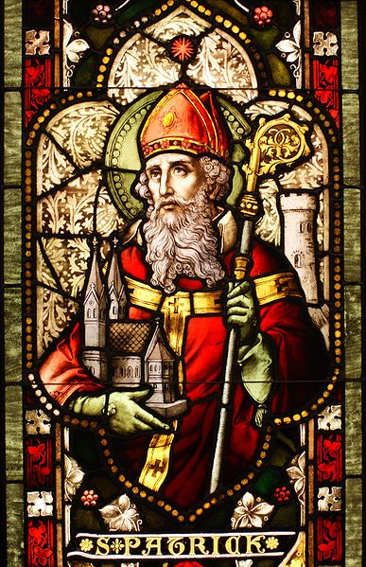
Patron Saint Saint Patrick
When he was about 16, he was captured from his home by Irish raiders and taken as a slave to Ireland, where he lived for six years before escaping and returning to his family. After entering the Church, he returned to Ireland as a bishop, but little is known about the places where he worked.

Slide 20
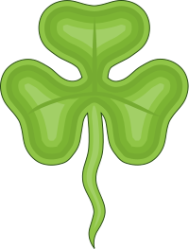
National flower of Wales Shamrock
The Shamrock, a three-leafed plant similar to a clover, which is an unofficial symbol of Ireland and Northern Ireland. Shamrocks bring good luck. This flower is related to an Irish tale of St. Patrick, which tells of how Patrick used the three-leafed shamrock to explain the Trinity. His followers adopted the custom of wearing a Shamrock on his feast day.

Slide 21
Coats of Arms of Northern Ireland
There is no official coats of arms of Northern Ireland

