Slide 1
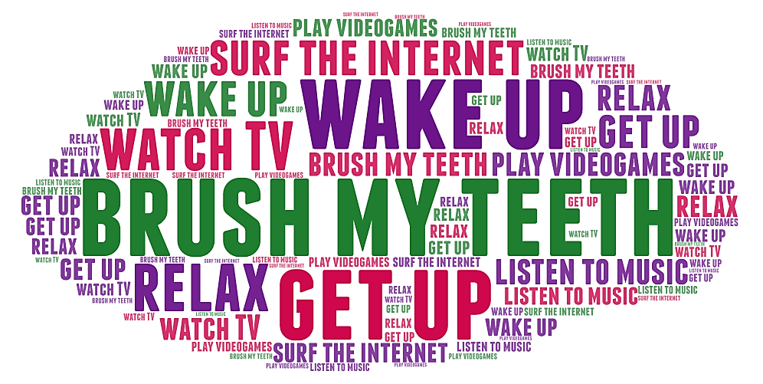

Slide 2
Plan of the presentation
When? | Who? | How often? | What?
In the (morning/ evening/afternoon)… | we | Usually Often Always | …
At (2 p.m.-a.m.)
Then
At (night/noon)
For breakfast /for lunch/for dinner

Slide 3
What have we learned and revised?
Healthy and unhealthy daily routine
The Present Simple
Words about daily routine

Slide 4
Homework
«5»
«4»
Write an email with a new daily routine for Marina
Make a list of good daily habits
OR
Send it to Marina: asiakl72@mail.ru

