Slide 1
True Friends
Жирова Ольга Николаевна,
Идентификатор: 100-735-693

Slide 2
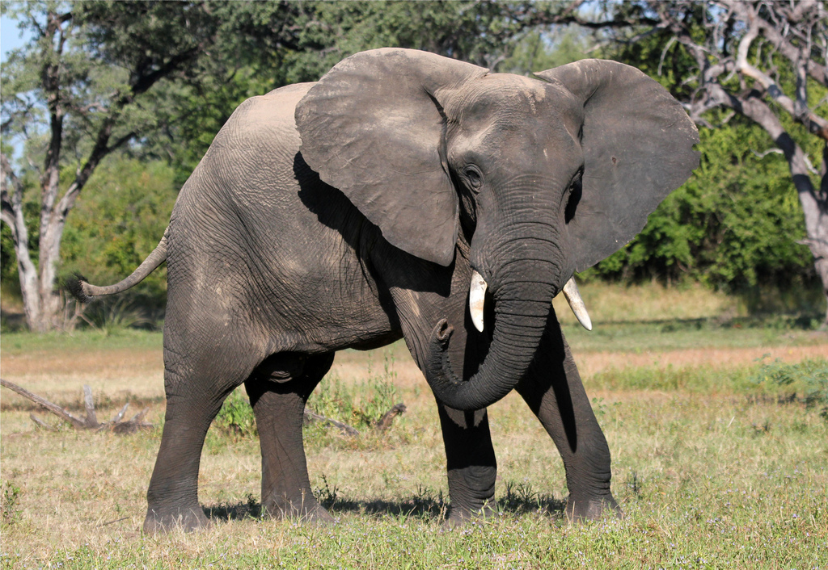

Slide 3
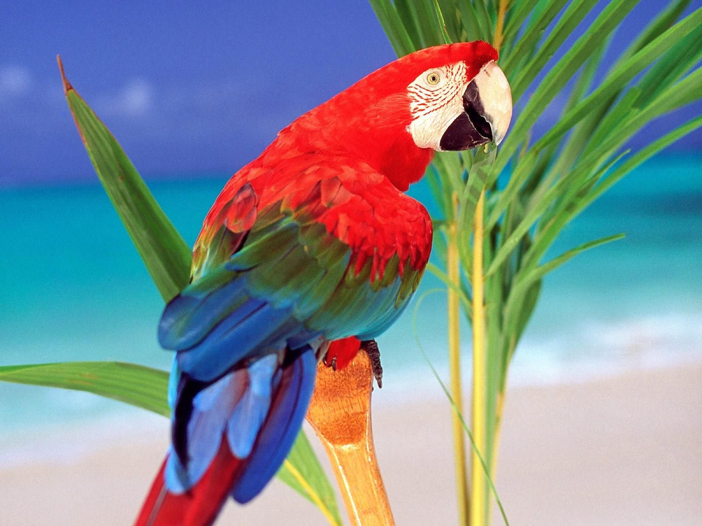

Slide 4
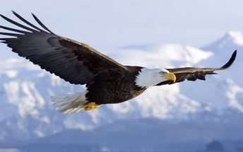

Slide 5
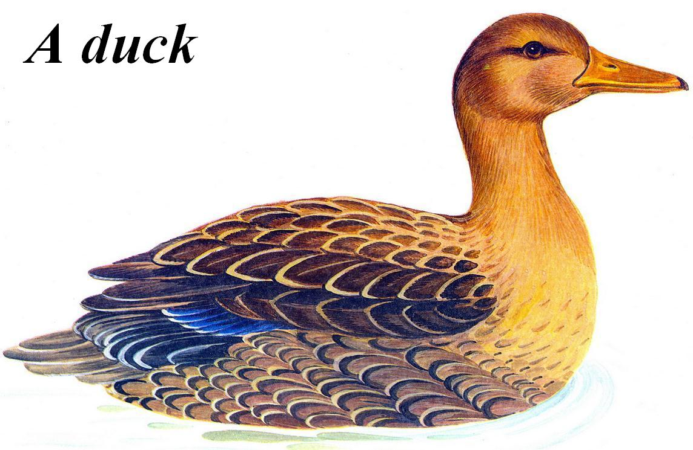

Slide 6
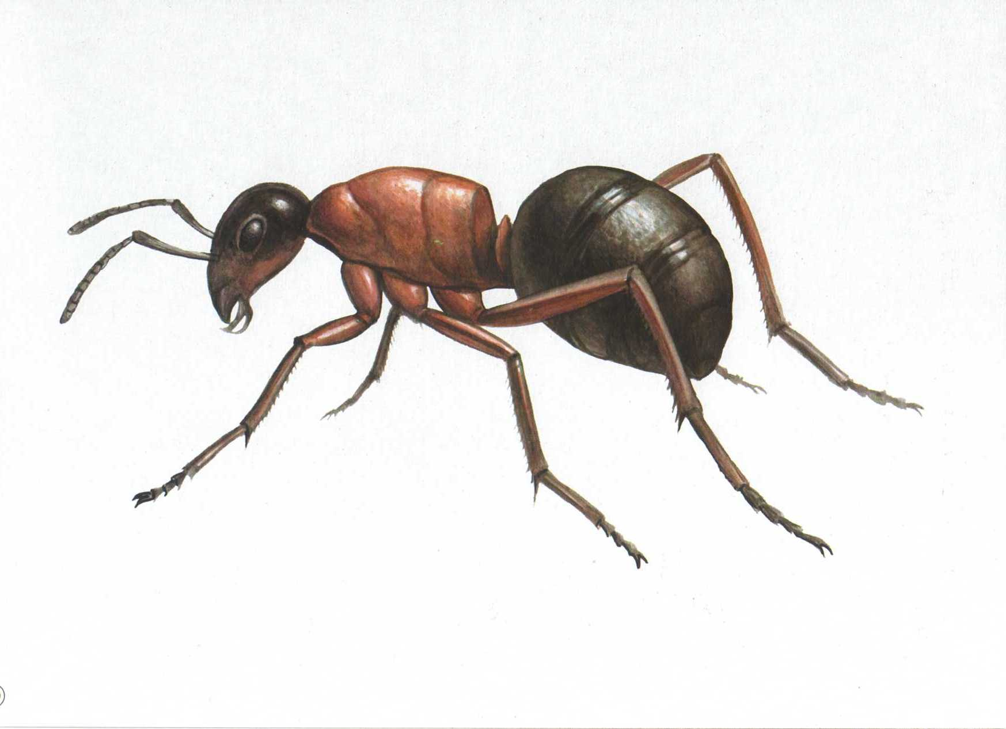

Slide 7
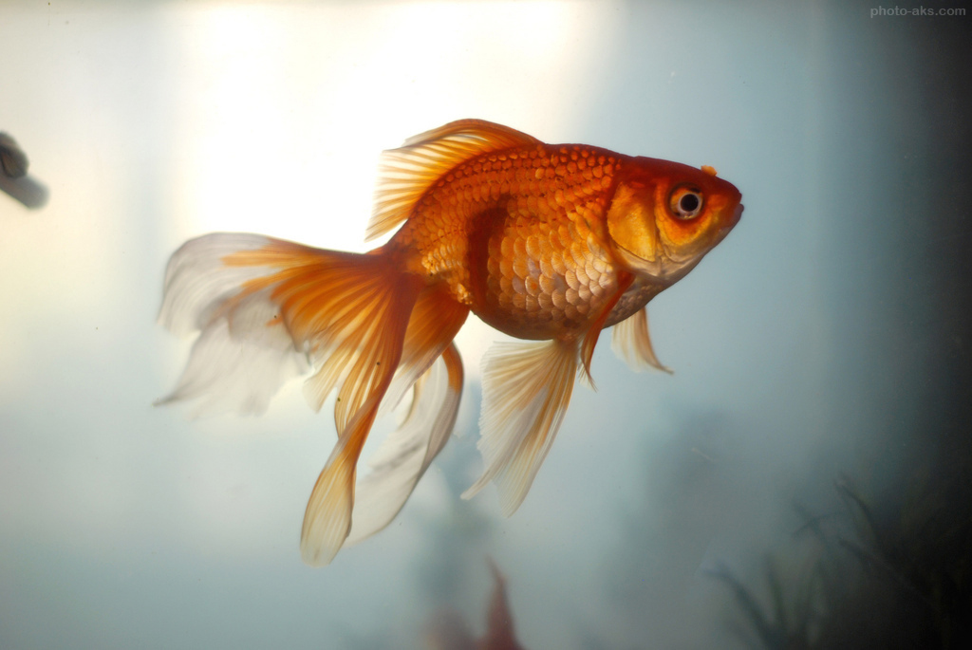

Slide 8
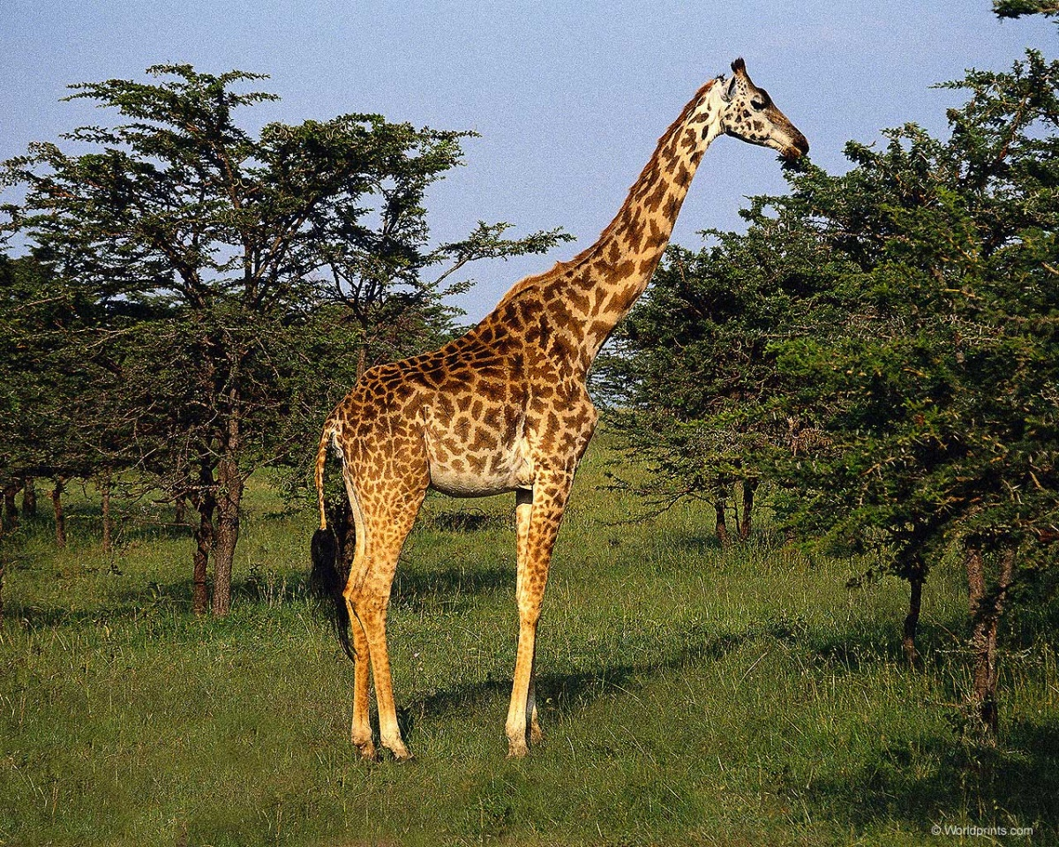

Slide 9
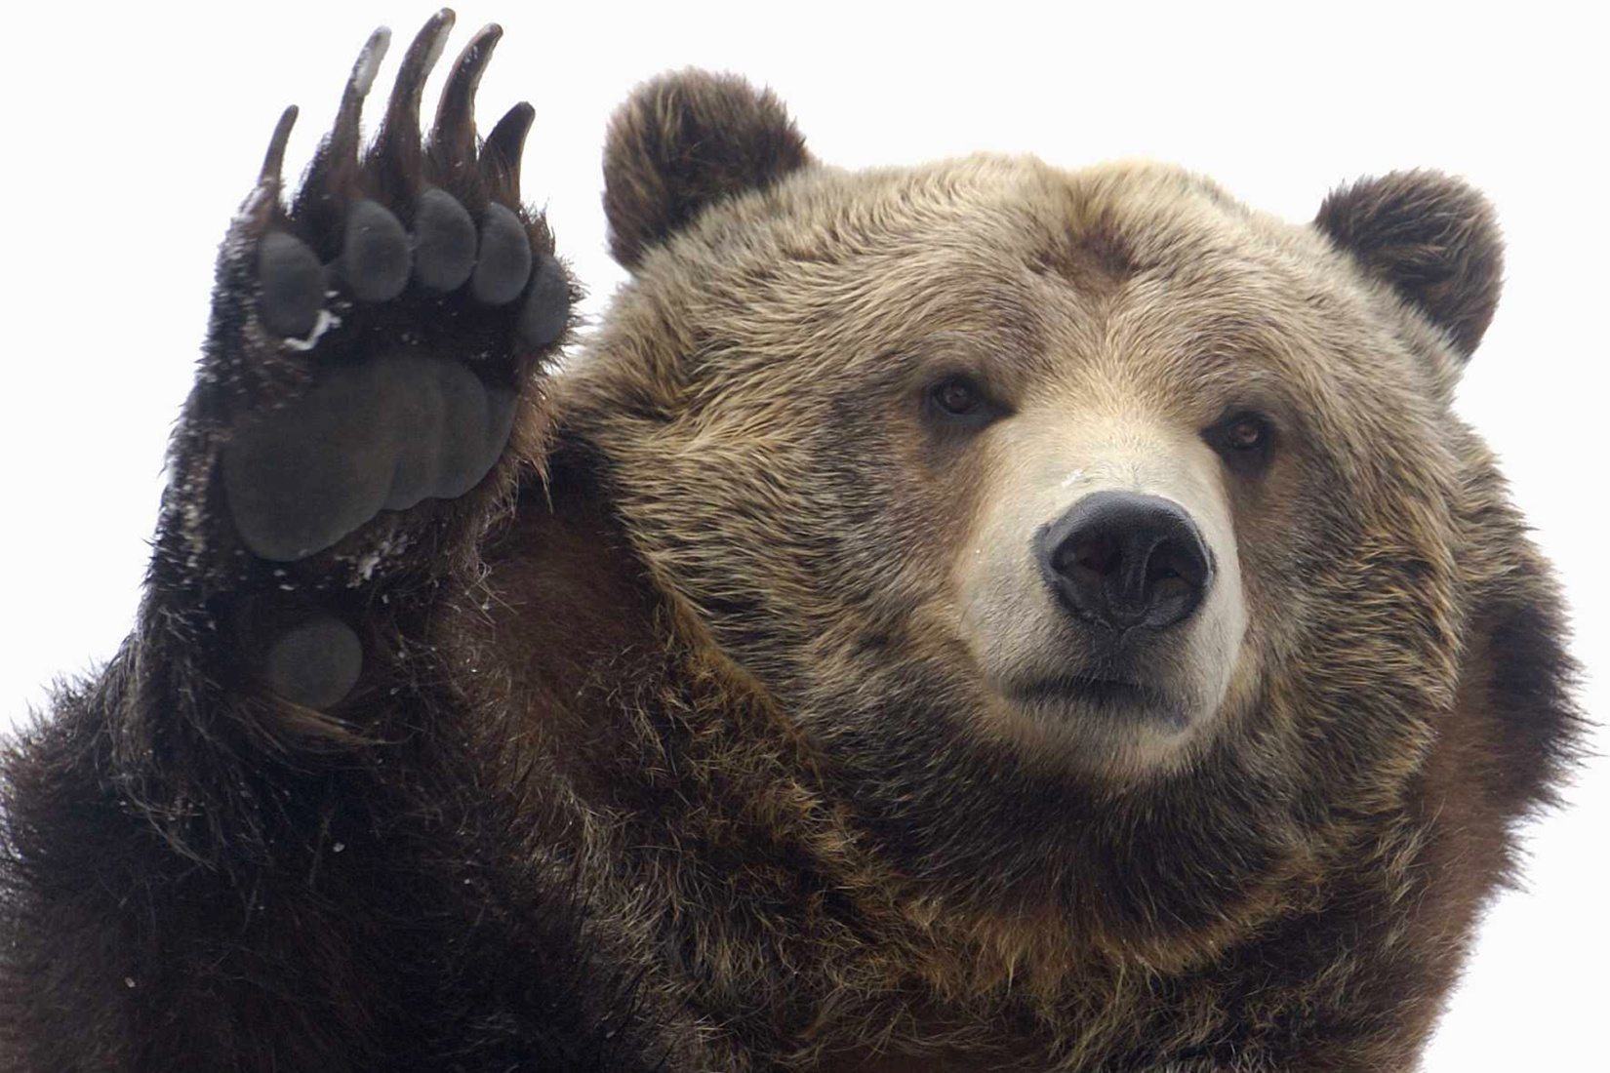

Slide 10
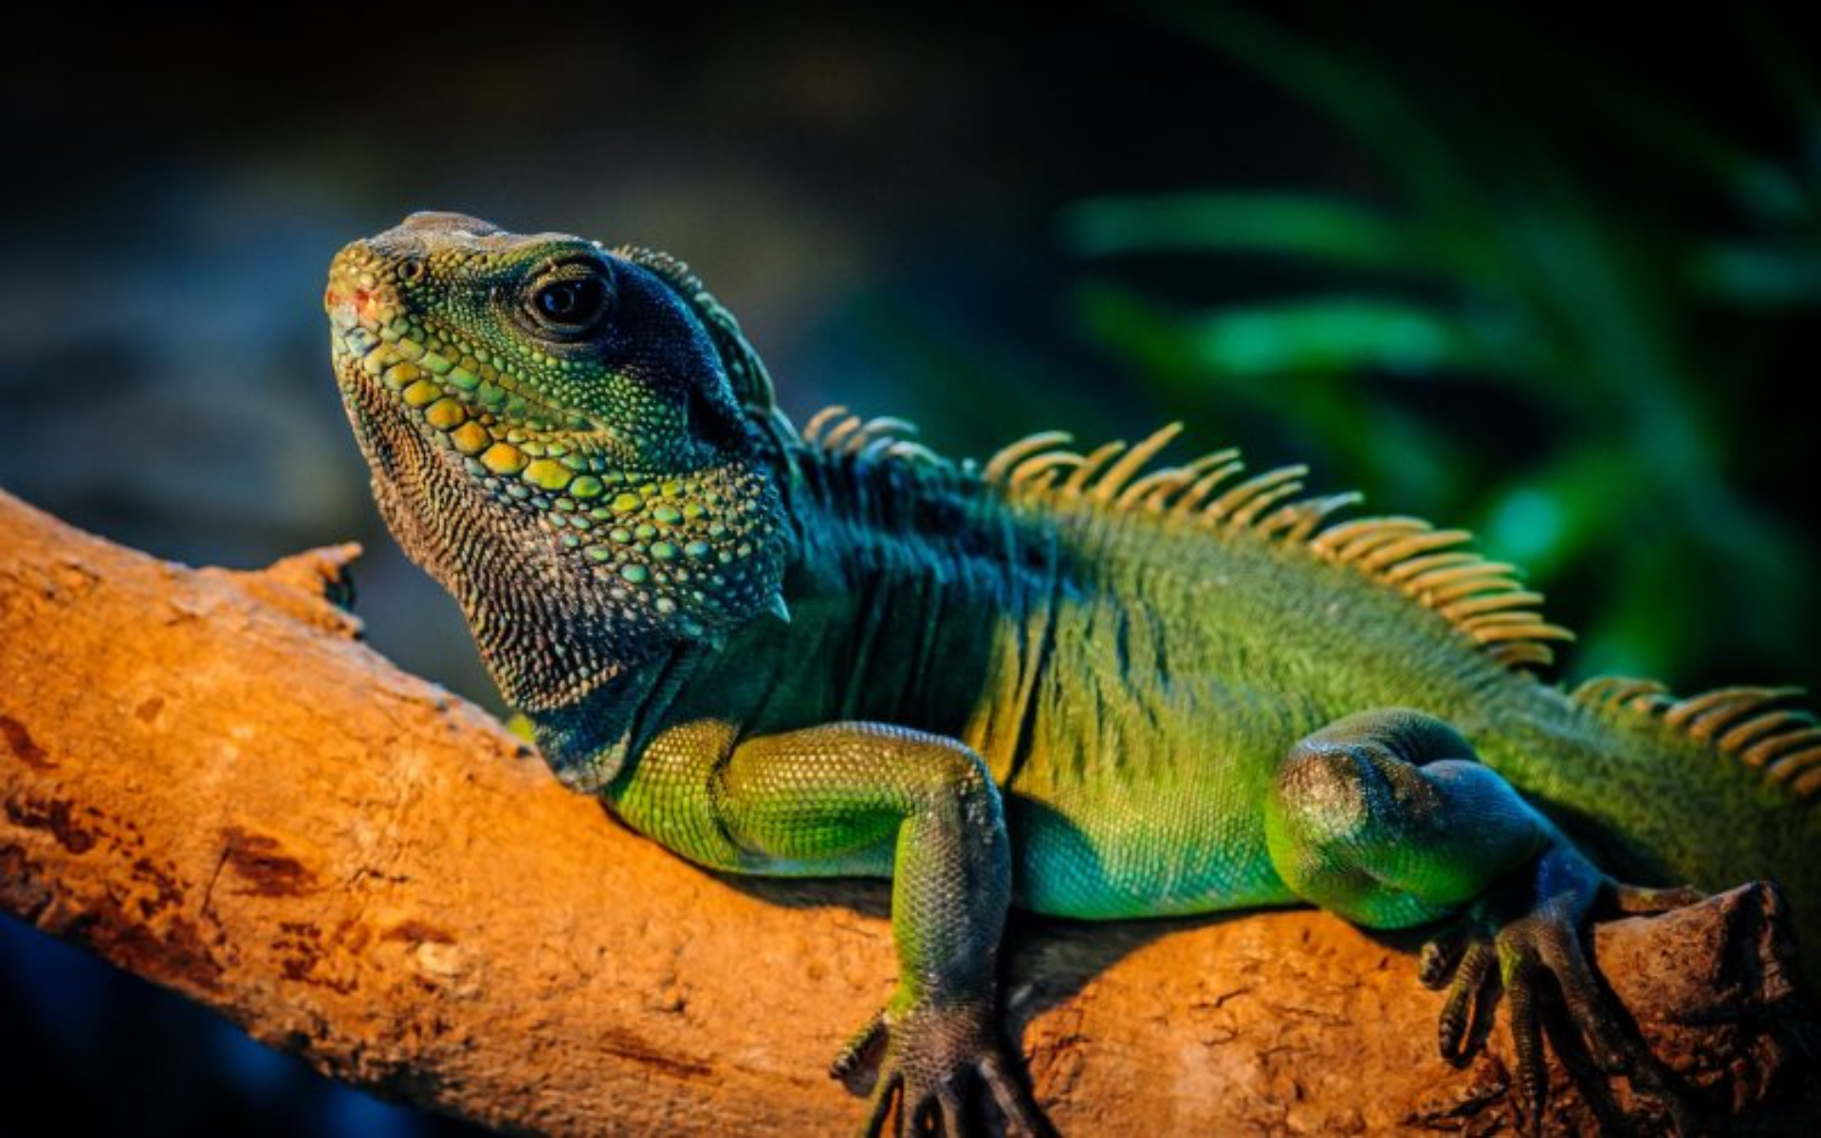

Slide 11
The theme is
«The Friends»

Slide 12
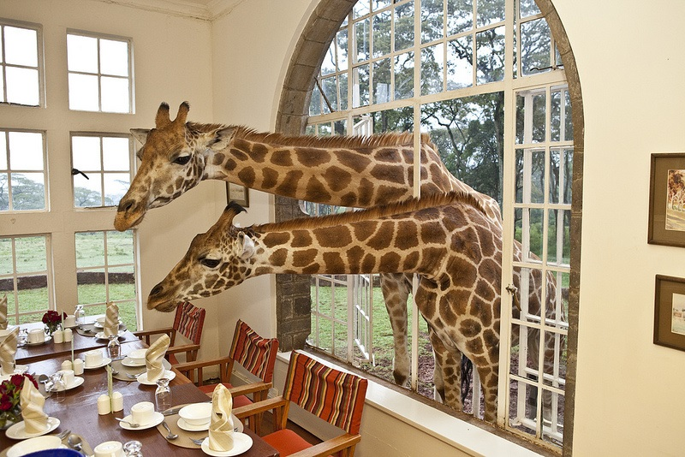

Slide 13
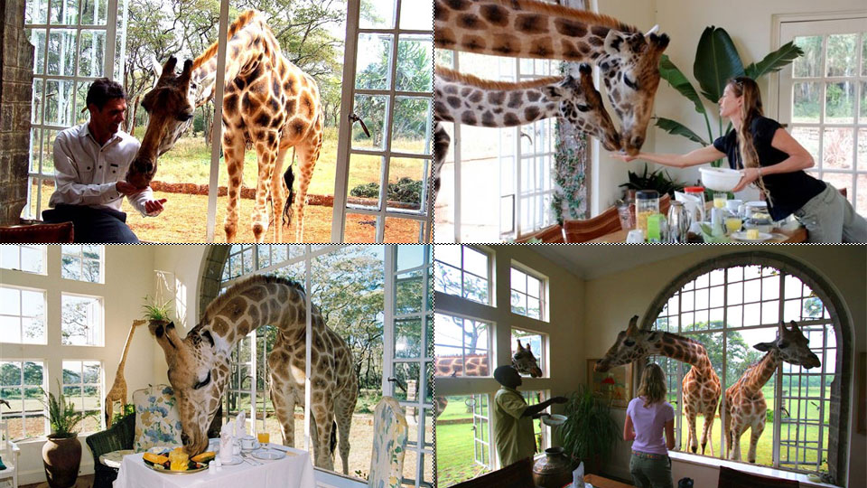
It is Giraffe Manor

Slide 14
Listen to the text. Read to find out the best answer. Find evidence in the text.
1. What animals live at Giraffe Manor?
2. What do the giraffes like doing in the morning?
3. What does Lynne enjoy?
4. What is special about the Rothschild giraffes?

Slide 15
It’s time to have a rest:
Head and shoulders, knees and toes, knees and toes,
Head and shoulders, knees and toes, knees and toes,
And eyes, and ears, and mouth, and nose,
Head and shoulders, knees and toes, knees and toes,

Slide 16
New words:
Let's train our tongues:
stare, normal, leaves twigs, slice, playful, personality,
leader, treat, guests, hug, typical, conservation project,
rare, in the wild, acne, estate, exotic, owner, staff, do their best,
tourists, feel, welcome, gentle

Slide 17
Check yourselves.
.
1. stare
2. staff
3. treat
4. rare
5. estate
6. guests
7. leaves, twigs
8. leader
9. do their best

Slide 18
Use these words:
- can take photos;
- rare animals;
- wild African animals;
- African wildlife;
- conservation project;
- to save the animals’
- the Rothschild giraffe

Slide 19
Home task.
Open your books on page 51, ex.7.
Imagine you are at Giraffe Manor. Send your English pen friend an email. In your email write: where you are, what the place is like, what is special about it and what you like the most.

