Slide 1
slim
fat
healthy
unhealthy

Slide 2
People`s lifestyle
work
sport
hobbies
?

Slide 3
Food
and
drinks

Slide 4
“We don`t live to eat,
but eat to live.”
( Socrat )

Slide 5
Warming - up
[ʌ]
pumpkin
butter
nuts
[æ]
cabbage
carrot
apple
[ɪ]
fish
milk
dill
[ı:]
cheese
beans
meat
[ͻ:]
sausages
water
salt
[ǝʊ]
toast
coke
loaf

Slide 6
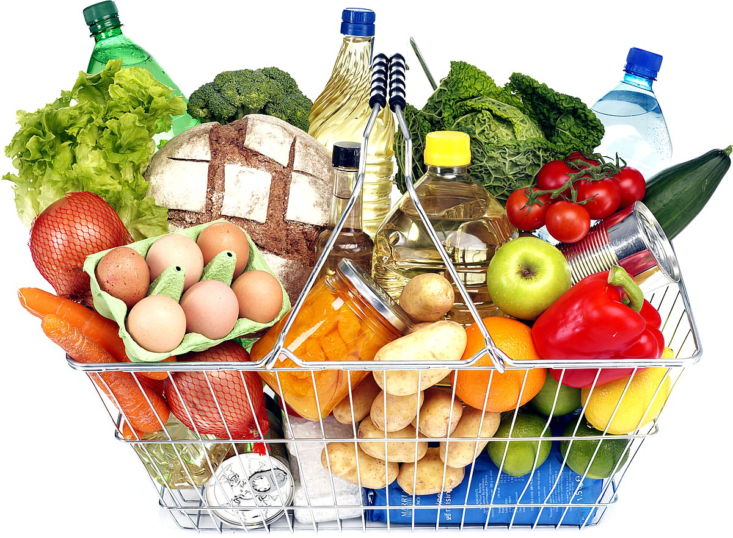
In what shops and departments can people buy food?
the butcher`s
the dairy
the baker`s
the grocer`s
the greengrocer`s
the fishmonger`s
Where?
What?

Slide 7
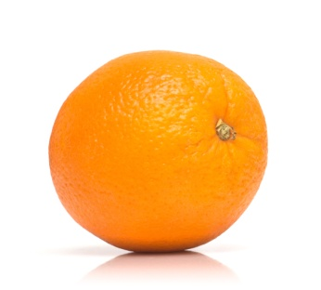
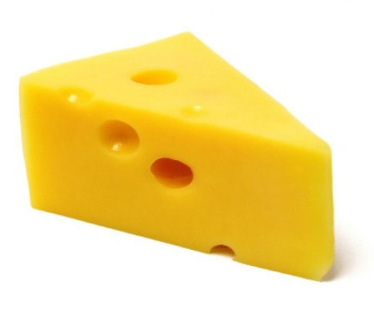
Riddles
It is a drink. It`s black. It`s not tea.
We can drink it with milk.
It is the name of a fruit.
And it is a colour.
You smile when you name it.
The mouse likes it very much.

Slide 8
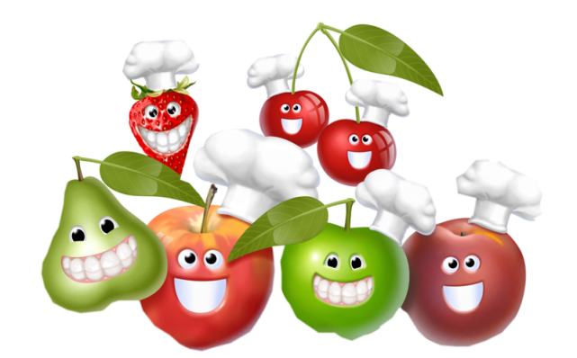
English Proverbs
Too many cooks spoil the broth.
Half a loaf is better than none.
Hunger is the best sauce.
Tastes differ.
An apple a day keeps the doctor away.
У семи нянек дитя без глазу.
О вкусах не спорят.
Яблоко в день гонит доктора в дверь.
d) Лучше синица в руках, чем журавль в небе.
e) Голод не тётка.
1a
2d
3e
4b
5c

Slide 9
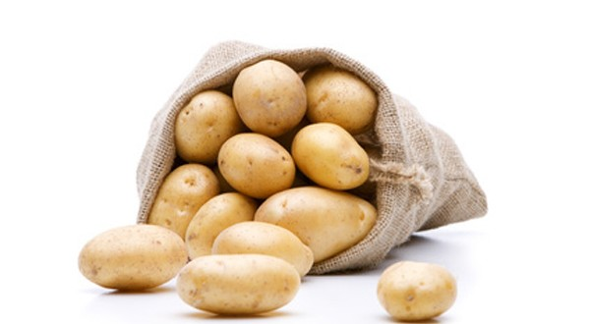
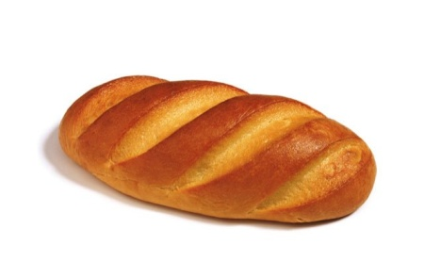
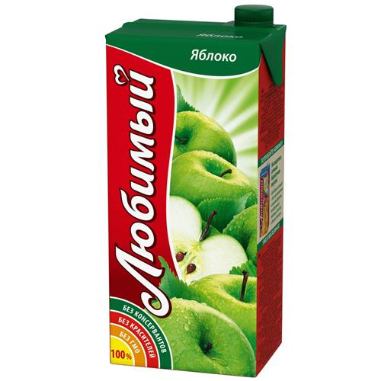
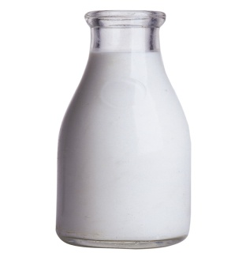
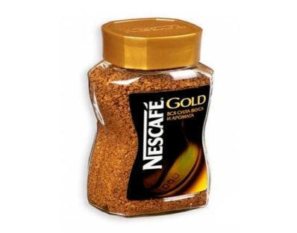
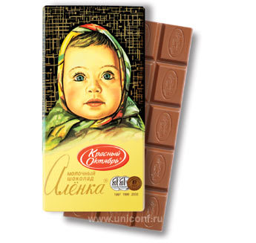
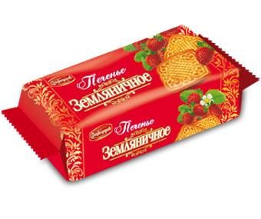
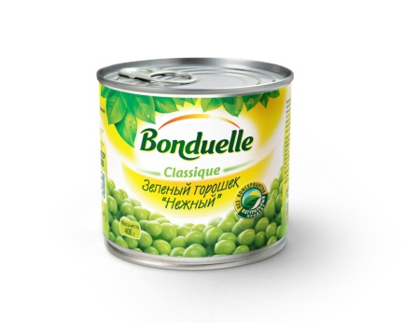
a
b
1) a packet of …
2) a bar of …
3) a bag of …
4) a loaf of …
5) a jar of …
6) a carton of …
7) a bottle of …
8) a tin of …
c
d
e
f
g
h
1g 2f 3a 4b
5e 6c 7d 8h

Slide 10
What is good for
people`s health?
It`s cool to live!
Жить здорово!

Slide 11
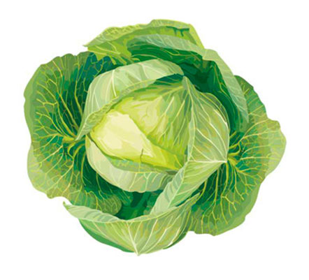
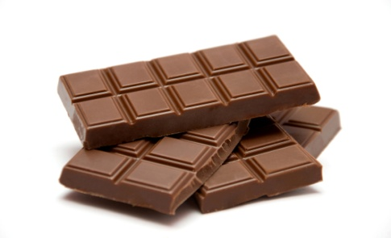
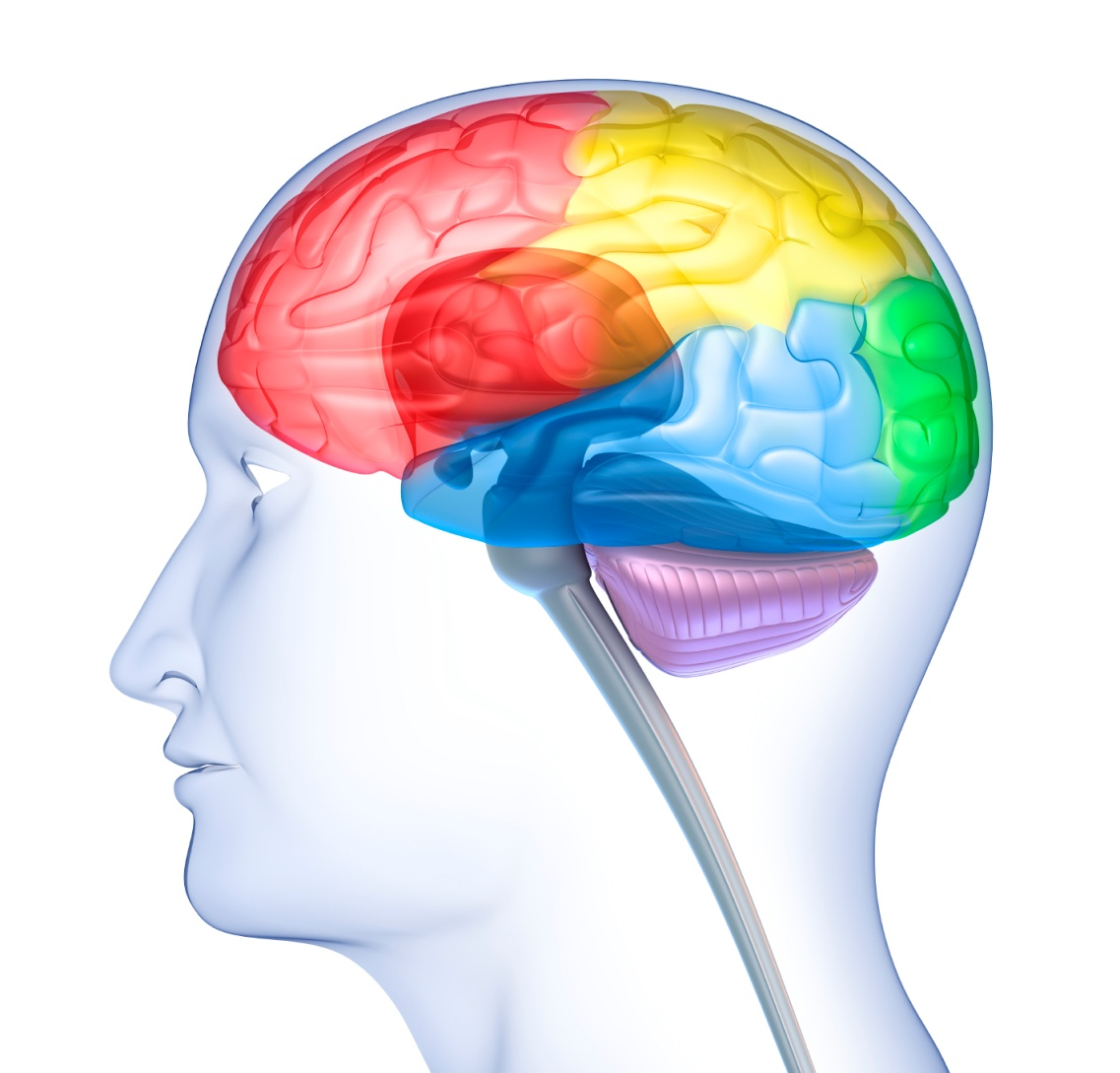
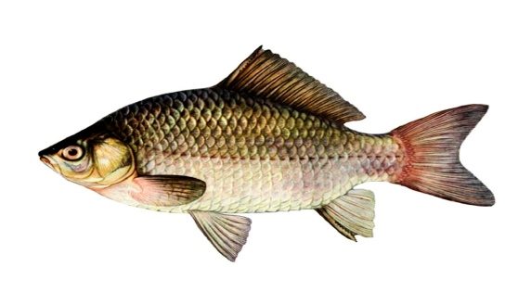
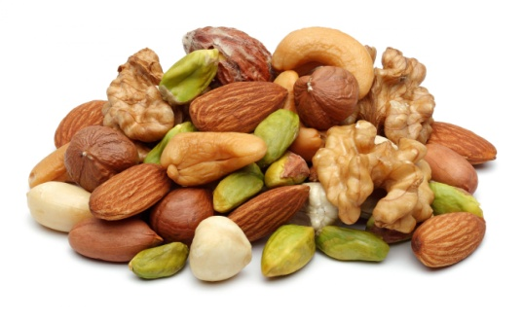
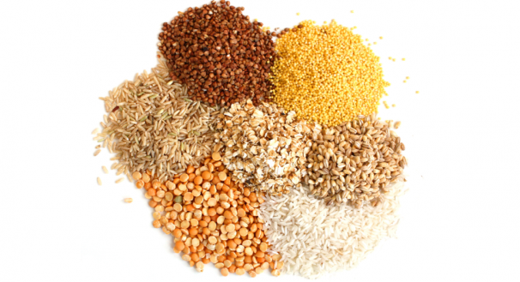
brains

Slide 12
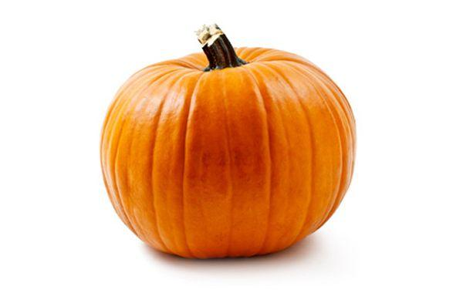
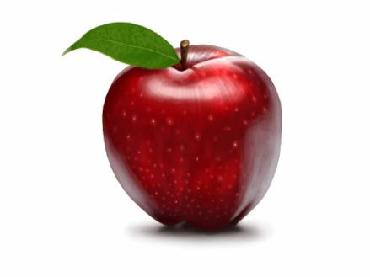
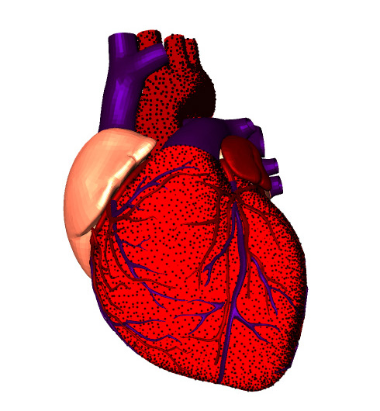
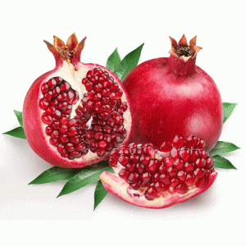
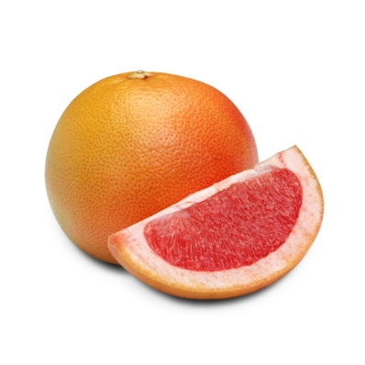
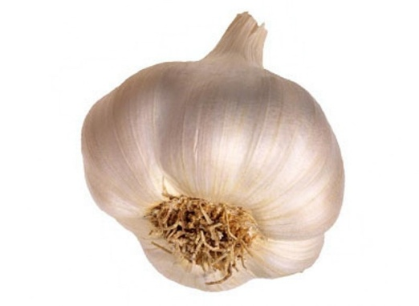
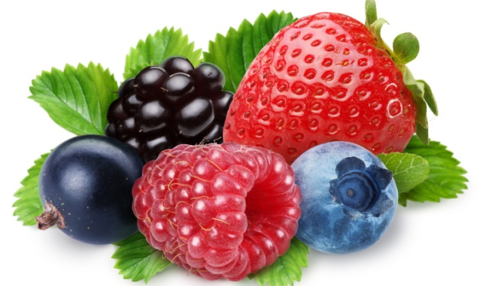
brains
heart

Slide 13
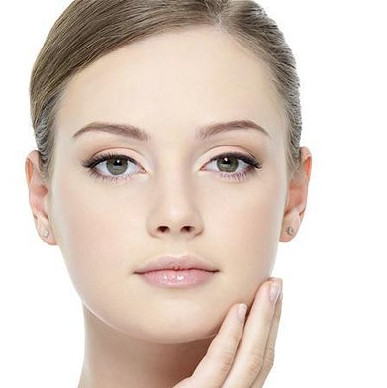
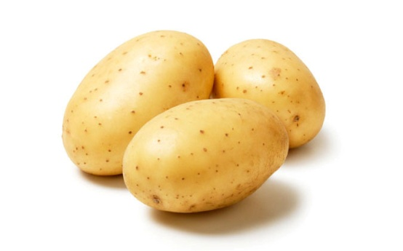
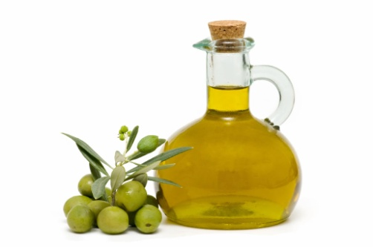
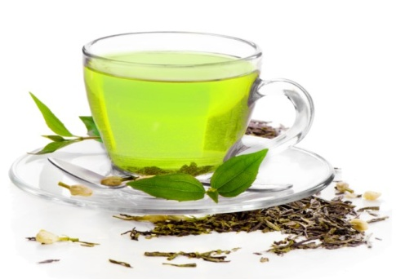
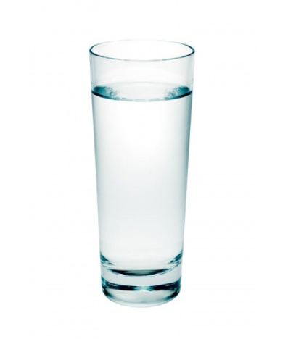
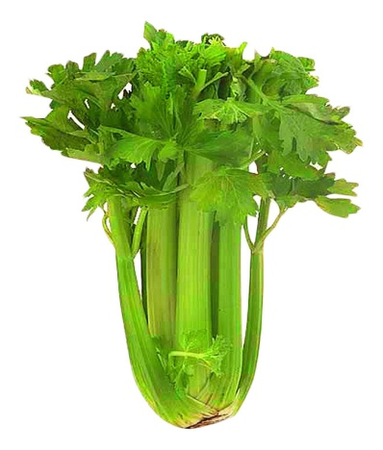
skin

Slide 14
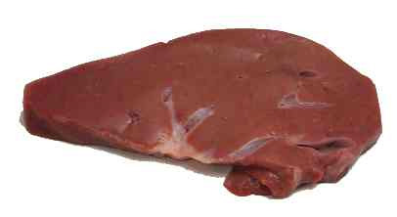
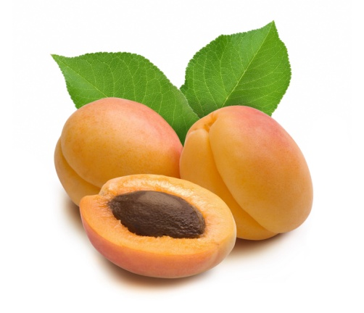
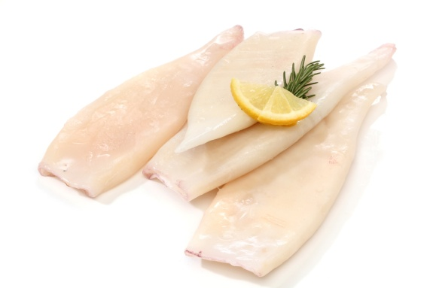
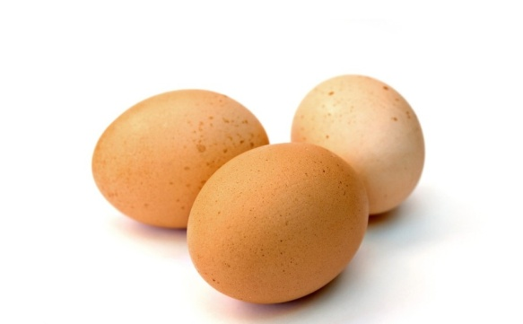
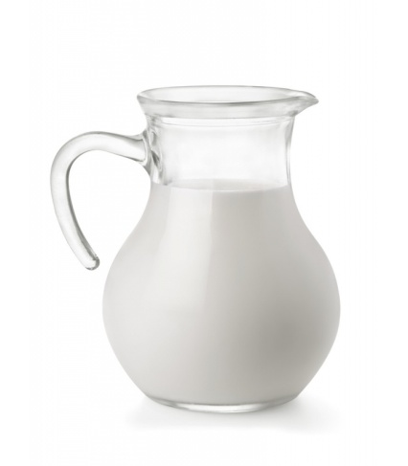
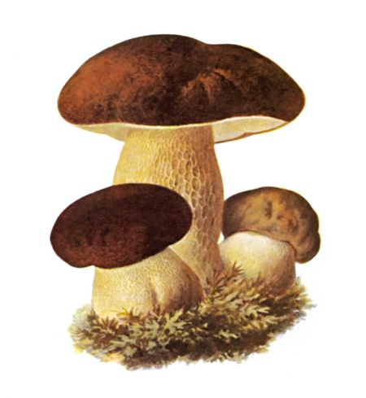
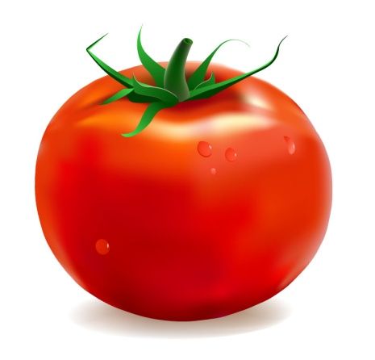
bones

Slide 15
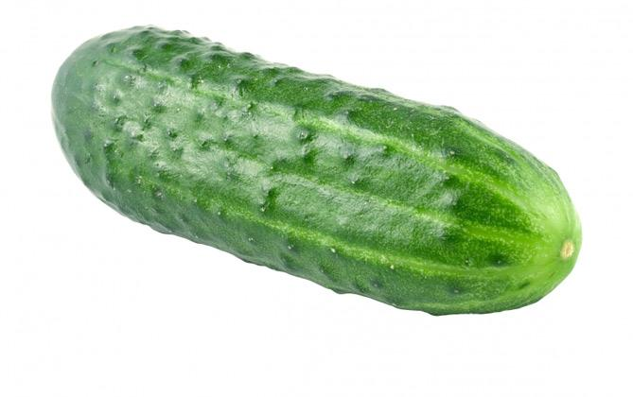
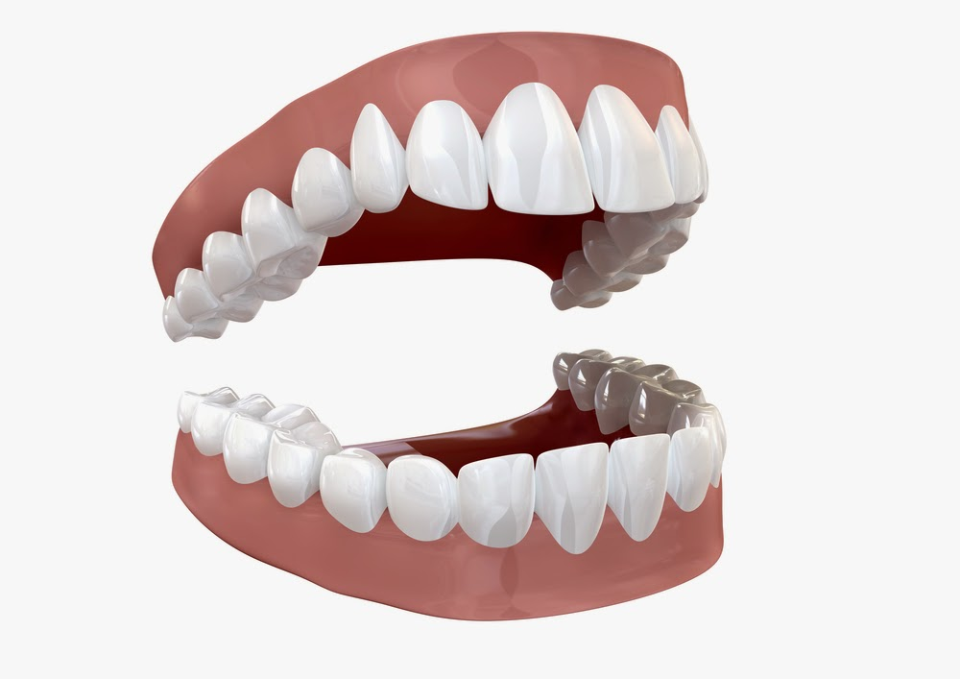
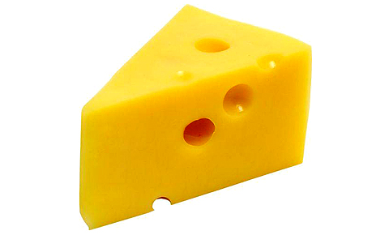
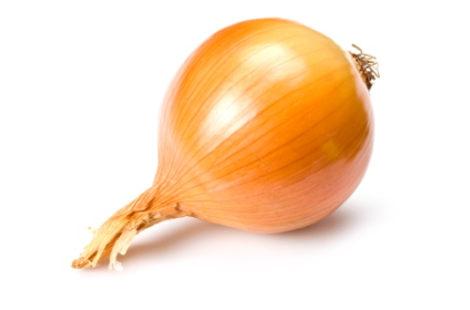
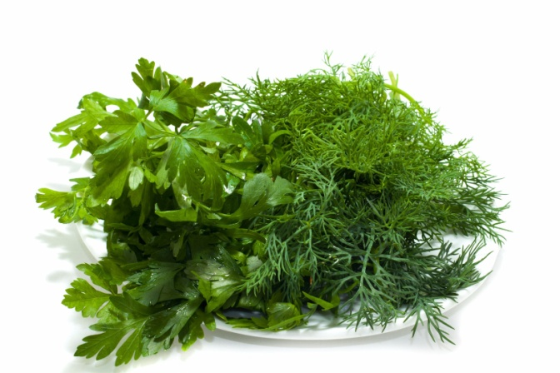
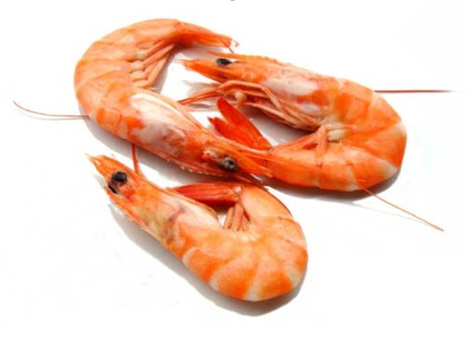
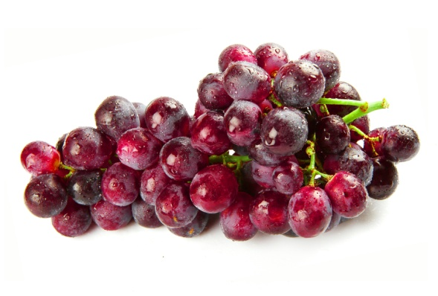
teeth

Slide 16
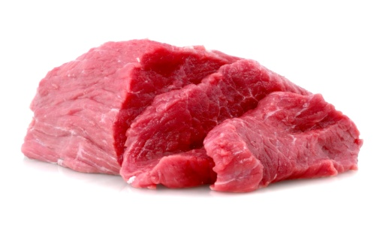
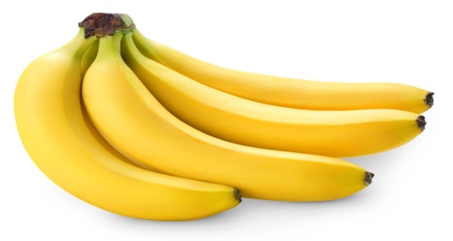
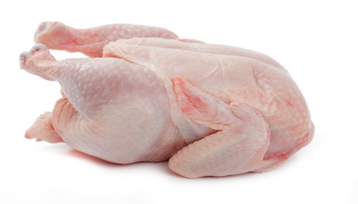
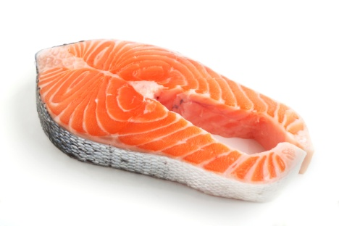
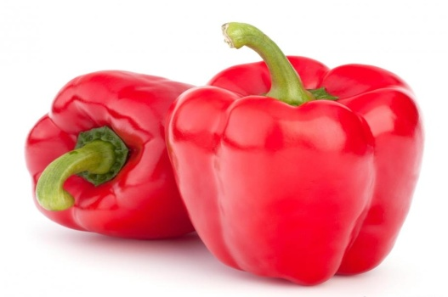
muscles

Slide 17
eyes

Slide 18
YOU ARE
WHAT YOU EAT!

