Slide 1
Открытый урок по теме: “Healthy lifestyle”для 3го класса Общеобразовательной школы.
Подготовила: Волобуева А.В.
Учитель английского языка ГБОУ школы №331 Невского района Санкт-Петербурга

Slide 2
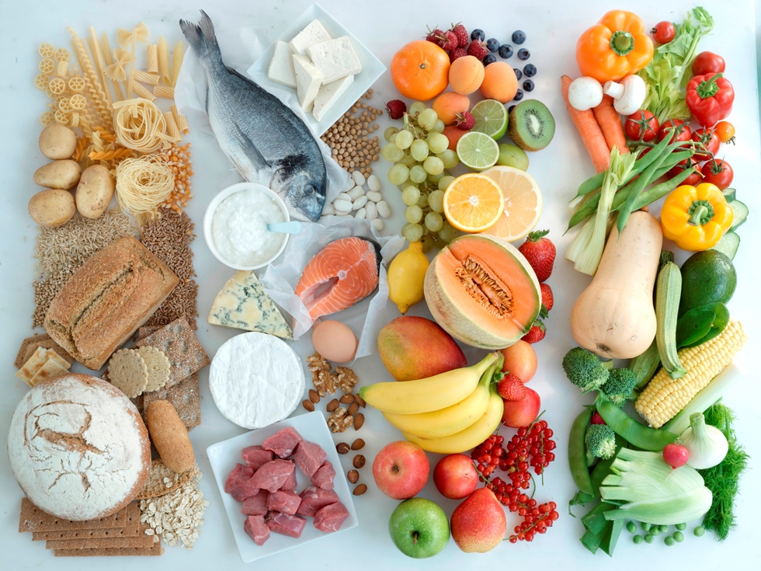

Slide 3
Healthy Lifestyle

Slide 4
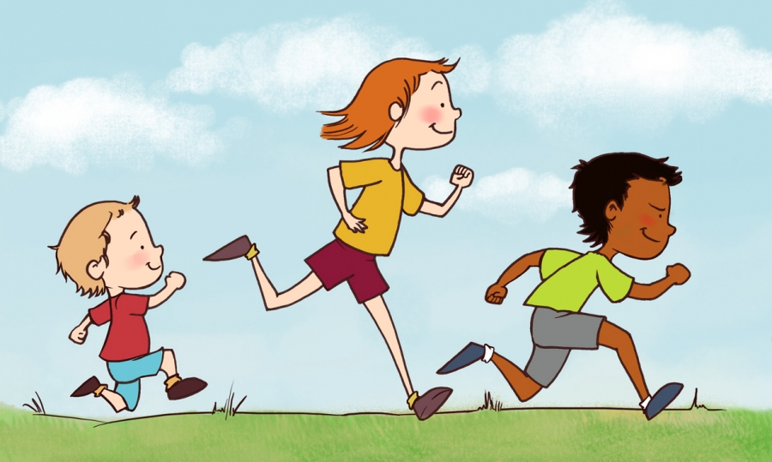
RUN

Slide 5
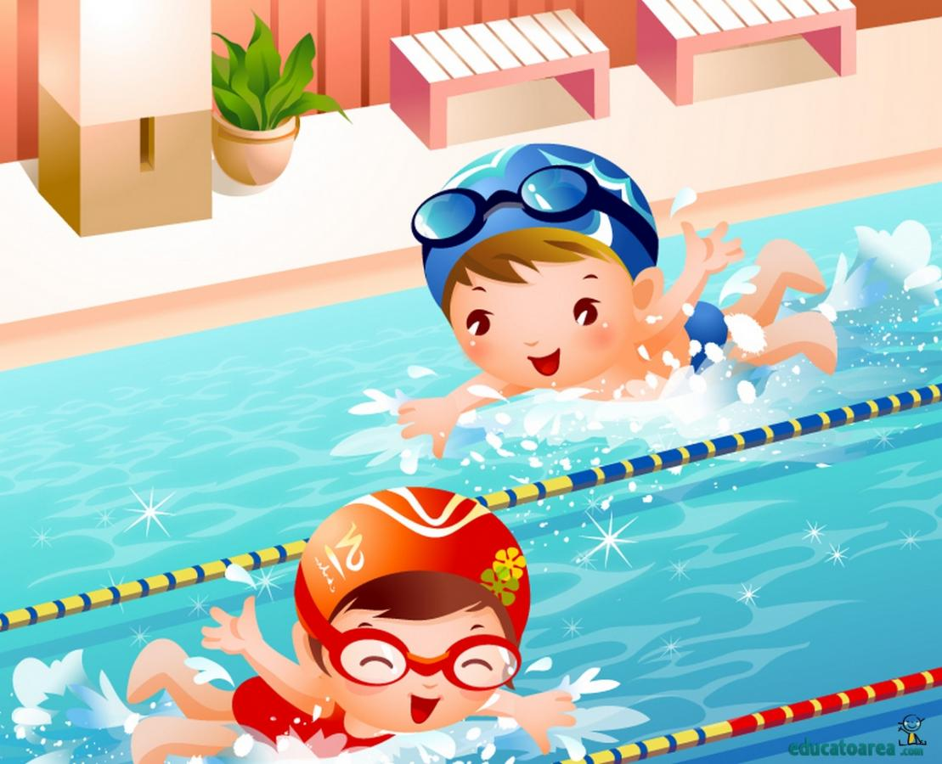
SWIM

Slide 6
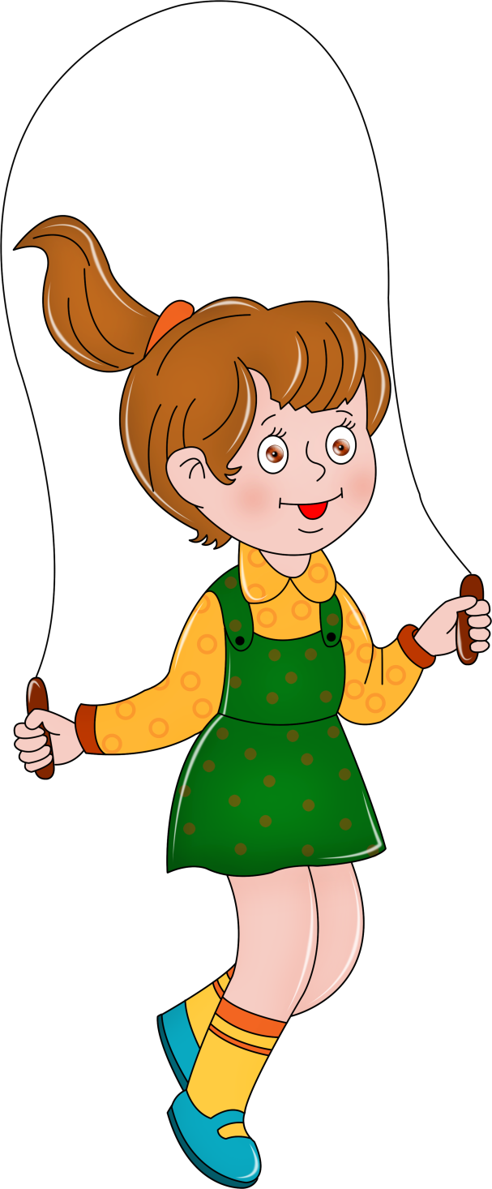
JUMP

Slide 7
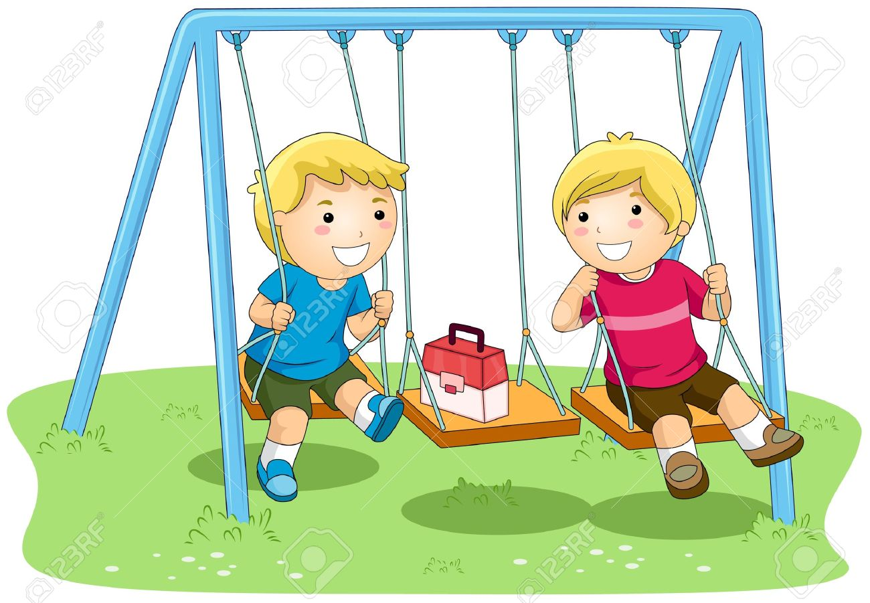
SWING

Slide 8
Run like a horse,
jump like a frog,
swim like a fish,
dance like a ballerina, walk like a soldier.

Slide 9
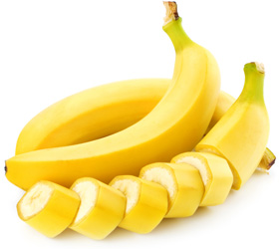
Chimps like to eat it.

Slide 10
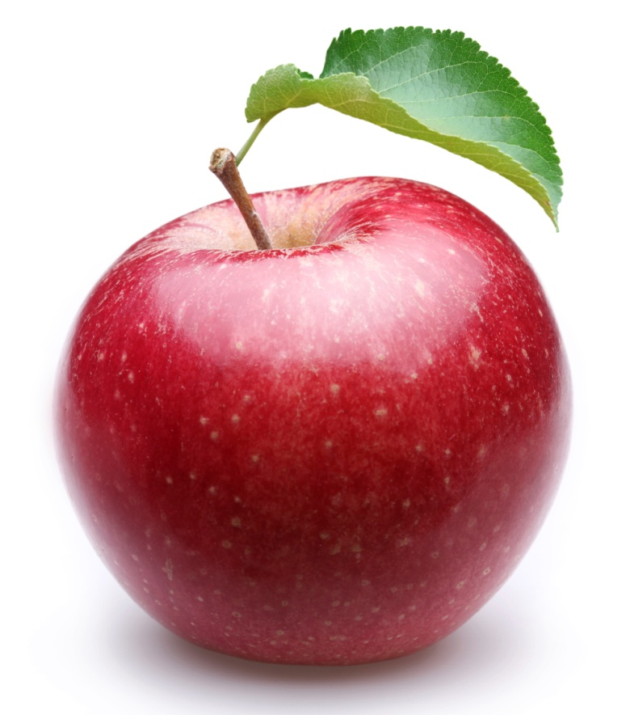
You can get it from an apple tree.

Slide 11
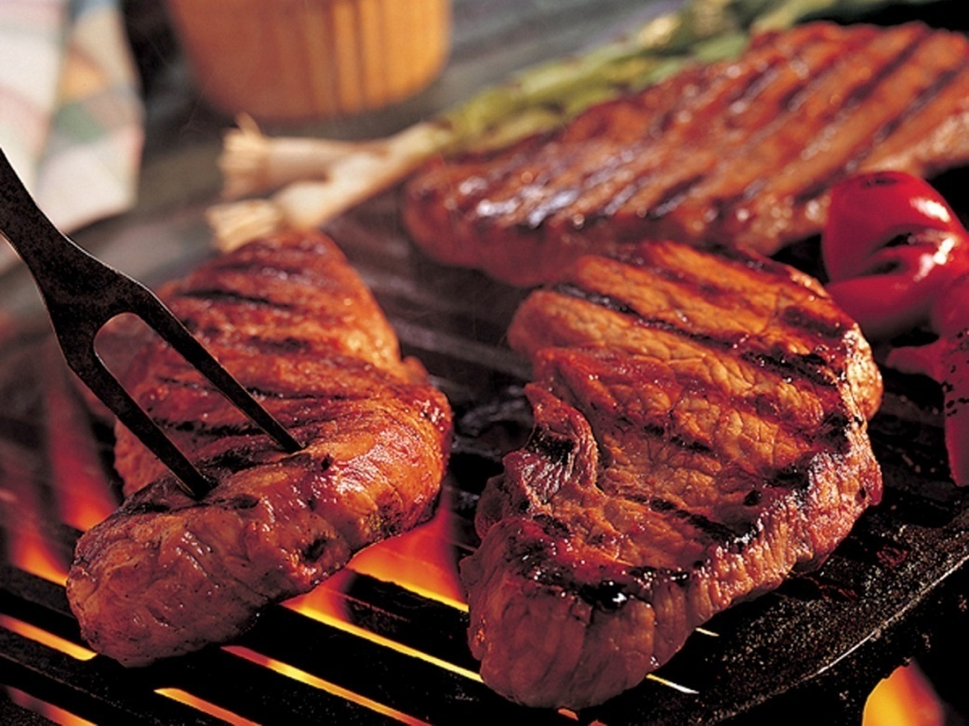
You eat it to be strong; the first letter of the word is “M”.

Slide 12
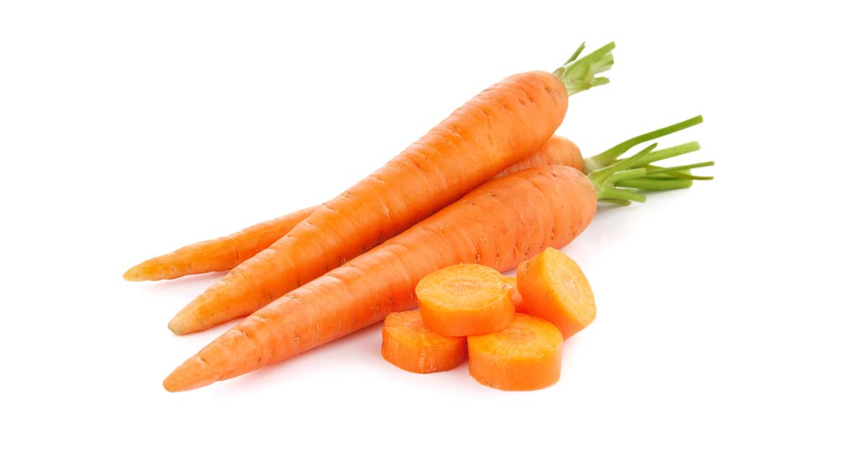
Rabbits and hares like it very much.

Slide 13
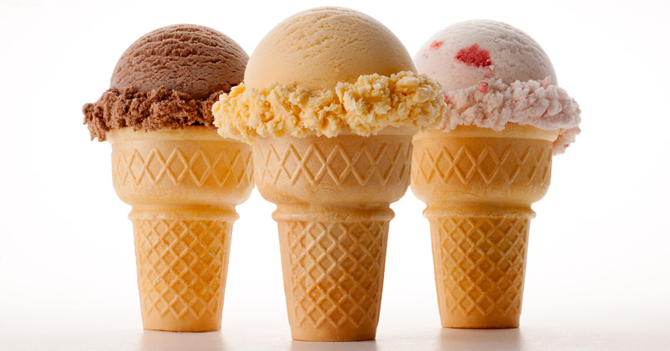
When the weather is hot you like to eat it very much.

Slide 14
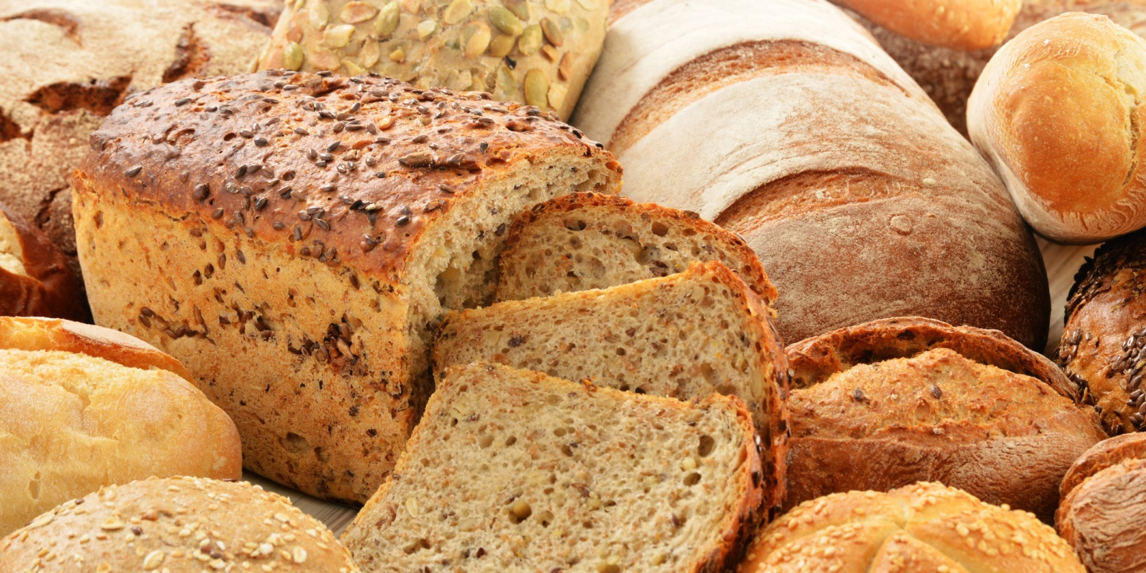
You eat it with butter and cheese.

Slide 15
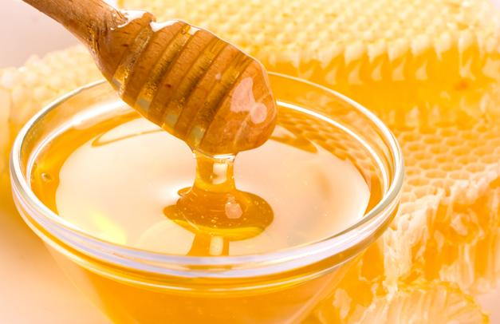
Bees get it from flowers.

Slide 16
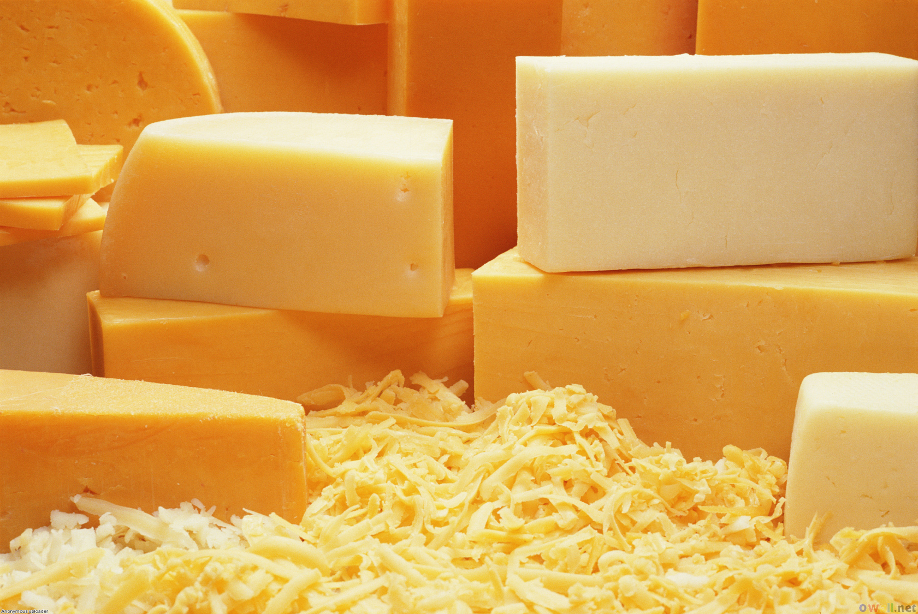
Mice like it very much.

Slide 17
J_ICE
M_ _ K
T-SH_ _T
S_O_TS
JUICE
MILK
T-SHIRT
SHORTS

Slide 18
APC
AOTC
HOESS
ATH
CAP
COAT
SHOES
HAT

Slide 19
To be healthy we should run,
To be healthy we should swim,
To be healthy we should jump,
To be healthy we should swing.
To be healthy we should eat:
Bananas, apples and some meat.
Carrots, and sometimes ice cream.
Bread, honey and some cheese.
To be healthy we should drink:
Juice, kefir and milk.
When it’s hot we should wear:
T-shirt, shorts and cap on the hair.
When it’s cold we should wear:
Coat, shoes and hat on the hair.

Slide 20
I jump out of bed in the morning,
I jump out of bed in the morning,
I jump out of bed in the morning,
And say it’s a very nice day.
I Wash my face in the morning,
I brush my teeth in the morning.
I wave goodbye in the morning.
I walk to school in the morning.

Slide 21
Thank you
for the lesson.
Good-bye.

