Slide 1
MY HOUSEHOLD DUTIES
Made by Valery Kalmykov, the pupil of the 6a form

Slide 2
I hate shopping. I can never choose what really I want. But everybody in our family has some household duties. So do I.
I HAVE TO BUY FOOD.

Slide 3
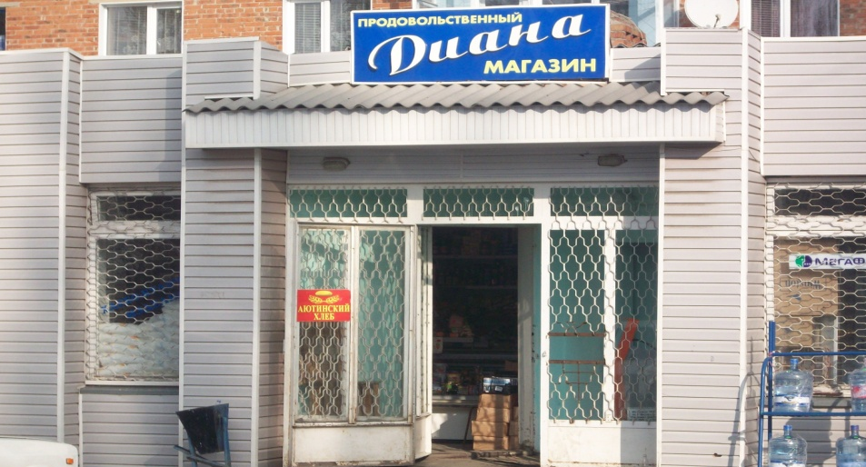
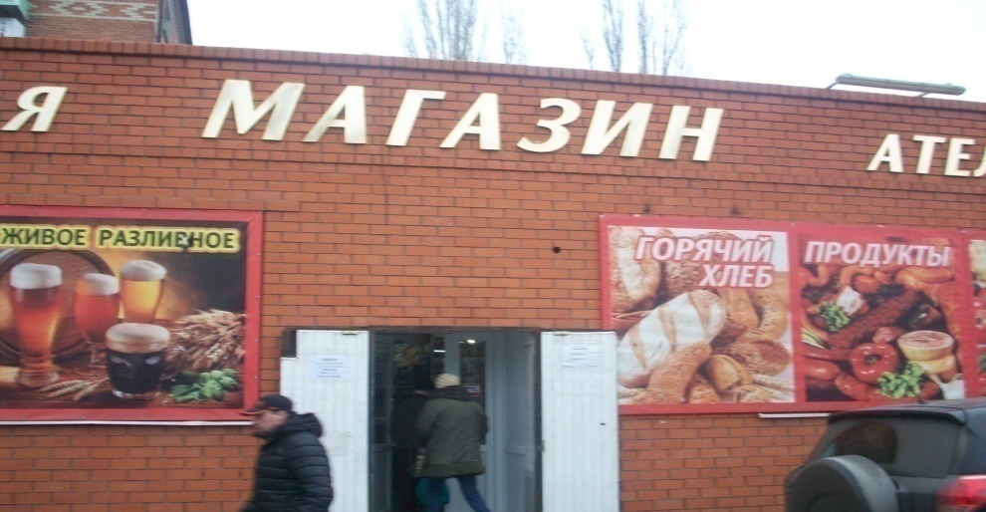
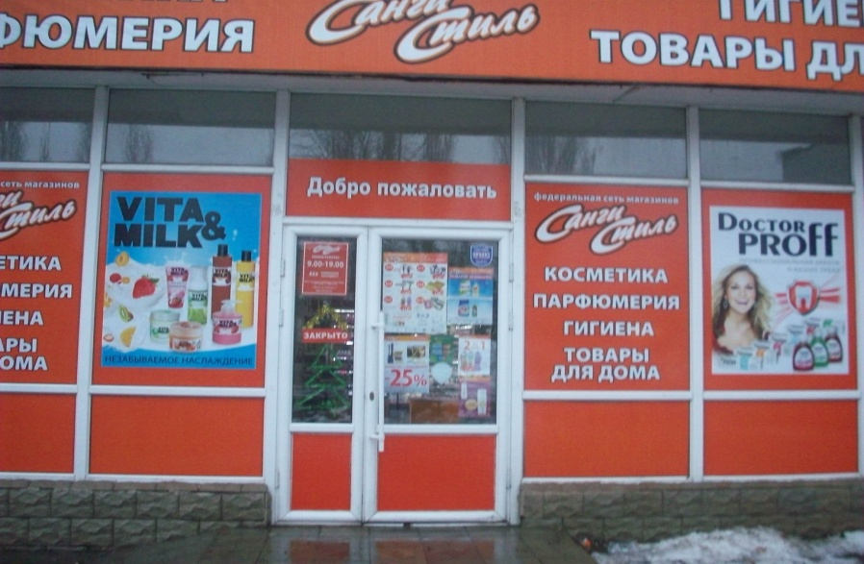
THERE ARE MANY SHOPS IN OUR STREET.

Slide 4
I LIKE TO BUY FOOD IN THE SHOP “MAGNIT”. IT IS THE LARGEST ONE.

Slide 5
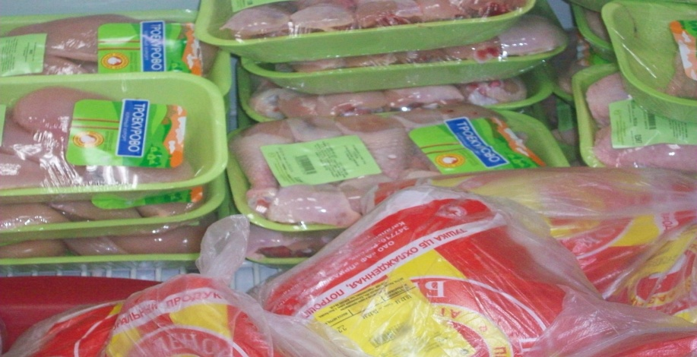
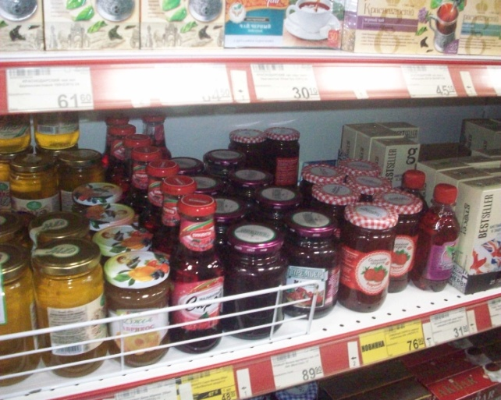
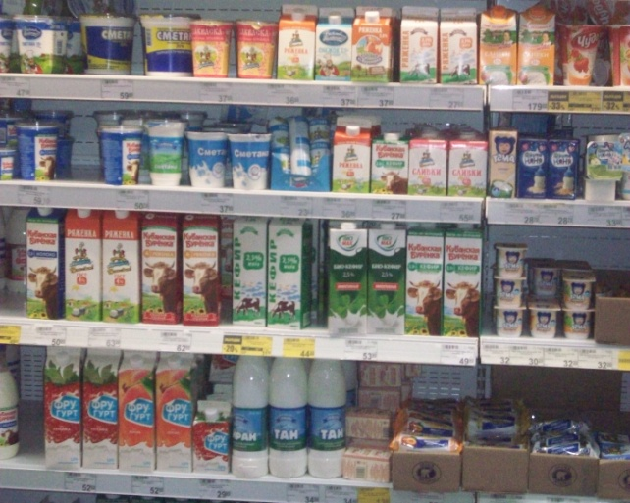
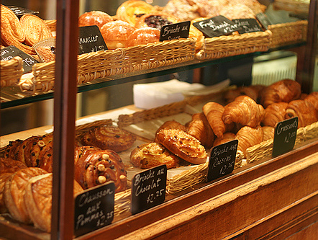
THERE ARE MANY DEPARTMENTS IN THIS SHOP:
Greengrocer’s
Butcher’s
Grocer’s
Dairy
Baker’s

Slide 6
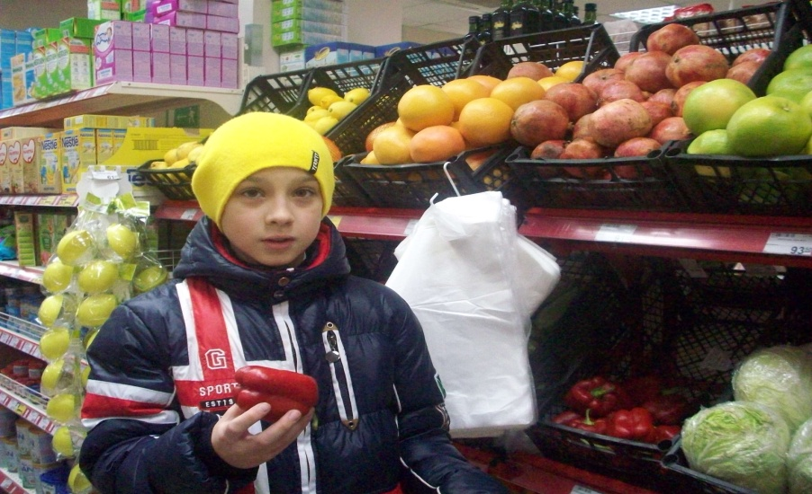
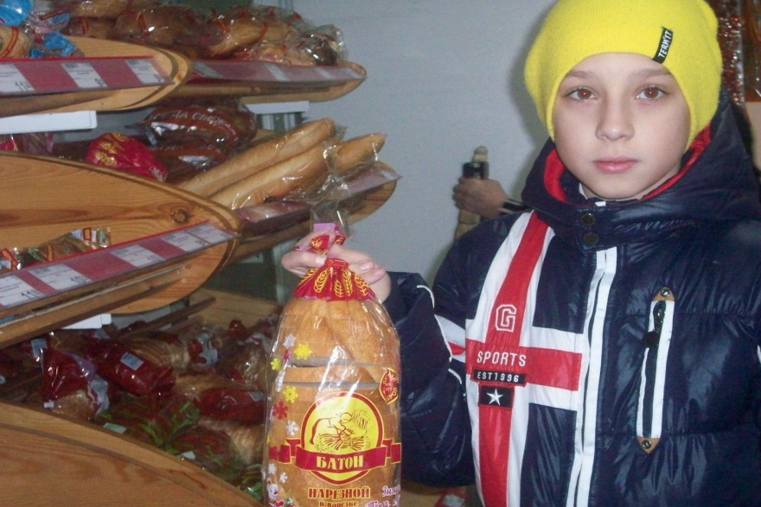
I buy milk at the milk and butter department .
Then I go to the greengrocer’s and buy some apples, lemons or tomatoes.
Bread and rolls are always fresh in the baker’s.

Slide 7
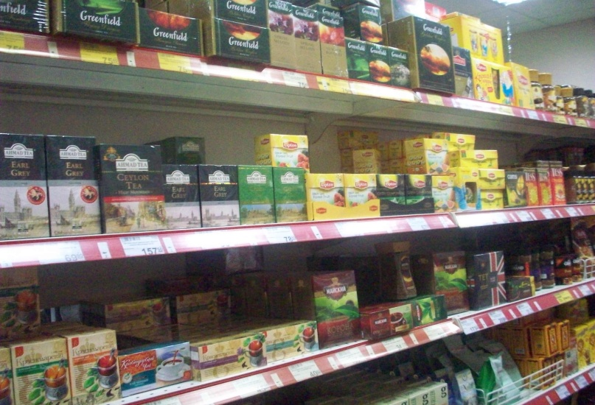
Sometimes I buy sweets or a bar of chocolate
Now I know how much is everything.
I always help my mother.

