Slide 1
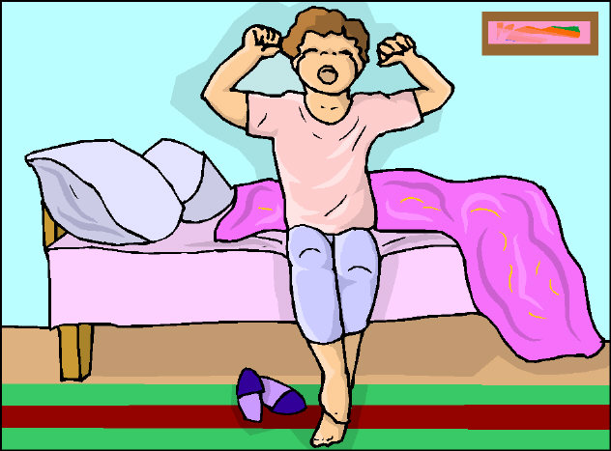
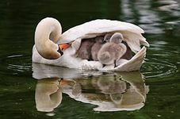
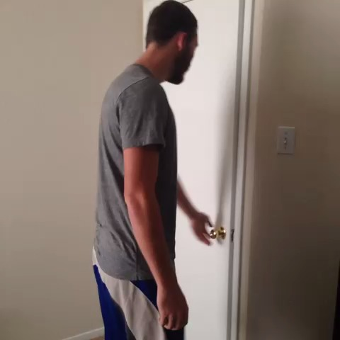
Get back
Go to bed
Wake up
Go to sleep
Look after
Get up
Go out
Бекасова Е.Р. №240-322-448

