Slide 1
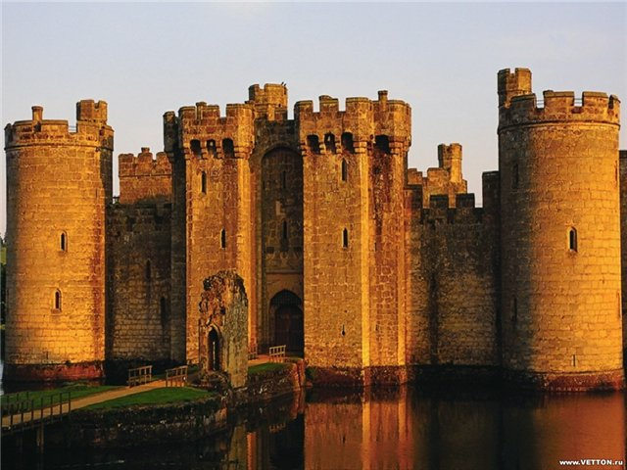
Houses in the Past and Houses in the Future

Slide 2
proverbs and sayings supporting the importance of home to a person:
Complete the sentenses:
East or West, …..
There is no place ….
My house is ….
Home, sweet ….
Home is where ….

Slide 3
proverbs and sayings supporting the importance of home to a person:
Complete the sentences:
East or West, home is best.
There is no place like home.
My house is my fortress.
Home, sweet home.
Home is where the heart is.

Slide 4
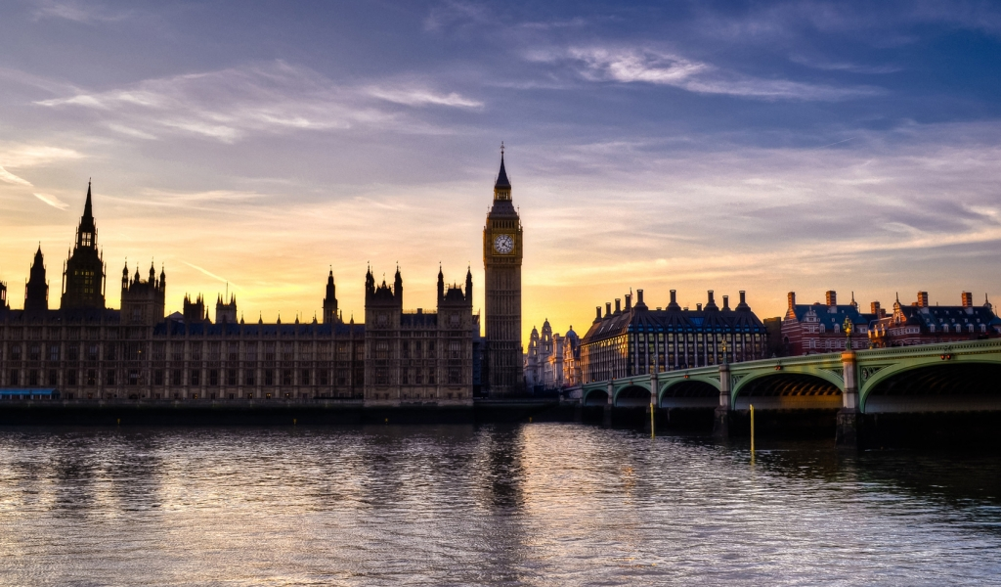
House is essential for man’s life. A house serves as a shelter and a place to satisfy all our needs: we sleep, eat, hide ourselves from bad weather, store personal property, work and rest there.

Slide 5
What is a difference between a house and a home?
House a building that you live in. | Home The place where you belong and feel comfortable, where you grew up, the place that brings back old memories or feelings.

Slide 7
An Englishman’s motto is “My home is my castle”.

Slide 8
a detached house

Slide 9
a semi-detached house

Slide 10
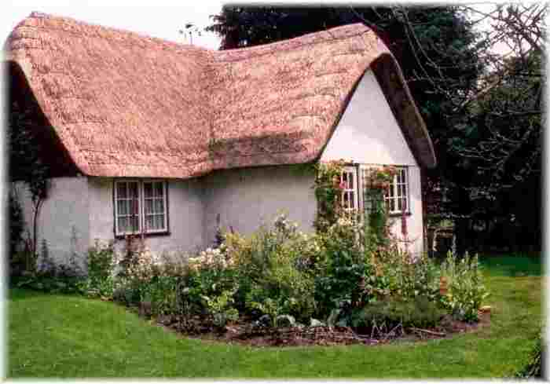
cottage

Slide 11
bungalow

Slide 12
terraced house

Slide 13
mansion

Slide 14
a block of flats

Slide 15
skyscraper

Slide 16
caravan

Slide 17
castle

Slide 18
A Typical British House

Slide 19
Castles of Britain

Slide 20
Remember the words
date back
fortress
spooky
ghost
medieval
tower
view
raven
volcano
masterpiece
a. шедевр
b. башня
c. относиться к …
d. ворон
e. вид
f. средневековый
g. вулкан
h. жуткий
i. призрак
j. крепость

Slide 21
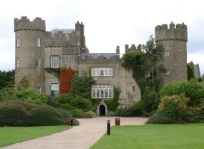
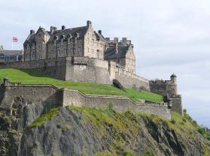
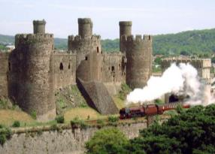
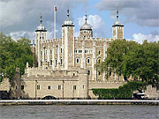
Journey route
Malahide Castle
Edinburgh Castle
Conwy Castle
Tower of London

Slide 22
Homes of Future

Slide 23
Circle the best words to complete these sentences.
1.In the first house shown in the video, the shower water is heated by electricity / wind energy / solar energy .
2. These houses are experimental / for sale / real people’s homes .
3.The technology in these houses helps them make more efficient use of energy / water / space compared to ordinary houses.
4. There’s a card scanner / fingerprint scanner / retina scanner to open the door.
5. When it’s hot, the windows / curtains / shutters close automatically.
6. The chair also contains books / food and drink / toys .

Slide 24
What kind of homes will we live in the future? What kind of technology will we have?
1…….. I would love a self-cleaning house 2…….. I'd like an eco-house 3…….. I'd like a front door 4…….. I'd like a TV in each room 5…….. I'd like a robot chef 6…….. I would love a bed | a. that could cook all my meals for me. b. so I could watch the football everywhere. c. that does all the housework for me. d. with a fingerprint scanner for security. e. that automatically makes itself every morning. f. that uses renewable energy.

