Slide 1
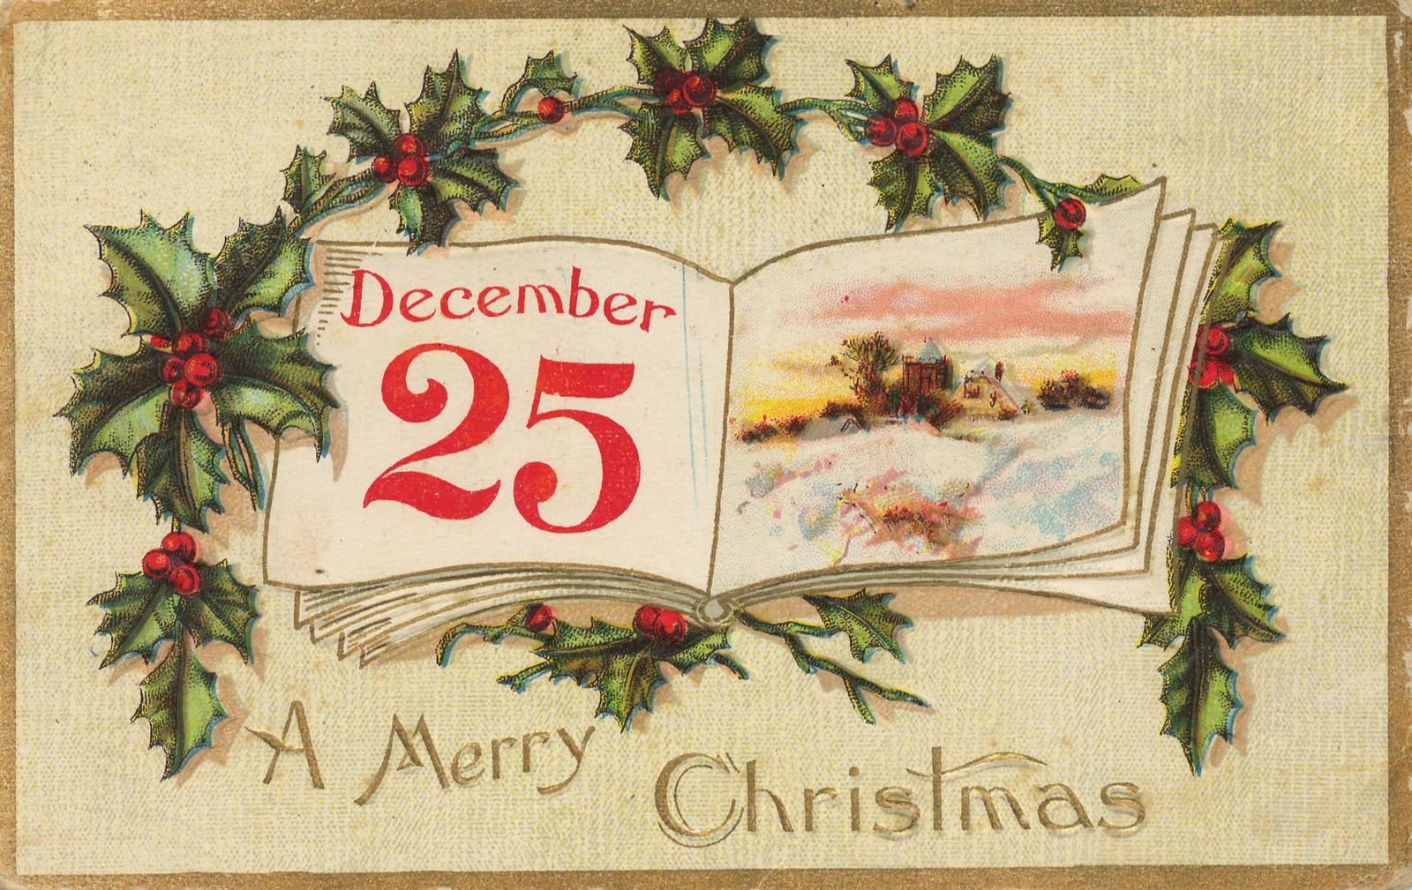
Захарьина Ольга Валерьевна, учитель английского языка МБОУ "Общеобразовательный лицей №17"г. Северодвинск Архангельской области
2015

Slide 2
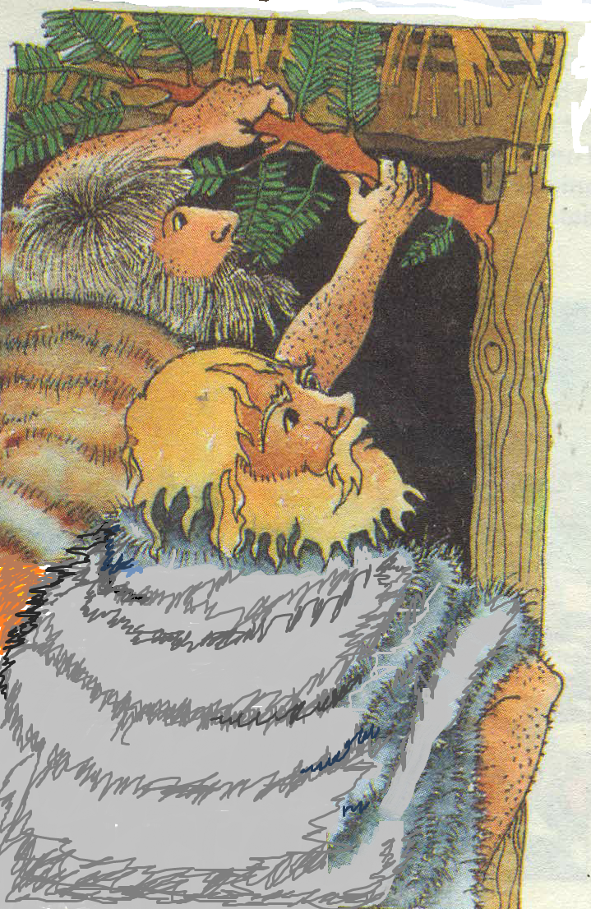
4,000 years ago
people hung
evergreen
branches on
their houses to
encourage the
seeds to grow
in spring.

Slide 3
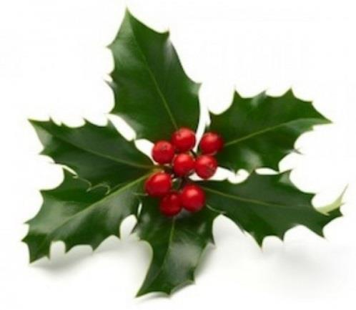
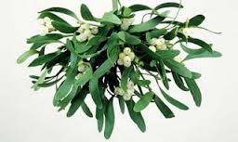
Holly
Mistletoe

Slide 4
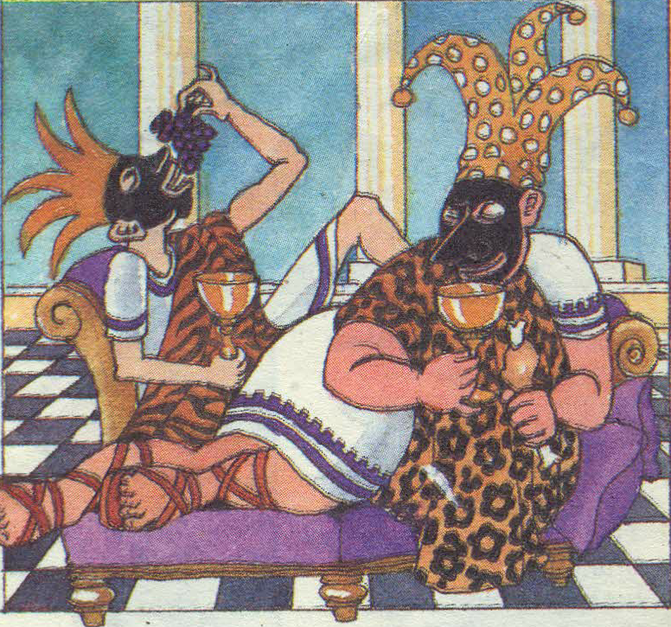
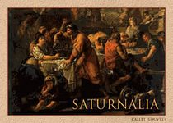
Where do Christmas traditions
come from?
Roman Empire
Saturnalia

Slide 5
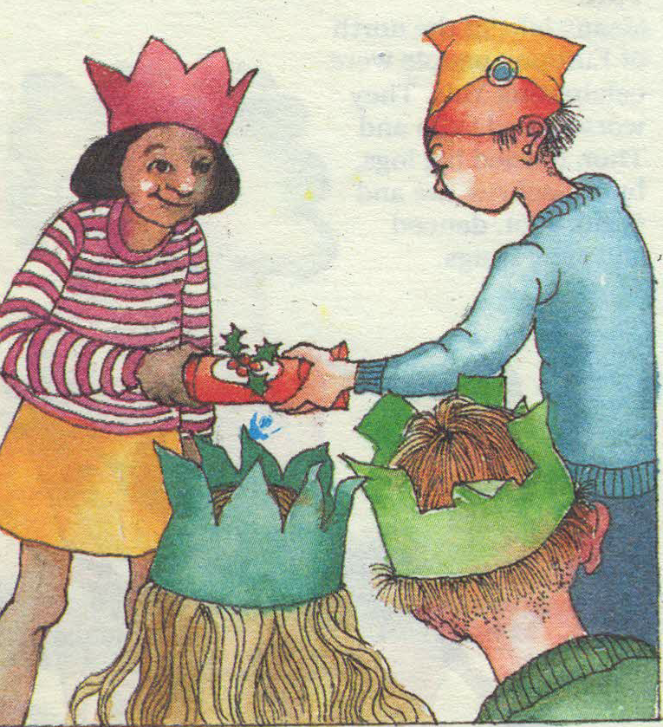

Slide 6
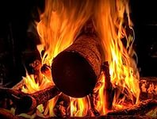
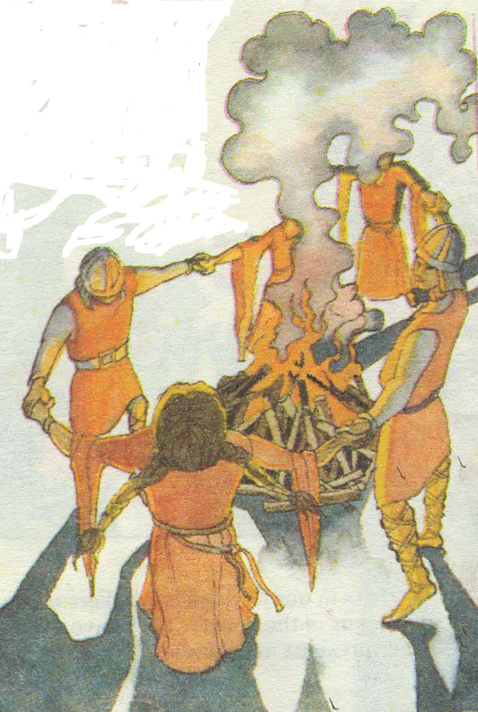
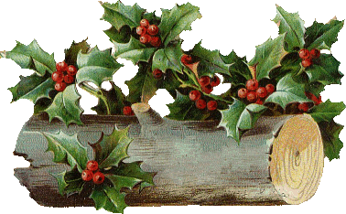
North of Europe
Yule

Slide 7
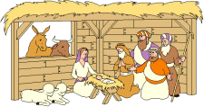
Christ’s Mass - a traditional church
service at which people give praise to God

Slide 8
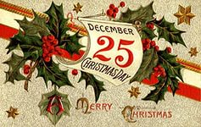
When was Jesus Christ born?
Great Britain
Russia

Slide 9
