Slide 1

CINEMA

Slide 2


Cinema Quiz
Is cinema a popular art nowadays?

Slide 3
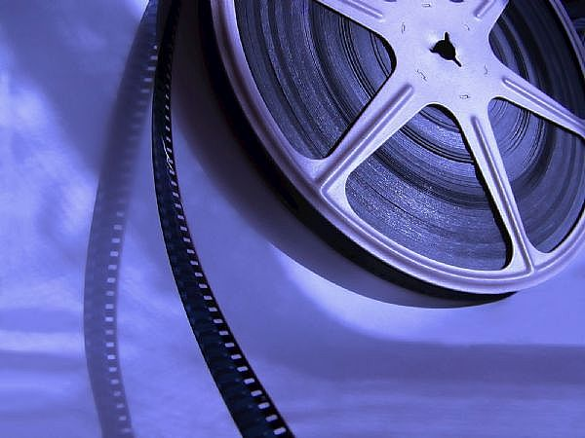
Cinema Quiz
When was cinema born?
It was born at the end of the 19th century

Slide 4
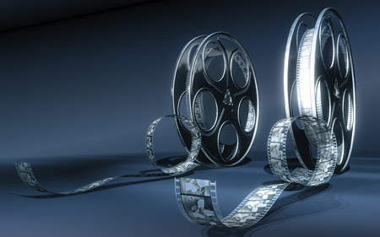
Cinema Quiz
Who showed the first movies to the public?
The Lumiere Brothers

Slide 5
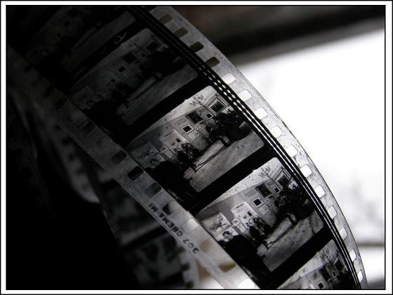
Cinema Quiz
Who made the first film in which actors sang and spoke?
Warner Brothers in Hollywood

Slide 6
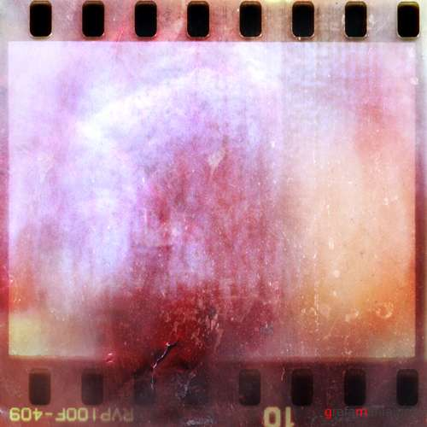
Kinds of films
Ready?
Here we go!!!
A musical
A horror
A fantasy
A comedy
A drama
A cartoon
A thriller
A historical film

Slide 7
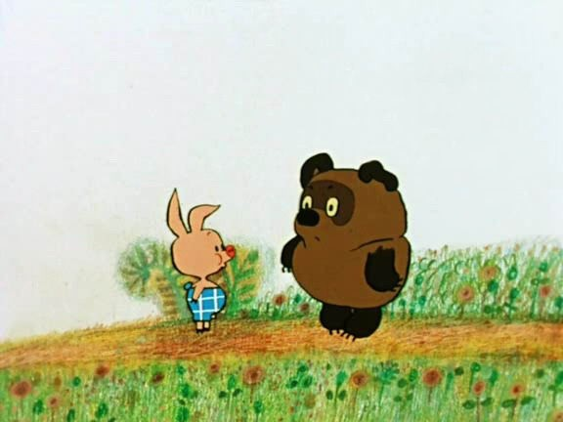

Slide 8
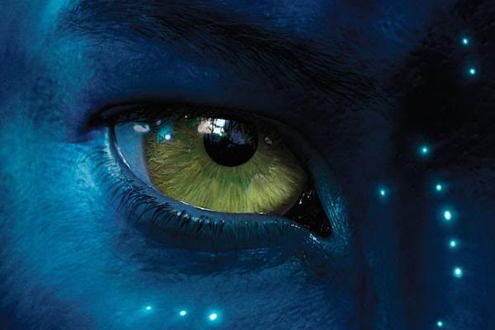

Slide 9
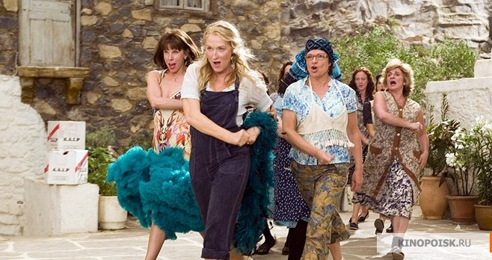

Slide 10
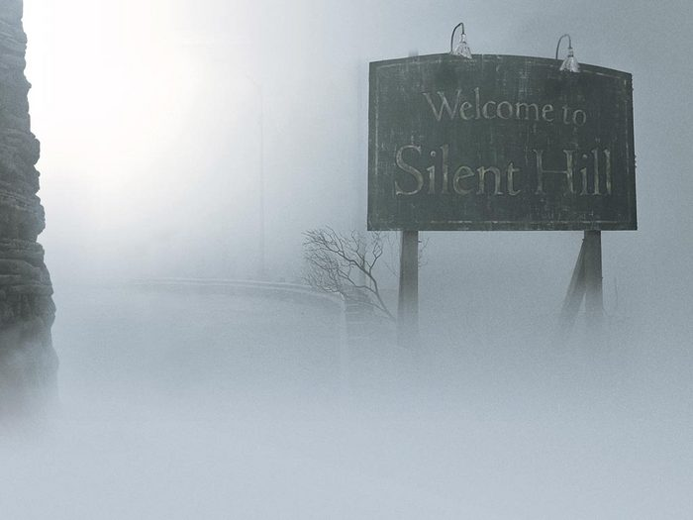

Slide 11
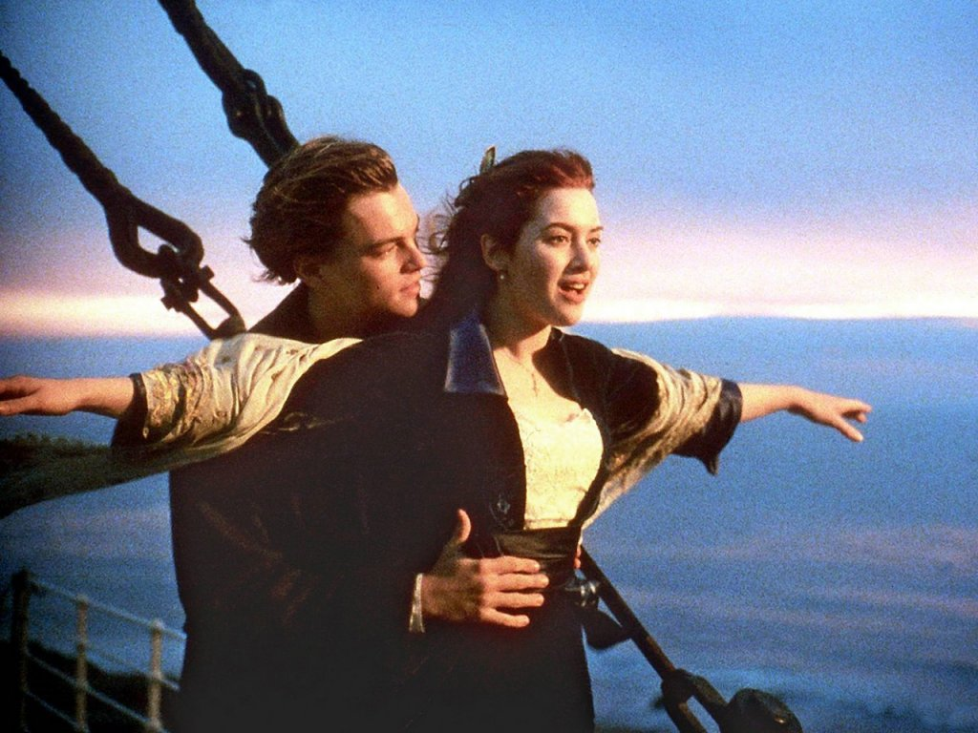

Slide 12
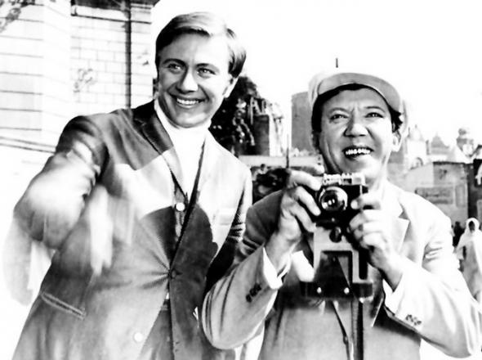

Slide 13
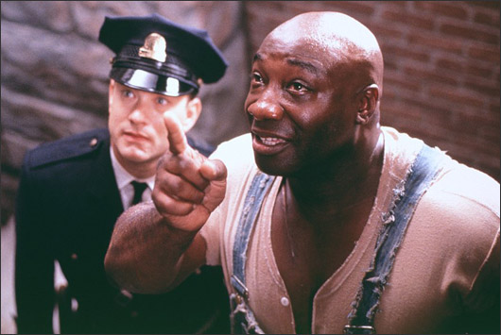

Slide 14
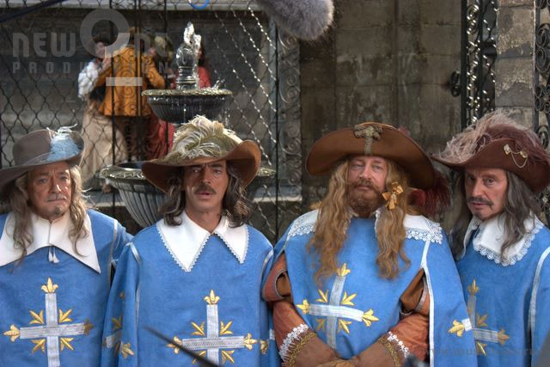

Slide 15
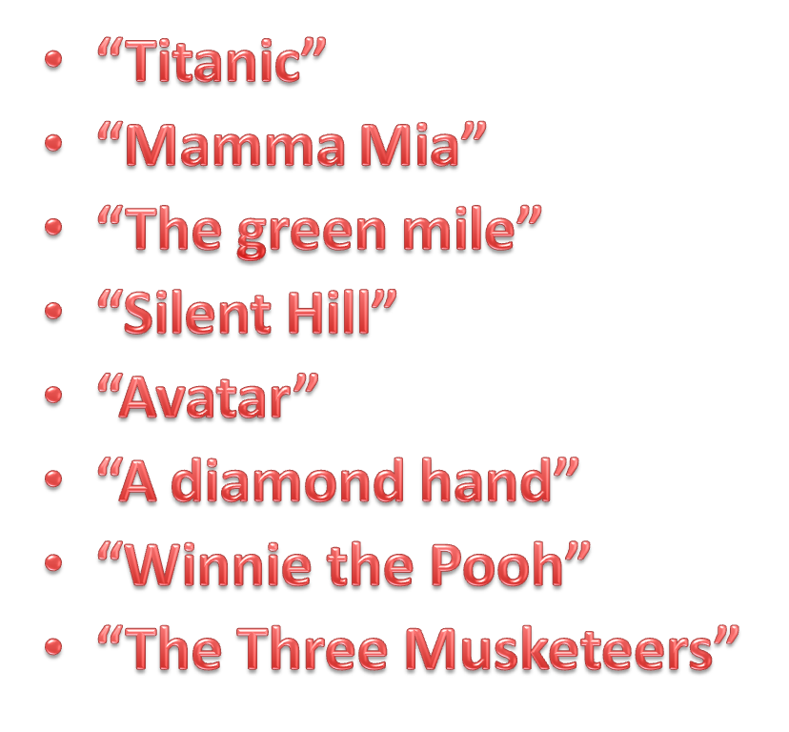
Match the films with their kinds.
“Titanic”
“Mamma Mia”
“The green mile”
“Silent Hill”
“Avatar”
“A diamond hand”
“Winnie the Pooh”
“The Three Musketeers”
A cartoon
A thriller
A comedy
A historical film
A musical
A drama
A horror
A fantasy

Slide 16
Match these films with their types
The Green Mile
Avatar
Titanic
Silent Hill
Winnie the Pooh
Mamma Mia
A diamond hand
The Three Musketeers
A thriller
A fantasy
A drama
A horror
A cartoon
A musical
A comedy
A historical film

Slide 17
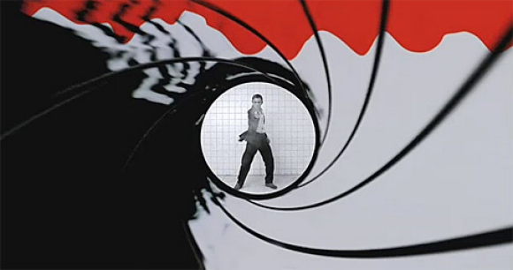
Cinema will never die…

