Slide 1
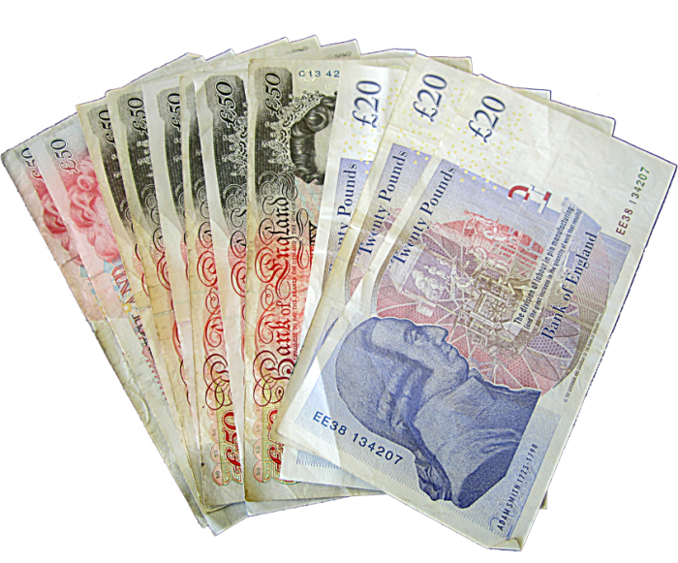
Shopping
and
Money

Slide 2
Do you like shopping?
What famous shops in St. Petersburg
do you know?
What is shopping for you?
What kinds of shops do you know?
Why do people need money?

Slide 3
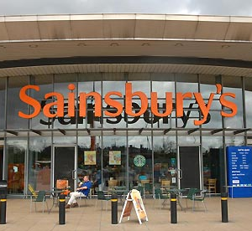
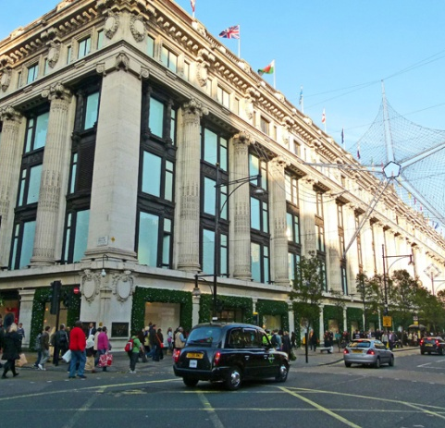
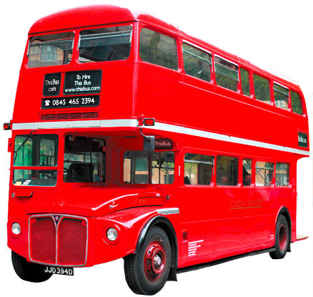
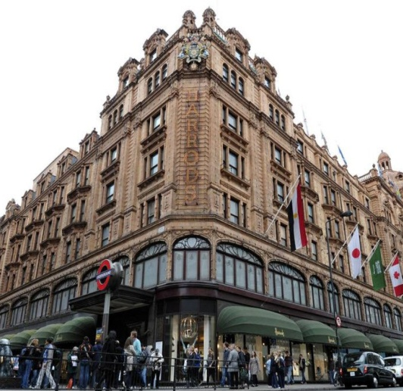
Liberty
Foyles
4
3
Sainsbury’s
5
LET’S GO
SHOPPING!
2
Selfridges
1
Harrods

Slide 4
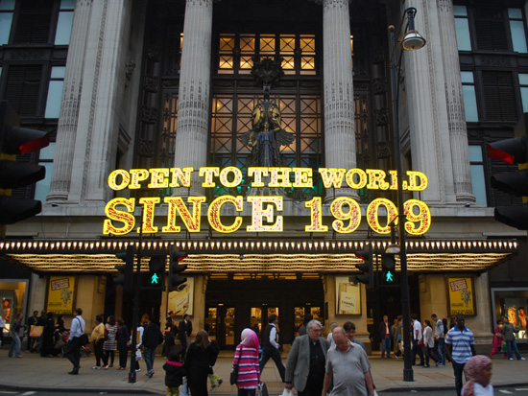
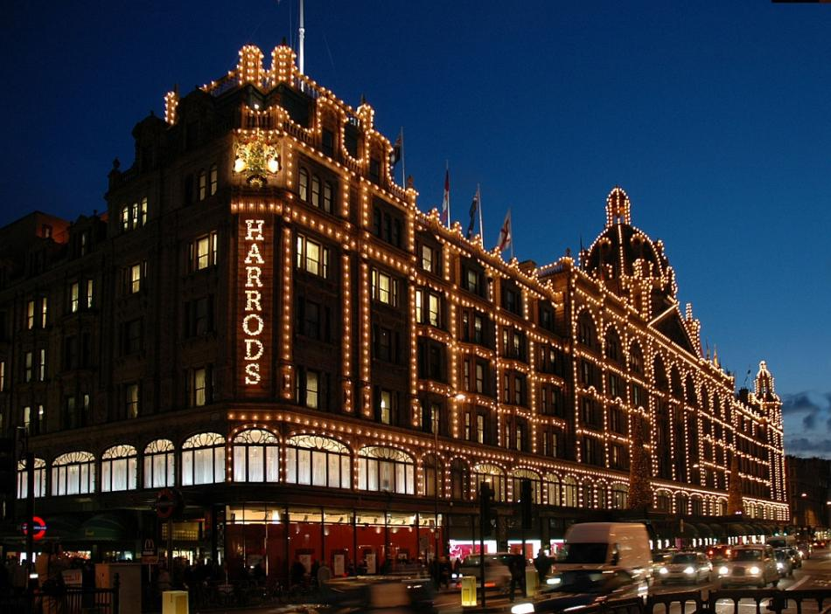
Harrods is the most famous London’s department store. Harrods has about 230 department stores, among them 16 food stores and 34 fashion clothes departments. The store runs a library, has a bank, offers sightseeing tours, and it has even a kennel for customers’ dogs. Harrods is not just a department store, it is a popular tourist destination. Everyday more than 50 000 customers visit Harrods.
Selfridges is one of the best places to visit in London for its stylish mix of fashion, furniture, food and beauty. Located in Oxford Street, Selfridges is the ultimate shopping experience and the destination for all the latest in the world of fashion. It was opened on March 15, 1909 and was designed as a department store from the beginning. Its founder, Harry Gordon Selfridge, boasted that he "made the store the third biggest attraction for sightseers in London," next to Buckingham Palace and the Tower of London.

Slide 5
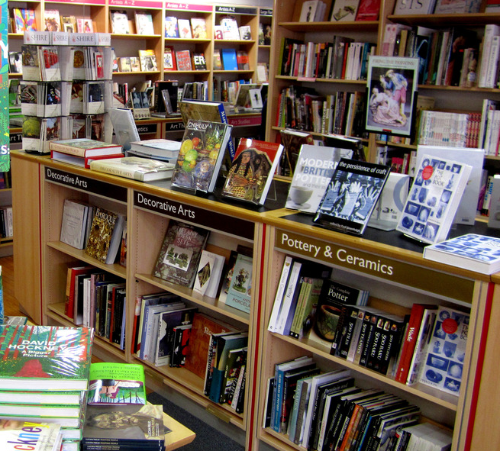
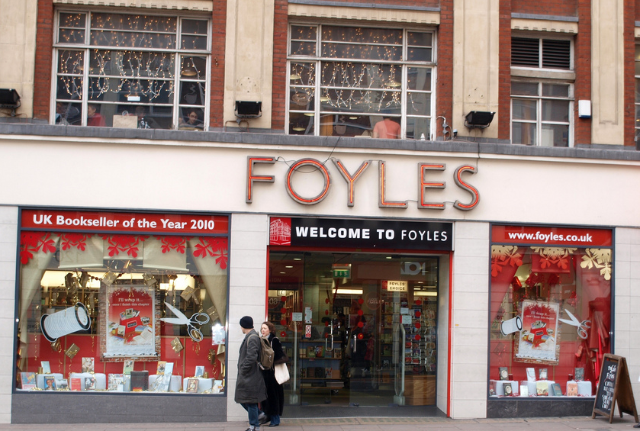
Foyles is one of London's most famous bookshops. It has five floors crammed with every kind of book imaginable. The store has been on Charing Cross Road since 1906 and still stocks the UK's largest range of books. Shoppers can also relax and listen to music in Ray's Jazz Café or visit the art gallery.
Liberty, located in Regent Street, is the region's top shopping destination. It was first built in 1968 on land known as 'Liberty'. There are over 100 top name shops, including a wide range of fashion, lifestyle retailers and independent names. The Liberty also hosts a variety of exciting events throughout the year.

Slide 6
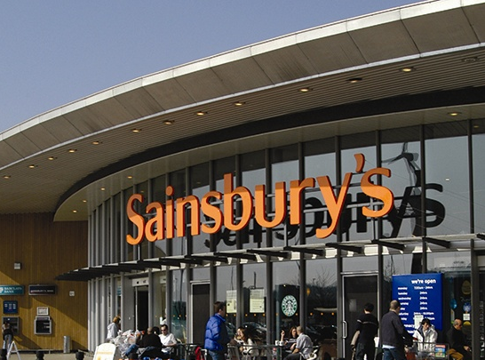
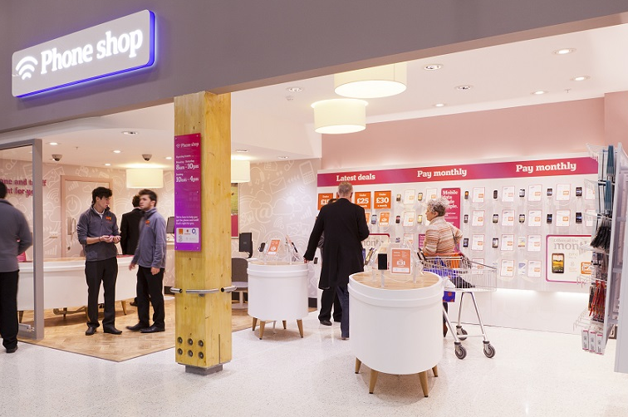
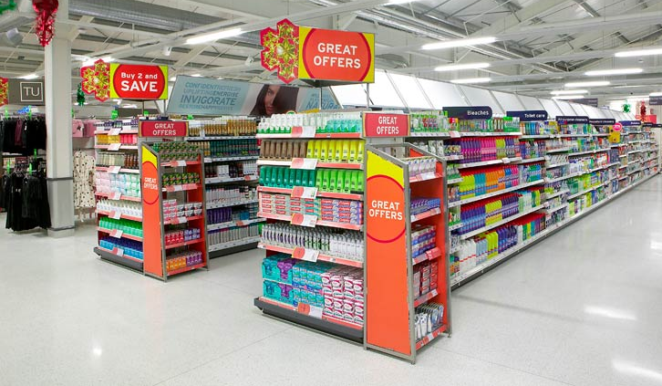
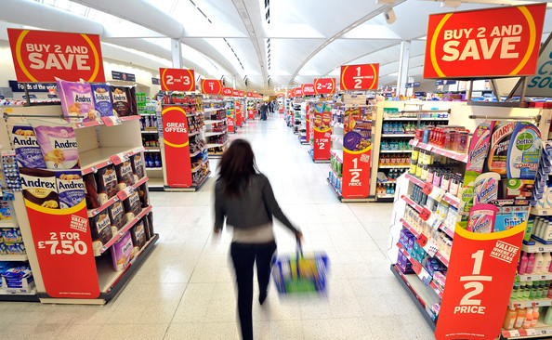
Sainsbury´s is one of the oldest shops with rich history in the city of London. It opened its first store in 1869 and, slowly, became one of the city´s most important supermarkets. It is open 24 hours. This store has everything necessary. You can visit the store at any time and find exactly what you need: from food stuffs to computer games as well as clothes and technology. If your camera´s batteries have run out, Sainsbury´s will sort you out and, if you´re hungry when everything else is closed, this is definitely the place to go.

Slide 7
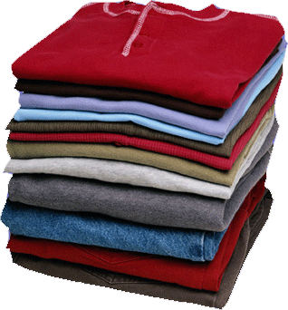
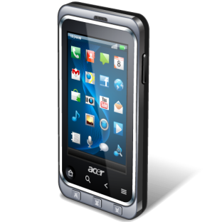
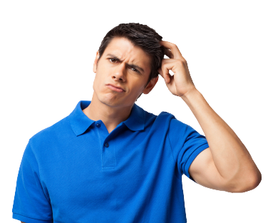
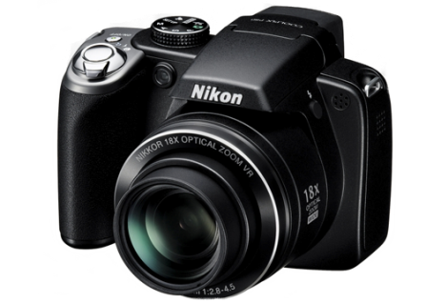
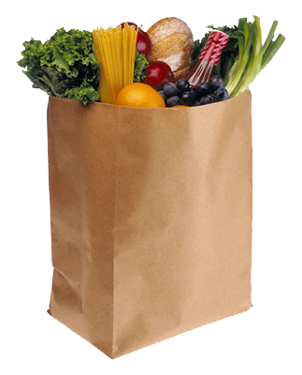
In a few weeks my friend Mike is going to England and of course he will do shopping. Please give him advise what shop he should visit to buy:
1) a camera 2) clothes 3) food and drinks 4) bestsellers and popular books
5) a mobile phone
E.G. You can buy a new camera at Sainsbury’s. There is a technology department store.

Slide 8
Let us have a break
and buy some goods!

Slide 9
Read the text
and think of the questions
What do you associate money with?
What kinds of shops are mentioned in the text?
What goods can you buy: at the baker’s, at the green grocer’s, at the confectionary shops?
How can you pay for goods?

Slide 10
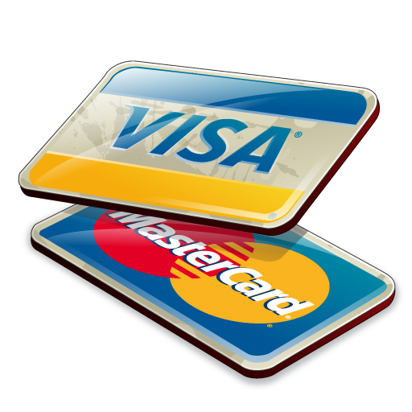
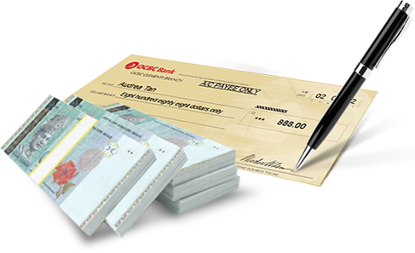
Money is not only bills and coins.
Why and when do we use these types of money?
Choose the type of money for each situation and explain you choice:
-shopping in the supermarket
-paying for your electricity bill
-shopping abroad
-making a new hair style at the beauty salon
-visit to the dentist

Slide 11
Your home task is to
retell the text

Slide 12
Thank you
for the
good job!

