Slide 1
WHAT MUSICAL INSTRUMENT IS IT?

Slide 2
BAGPIPE

Slide 3
WHAT MUSICAL INSTRUMENT IS IT?

Slide 4
V I O L I N

Slide 5
WHAT MUSICAL INSTRUMENT IS IT?

Slide 6
T R U M P E T

Slide 7
WHAT MUSICAL INSTRUMENT IS IT?

Slide 8
D R U M S

Slide 9
DO YOU KNOW THEIR NAMES?

Slide 10
JOHN LENNON PAUL МC CARTNEY RINGO STARR GEORGE HARRISON

Slide 11
DO YOU KNOW THEIR NAMES?

Slide 12
DAVE GAHAN MARTIN GORE ANDY FLETCHER VINCE CLARKE

Slide 13
THE KING OF ROCK-&-ROLL! HIS NAME…

Slide 14
E L V I S P R E S L E Y

Slide 15
WHO IS SINGING THIS SONG? “H A N D S U P”

Slide 16
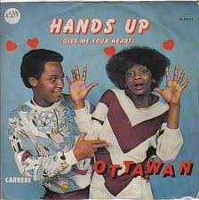
O T T A V A N

Slide 17
WHO IS SINGING THIS SONG? “YOU ARE MY HEART, YOU ARE MY SOUL”.

Slide 18
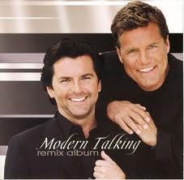
M O D E R N T A L K I N G

Slide 19
WHO IS SINGING THIS SONG? DON’T WORRY BE HAPPY!

Slide 20
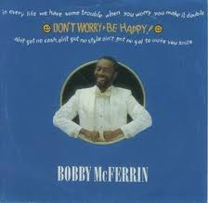
BOBBY MC FERRIN

Slide 21
WHO IS SINGING THIS SONG? “I WANNA BE LOVED BY YOU”

Slide 22
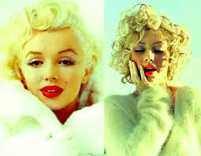
M E R I L Y N M O N R O E

Slide 23
WHO IS SINGING THIS SONG? “B I L L I E J E A N”

Slide 24
MICHAEL JACKSON

Slide 25
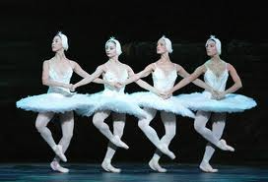
THIS BALLET WAS COMPOSED BY TCHAIKOVSKY.

Slide 26
S W A N L A K E

Slide 27
WHO IS SINGING THIS SONG? “VENUS”

Slide 28
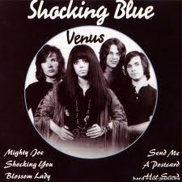
“SHOCKING BLUE”

Slide 29
THIS SOUNDTRACK IS FROM THE MOVIE…

Slide 30
A G E N T 007. J A M E S B O N D

Slide 31
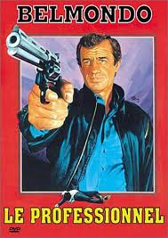
THIS SOUNDTRACK IS FROM THE MOVIE “ PROFESSIONAL “ WNO IS THE COMPOSER?

Slide 32
E N N I O M O R R I C O N E

