Slide 1
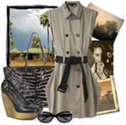
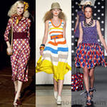
CLOTHES

Slide 3
The clothes rhyme
Socks and shoes and jeans and shirt
Trousers, coat and blouse and skirt

Slide 4
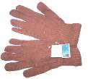
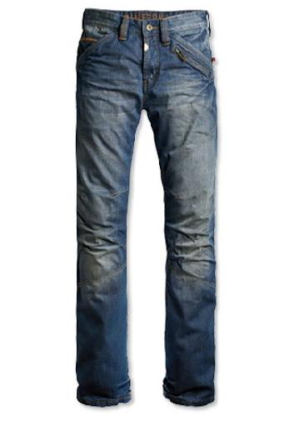
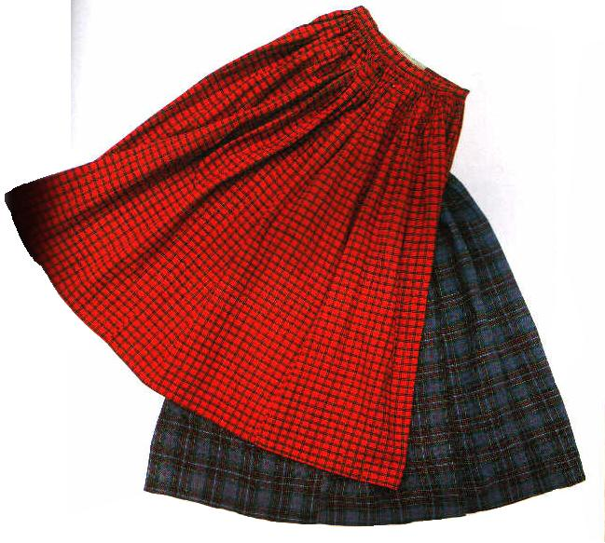
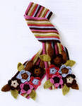
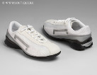
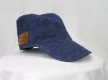
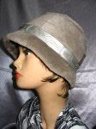
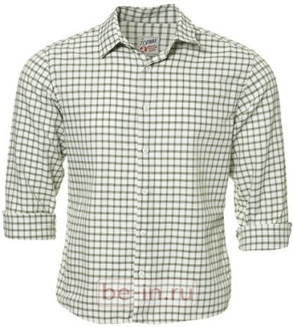
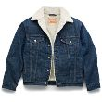
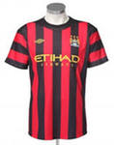
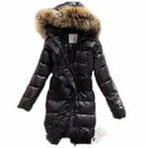
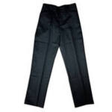
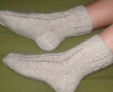
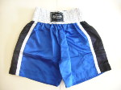
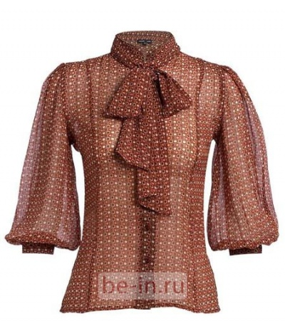
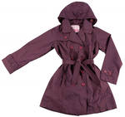
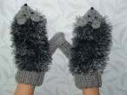
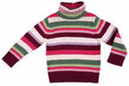
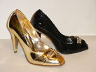
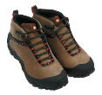

Slide 5
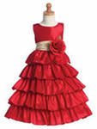

Slide 6
My favourite clothes are …

Slide 7
What do you wear on your head? I wear …

Slide 8
What do you wear on your feet? I wear …

Slide 9
What do you wear on your hands? I wear …

Slide 10
Let`s sing a song.
A hat and a cap
A cap and a hat
Boots and shoes
Shoes and boots
Gloves and mittens
Mittens and gloves

Slide 11
Ann has a …. …. and a … … on .
Ted has … … and a … … on.

Slide 12
Find the differences

Slide 13
Alice and Billy visited Baby Elephant yesterday. Listen and colour their clothes.

Slide 14
Alice had a yellow dress on. Billy had blue jeans and red T-shirt on.

Slide 15
I am a clown !

Slide 16
Shopping for clothes

Slide 17
In the shop
A: Can I … you?
C: Show me the …, please.
A: Here … … .
C: I like the … . How much … …?
A: … pounds.
C: Thank you. Bye.
A: …

Slide 18
Dress the doll
1) Put on grey trousers. 2) Put on grey jeans.
Put on brown boots. Put on purple sweater.
Put on a new coat. Put on a new jacket.
Put on a long scarf. Put on blue trainers.
Put on a blue warm hat. Put on an orange cap.
3) Put on a nice shirt.
Put on new boots.
Put on a skirt.
Put on a blue jacket.
Put on a green hat.

Slide 19
HOMEWORK:
Make a crossword on the theme
“Clothes”

Slide 20
Thank you for the lesson!
GOODBYE !

