Slide 1
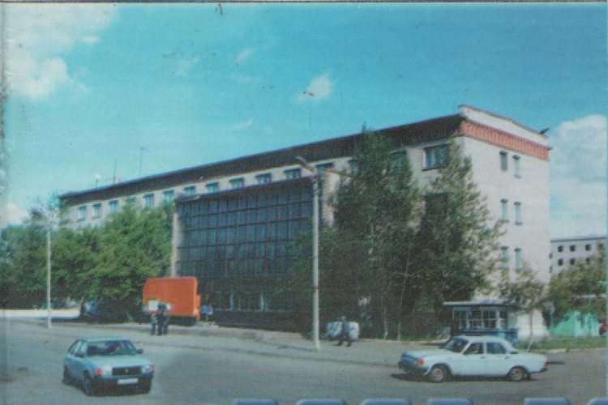
At the Post Office

Slide 2
Find the words on our topic, these pictures will help you!
l | e | t | t | e | r | b | o | x
s | n | a | b | s | d | e | f | p
t | v | f | p | a | p | e | r | o
a | e | a | d | d | r | e | s | s
m | l | e | t | t | e | r | l | t
p | o | s | t | c | a | r | d | m
h | p | o | s | t | e | r | k | a
j | e | i | y | w | d | d | e | n

Slide 3
What is this?
1)Terelt – 2) Srepot – _____ 3) Tpasm – _____ 4) Aprep – _____ 5) Masotpn – _____

Slide 4
– Let’s check your answers:
Letter
Poster
Stamp
Paper
Postman

Slide 5
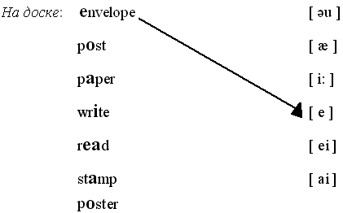
Match the words and the sounds

Slide 6
1
 |  | 2
 | 3
 |  | 4
5
 | 6

Slide 7
Заполните кроссворд, и в выделенных клетках вы прочитаете слово. Какие два значения оно имеет?
1. Конверт 2. Ручка 3. Открытка 4. Марка 5. Бумага 6. Улица

Slide 8
Answer Jim’s letter!
18 March
Dear pen friends,
My name is Jim. My surname is Brown.
I am 9. I live in London. My birthday is on the 22nd of March. I would like to have postcards for my birthday.
Please write back.
Yours,
Jim.

Slide 9
Write a letter to Jim!
Dear pen friend,
My name is …………
My birthday is on the ………..
I’ve got a ………..
I like to ………..
I like summer, because I can………..in summer.

Slide 10
Make up and write the sentences
а) writes, He, letters, friends, to, his – ______________________________
b) like, We, get, to, letters. – ______________________________
с) the, Where, are, envelopes? – ______________________________
d) are, you, Where, from? –

Slide 11
Fill in:
write, address, paper, post office, envelope, stamp, post, letterbox.
Take clean ……………………………... and a pen.
Sit down and ……………………………... a letter.
Put the letter into an …………………………….. .
Put a ……………………………... on the envelope.
Write an …………………………. on the envelope.
Take your letter and go to the ………………… .
Find a ……………..... and ………..…… the letter.

Slide 12
Thank you! Good bye!

