Slide 2
Arts
literature
cinema
dancing
theatre
drawing
architecture
music
sculpture

Slide 3
Literature

Slide 4
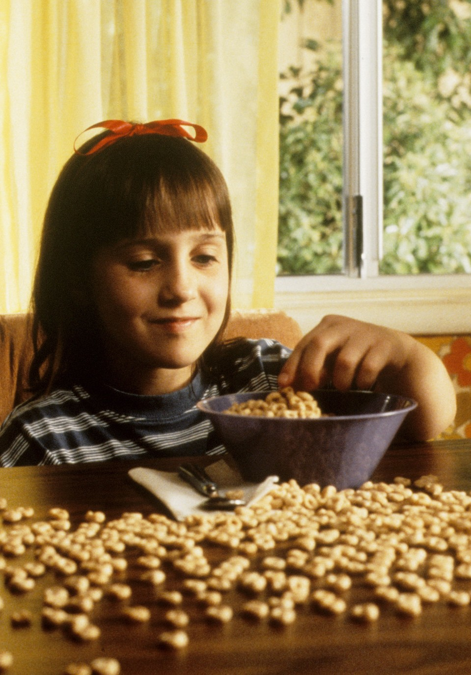
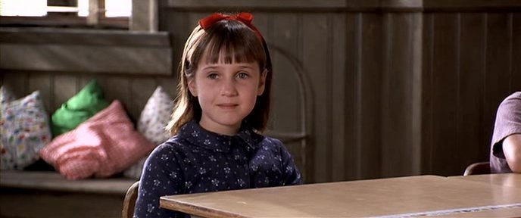
Matilda

Slide 5
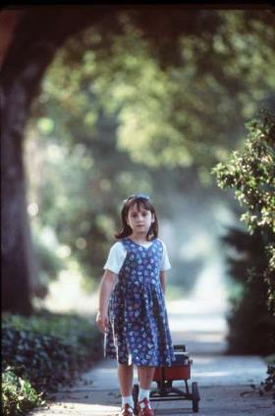
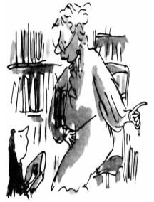
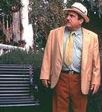
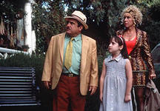

Slide 6
Watching TV is enough to become a well-informed and well-educated person

Slide 7
Write a short essay explaining your position. Organize it according to the plan:
Introduction
Arguments (2-3)
Conclusion
Write 100- 150 words (The following words will help you: I think, first of all, then, finally, to sum up, in conclusion)

