Slide 1
Education is the movement from the darkness to light.
(Alan Bloom, the US philosopher)

Slide 2
Schools around
the world

Slide 3
SCHOOL?
What comes to your mind when you here the word

Slide 4
Listening

Slide 5
Match the types of the schools with their
descriptions:
Boarding school a school for boys and girls
Single sex school a school students go for a
practical reason
Co-educational school a school for only boys or
girls
State school a school owned by the
government
Private school a school which students
live in during school term
A specialist school a school you usually have
to pay to go

Slide 6
There are some school rules which all pupils must follow. Which one are true for our school?
- Students wear school uniform.
- Facilities and equipment are good.
- The teachers are strict.
- There is a selection of unusual subjects to choose from.
- Students sit a lot of exams.
- Most students take part in extra- curricular activities.
- Students get a lot of homework.

Slide 7
Work in groups

Slide 8
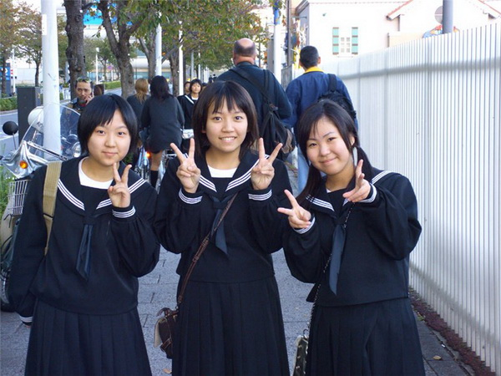
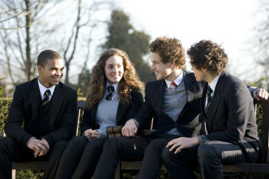
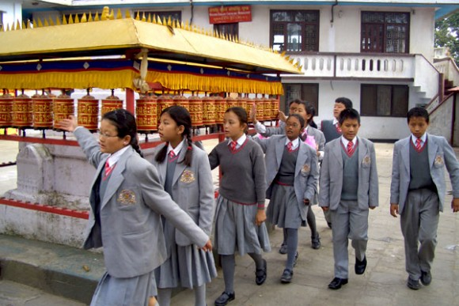
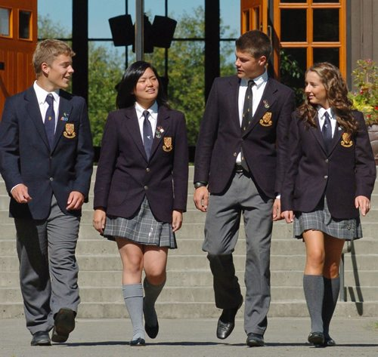
China
The USA
Nepal
The UK

Slide 9
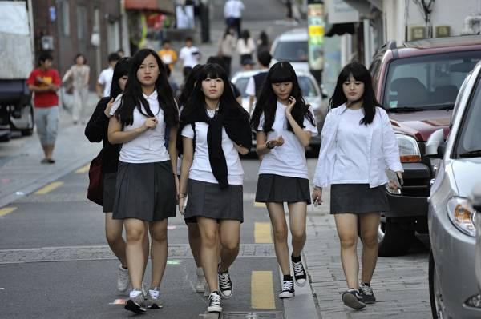
Korea
Japan

Slide 10
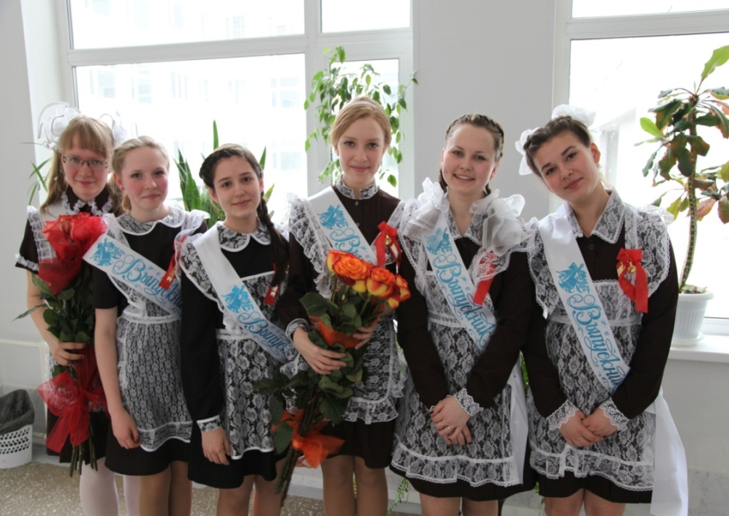
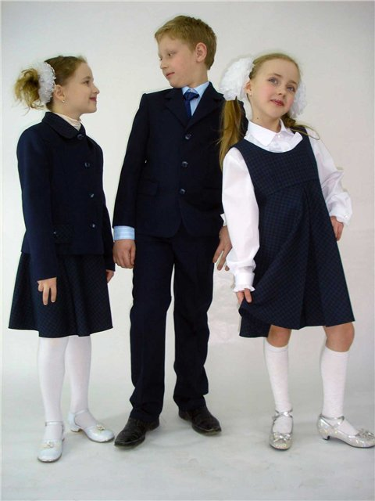
School №4
Russia

Slide 11
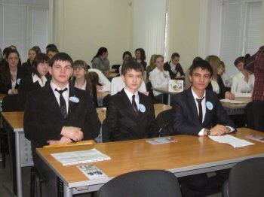
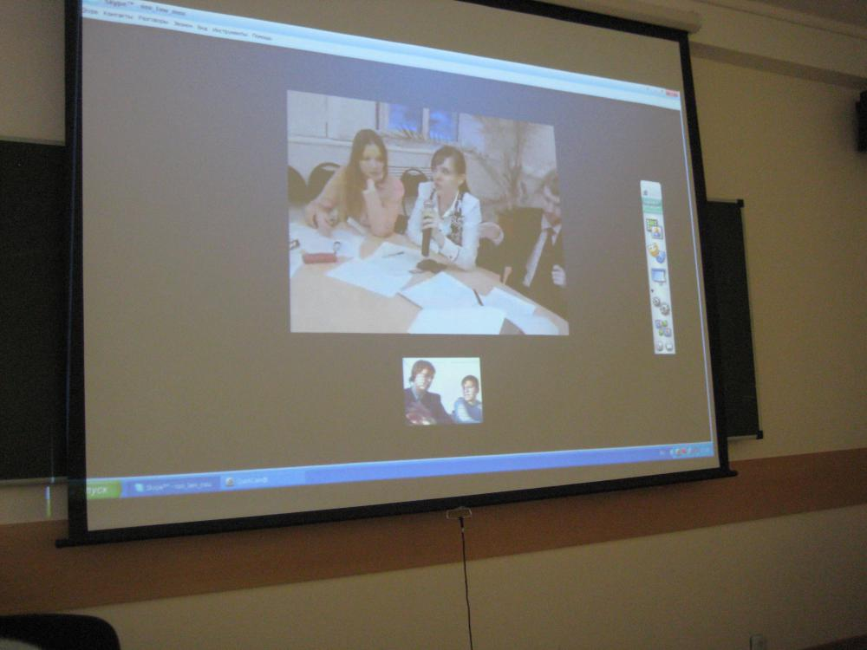
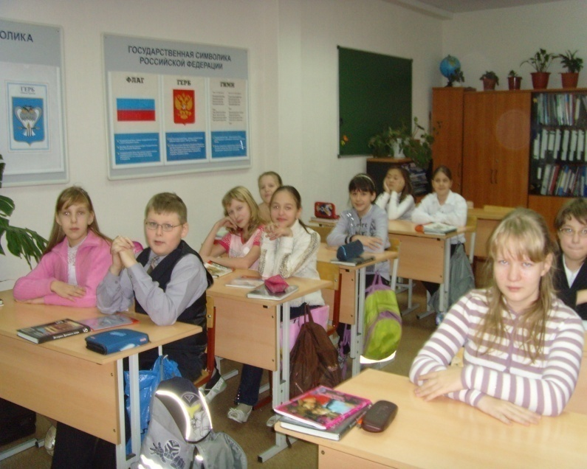
TV bridge
between the British and
Russian students

Slide 12
I’m happy
I’m in exellent mood
I’m sad
I’m a bit worried

Slide 13
GOOD LUCK!

