Slide 1
Bob Dylan
By
Valentin Morozov, Vadim Khammatov, Daniil Dudnikov, Miraziz Isazade

Slide 2
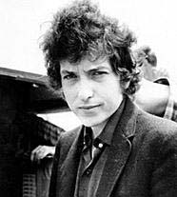
Factfile
Full name: Robert Allen Zimmerman
Nickname: Dylan Thomas
Date of birth: May 24, 1941
Place of birth:Duluth, Minn., U.S.
Began his musical career:
In the early 1960s he performed professionally in Greenwich Village coffeehouses and released albums

Slide 3
Factfile
His first musical success:
in 1965 and 1966
Songs: The landmark albums Highway 61 Revisited (1965) and Blonde on Blonde (1966) established him as a leading figure in rock music . Blood on the Tracks (1975), Time Out of Mind (1997) and Love and Theft (2001)

