Slide 1
You are welcome!
I am glad
to see you!

Slide 2
“WE ARE CADETS”

Slide 3
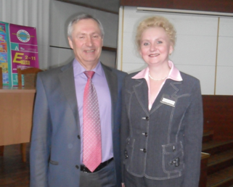
Зав. отделом АСУП
издательства «Просвещение»,
руководитель авторского коллектива
линии УМКС «English 2-11»,
кандидат педагогических наук, профессор
Кузовлев В.П.
«Иностранному языку научить нельзя,
иностранному языку можно только
научиться».

Slide 4
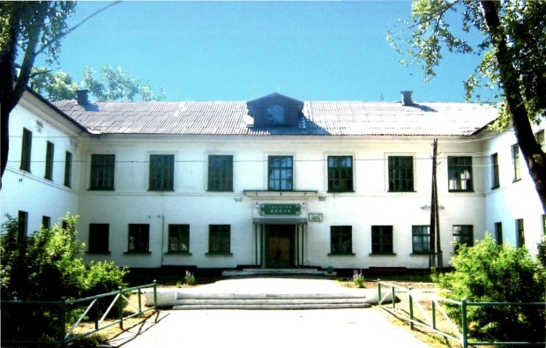
fghghjkkk
fghnjmk
activity
independence
ghjkkkkk
creativity
активность
самостоятельность
творчество

Slide 5
Read the words and find antonyms:
polite stupid
attentive coward
friendly evil
clever hate
kind inattentive
brave unfriendly
win impolite
love lose

Slide 6
Whom can we
call a cadet?
What person can be
called a real patriot?
What is Motherland
for you?
What can you say
about Russian Flag?

Slide 7
The National Flag of Russia
earth
sky
liberty

Slide 8
History of the
cadet movement
History of the
Armed Forces
Army close fight
Medical training
Drill training
Fire training
Physical training
Choreography and ballroom dancing
Choral singing
Etiquette
Tourism
Psychology of
communication
Safety of
life activity
Cadet disciplines

Slide 9
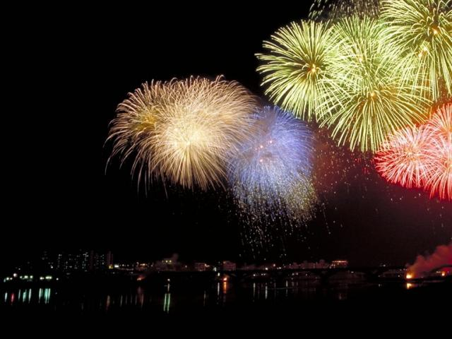
Action time!

Slide 10
What should / shouldn`t a real cadet do?
love school and respect teachers
bully classmates and fight with them
care about how he/she looks like
study well and go in for sport
be polite, helpful and honest
be lazy and boastful
keep his/her things in order
8) know the history of his/her country

Slide 11
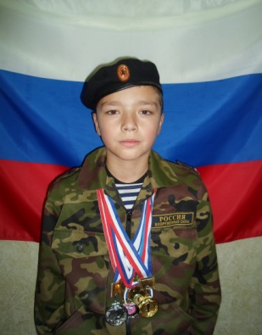
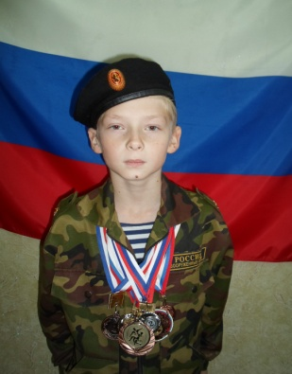
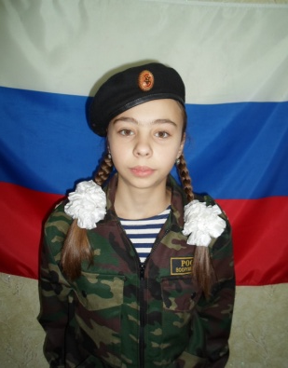
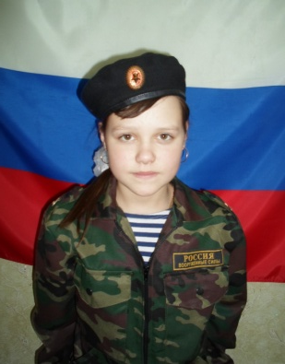
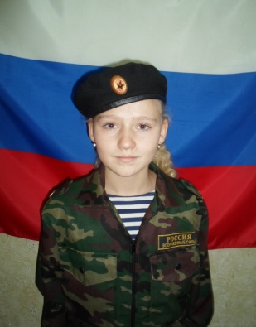
talkative
clever
sporty
helpful
friendly
honest
1
2
3
4
5
6
likes to chat with classmates and other people.
has different medals and prizes.
always tells the truth.
studies well and has excellent marks.
has a lot of friends and spends time with them.
can help to do homework or a test.
Pattern: Victoria Alexandrovna is bossy because she likes to give commands.

