Slide 1







FAMILY MATTERS

Slide 2
The aims:
To develop communication skills
To practise providing counter argumentation
3. To role-play debates

Slide 3

A HAPPY FAMILY

Slide 4
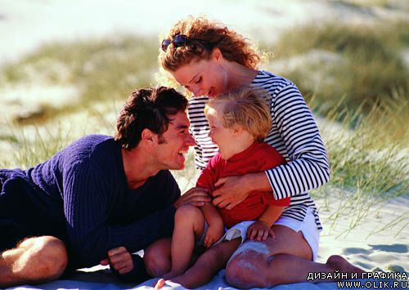
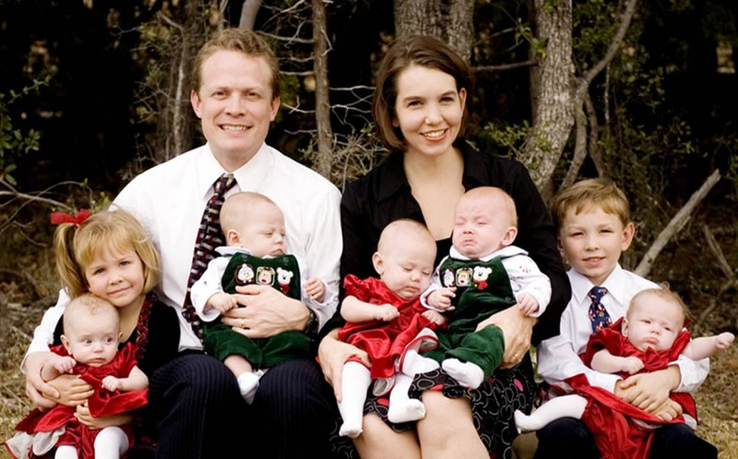
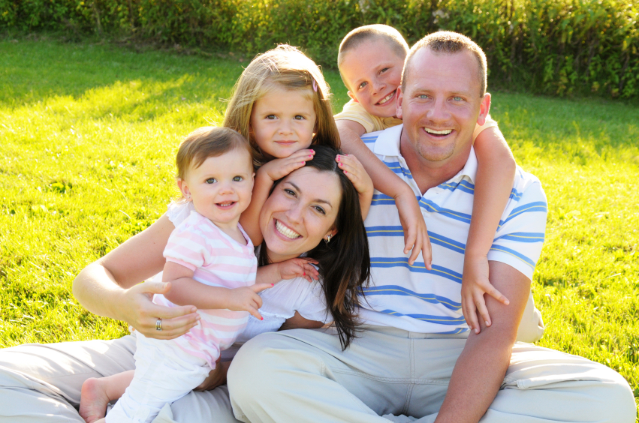
The ideal number of children in a family is …

Slide 5
It is better to be an only child in a family.

Slide 6
HOMETASK:
Watch the clip ‘Parenting: Fighting Siblings’ the link: www.youtube.com/watch/v=gku_4Yf-1Fk
Use some helpful advice given by the psychologist while writing a letter to your pen friend
Follow the exam format requirements

Slide 7
You have received a letter from your English-speaking pen friend Jason, who writes:
… My mother’s gone right off me since Rosie was born. She has never been a particularly attentive mother. But just lately I have been feeling emotionally deprived. How do you usually feel if your parents ignore you? Have you ever turned to a psychologist for advice? Which advice do you find helpful? …

