Slide 1
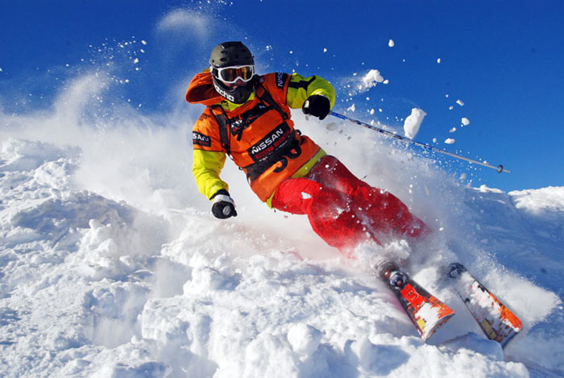
Tips for Those Who are Going to Mountain Ski Resort

Slide 2
My plan
1)Aim of the trip
2)Outfit
3)Equipment
4)Skiing or snowboarding lessons
5)Ski lift and ski pass
6)Orientation
7)Communication
9)Accidents
10)Conclusion

Slide 3
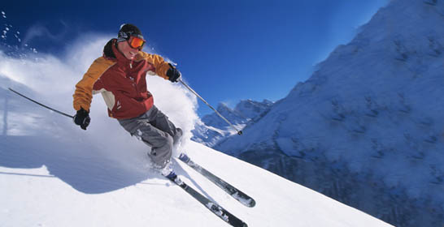
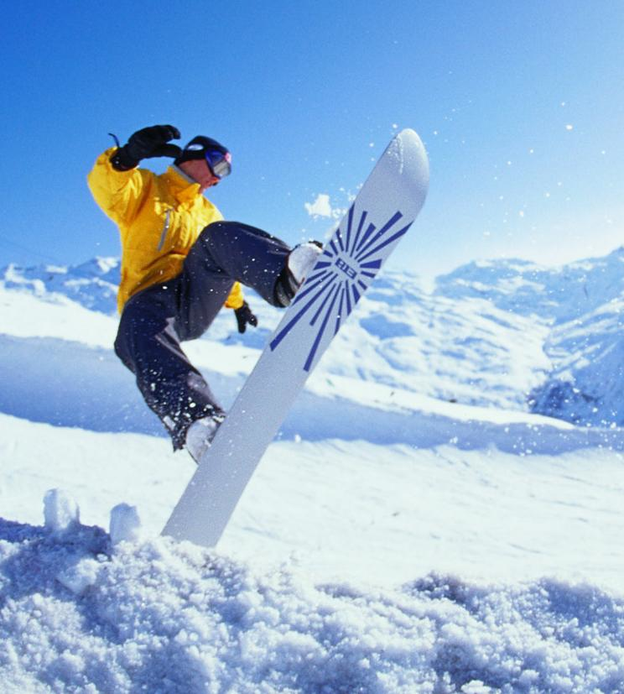
Aim of your trip
Would you like to go
skiing
snowboarding?
or
Or both?

Slide 4
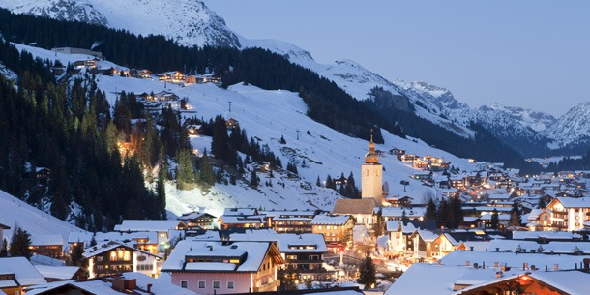
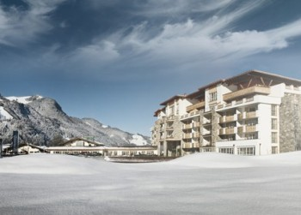
Would you like to stay
at a 5 star hotel
at a budget one?
or

Slide 5
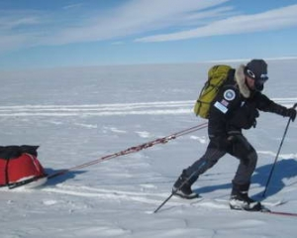
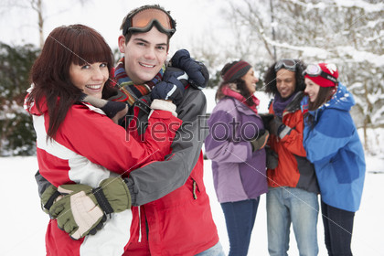
Would you like to go with
friends
or
alone?

Slide 6
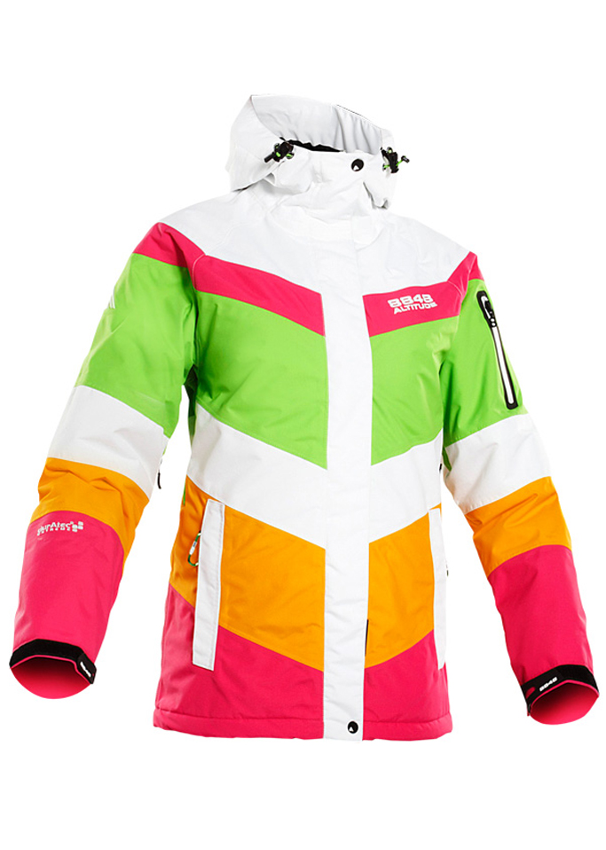
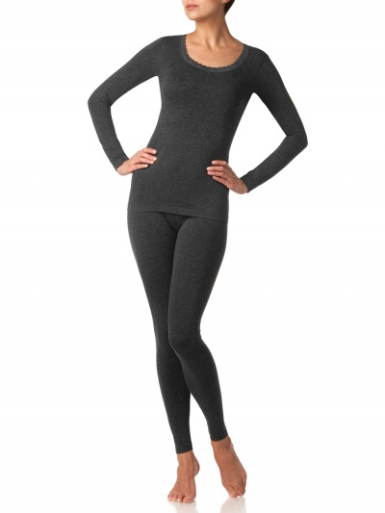
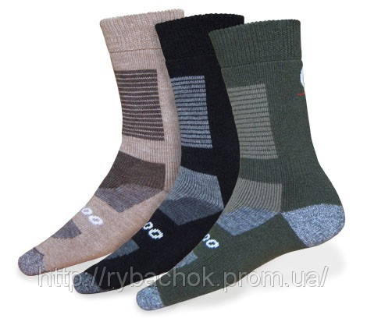
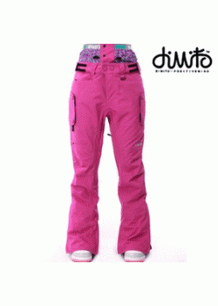
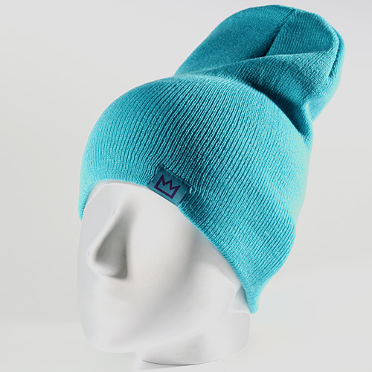
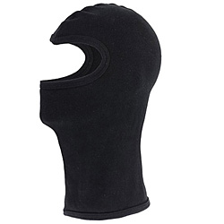
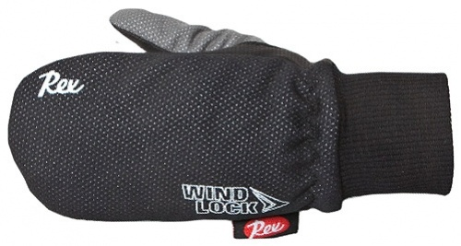
Outfit
It should consist of:
Ski pants
ski jacket
thermal underwear
Thermo socks
Ski gloves
Cap comforter
Ski cap

Slide 7
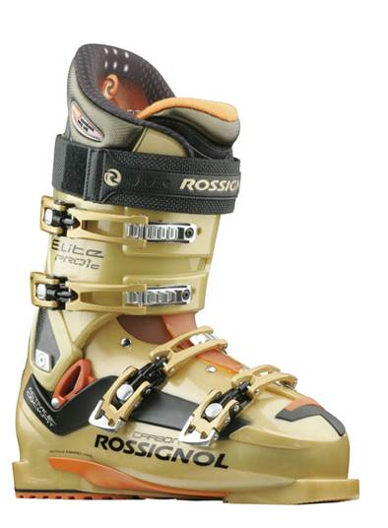
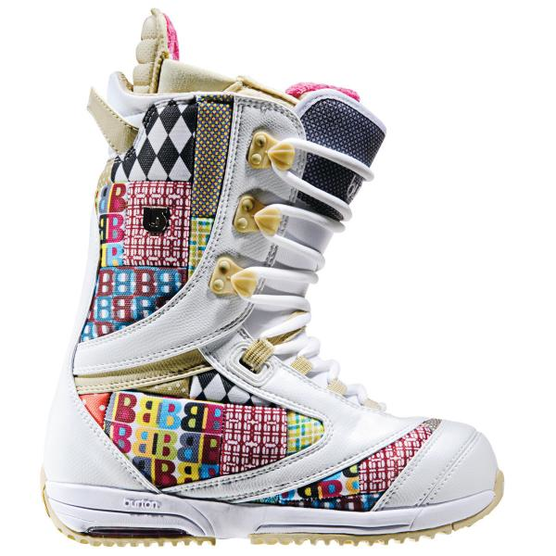
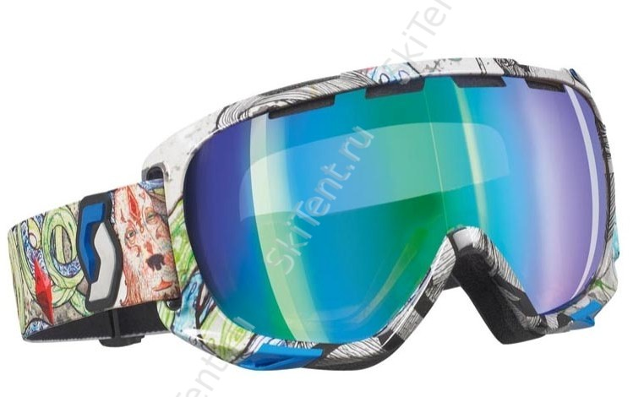
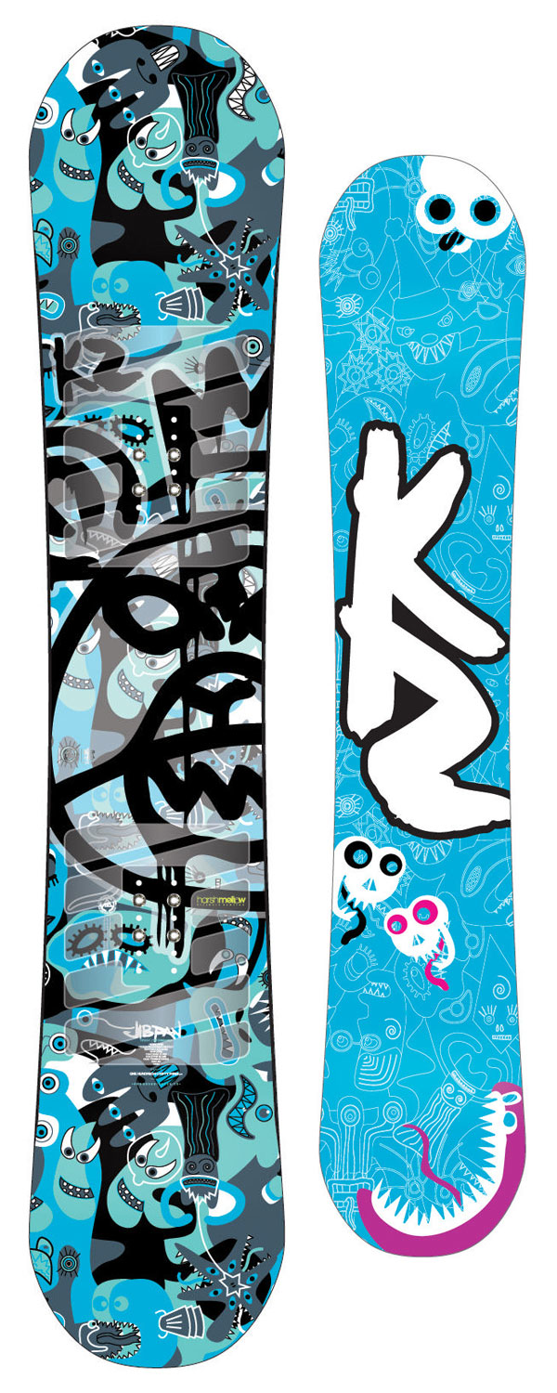
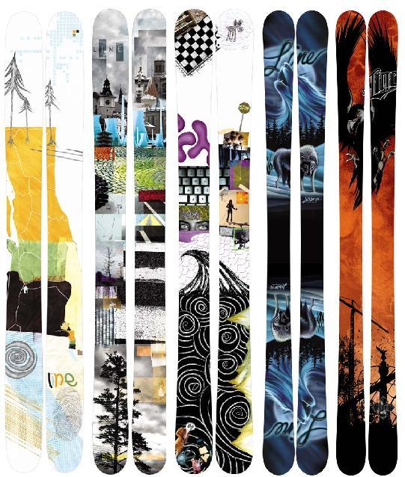
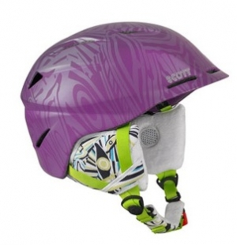
Equipment
Ski boots
Ski goggles
snowboarding boots
snowboard
Mountain ski
ski hamlet

Slide 8
Skiing or snowboarding lessons
You will require some ski lessons with the instructor
The instructor will teach you some special skills

Slide 9
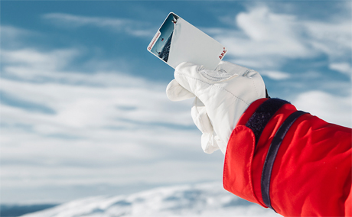
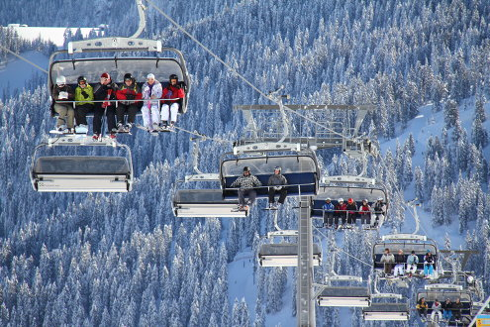
Ski lift and ski pass
Be very careful with a ski lift. Ask the assistants for help
You should buy a ski pass,without it you can’t use a ski lift

Slide 10
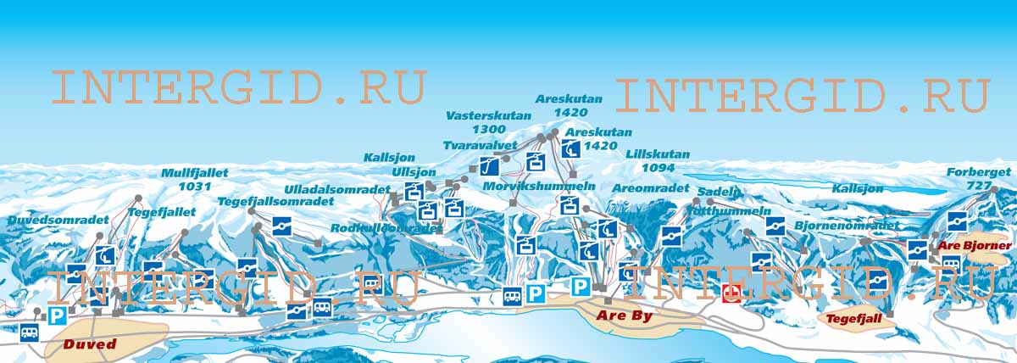
Orientation
Be sure which slope to chose
Don’t worry , look at the map.
Ask for help

Slide 11
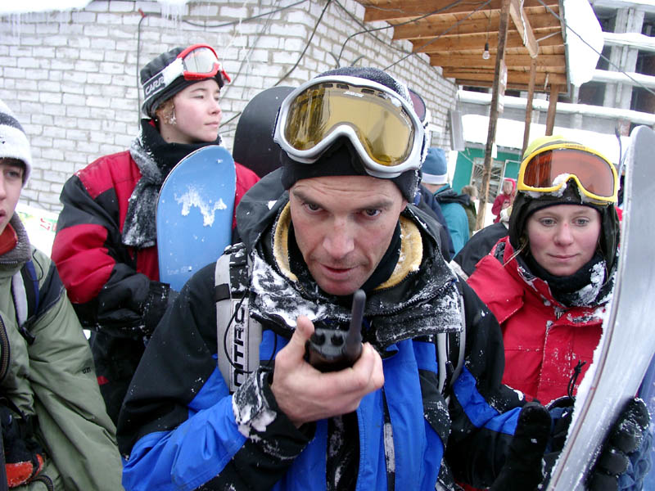
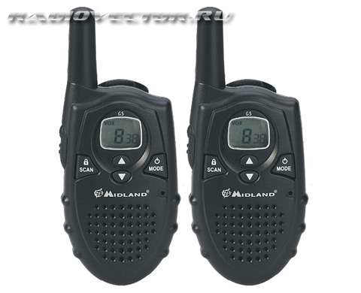
Communication
Portable radio transmitter

Slide 12
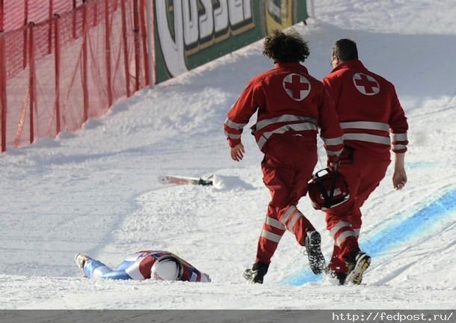
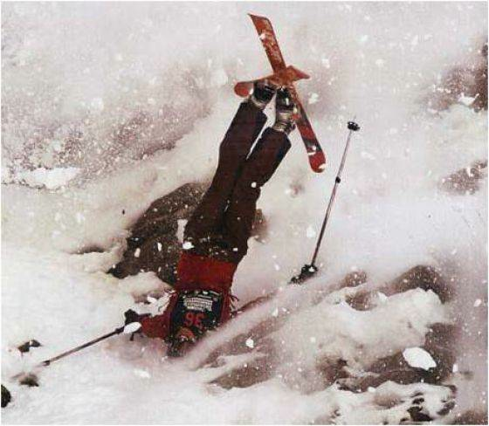
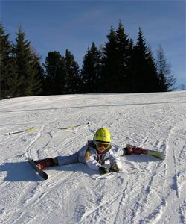
Accidents
Second type of accidents
Calm down , stand still , use your portable radio transmitter
First type of accidents
Keep patient and continue skiing
The help will come soon

Slide 13
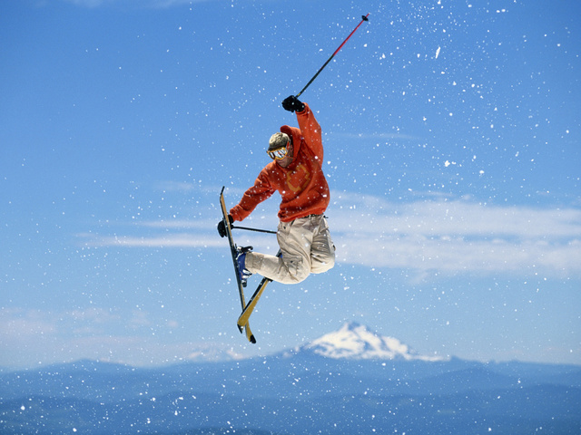
Conclusion
One day you will become a real professional
There are the most important tips for beginners

Slide 14
Thank for your attention!

