Slide 1
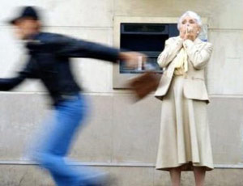
Avoiding an attack

Slide 2
Aim:
To provide my classmates with tips for safety in in traveling alone.
Plan:
The way of moving
Proper luggage.
Your look while traveling.
Attention and carefulness in a journey.

Slide 3
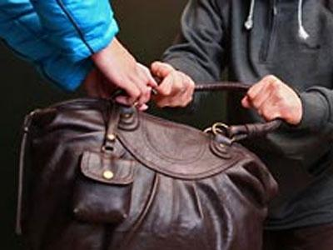
If you travel alone you need to follow some simple rules to avoid attack.

Slide 4
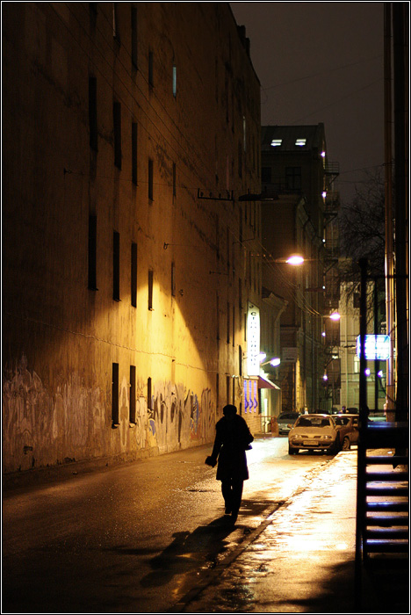
Try not to walk alone.
Women who are alone at night seem to be an easier target than those in a group.

Slide 5
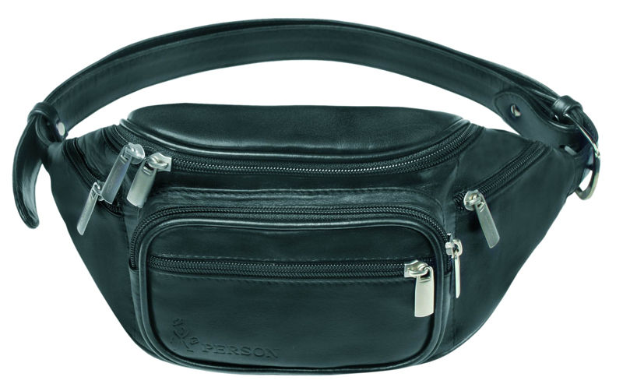
Try not to carry a lot of things with you.
Leave the things you don’t need at home.
Use a small cross-body bag instead of a handbag or a purse when you travel.

Slide 6
Walk with confidence and always look up.
Even in a new place walk like you know, where are you going and what is going on.
Don’t look like a victim. Hold your head up and look ahead of you, not down at the pavement.

Slide 7
Notice suspicious people to identify them later if needed.

Slide 8
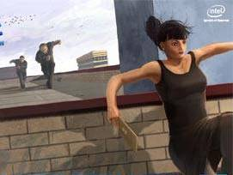
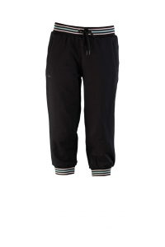
If someone follow you, cross the street or change directions.
Don’t wear too short dresses or skirts, better – trousers.

Slide 9
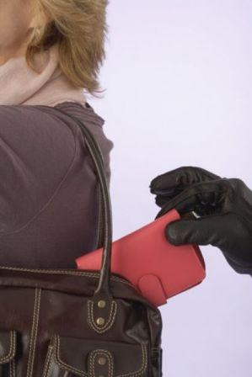
If you follow these simple rules you will be save and happy!
Thanks for your attention!

