Slide 1
Нетрадиционные формы обучения английскому языку.
МОУ Гимназия № 1 имени В. Я. Шишкова
Учитель Рачкова С.Г.

Slide 2
День рождения куклы Алисы.
Открытый урок во 2 классе.

Slide 3
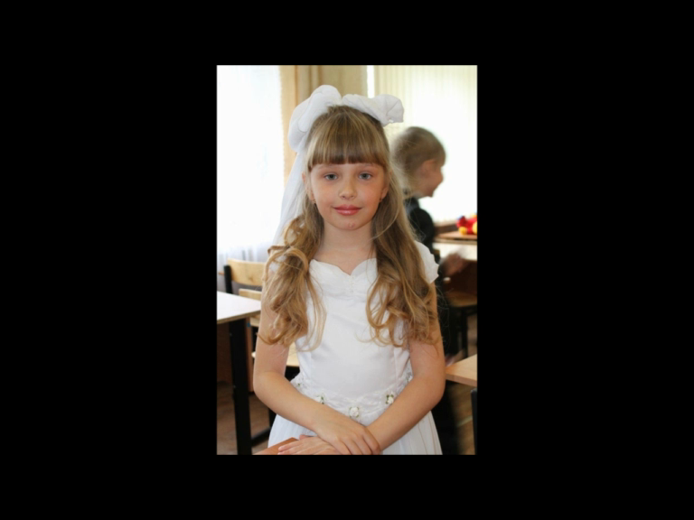

Slide 4
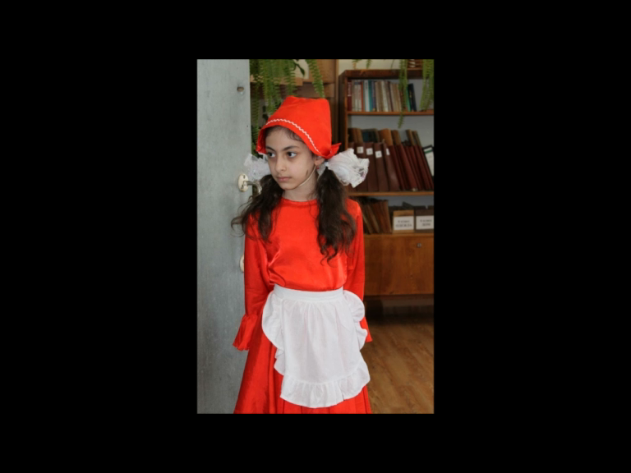

Slide 5
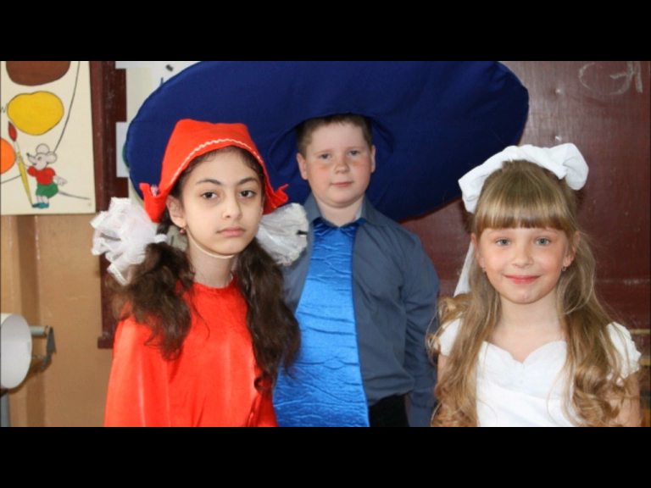

Slide 7
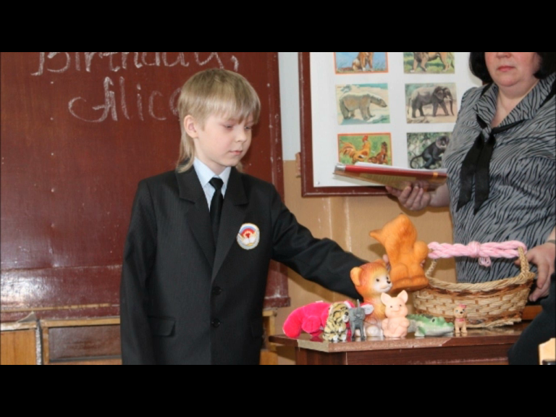

Slide 8
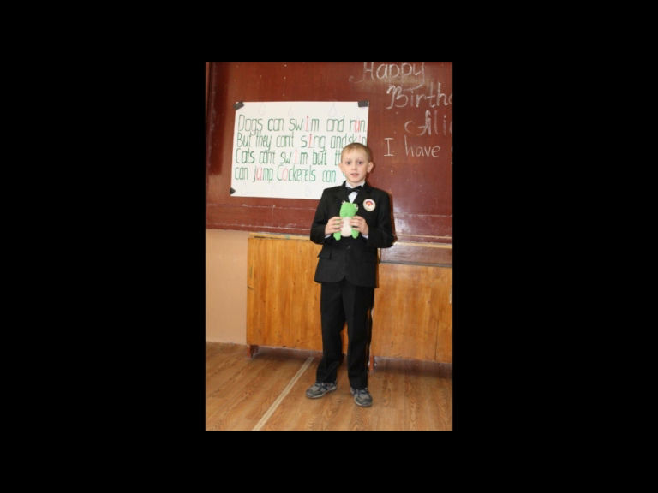

Slide 9
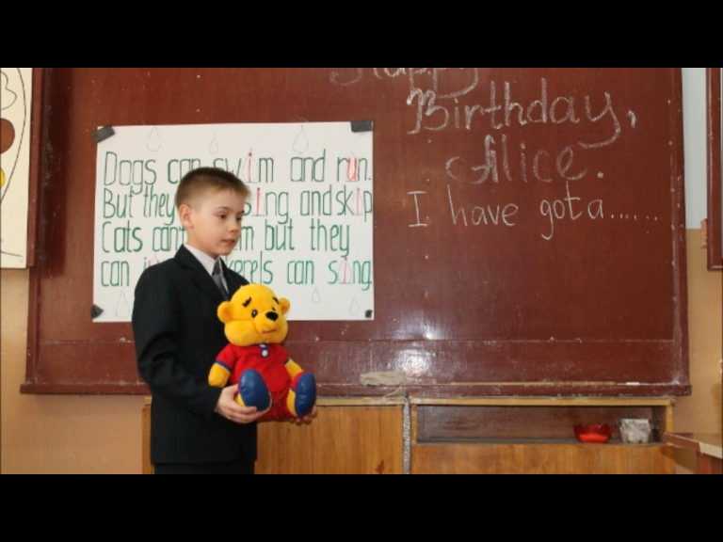

Slide 10
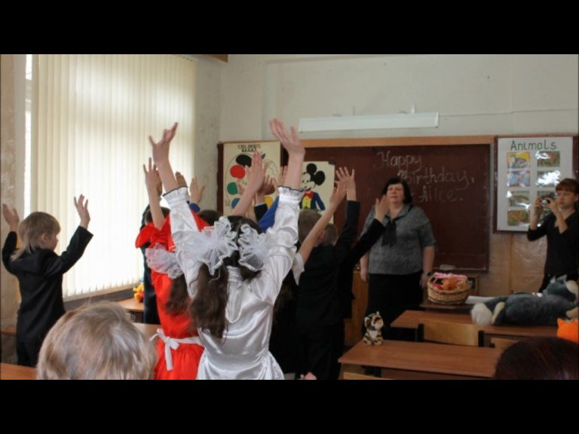

Slide 13
Викторина
«Экскурсия по Санкт –Петербургу»

Slide 14
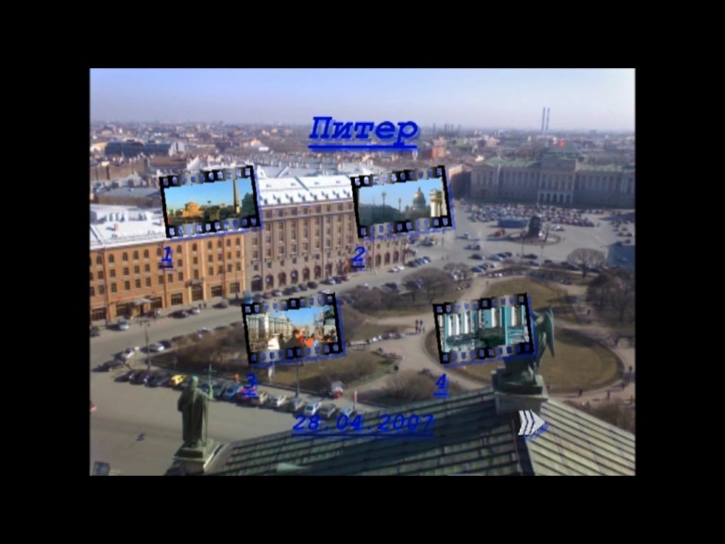

Slide 15
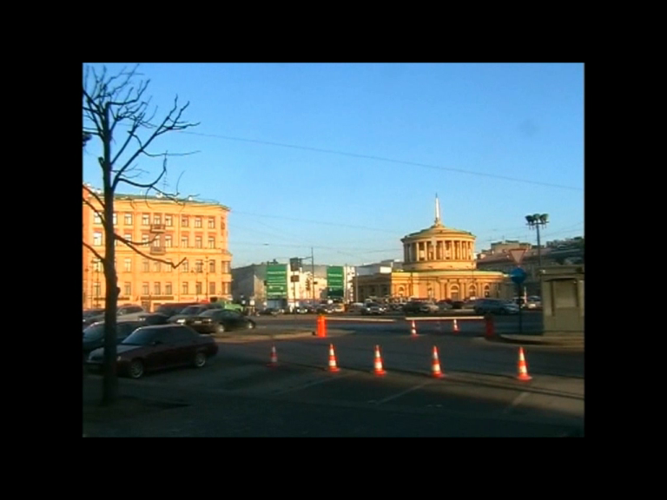

Slide 17
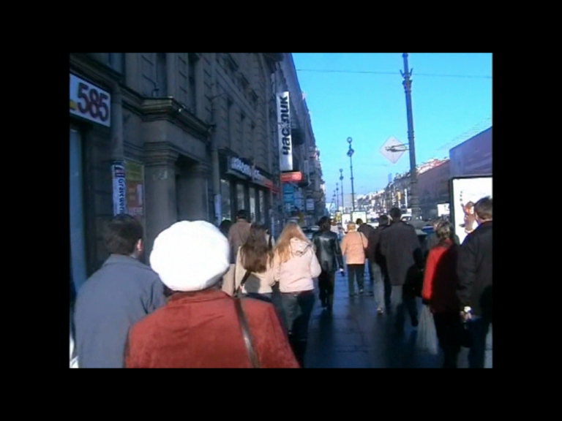

Slide 19
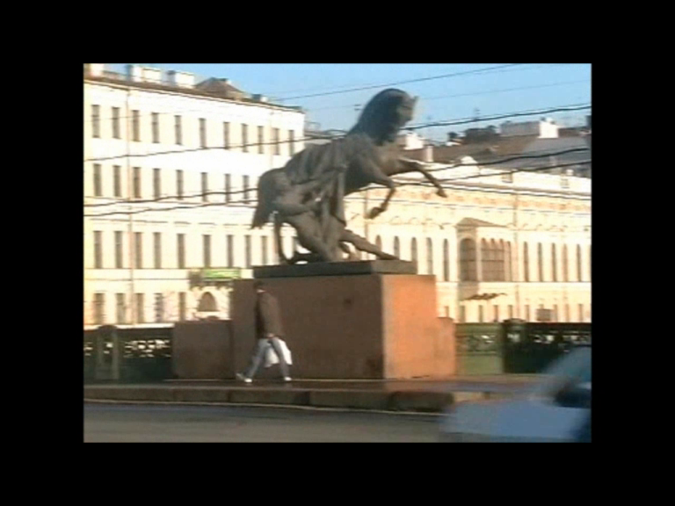

Slide 20
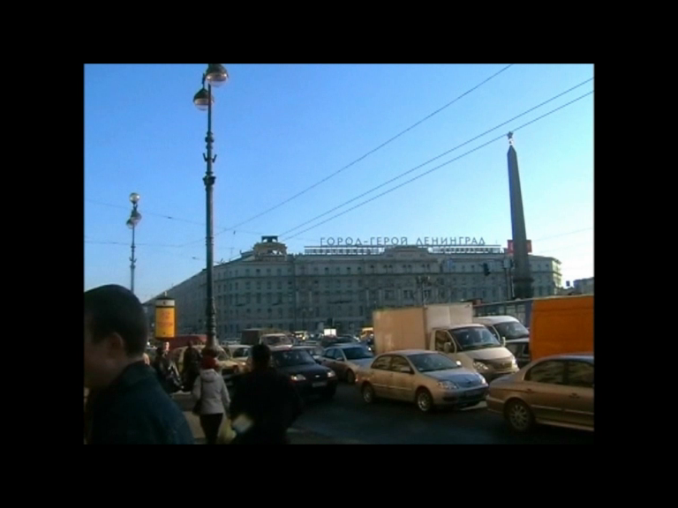

Slide 22
A Project
Авторы проекта:
Степанова Наталья
Смирнова Кристина
Спасская Наталья
Голубева Анастасия

Slide 27
My Favourite Pet
Работу выполнил
Ученик 6 «В» класса
Голубев Никита

Slide 28
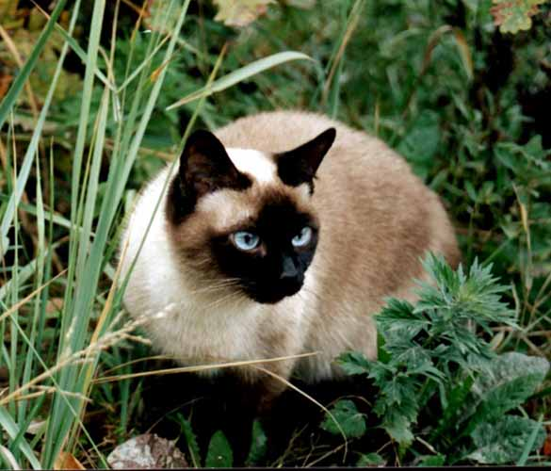
My Favourite Pet is Simka!

Slide 29
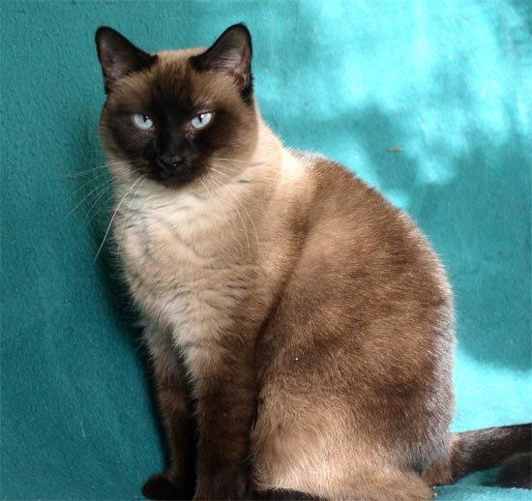
It is slim, pretty and handsome.

Slide 30
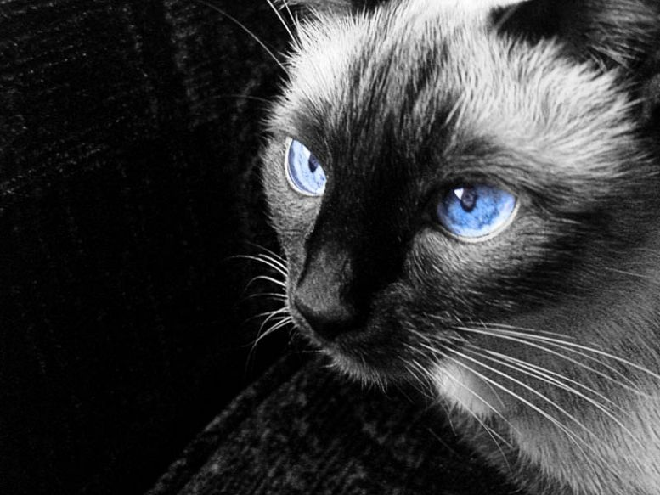
His eyes are blue. My cat is black-and-white.

Slide 31
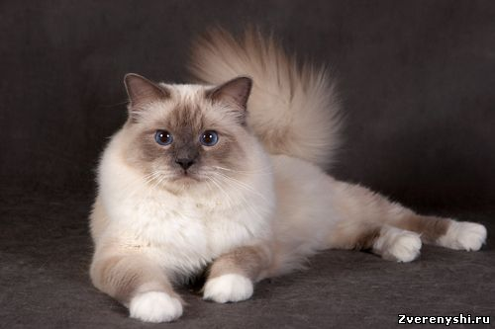
She likes to sleep and play.

Slide 32
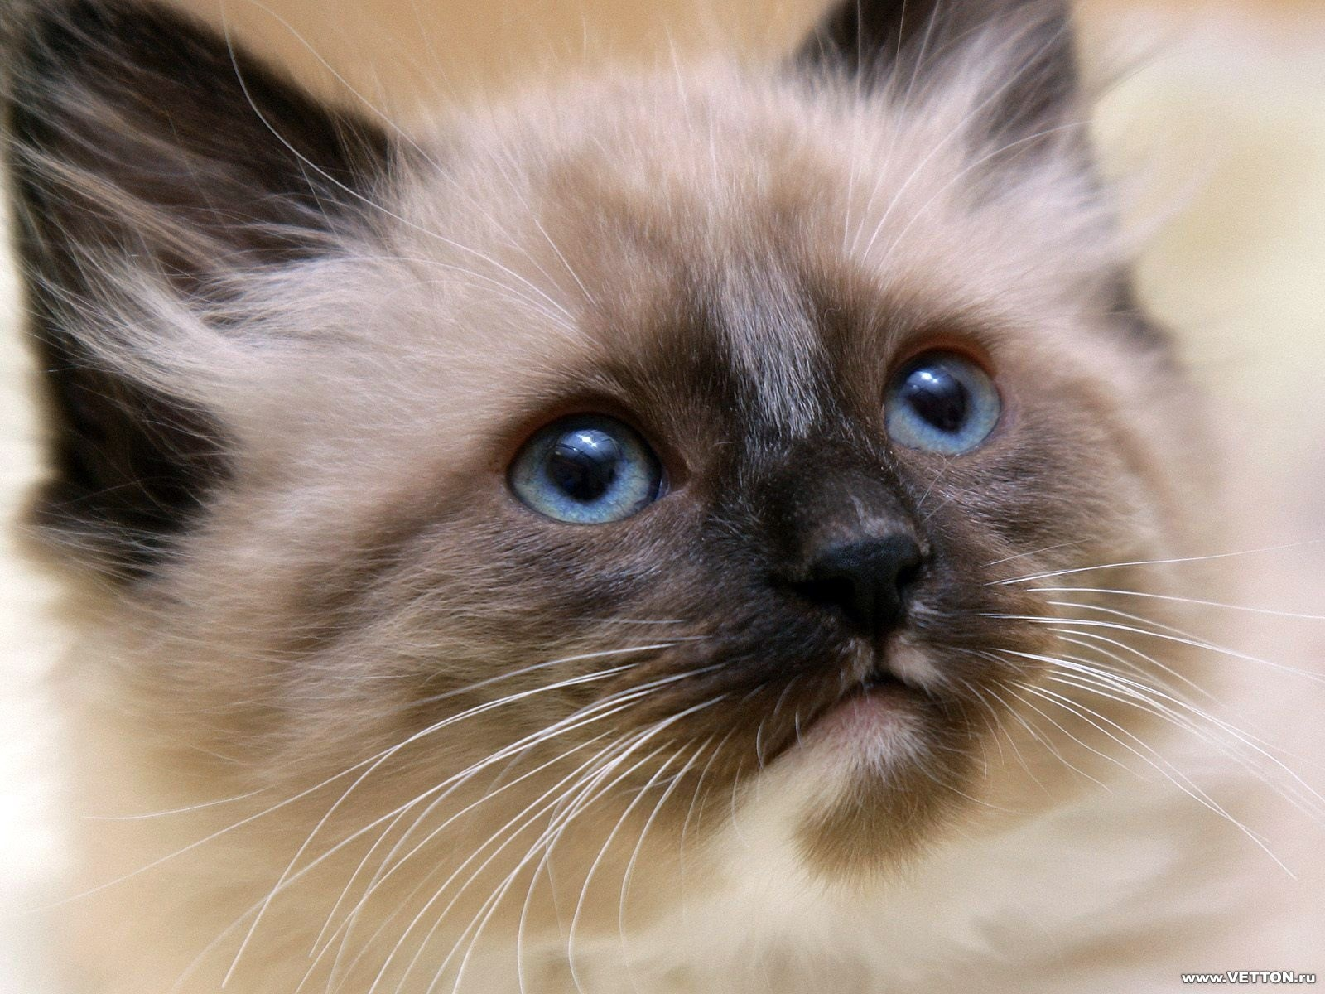
I think he is spesial, because Simka is smarter than large animals. He is the best friend.

Slide 33
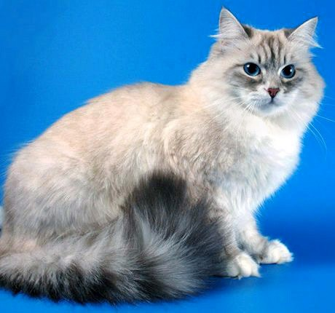
My pet can jump

Slide 34
My Favourite Pet.
I have got a parrot.
My favorite pet is funny and beautiful. He is small.
His name is Yasha.
Here it is.

Slide 35
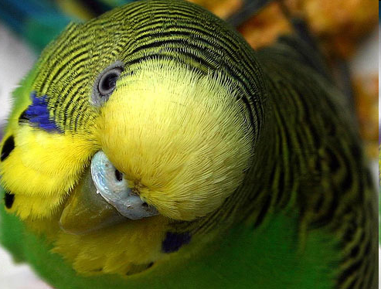
Yasha is very cheerful. He
is green . He can speak.
Sometimes I let him out of
the cage.
He likes flaying. He often
plays the bell. He likes to
look in the mirror.
I love my pet!

Slide 36
My dream pet.
Выполнил ученик 6-б класса
Яковлев Максим.

Slide 37
My favorite pet.

Slide 38
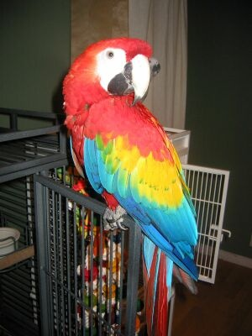
He is bright ,big and beautiful. Он яркий, большой, красивый.

Slide 39
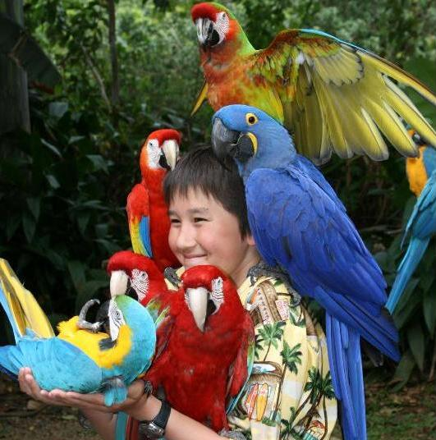
The parrot is my friend. Попугай мой друг.

Slide 40
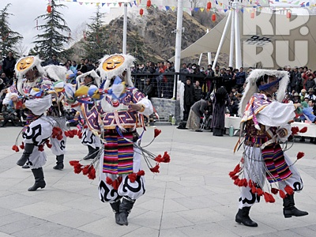
New Year Around the World

Slide 41
Thailand
In Thailand New year celebrations are very funny. People throw water on each other, even at strangers! They roam the streets with buckets of water, water guns or even a garden house.

Slide 42
US
In many parts of the US people eat black-eyed peas on New Year’s Day – for good luck. Another “good luck” vegetable is cabbage.

Slide 43
China
New year celebrations in China last 15 days, and there are dragon parades and lion dances in the streets. It’s the noisiest and most exciting holiday of the year. If the New Year falls on the year of any particular animal the Chinese try not to eat that animal’s meat.

Slide 44
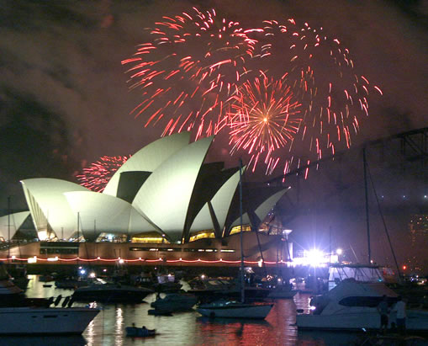
CHRISTMAS DOWN UNDER

Slide 45
Australia

Slide 46
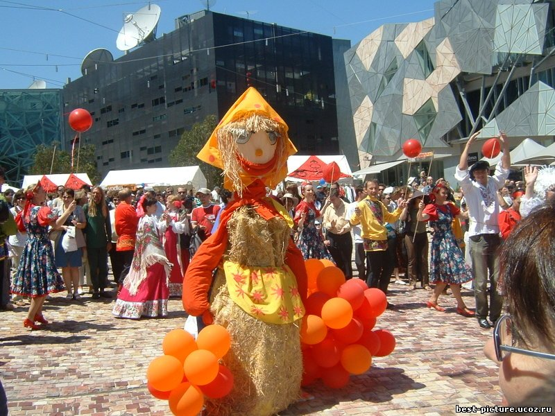
They have a swim, play cricket or volleyball, surf or just sit around with family and friends enjoying Christmas dinner. Santa Claus arrives at Australian beaches on a surfboard — quite a change from sliding down a chimney! And since the weather is hot he often wears a swimsuit or funny baggy shorts.

Slide 47
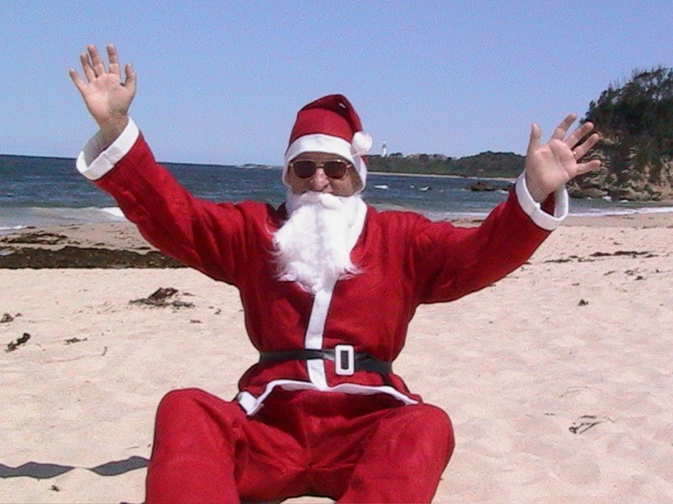
Many Christmas decorations and symbols are the same as in Great Britain or the USA: Christmas trees (usually plastic), Dickensian images of turkeys and plum puddings, snow scenes...

Slide 48
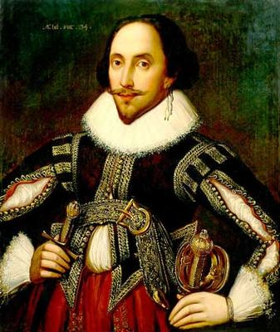
SHEKESPEARE’S UNIVERSE
8а класс

Slide 49
The rolling Shakespearean countryside, the romantic river Avon with its swans, the beautiful sixteenth-century Tudor cottages and all things theatrical bring to this little town visitors from all over the world. The largest crowd gathers there on the Bard’s birthday, this is April 23rd, the day when William Shakespeare was born and, by a strange coincidence, died.

Slide 50
On the way to Holy Trinity Church the pro­cession pauses for the flag ceremony. The bugles are blown and then flags of many coun­tries are unfurled, to applause from the crowd. At the same time, banners representing all the works by Shakespeare are unfurled on flag poles lining the streets.

Slide 51
There are lots of places in Stratford associated with Shakespeare and his life. The main attractions include:
Shakespeare’s Birthplace (the house where William Shakespeare was born and spent his childhood);

Slide 52
Гимназическое
Евровидение

Slide 53
Россия
6-б класс

Slide 54
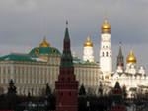

Slide 55
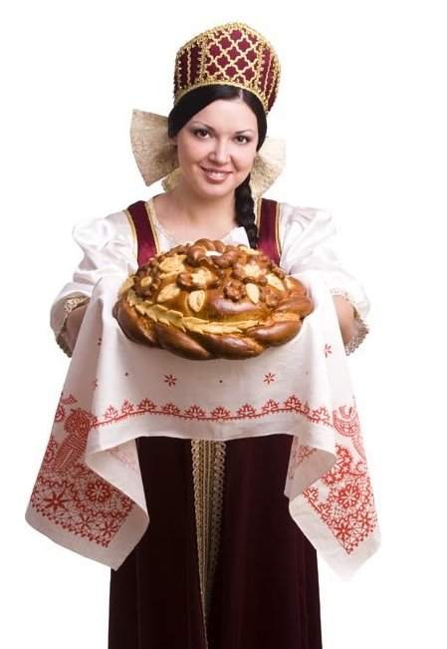

Slide 56
