Slide 1
Описание
внешности

Slide 2
Описание внешности
Face: round, oval, funny, kind, angry, sad,…
Eyes: green, brown, blue, big, small,…
Ears: small, big, clean, long,…
Nose: short, long, big, small,…
Hair: blond, dark, red, grey, long, short,…

Slide 3
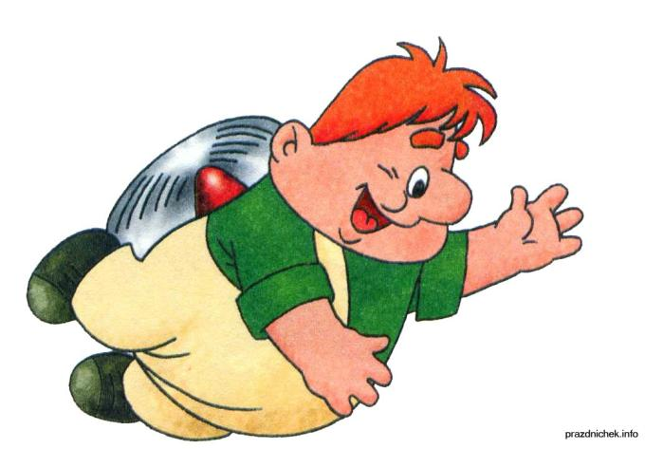
He / She has … face, … nose.
His /Her eyes are …
His / Her hair is …

Slide 4
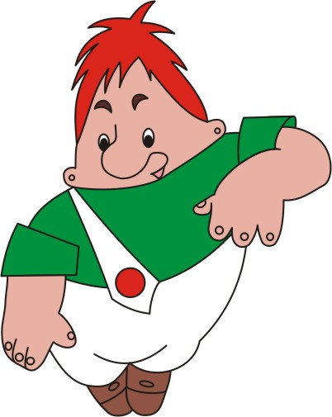
Karlson
Karlson has a round face.
His eyes are big and kind.
His nose and ears are small.
Karlson has red hair.

Slide 5
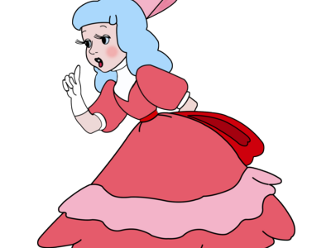
Malvina

Slide 6
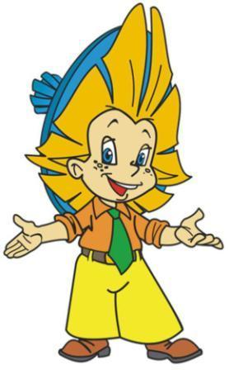
Neznaika

Slide 7
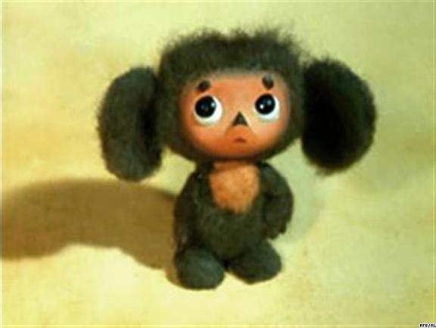
Cheburashka

Slide 8
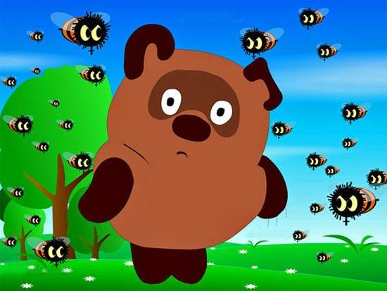
Winni-The-Pooh

Slide 9
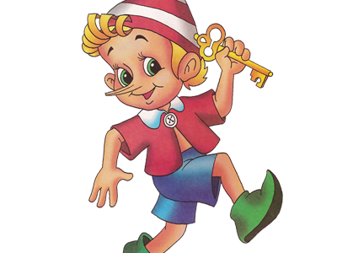
Buratino

