Slide 1
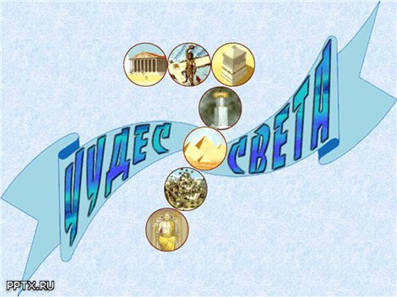
Урок по теме
«Удивительный мир. Древние чудеса света»
г. Мирный Саха (Якутия) МОУ СОШ № 26
Учитель: Сатурченко Н.А.

Slide 2
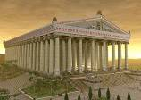
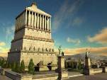
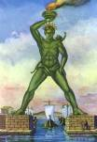

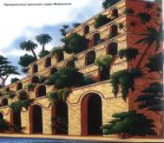
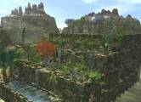
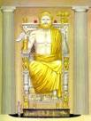
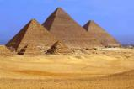
Look at the pictures and match them using the names from the list.
The Pharos of Alexandria
The Pyramids
The Statue of Zeus at Olympia
The Temple of Artemis at Ephesus
The Hanging Gardens of Babylon
The Colossus of Rhodes
The Mausoleum at Halicarnassus
1.
5.
2.
6.
3.
3.
1 - D 2 - F 3 – E 4 - B
5 – G 6 – A 7 – C
7.
4.

Slide 3
Let’s pronounce them correctly
Egypt [‘i:ʤipt] Iraq [I’ra:k]
Turkey [‘tз:ki] Alexandria [,ælig’za:ndriǝ]
Necropolis [ni’krɒpǝlis] Peru [pǝ’ru:]
China [‘ʧаinǝ] Jordan [‘ʤo:dǝn]
Mexico [‘meksikǝu] Taj Mahal [,tɑ:ʤ mǝ’hɑ:l]
Zeus [zju:s] Artemis [‘a:timis]
Colossus [kǝ’lɒsǝs] Rhodes [rǝudz]
Mausoleum[,mǝsǝ’li:ǝm ] Pharaoh [‘feǝrǝu]

Slide 4
The Seven Ancient Wonders
Wonder | Date of construction | Builder | Purpose | Date and cause of destruction | Modern location
Great pyramid of Giza | 2584–2561 BC | Egyptians | as a tomb for the dynasty Egyptions Pharaoh Khunfu | Still in existence | Giza Necropolis, Egypt
Hanging Gardens of Babylon | Around 600 BC (possibly legendary) | Babylonians | to cheer up Nebuchadnezzar's homesick wife | After 1st century BC/ Earthquakes | Babyl province, Iraq
Temple of Artemis | c. 550 BC | Lydians, Persians, Greeks | dedicated to a goddess Artemis | 356 BC Arson by Herostratus) AD 262 (by the Goths) | Near Selcuk, Izmur Province, Turkey
Statue of Zeus at Olimpia | 466–456 BC (Temple) 435 BC (Statue) | Greeks | to worship the “King of Gods” | 5th–6th centuries AD / Fire | Olimpia, Greece
Mausolium of Halicarnassus | 351 BC | Persians, Greeks | as a tomb for Mausolus, a satrap in the Persian Empire and Artemisia of Caria his wife and sister. | by AD 1494 Earthquakes | Bodrum, Turkey
Colossus of Rhodes | 292–280 BC | Greeks | to celebrate Rhodes' victory over the ruler of Cyprus, Antigonus I Monophthalmus | 226 BC Earthhquake | Rhodes, Geece
Lighthouse of Alexandria | 280 BC | By the dynasty of Ptolemies, Egypt, Greeks | to guide sailors into the harbour at night time. | AD 1303–1480 Earthhquake | Alexandria, Egypt

Slide 5
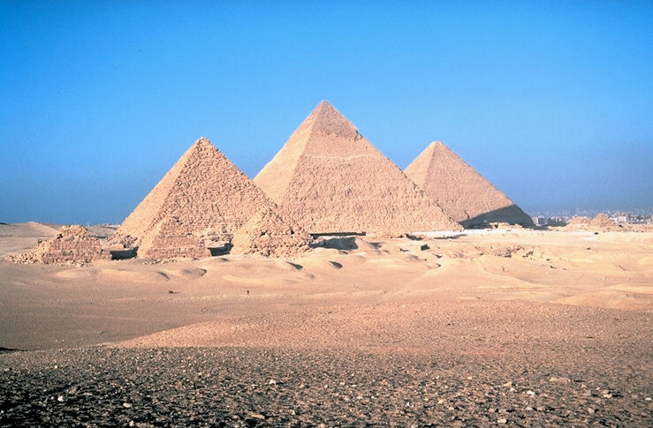
The Great Pyramids

Slide 6
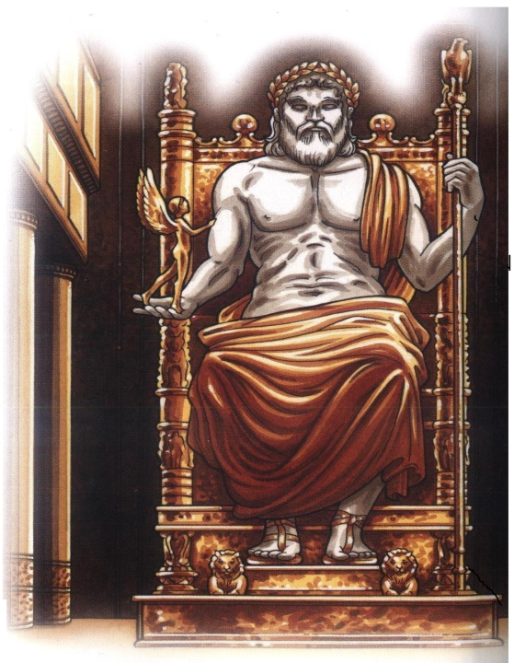
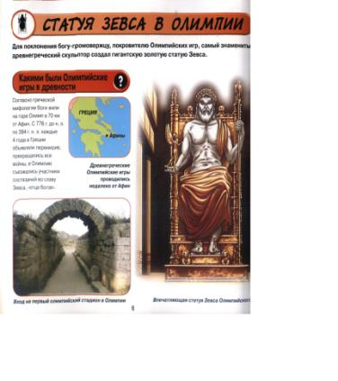
The Statue of Zeus
at Olympia

Slide 7
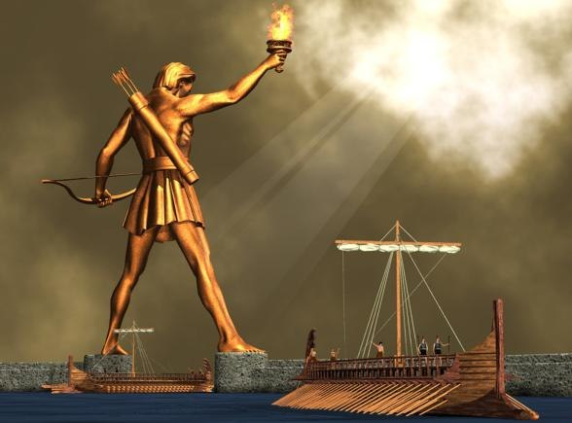
The Colossus of Rhodes

Slide 8
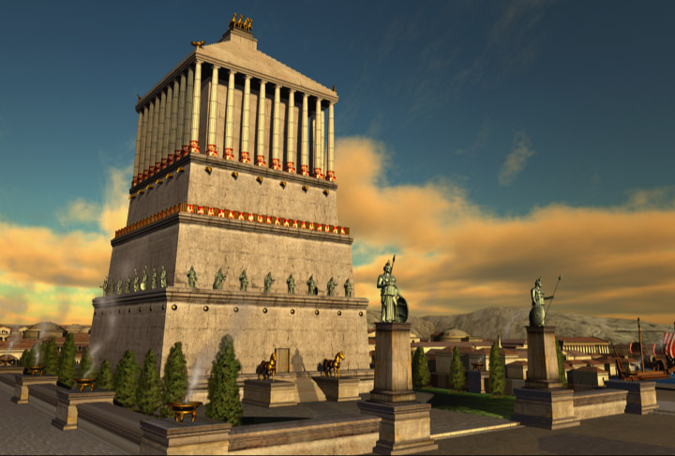
The Mausoleum
at Halicarnassus

Slide 9
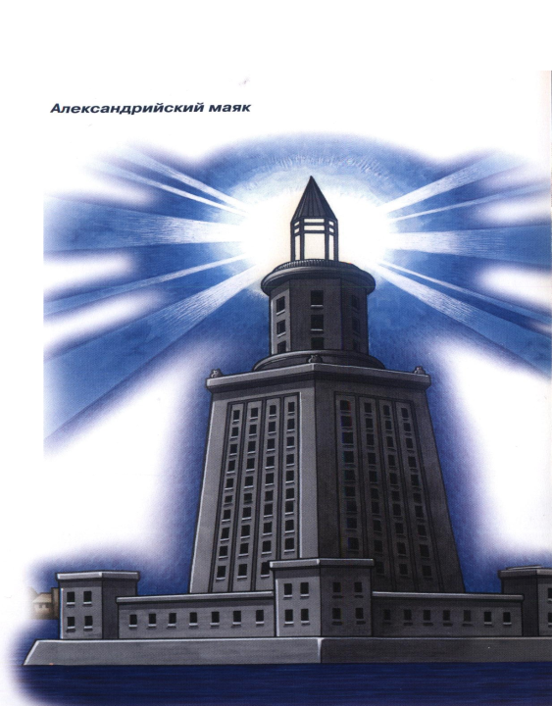
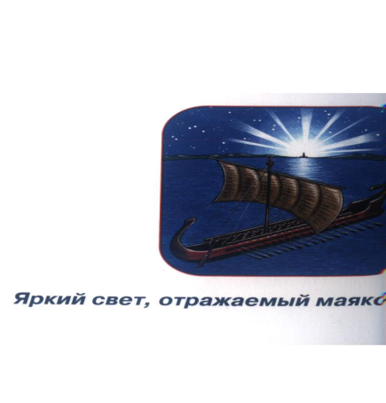
The Pharos of Alexandria

Slide 10
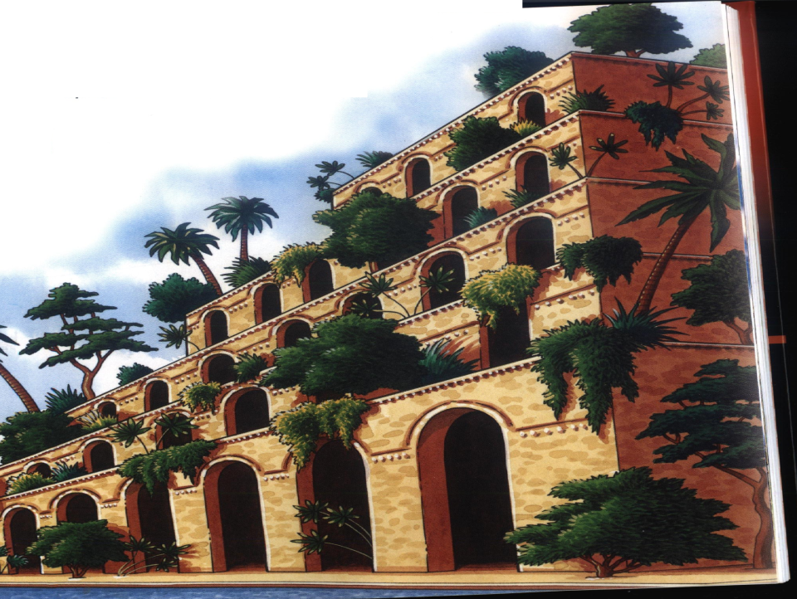
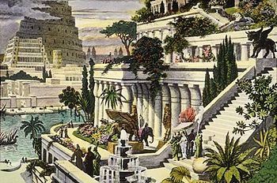
The Hanging Gardens of Babylon

Slide 11
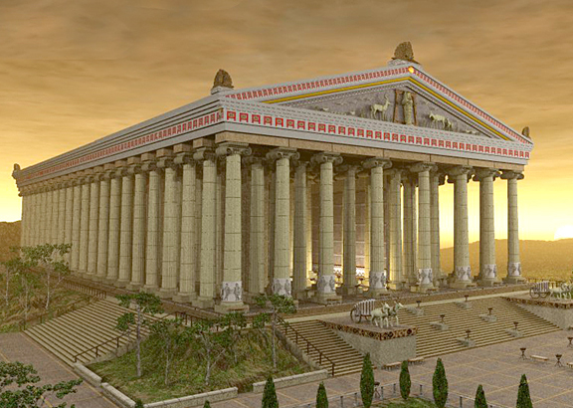
The Temple of Artemis at Ephesus

Slide 12
IV. Seven wonders of the world discussion
1. Do you think people should try to rebuild those of the Seven wonders of the world that have disappeared?
2. If you could design a wonder of the world, what would you design?
3. What makes a wonder a wonder?
4. Is it important to have an official list of the wonders of the world?
5. Do you know seven wonders of the Medieval World?

Slide 13
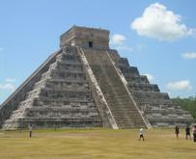
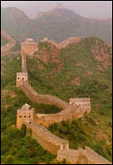
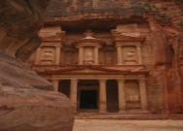
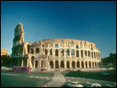
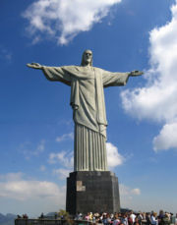
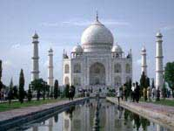
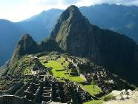
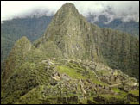
These are the wonders of the medieval age
1. The Great Wall of China
2. Petra Jordan
3. Christ Redeemer Statue Brazil
4. Machu Picchu Peru
5. Pyramid at Chichen Itza
Mexico
6. Roman Colosseum Italy
Taj Mahal India
1
5
2
6
3
7
4

Slide 14
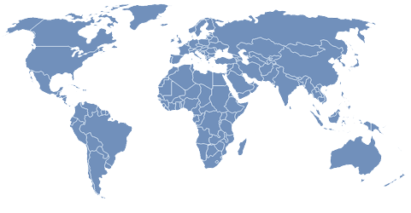
Your homework:
Do research on the Internet
about new seven wonders of the world
and describe them.
See ”Tips for doing internet research”
in “Learning strategies”
(Enjoy English-10, M.Z. Biboletova).
Notes:
Wonder
Date of construction
Builder
Purpose
Date and cause of destruction
Modern location
Great Pyramid of Giza
2584–2561 BC
Egyptians
as a tomb for 4th dynasty Egyptian Pharaoh Khufu
Still in existence
Giza Necropolis, Egypt
Hanging Gardens of Babylon
Around 600 BC (possibly legendary)
Babylonians
to cheer up Nebuchadnezzar's homesick wife
After 1st century BC/
Earthquakes
Al Hillah, Babil Province, Iraq, or Kouyunjik, Nineveh Province, Iraq
Temple of Artemis at Ephesus
c. 550 BC
Lydians, Persians, Greeks
dedicated to a goddess Artemis
356 BC (Arson by Herostratus)
AD 262 (by the Goths)
near Selçuk, Izmir Province, Turkey
Statue of Zeus at Olympia
466–456 BC (Temple) 435 BC (Statue)
Greeks
to worship the “Father of Gods”
5th–6th centuries AD / Fire
Olympia, Greece
Mausoleum of Halicarnassus
351 BC
Carians, Persians, Greeks
as a tombfor Mausolus, a satrap in the Persian Empire, and Artemisia II of Caria, his wife and sister.
by AD 1494
by flood
Bodrum, Turkey
Colossus of Rhodes
292–280 BC
Greeks
to celebrate Rhodes' victory over the ruler of Cyprus, Antigonus I Monophthalmus
226 BC
Earthquake
Rhodes, Greece
Lighthouse of Alexandria
c. 280 BC
Ptolemaic Egypt, Greeks
to guide sailors into the harbour at night time.
AD 1303–1480
Earthquake
Alexandria, Egypt

