Slide 1
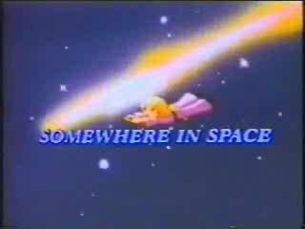
Travelling in Space

Slide 2
The letter
Dear everyone,
We arrived here yesterday. Its very beautiful.
There are tsrsa in the ysk.
They are big and llasm.
They are cold and oth.
There is life on one planet. It is planet the htaer.
Are we alone in the ecpsa?
Can we find dnierfs in the space?
See you soon,
Love,
The Little Prince

Slide 3
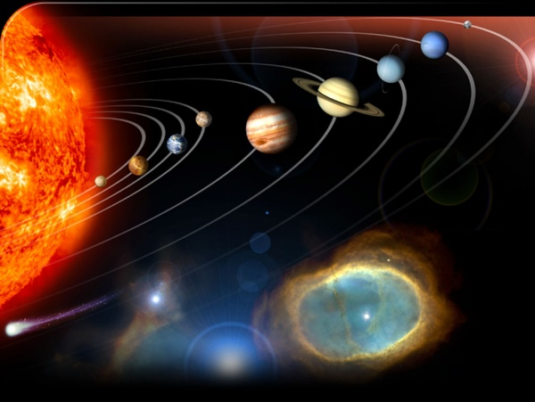
Space

Slide 4
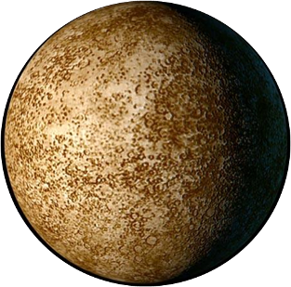
Mercury
Mercury — the planet of Solar system closest to the Sun, addresses round the Sun for 88 days.

Slide 5
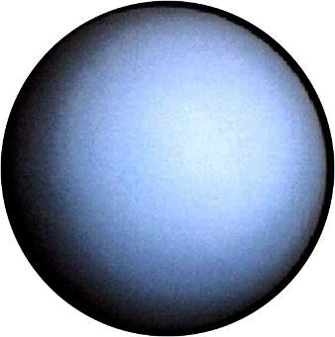
Uranus
Uranium — the seventh from the Sun, the third on diameter and the fourth planet on weight of Solar system. The full reference of Uranium round the Sun makes 84 years.

Slide 6
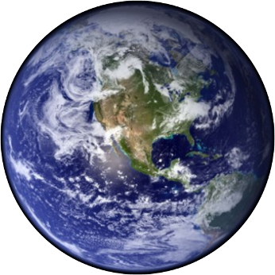
The Earth
The Earth — the third planet from the Sun of the Solar system, the largest on diameter, weight and density among planets of terrestrial group. The Earth addresses round the Sun and does round it for 365,26 days.

Slide 7
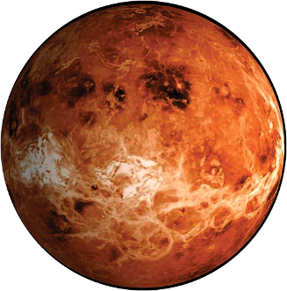
Venus
Venus — the second planet of Solar system with a cycle time in 224,7days.

Slide 8
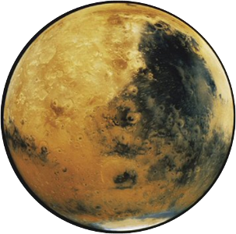
Mars
Mars — the fourth from the Sun and the seventh planet on the sizes of Solar system. The cycle time round the Sun is equal to 687 days.

Slide 9
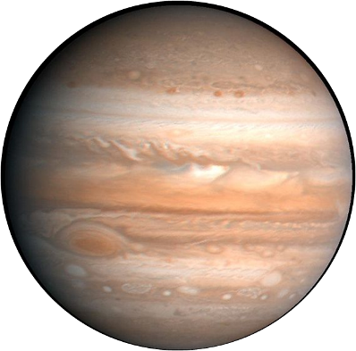
Jupiter
Jupiter — the fifth planet from the Sun, the largest in Solar system. The biggest planet of Solar system, the giant.

Slide 10
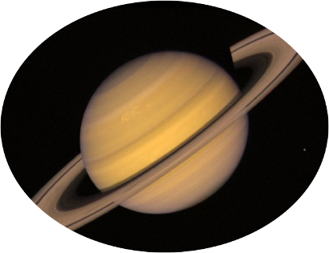
Saturn
Saturn — the sixth planet from the Sun and the planet second for the sizes in Solar system after Jupiter. Saturn addresses round the Sun for 10 759 days (29,5 years).

Slide 11
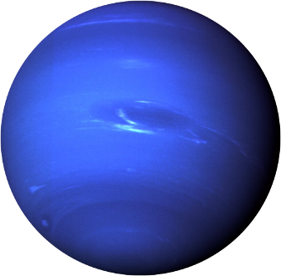
The Neptune
The Neptune — the eighth and most distant planet of Solar system. The Neptune also is the fourth on diameter and the third planet on weight. The complete revolution round the Sun occupies from it 164,79 years.

Slide 12
The letter
Dear everyone,
We arrived here yesterday. Its very beautiful.
There are in the .
They are big and .
They are cold and .
There is life on one planet. It is planet the .
Are we alone in the ?
Can we find in the space?
See you soon,
Love,
The Little Prince
tsrsa
stars
ysk
sky
llasm
small
oth
hot
htaer
Earth
ecpsa
space
dnierfs
friends

Slide 13
The letter
Dear everyone,
We arrived here yesterday. Its very beautiful.
There are stars in the sky.
They are big and small.
They are cold and hot.
There is life on one planet. It is planet the Earth.
Are we alone in the space?
Can we find friends in the space?
See you soon,
Love,
The Little Prince

