Slide 1
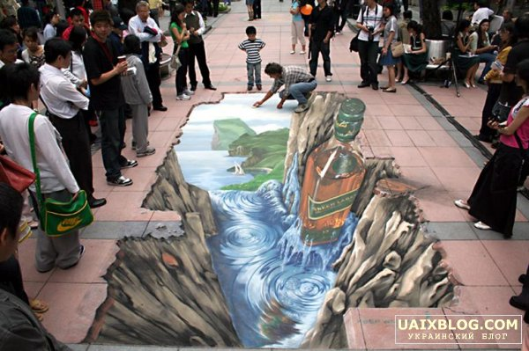
Pavement art

Slide 2
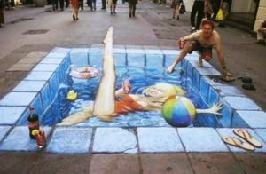
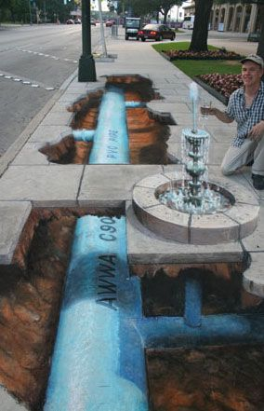
Street Painting is one of the directions of street art, which differ from graffity, as deals with asphalt. The Open-air gallery appeared with drawings of Julian Beever, the very known artist-madonnari.

Slide 3
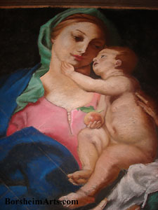
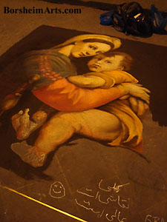
Street painting has been recorded throughout Europe since the 16th century. Street painters in Italy are called madonnari, they often created pictures representing the Madonna. In England they are called screevers.

Slide 4
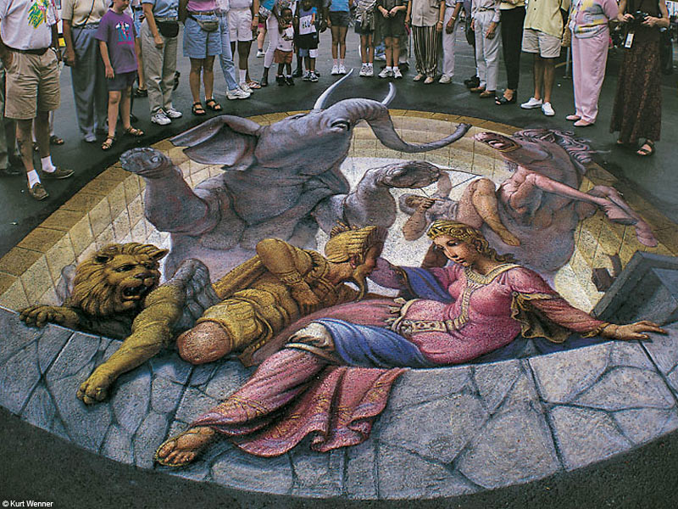
Over the past decades various artists have developed new styles based on the work of artists such Michelangelo, Andrea Mantegna, Hans Holbein.

Slide 5
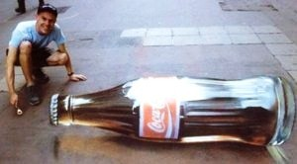
The commercial companies often use services of artists-madonnari for advertising their production.

Slide 6
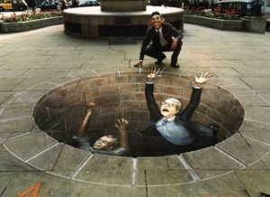
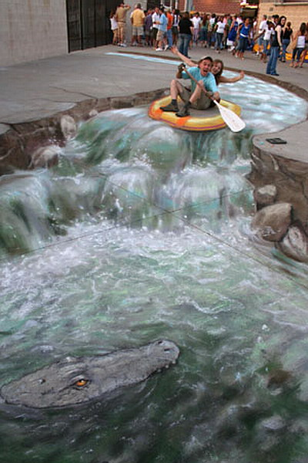
Today this work is called anamorphic or 3D, although in the past it was called one-point perspective.

Slide 7
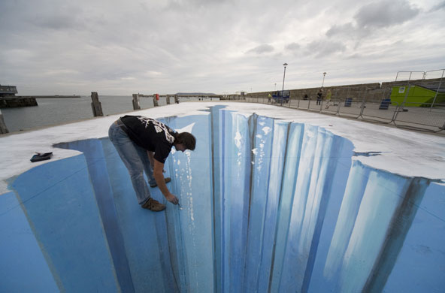
The End

