Slide 2
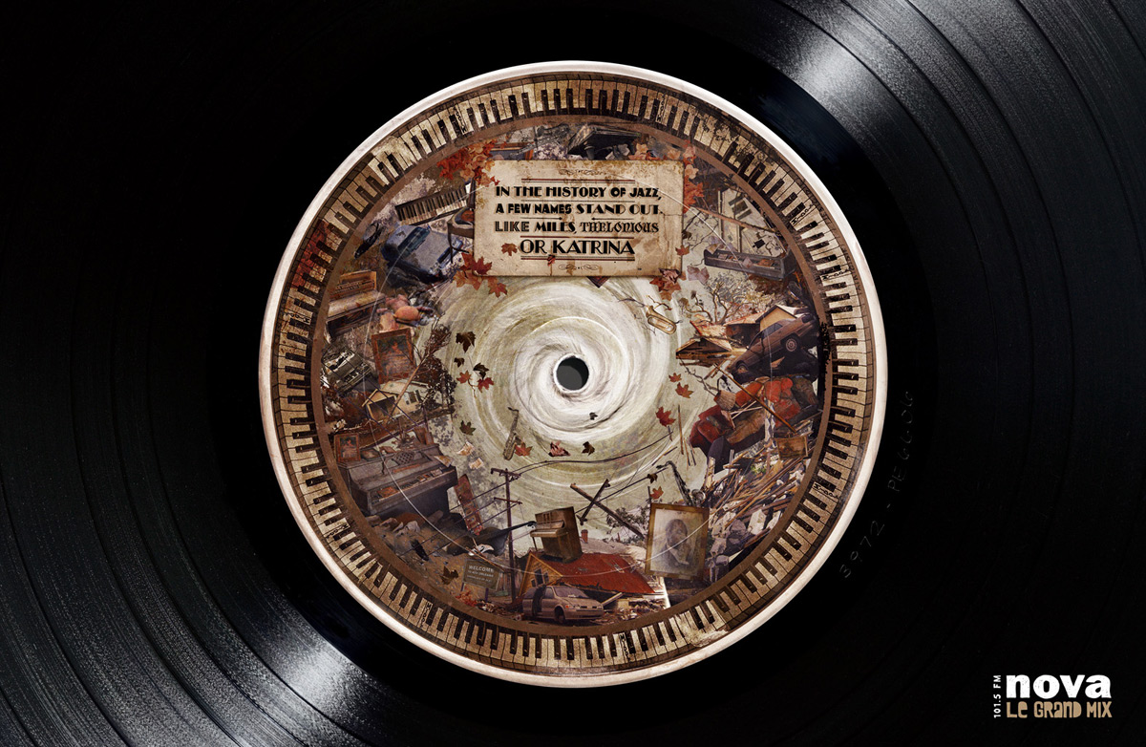
Jazz is a musical form which originated at the beginning of the 20th century in African American communities in the Southern United States from a confluence of African and European music traditions.

Slide 3
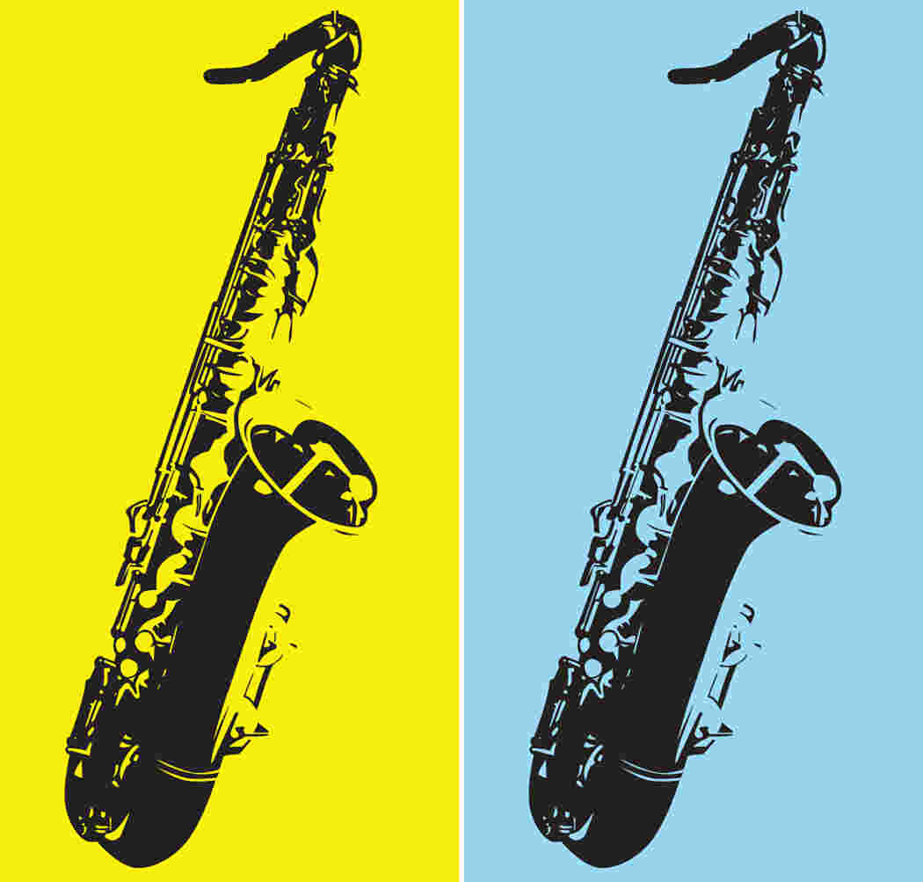
From its early development until the present, jazz has incorporated music from 19th and 20th century American popular music. Its West African pedigree is evident in its use of blue notes, improvisation, polyrhythm, syncopation, and the swung note but one of jazz's iconic figures Art Blakey has been quoted as saying, "No America, no jazz. I’ve seen people try to connect it to other countries, for instance to Africa, but it doesn’t have a damn thing to do with Africa".

Slide 4
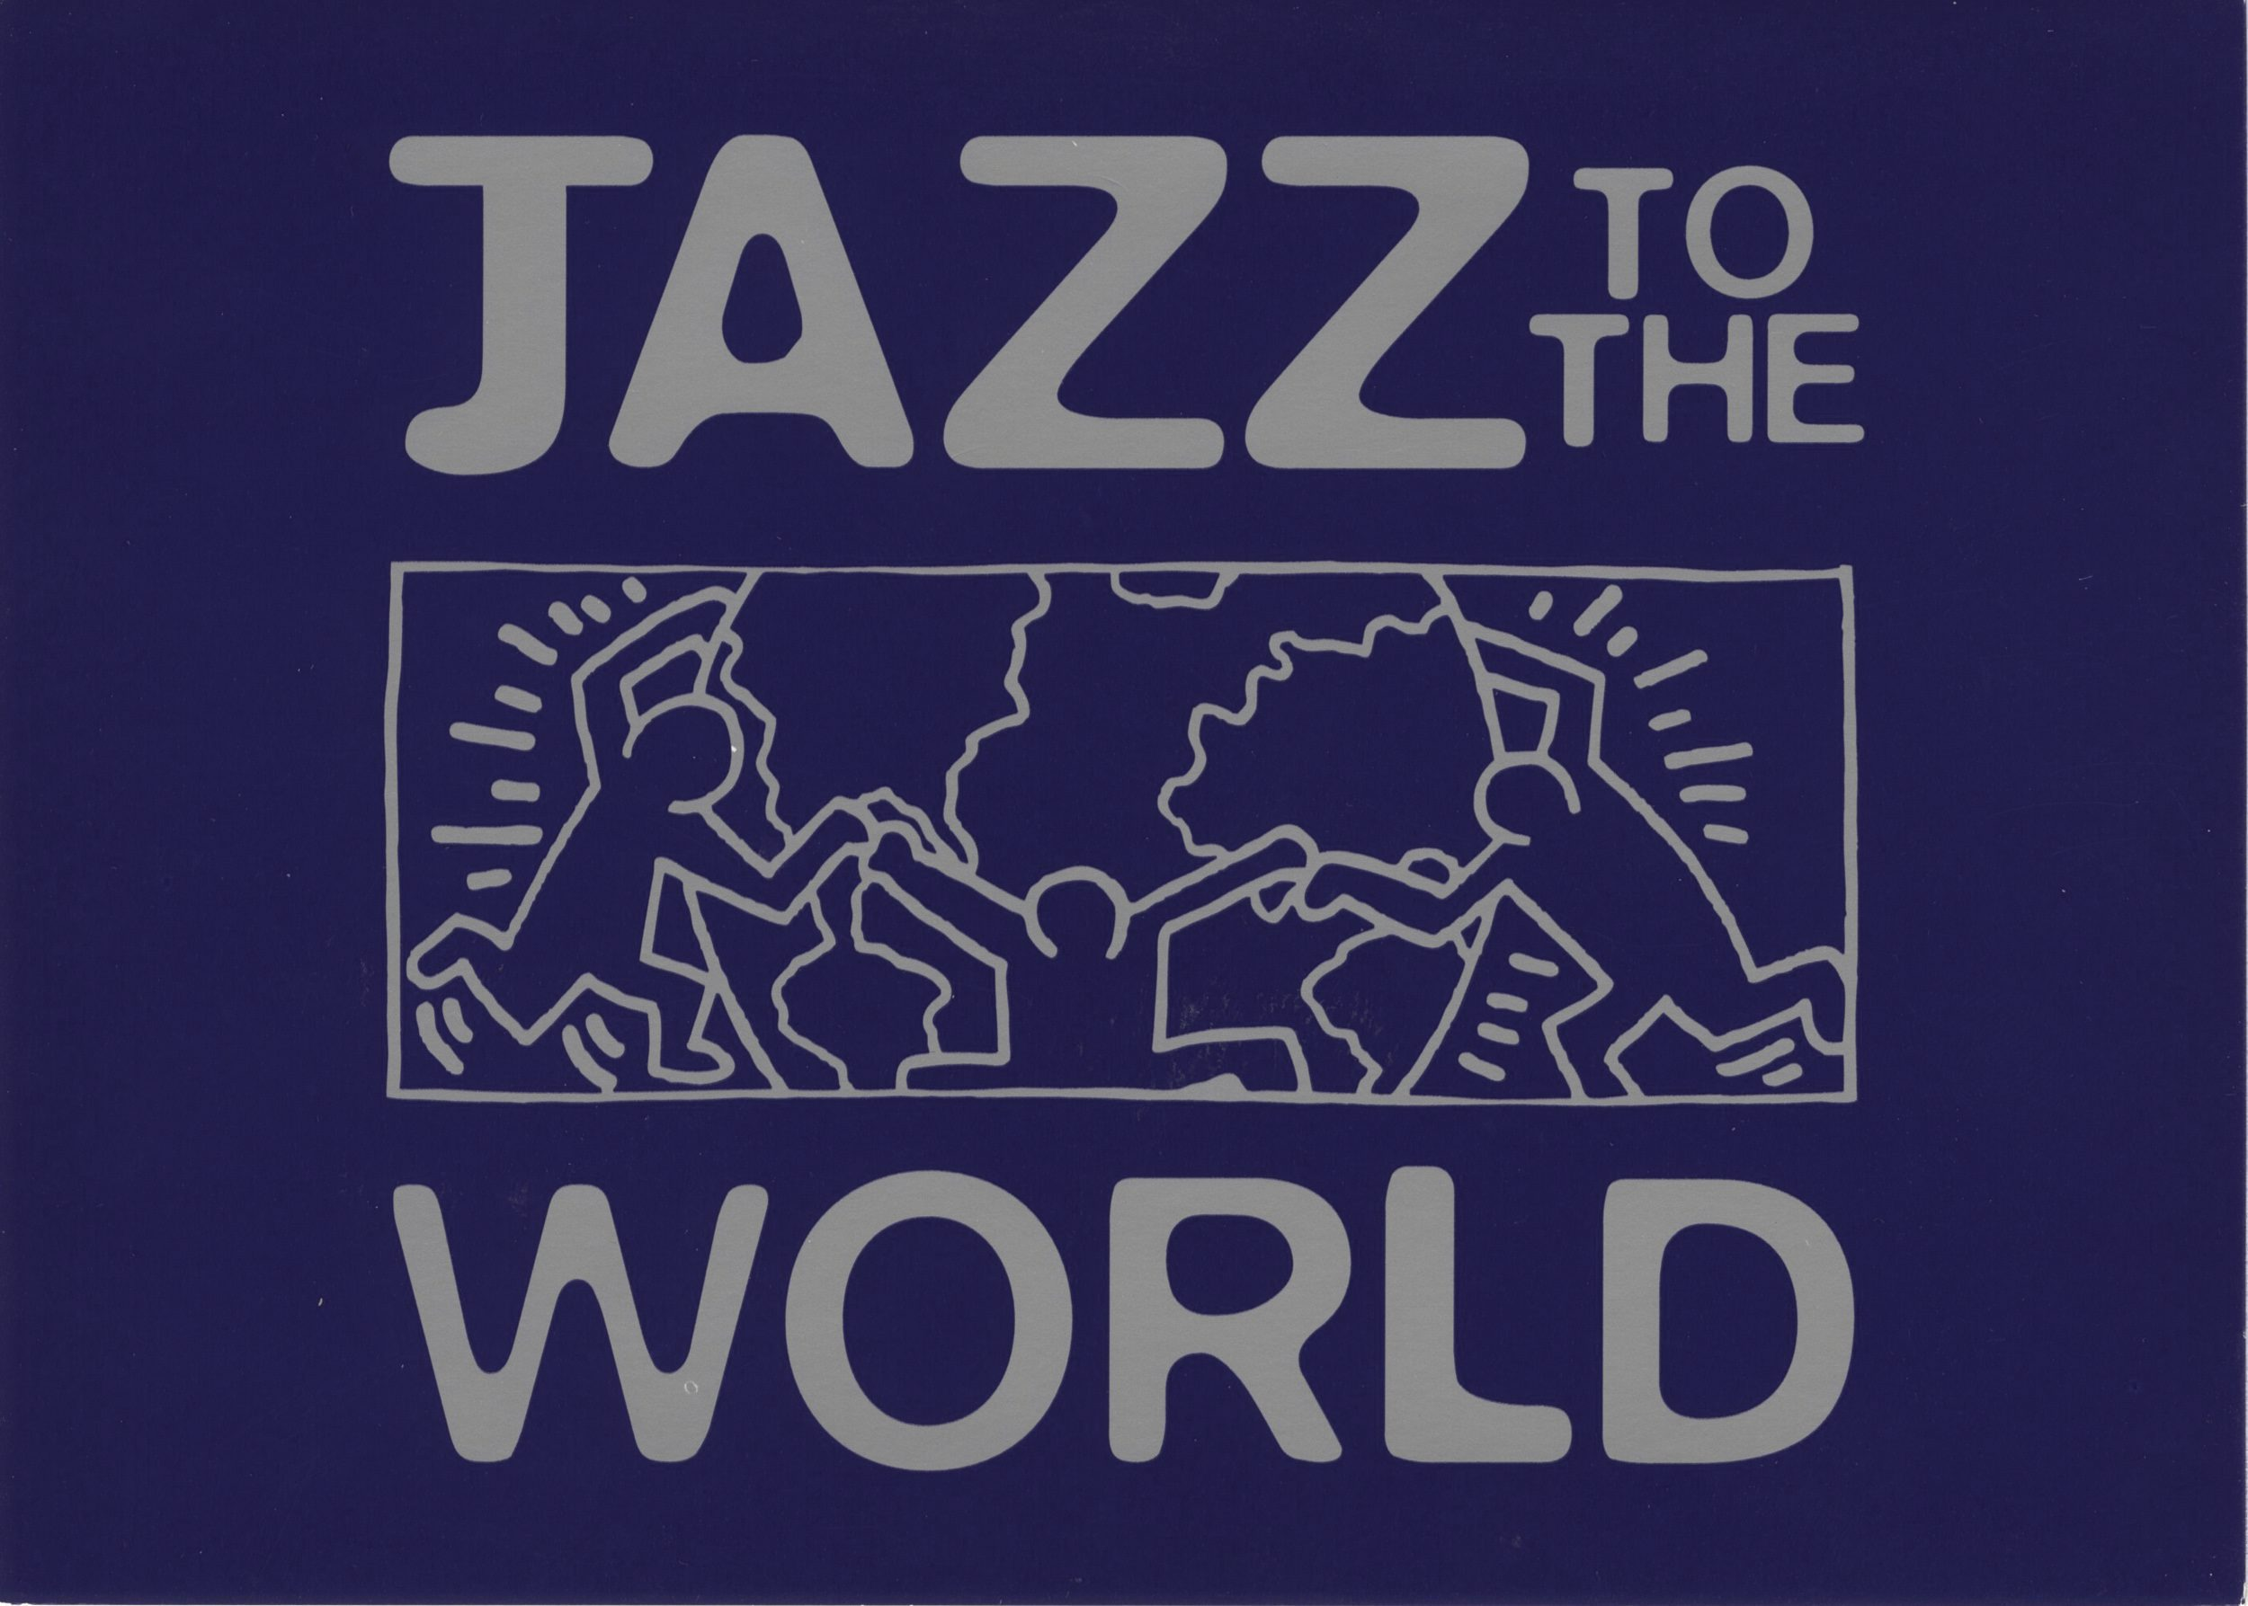
From its beginnings in the early 20th century, Jazz has spawned a variety of subgenres, from New Orleans Dixieland dating from the early 1910s, big band-style swing from the 1930s and 1940s, bebop from the mid-1940s, a variety of Latin jazz fusions such as Afro-Cuban and Brazilian jazz, and free jazz from the 1950s and 1960s, jazz fusion from the 1970s and late 1980s developments such as acid jazz, which blended funk and hip-hop influences into jazz.

Slide 5
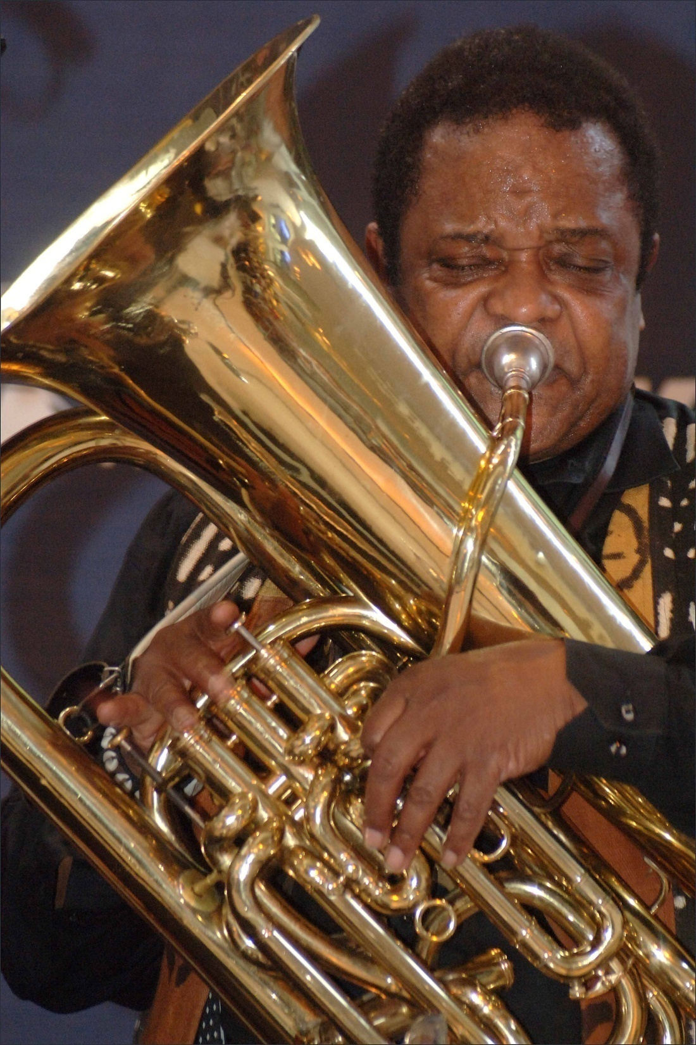
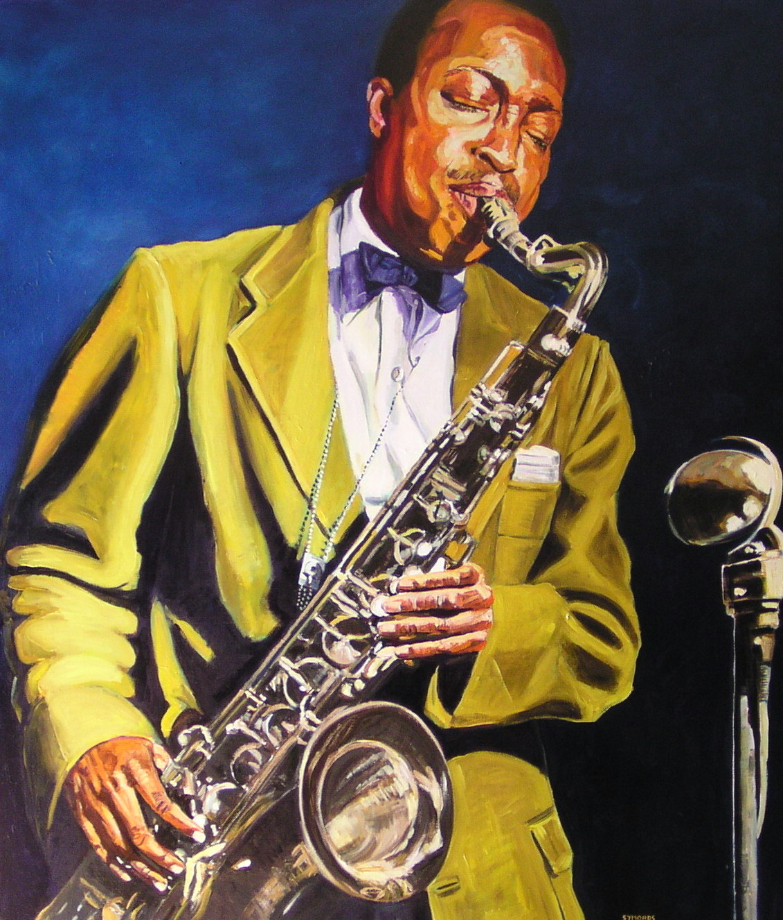
The word "jazz" began as a West Coast slang term of uncertain derivation and was first used to refer to music in Chicago in about 1915.

Slide 6
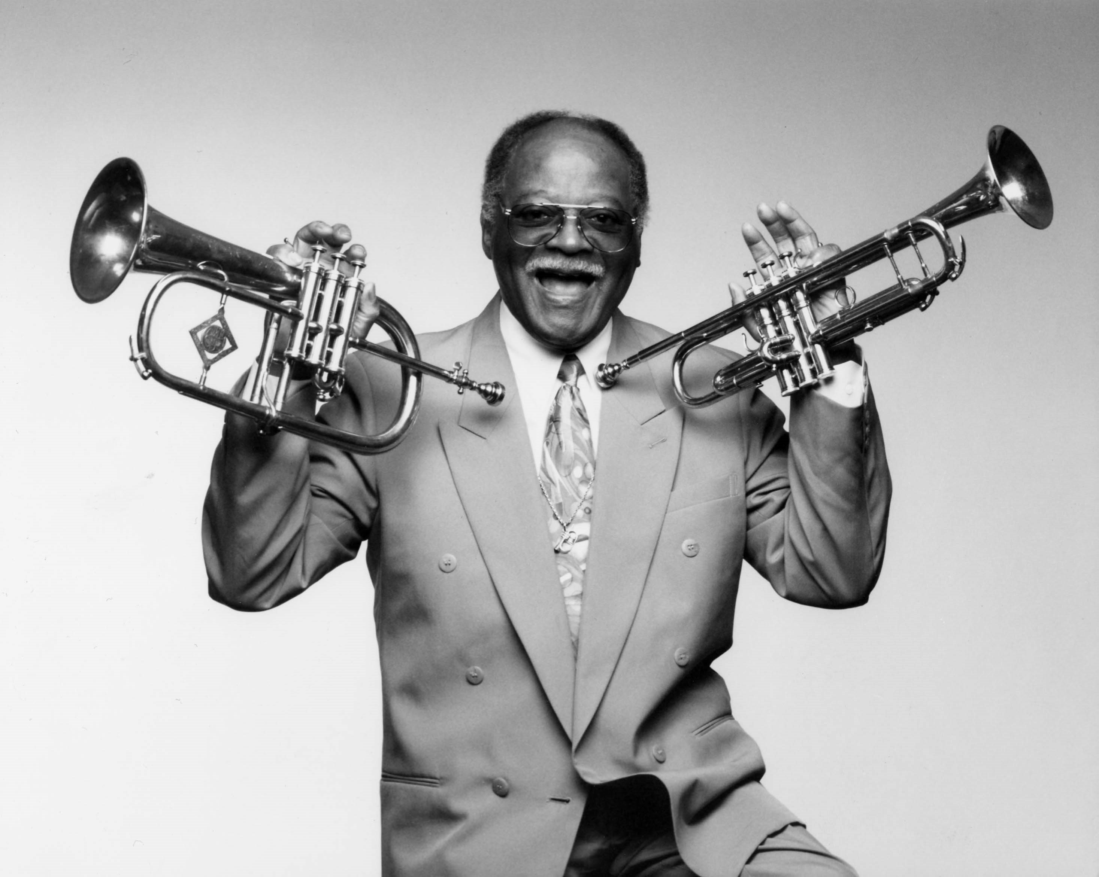
As the music has spread around the world it has drawn on local national and regional musical cultures, its aesthetics being adapted to its varied environments and giving rise to many distinctive styles.

Slide 7
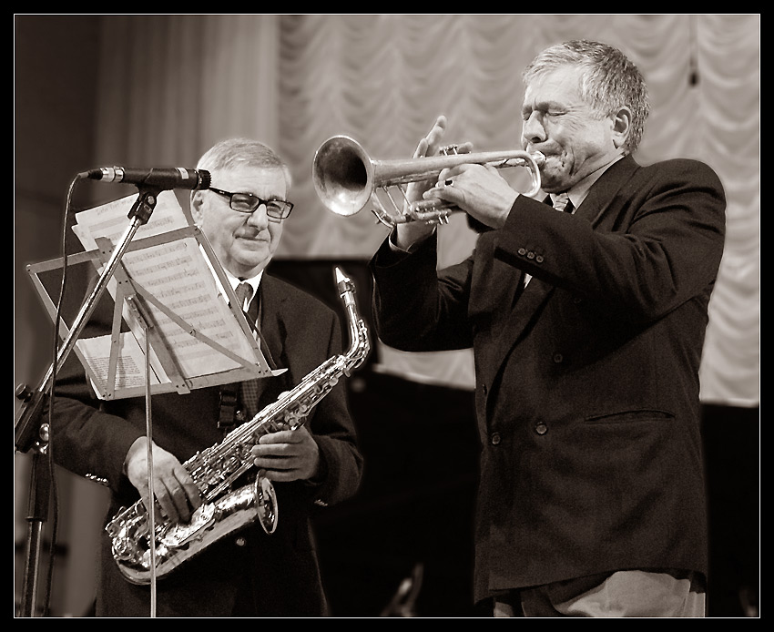
Jazz can be very hard to define because it spans from Ragtime waltzes to 2000s-era fusion. While many attempts have been made to define jazz from points of view outside jazz, such as using European music history or African music, jazz critic Joachim Berendt argues that all such attempts are unsatisfactory. One way to get around the definitional problems is to define the term “jazz” more broadly. Berendt defines jazz as a "form of art music which originated in the United States through the confrontation of blacks with European music"; he argues that jazz differs from European music in that jazz has a "special relationship to time, defined as 'swing'", "a spontaneity and vitality of musical production in which improvisation plays a role"; and "sonority and manner of phrasing which mirror the individuality of the performing jazz musician".

Slide 8
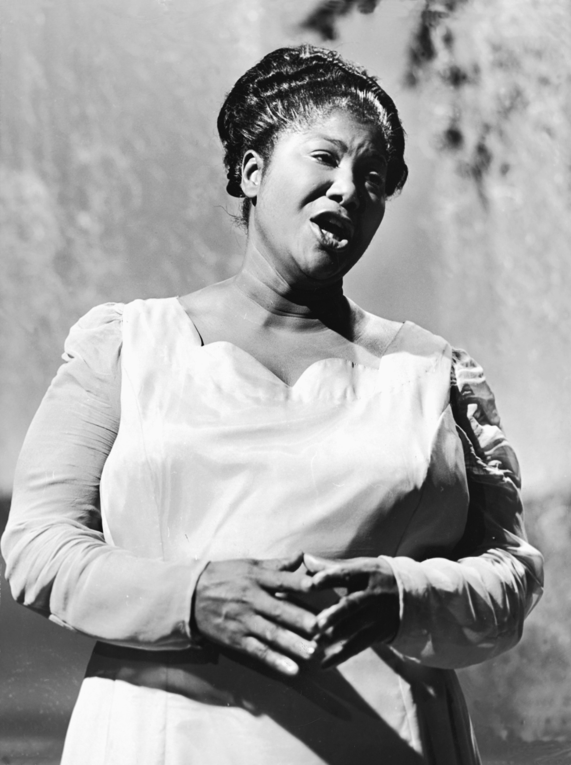
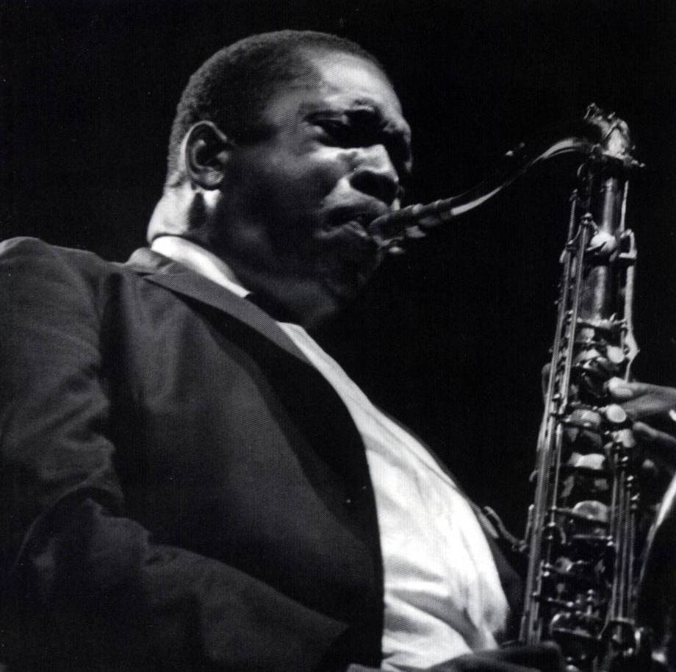
THE END

Slide 9
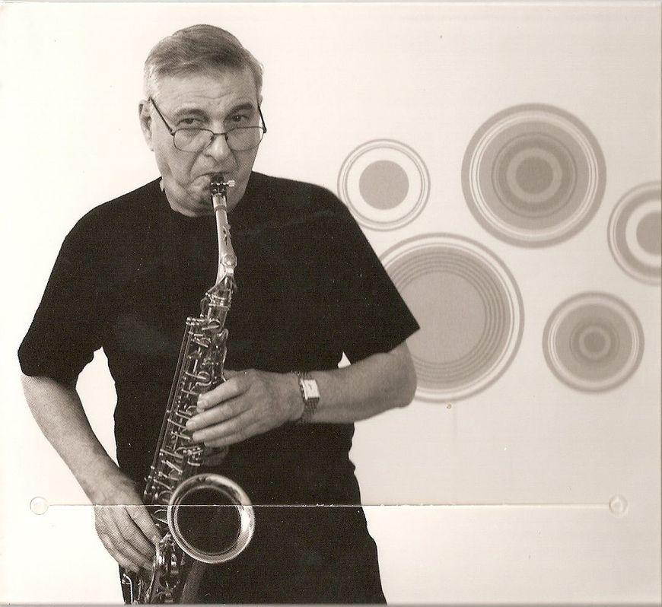
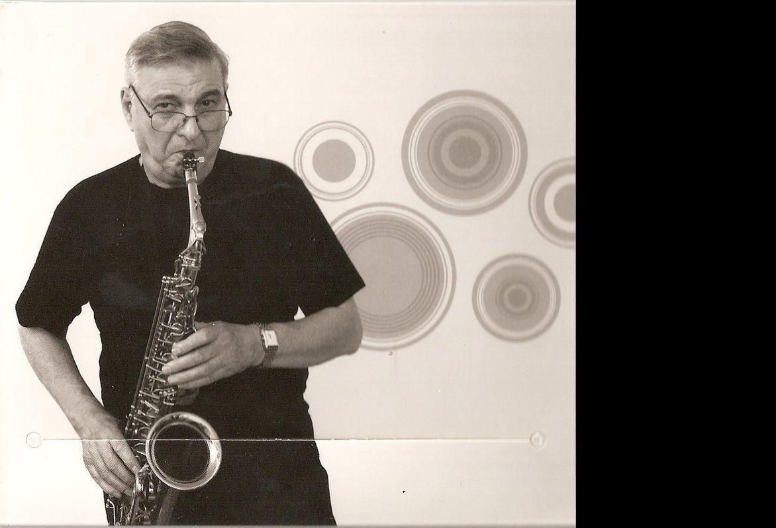
Georgy Garanyan
In memory of

