Slide 1
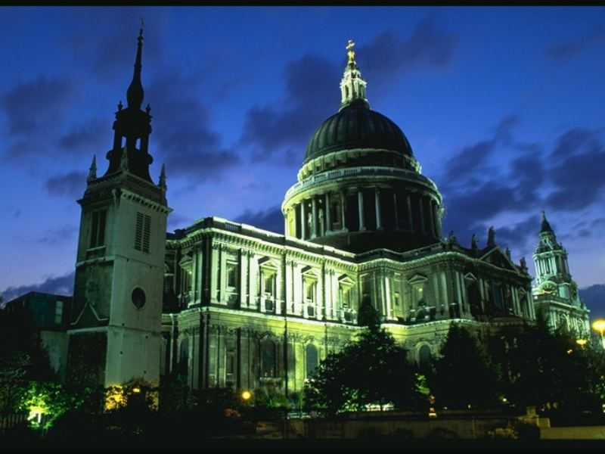
St. Paul's Cathedral

Slide 2
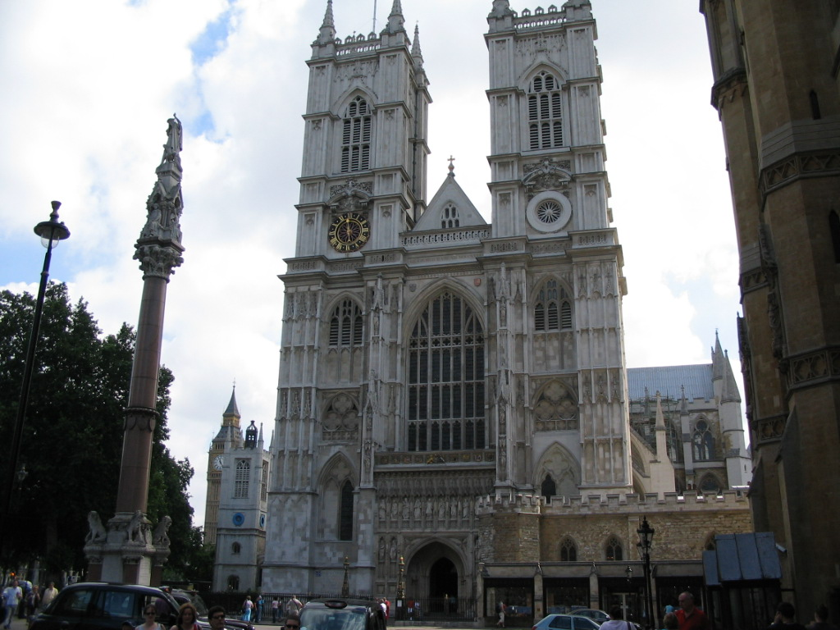
Westminster Abbey

Slide 3
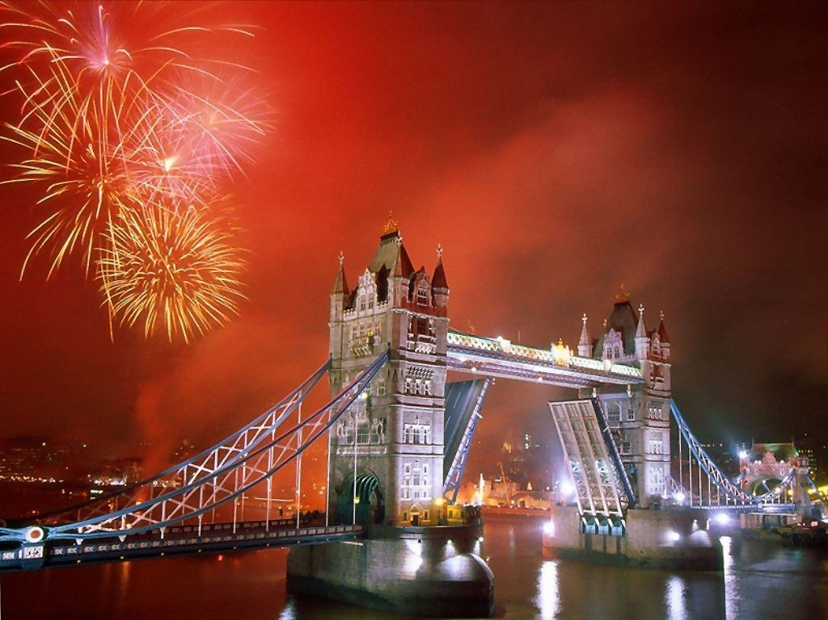
The Tower Bridge

Slide 4
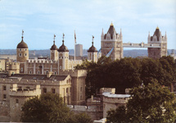
TOWER OF LONDON

Slide 5
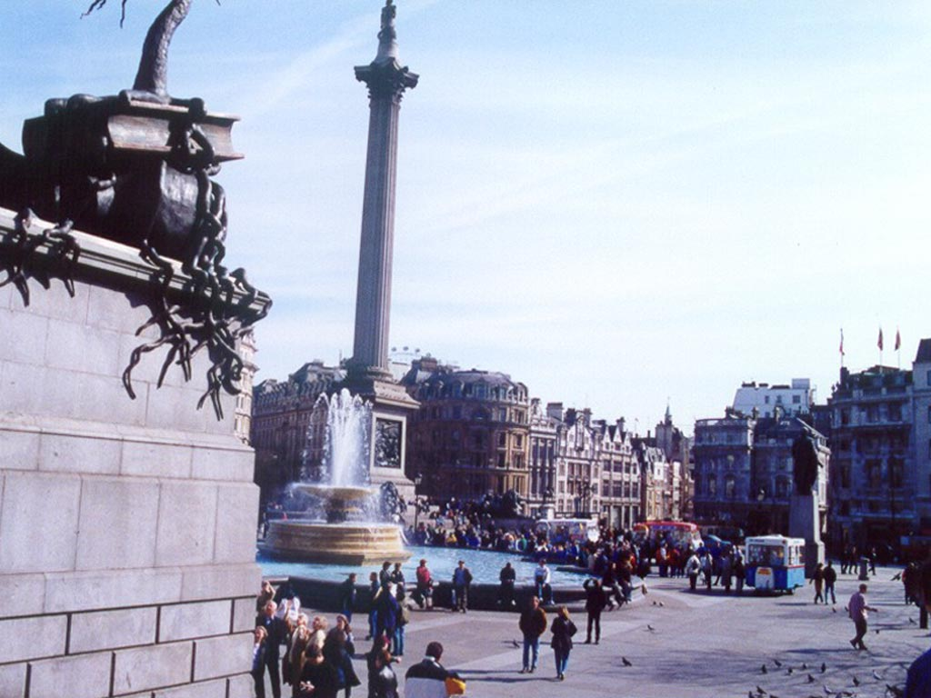
Trafalgar Square

Slide 6
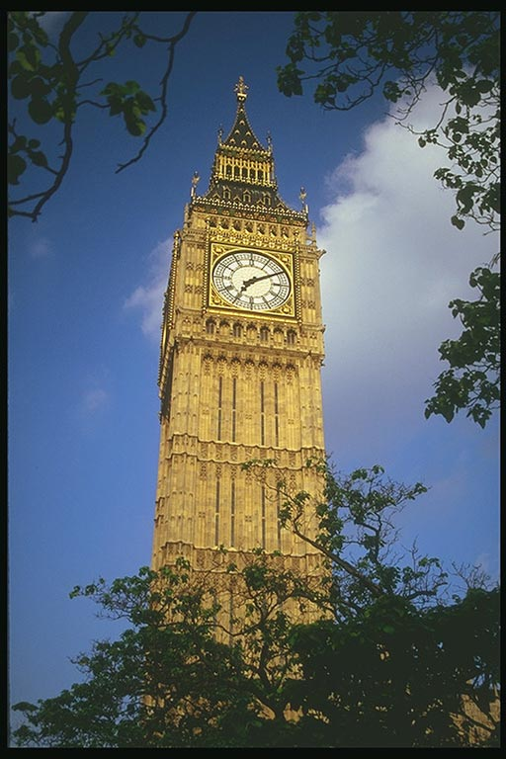
BIG BEN

Slide 7
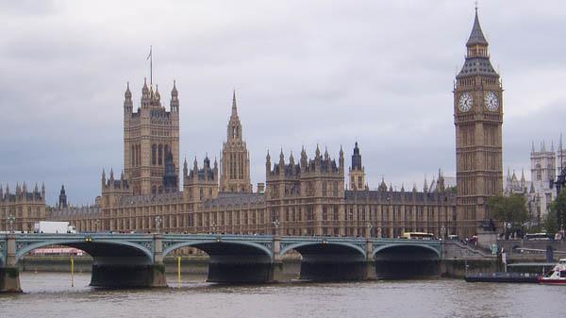
Westminster Abbey and the House of Parliament

